Slide 1
Integration of Australian Curriculum Stage 2
General Mathematics
Essential Mathematics
Term 2, 2016

Slide 2
Program
Overview of subject outlines
Assessment overview
Task design and programming
Learning and assessment plans
Examination
E-Assessment

Slide 3
Integration of the Australian Curriculum with SACE
Reference group
Writing teams
Focus group
Online consultation
Revision based on online consultation
Accreditation, Recognition and Certification Committee
SACE Board approved

Slide 4
Mathematics Subjects
Stage 1 subjects 2016 | Stage 2 subjects 2017
Mathematics | Specialist Mathematics
 | Mathematical Methods
General Mathematics | General Mathematics
Essential Mathematics | Essential Mathematics

Slide 5
ATAR and Preclusions
All 2017 Stage 2 mathematics subjects are eligible to contribute to ATAR
Precluded combinations
General Mathematics and Mathematical Methods
General Mathematics and Essential Mathematics
Essential Mathematics and Mathematical Methods
Mathematical Pathways (historical) and Essential Mathematics
SATAC website
www.satac.edu.au/updates-for-2017-and-2018-tertiary-entrance

Slide 6
Stage 2 Mathematics Subjects
Current Stage 2 subjects | Stage 2 subjects from 2017
Specialist Mathematics | Specialist Mathematics
Mathematical Studies | Mathematical Methods
Mathematical Methods
Mathematical Applications | General Mathematics
Mathematical Pathways | Essential Mathematics

Slide 7
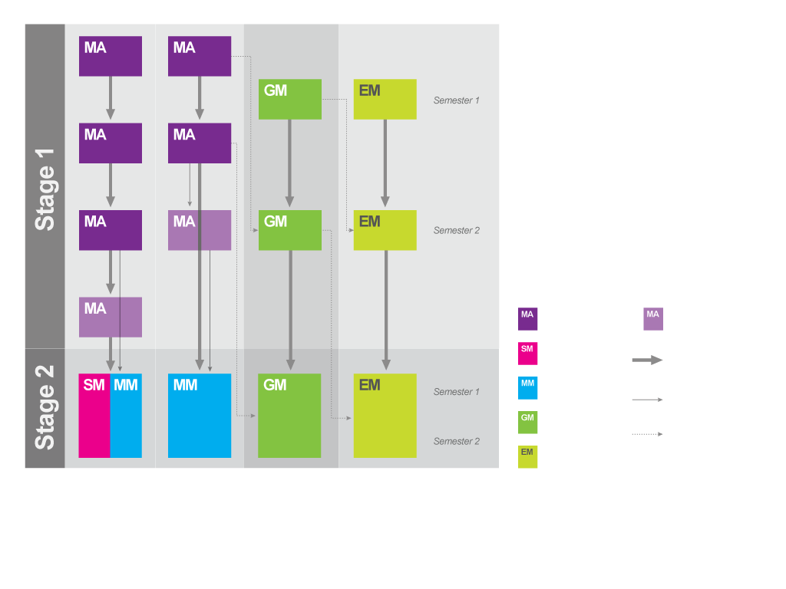
Pathway Options

Slide 8
Capabilities
Integrated Australian Curriculum capabilities
Literacy
Numeracy*
Information and communication technology capability*
Critical and creative thinking*
Personal and social capability
Ethical understanding
Intercultural understanding

Slide 9
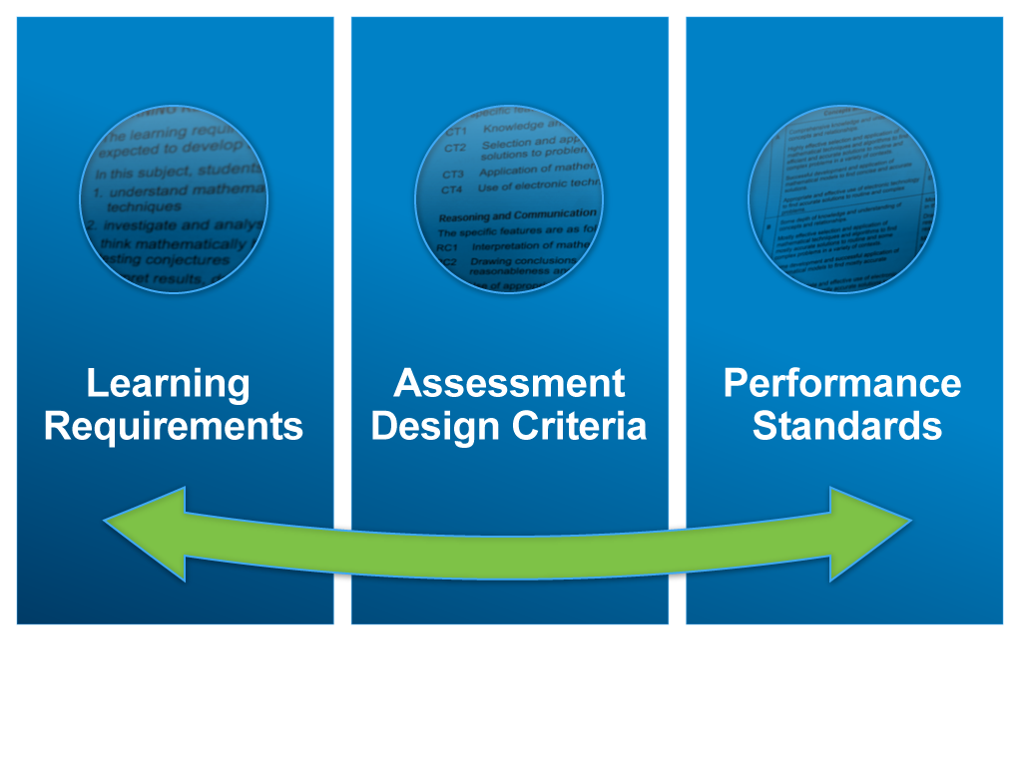

Slide 10
Content
Topics
five topics described – each divided into subtopics
key questions and key concepts
considerations for developing teaching and learning strategies
Open Topic option – Topic 6

Slide 11
Open Topic
Open topic
Flexibility for teachers to design programs to meet the needs and interests of their students
Relevant to local context
Comparable standard to other topics in the subject outline
Examples:
General – Applied Geometry, Introduction to Calculus
Essential – Probability, Optimisation

Slide 12
Focus Questions
How can the content be sequenced?
Are there any considerations in content sequence with the examined and non-examined subjects?
Could I use or adapt a sample program?
Would you consider the option of an Open Topic?

Slide 13
Assessment
Assessment Design Criteria
Concepts and Techniques
Reasoning and Communication
Specific Features
Performance Standards

Slide 14
Assessment Scope and Requirements
General Mathematics
School Assessment (70%)
Assessment Type 1: Skills and Applications Tasks (40%)
Equivalent of 1 SAT without the use of a calculator or notes
Assessment Type 2: Mathematical Investigation (30%)
External Assessment (30%)
Assessment Type 3: Examination (30%)
Calculators and notes allowed for entire examination

Slide 15
Assessment Scope and Requirements
Essential Mathematics
School Assessment (70%)
Assessment Type 1: Skills and Applications Tasks (30%)
Equivalent of 1 SAT without the use of a calculator or notes
Assessment Type 2: Folio (40%)
External Assessment (30%)
Assessment Type 3: Examination (30%)
Calculators and notes allowed for entire examination

Slide 16
Assessment Type 1: Skills and Applications Tasks
General Mathematics
Assessment Type 1: Skills and Applications Tasks (40%)
five skills and applications tasks, including at least one skills and applications task from the two non-examined topics (one task per topic)
equivalent of one SAT without the use of a calculator or notes
non-examined topics are Topics 1 and 2 (or Topic 6 if used)

Slide 17
Assessment Type 1: Skills and Applications Tasks
Essential Mathematics
Assessment Type 1: Skills and Applications Tasks (30%)
four skills and applications tasks, including at least one skills and applications task from the non-examined topics (one task per topic)
equivalent of one SAT without the use of a calculator or notes
the non-examined topics are Topics 1 and 3 (or Topic 6 if used)

Slide 18
Focus Questions
Could I adapt a sample SAT?
Can I do more testing?
Do the SATs need to cover all the content?
Which topics provide opportunities for a non-calculator SAT (or part of SAT)?
Can you adapt current tasks that are still appropriate in the redeveloped subject outline?

Slide 19
Assessment Type 2: Mathematical Investigation
General Mathematics
Assessment Type 2: Mathematical Investigation (30%)
two investigations
can focus on any of the topics, including the Open Topic (if chosen)
page limit - maximum of 12 single-sided A4 pages
appendices may be used but do not form a part of the assessment decision

Slide 20
Assessment Type 2: Folio
Essential Mathematics
Assessment Type 2: Folio (40%)
three folio tasks
can focus on any of the topics, including the Open Topic (if chosen)
page limit - maximum of 8 single-sided A4 pages
appendices may be used but do not form a part of the assessment decision

Slide 21
Focus Questions
How much support and direction can I provide my students within the tasks?
How do you provide opportunities for an open-ended investigation?
Does the task allow students to provide sufficient evidence in the specified page limit?
Does the task need to assess RC5?
Can you adapt current tasks that are still appropriate in the redeveloped subject outline?

Slide 22
Assessment Type 3: Examination
General Mathematics
Assessment Type 3: Examination (30%)
Calculators and notes allowed for entire examination
No formula sheet
One booklet not separated into topics
2 hours
Examined topics
Topic 3 – Statistical Models
Topic 4 – Financial Models
Topic 5 – Discrete Models

Slide 23
Assessment Type 3: Examination
Essential Mathematics
Assessment Type 3: Examination (30%)
Calculators and notes allowed for entire examination
No formula sheet
One booklet separated into topics
2 hours
Examined topics
Topic 2 – Measurement
Topic 4 – Statistics
Topic 5 – Investment and Loans

Slide 24
Stage 2 External Assessment Graphics Calculators
Approved from 2016 for external examinations – 3 additional calculators
Casio fx-CG20AU
Texas Instruments – TI 84 Plus C – silver edition
Texas Instruments – TI 84 Plus CE
Information sheet 49 - approved calculators for external examinations

Slide 25
4 Phases of Quality Assurance

Slide 26
Learning and Assessment Plans
simplified form
a cover sheet and assessment overview
pre-approved LAPs
example LAPs

Slide 27
Focus Questions
Could you use a pre-approved learning and assessment plan (LAP)?
Can I make changes to a pre-approved LAP?
When do I need to submit a LAP for approval?

Slide 28
Feedback: Stage 1 & Stage 2
Please provide any feedback to SACE Officers
Deanna.Isles@sa.gov.au
Louise.Lycett@sa.gov.au
Lois.Ey@sa.gov.au
Matt.Costin@sa.gov.au

Slide 29
SACE E-Assessment
E-Clarifying/Learning
E-Moderation
E-Submission of student work
E-Marking
E-Examinations

Slide 30
What’s next?
School planning – subjects
Your planning
familiarise yourself with the subject outline/s
teaching program
learning and assessment plan
tasks

