Slide 1
SACE Management Conference
2020 Semester 2

Slide 2
Swift communications
Welcome
Mute mic please
Discussions- Hand up through participants or chat question
2 July – Changes to Locally assessed languages (continuers and background speakers) for 2021
17 July – COVID-19 readiness – Term 3 – important updates for school leaders
20 July – COVID-19 readiness Term 3 – You Can Ask That! video
27 July – Be part of the Class of 2020 Year 12 video
3 August – COVID-19 readiness – Languages oral exam update
5 August – The Standard – Term 3, August 2020 edition
5 August – Get ready for online submission in Semester 2 2020
5 August – Get ready for online submission in Semester 2, 2020 – important information for school ICT staff
12 August – Welcome to ‘thrive’
13 August – Welcome to Prescient
Notes:
Welcome, my name is ………. and I will be hosting today’s SACE management conference.
Just some zoom meeting protocols, before we begin. Please have your mic on mute unless invited to speak. Question will be taken at the end of each section through hand up in participants or through typing a question in chat. If we are unable to answer your chat question due to time, the sectional presenter will answer in the chat environment during the session.
The following is a summary of recent swift communications you can refer back to, that provides additional information you may need in undertaking your role as SACE coordinator or leader at your school.

Slide 4
Stage 1 Moderation / Stage 1and Stage 2 Modified Subjects Review
Schools were advised in February of the Stage 1 compulsory subjects to be moderated in 2020.
All subject enrolments are results due December.
Moderation/Review will occur in November.
Schools were sent communication regarding subjects required for moderation, based on enrolments, via email from Monday 24th August.
Notes:
Read screen.

Slide 5
Stage 1 Moderation / Stage 1 and Stage 2 Modified Subjects Review
Reminder:
If subjects are added, or no longer being taught (i.e. all students withdrawn), after the due date please contact the AskSACE team asap.
Notes:
Reminders
If subjects are added or no longer being taught (i.e. all students withdrawn) after the due date please contact the AskSACE team as this may impact on moderation and/or review requirements

Slide 6
Changes
New Model - Semester 2
Moderation and Review will take place online in Microsoft Teams and in a dispersed model.
Schools are asked to release nominated moderators and/or reviewers on the day(s) scheduled to carry out this work.
Schools will be funded by TRT(s).
Notes:
Moderation and Review – New Process
Moderation and review is scheduled to occur week beginning 9 November as per the calendar.
Moderation and review in Semester 2 will take place online in Microsoft Teams and in a dispersed model.
Schools are asked to release nominated moderators and/or reviewers on the day(s) scheduled to carry out this work in the school.
Lead practitioners will be used as supervisors with SOCA support.
This model was successfully trialed for the ‘students at risk – SACE completers’ process in June.

Slide 7
Stage 1 Moderation and Review Changes
Training will occur in Microsoft Teams on the first morning of moderation/review.
Benchmarking activities will follow in PLATO.
We are trialing single moderator and reviewer model.
Notes:
Moderator and Reviewer training
Training will occur in Microsoft Teams on the first morning.
Benchmarking activities will follow in PLATO.
This will enable the process to begin earlier.
It will also reduce teacher time out of schools.
We are trialing single moderator and reviewer model for semester 2 to align more with Stage 2 processes.

Slide 8
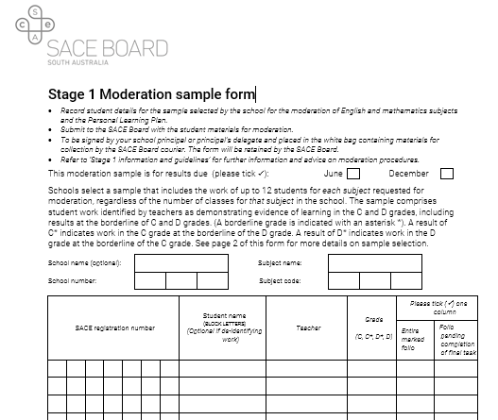
Stage 1 Moderation
Moderation Sample
There is no change to the sample selection guidelines
(refer to IS 16)
The inclusion of the Stage 1 Moderation Sample Form is vital to the moderation process
Notes:
No change for the selection of samples for stage 1 moderation. Please refer to information sheet 16.
The ‘Stage 1 Moderation Sample Form’ must be completed and uploaded
The ‘Student Description Sheet’ for modified subjects review must be completed and uploaded
File naming for Review student samples will be similar. This will be communicated once later this term.

Slide 9
Stage 1 Moderation
Submission of materials:
The submission of moderation materials will be electronic via Kiteworks.
Schools are requested to use the following filename convention for moderation samples:
123456X-1xxx10-atx-free text
▪ 123456X = student registration
▪ 1xxx10 = subject code and credits
▪ atx = assessment type
▪ xxx = free text.
Notes:
Submission of materials
The SACE Board is planning for electronic submission of moderation and review materials via Kiteworks – our secure file transfer system.
This worked effectively for remote/isolated and SACEi schools in 2019 and 2020.
It also worked for the ‘students at risk – SACE completers’ process in June.
The ‘Stage 1 Moderation Sample Form’ must be uploaded
The ‘Student Description Sheet’ for modified subjects review must be uploaded
File naming for Review student samples will be similar. This will be communicated once later this term.

Slide 10
Stage 1 and Stage 2 Modified Subjects Review
There are changes in the compilation of student samples.
In many cases an enormous volume of material is submitted, and some is repetitive.
For 2020 a selection of evidence is requested.
The evidence needs to align directly to the achievement of personal learning goals and identified capabilities.
E.g. As a guide 15 – 20 pages for a 10-credit subject.
Notes:
For modified subjects; As well as changes to submission and review there are changes proposed for the compilation of student samples.
In many cases an enormous volume of material is submitted and some of which is repetitive. Often this can mean 100 or more pages. This can be very overwhelming for reviewers.
A selection of evidence is being requested. The evidence needs to align directly to the achievement of personal learning goals and identified capabilities through the lens of the tasks. The number of pages will be dependent upon the number of personal learning goals, identified capabilities and tasks.
For example, this may be 10 – 20 pages for a 10 credit subject and 20 – 25 pages for a 20 credit……
Teacher professional judgement is encouraged in our environment of high trust and the starting position of finding evidence to support the schools assessment decision.

Slide 11
Stage 1 Clarifying 2020
Notes:
New Clarifying courses were developed for all Stage 1 compulsory subjects.
Schools leaders – Principals/SACE Coordinators/Curriculum leaders - are encouraged to support teachers in accessing these professional development activities prior to moderation.
This is in conjunction with your in-school clarifying procedures and activities to ensure teachers are on standard.
NOTE: There is also a new Clarifying course for Modified Subjects.

Slide 12
Schools online – Stage 2
Notes:
Cut of date for Stage 2 enrolments is Wednesday 2 September. After this date you will only be able to withdraw or add students to the official online results sheets.
Please ensure;
The enrolment status for subjects requiring submission is enrolled and not proposed.
Assessment Schools and Assessment Groups have been set up to reflect the joining of classes for assessment purposes. This is done by the teaching school in Schools Online.
Classes that should not be linked together for assessment purposes should be unlinked.
Teachers are correctly assigned to classes (for the purposes of Online Results Sheets).
All Schools Online user accounts are correctly set up and linked to the teacher accounts.

Slide 13
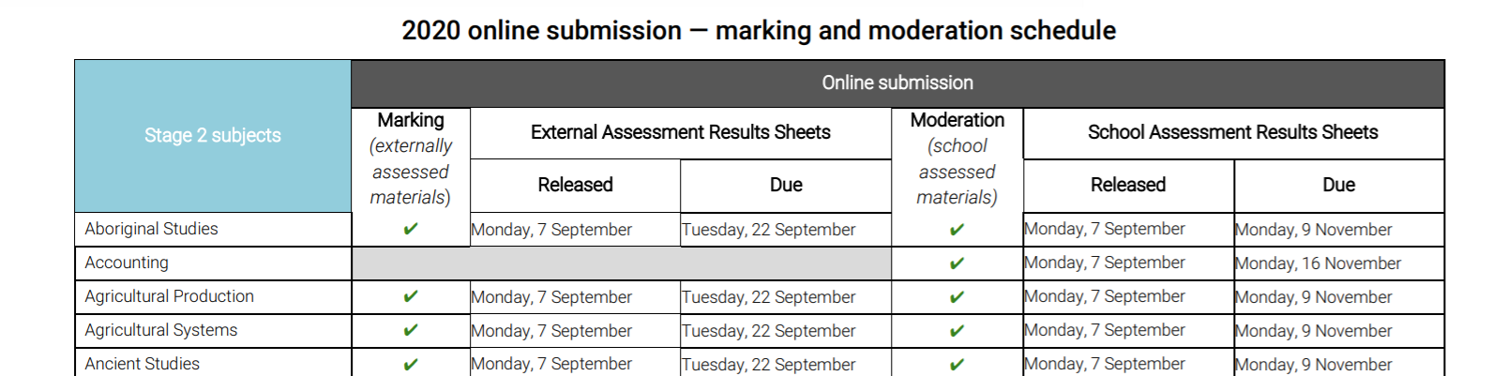
Schools online - access of Stage 2 results sheets
Notes:
Access to results sheets will be on the 7 September
A swift communication from the askSACE team with this schedule will be sent out soon.
For specific subject details please refer to the 2020 online submission- marking and moderation schedule to help you manage this process across all Stage 2 subjects.

Slide 14
Collection of hard copy materials
‘Week of 7 September external assessment results package for Dance and Drama will be sent to schools by courier’
‘Week of 12 October bags for Stage 2 Community Studies for final moderation will be sent to schools by courier’
Notes:
There has been operational changes to Stage 2 Dance and Drama external assessment as a result of COVID 19. An information email has been sent directly to Dance and Drama teachers and SACE coordinators relating to the requirements for external assessment and collection of assessment materials for these two subjects. This information is also available on the subjects website. For Dance and Drama external assessment results package will be sent to schools in the week of 7th September and collected by courier on 22 September.
For Community Studies bags will be sent to schools in the week of 12 October. Please refer to the community studies mini-site for details of packaging requirements.

Slide 15
Online submissions
Notes:
Result Sheets open in Schools Online on 7 September so teachers can start uploading materials from this date – teachers can upload as they go selecting ‘save’, and only ‘submitting’ after everything is completed. As schools you may wish to think through a best practice strategy for uploading student materials to avoid a last minute rush (especially to complete the PSR), and also to mitigate for any Covid-19 impacts.
Through our swift communications the SACE Board is targeting individual subjects and subject communities such as those of Mathematics and Science , Languages , and the subjects of Visual Arts- Arts and Visual Arts – Design, Digital Technology, and Physical Education to support transition into online submissions of student materials.

Slide 16
Sandpit
Notes:
The Sandpit is a dedicated practice area where Stage 2 teachers can become familiar with the online submission process by uploading assessment materials. Please note that this is a safe place as the Sandpit is not connected to the Schools Online database. Teachers can do no harm in here! Information and the sandpit link were provided to all Stage 2 teachers in an email on the fifth of August.
It may be a good idea to share with teachers new to online submission that the uploading of student materials in school assessment involves more steps in uploading student materials and completion of the schools assessment results sheet compared to external assessment result sheet which is generally uploading one file and entering a mark.

Slide 17
Online submission of materials
Notes:
On the SACE website there are support materials including FAQs for online submission of materials such as accepted file names and formats , tutorial videos , Information sheets for External and School assessment and a new feature – 2020 online schedule submission.
Tutorial videos are being updated to support teachers in online submission. A useful strategy is to create one single PDF document from multiple word documents to upload an individual student's work for an assessment type. This may be particularly useful information for Specialist Mathematics teachers, for example in Assessment Type 1 : SAT’s where student complete 6 tasks as a hard copy , scan and then combine all 6 SAT’s into one document for uploading.
A reminder for moderation of maths and science subjects, or any subjects where there are calculations, that the student work needs to be clearly marked. This enables the moderation process to focus on reviewing teacher’s decisions without having to mark student work. This is detailed in the FAQs for uploading materials for school assessment.

Slide 18
External Assessment – Investigations
When completing external assessment results sheet for investigations – if no evidence is submitted – use the W code (withdrawn) not a grade such as E- or entering a mark out of 30.
Withdrawn on the investigation online result sheet does not withdraw the student from the subject
Students need to be aware of the implications of being withdrawn from the external assessment
Special provisions application form should not be uploaded in student materials
Notes:
When uploading student external investigation work, it is important that teachers have not ticked or written comments or grades or attached a performance standards record on or with the work. It is important that the investigation topic/issue/question is identified on the front page of the investigation.
Implications of Withdrawing from External result sheet:
- student can still achieve the SACE based on their School Assessment result
- however, this will have ATAR implications as a non-completed external assessment task results in a zero score affecting ATAR calculations. This also applies when a student misses the exam without due cause.
Special Provisions – please don't upload completed Special Provisions – Form 32 into School Assessment Results sheet. This form contains confidential student information and shouldn't be sighted by the moderation team. Thanks for your cooperation with this vital step.
Thank you for all your support in working with all Stage 2 teachers in preparing for online submissions of students materials. A timely reminder that Stage 2 Community Studies remains a hard copy moderation process complete with the much-loved white bags.

Slide 19
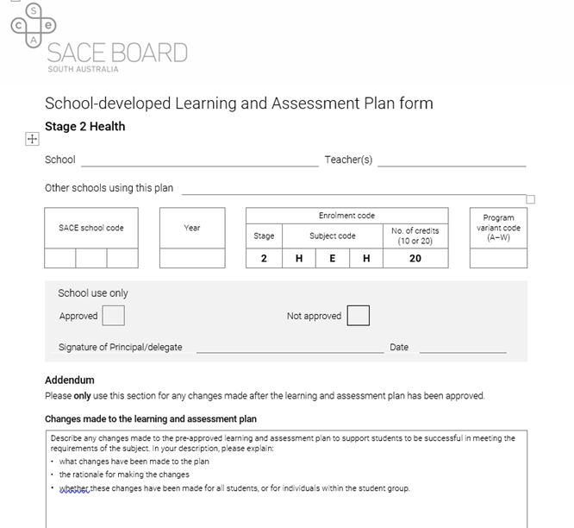
Stage 2 Moderation
Notes:
In 2020 Stage 2 Moderation will be online except for COMMUNITY STUDIES.
A reminder that the 2020 subject outline changes are for this year only. As result of the subject outline changes made, if a teacher decided to reduce the number of tasks as in the case of the Health subject outline changes – then they would document the changes made in relation to the LAP and individual assessment tasks on the Addendum. It is important that schools and teachers remember that no assessment type for school assessment was removed from any subject.
Please consider a strategy for supporting the uploading of student materials to avoid a last minute rush (especially to complete the PSR), and also to mitigate for any Covid-19 impacts, particularly if needing to access and upload student materials if working from home. It’s important to ensure materials submitted meet the subject outline requirements, and there is evidence for each assessment type in line with the subject specific changes approved by the SACE Board in response to Covid-19.

Slide 20
Stage 2 School Assessment Results Sheet
Grade and PSR
Notes:
School Assessment results sheets require teachers to enter grades for all students and tick the students selected for the sample. The performance standards record( PSR) and variations to moderation materials ( VMM) form will then appear and should be completed. The VMM is only filled in if there is missing tasks and special provisions.
The grade and the shaded performance standard on the school assessment result sheet is the source of truth.
Teachers materials includes learning and assessment plan (LAP) , assessment tasks and group video/audio file into teachers materials except for Research Project.
Solutions- For subjects which involve calculations such as Mathematical Methods or Physics solutions must be included to enable moderators to review teacher’s decisions without having to mark student work. The solutions are uploaded into teacher materials. Thanks.
Prior to mid-year 2020 Research Project moderation – the SACE Board communicated with schools that an additional sample will no longer be requested from a school where a moderator and supervisor have recommended an adjustment to a grade level where there are five or more students with the same result. Data analysis shows that in the rare instances an additional sample is requested from a school, the additional sample supports the original decision by the moderator and supervisor to adjust the result more than 80% of the time.
However we may still need to contact schools to follow-up on issues such as: Insufficient materials when not all assessment tasks are submitted for the assessment type. If a student sample does not include all the assessment tasks it is important that the VMM is completed.

Slide 21
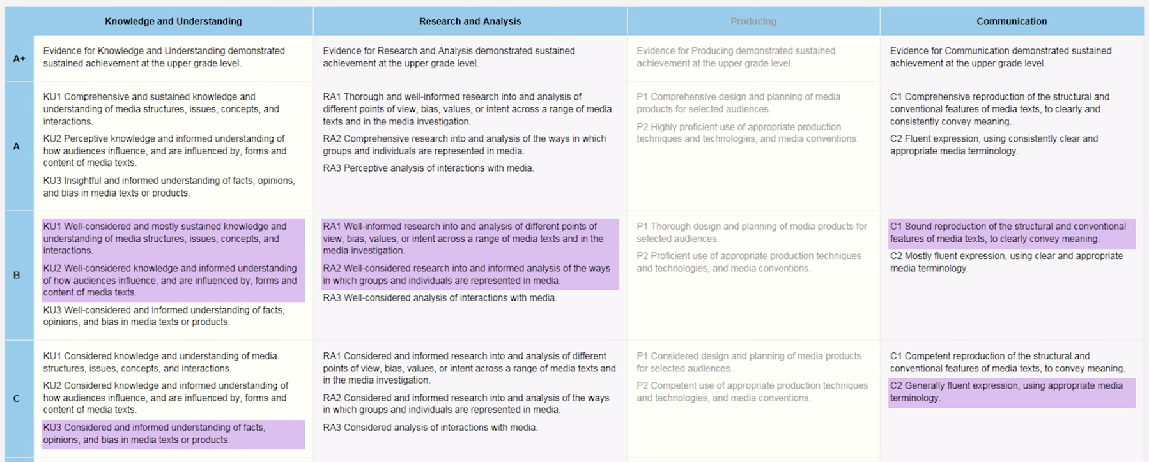
Performance Standards Record
Notes:
A Performance Standards Record (PSR) is completed in the School Assessment results sheets in Schools Online for those students identified in the sample. The performance standards record is a new feature to complete on the schools assessment results sheet as this was not required for hard copy moderation ( white bags ) on the assessment results sheets.
The PSR is a record of the overall achievement for each student in the moderation sample against the subject's performance standards for the relevant specific features in that assessment type. The PSR should reflect the grade given to the student for that assessment type. We acknowledge that this does take time for teachers to complete. Please ensure that the shading is accurate.
In this example the teacher has indicated a B- grade for this student. This includes some specific assessment features selected in the C grade level.
The grade and the shaded performance standards on the school assessment result sheet is the point of truth.
Do I need to complete a Performance Standard Record (PSR) for each assessment task submitted for moderation?
No, the PSR is required for each assessment type. This means that if several assessment tasks are submitted for an assessment type only one PSR is completed to reflect the student's achievement for the assessment type.

Slide 22
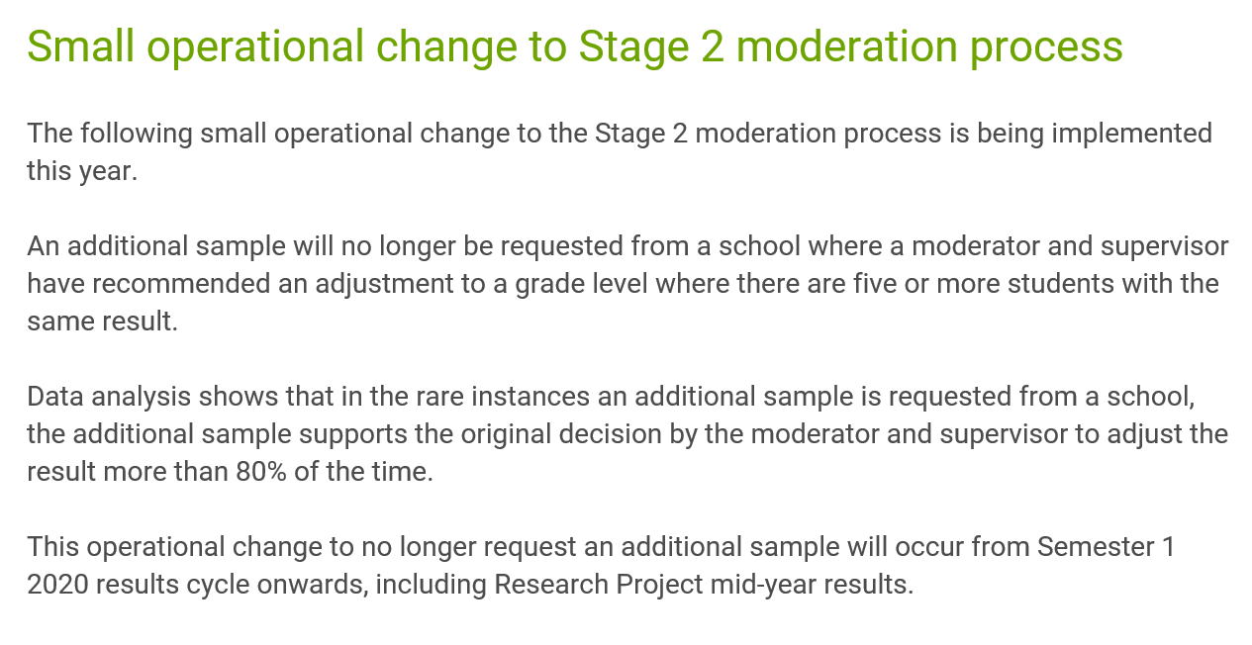
Notes:
We know we’ve spoken at the SACE Management Conferences about this before, but selecting the sample and completing the PSR is an important process, so please emphasize to teachers that it is worth investing time in particularly as this year there has been a small operational change to the Stage 2 moderation process.
This is a reminder that back in June it was communicated in ‘The Standard’ that additional samples will no longer be requested from schools where an adjustment to a grade level affects more than five students. Moderation decisions are based on the samples selected by the school, and this was the case for Semester 1 Research Project moderation, which went smoothly, and will be the process going forward.

Slide 23
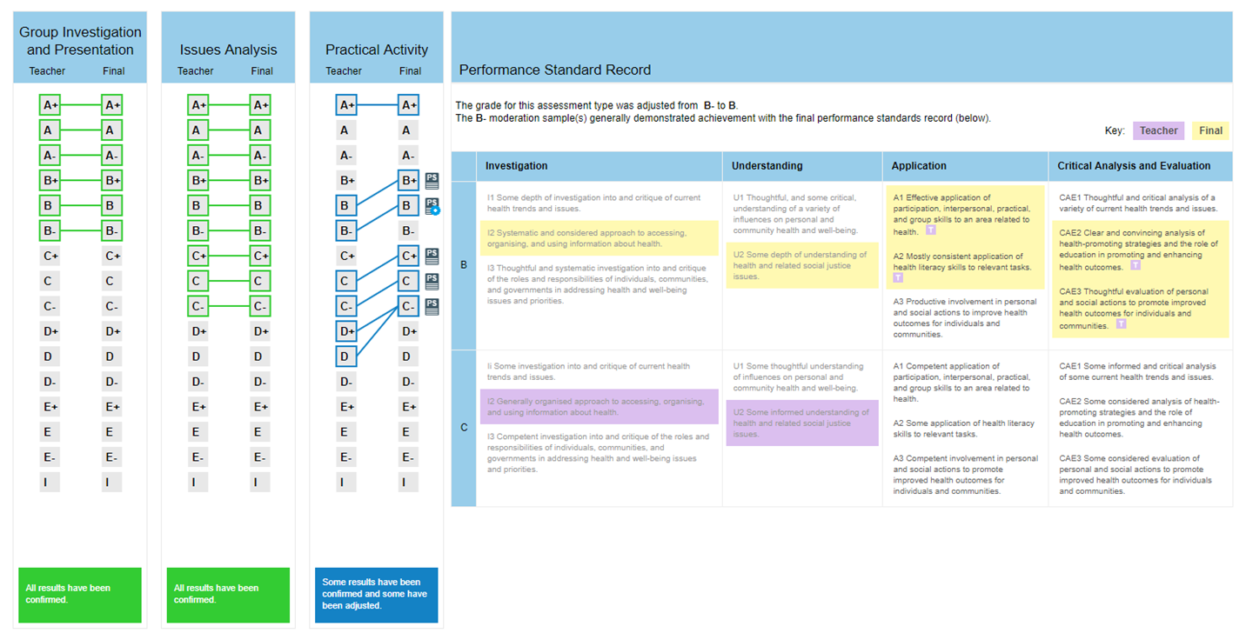
Moderation Summary
Notes:
Here is an example of Moderation Summary Report which can be accessed and downloaded from Schools Online - Result Reports. This report is available after results release.
In this moderation summary the AT1 and AT2 grades are confirmed but there were adjustments made to AT3 – the PSR image on the screen shows where the grade has been adjusted from a B- to B grade. The final grade is shaded in yellow and you can see where the there have been adjustments and where the teacher and moderator have agreed there's a purple T in final yellow shading. Schools are able to obtain feedback on adjustments to a grade/s by contacting the SACE Board.
As well as submission and moderation being online this year (for all subjects except Community Studies), moderation will occur in a dispersed format. This will be an entirely new for some moderation subject communities like the Maths, Sciences, Languages, Arts etc that we’ve already talked about. So thank you for supporting teachers to be involved in this process. Moderation panels are in the process of being finalised, and as with all dispersed moderation, it occurs after school hours and with private payment directly to moderators, in line with the marking process.
Once again thank you for your support and work with teachers in Online submissions and Stage 2 Moderation.

Slide 24
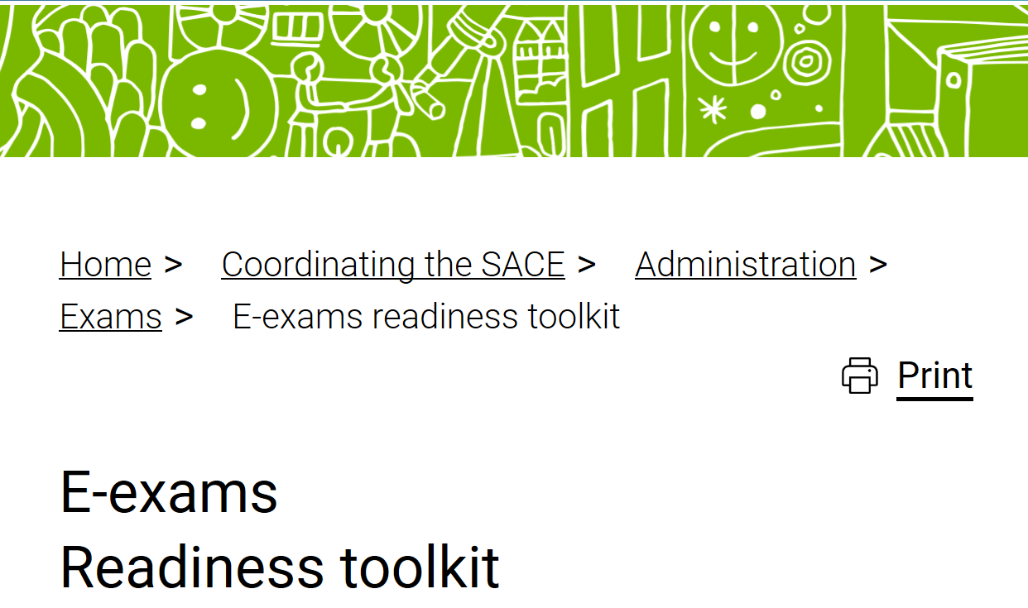
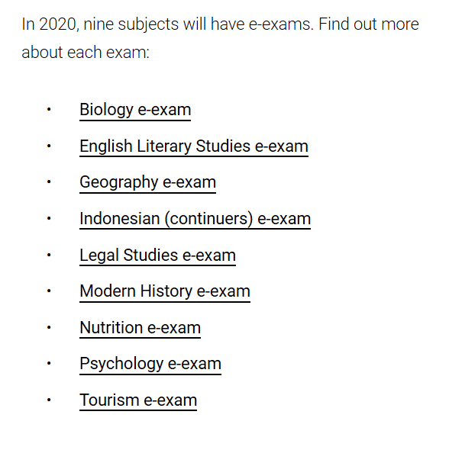
E –exams 2020
Recap:
Nine subjects offering e-exams in 2020
Introduction of audio/video content
Improvements to features and functionality
New Readiness Toolkit
New look practice window
Removal of paper back-up
Notes:
Nine subjects as shown above. First time a language exam will be delivered online.
Audio video content in Modern History, Psychology & Indonesian (Continuers)
Improvements – full screen view for reference materials
Readiness toolkit – one stop shop for exam personnel to prepare for e-exams. Supported by regular direct communications via email.
New look practice window we’ll talk about in a minute
Removal of paper back-up coming up too.

Slide 25
Road to November
Practice Window
Key technical and operational readiness activity
Closes on 11 September
Readiness Self-Assessment Survey
Opportunity to reflect on readiness to deliver e-exams in November
Week beginning 14 September
Final readiness confirmation
Week beginning 12 October
Notes:
Practice window
- Purpose – provide an opportunity to test technical and operational readiness
- currently half-way through the 5 week practice window
- Designed to provide increased flexibility in how you manage this key readiness activity.
- Non-subject specific but demonstrating all features and functionality across all 9 e-exam subjects
Readiness Self-assessment survey
- SACE Board partners with schools to deliver exams, including e-exams to students.
- opportunity to reflect on readiness. A tool for exam personnel to come together following practice window to discuss as a team
- following the completion of the practice window, SACE Coordinators will receive the survey via email.
- Schools who are new to e-exams in 2020 will be required to submit their survey to the SACE Board ahead of final readiness confirmation.
- Schools experienced in e-exams are strongly encouraged to complete the survey but will NOT be required to submit the results to the SACE Board.
Final readiness confirmation
- Confirmation of readiness to participate in e-exams in November
- will take the form of an email from SACE Board Chief Executive to Principal
- All schools will receive a final readiness confirmation
- there will still be an opportunity to receive additional support if you don’t feel completely ready. E.g still require technical or operational support
- due week beginning 12 October

Slide 26
No paper backup
No paper backup in 2020
In the event of an unrecoverable technical disruption
Special Provisions – Misadventure
Form 32/20
Teacher access to exam
Exams will be available on subject mini-sites following the completion of the exam.
Notes:
Following successful delivery of e-exams in 2018 and 2019, and given audio/video content is included in this year’s exams, a paper backup will not be provided this year.
As is the case for all exams, students can submit form 32 if they feel as though they have experience a disruption to their exam that has impacted on their ability to complete the exam.
As soon as possible following the completion of the exam, we will publish the exam on the subject minisite for teacher reference. This will only happen once all students have completed their exam.
Material that has not been cleared for copyright will be removed (with references included) until copyright clearance has been received.

Slide 27
2021 subject selection process
Shortlisted subjects are
Accounting
English as an Additional Language
Economics
French
German
Italian
Spanish
Change impact assessments are taking place with schools.
Confirmation of 2021 subjects is expected in late November.
Notes:
As we have in previous years, we’ve looked at the technical and operation implications of adding additional subjects to e-exams to develop a shortlist (as shown)
The next step is to understand the impacts on school administrators, teachers and students.
Those change impact assessments will commence shortly
Once we’ve conducted those assessments, we’ll bring that information together with the technical/operational assessment and provide a recommendation to our steering group as to which exams could be offered electronically in 2021.
We aim to confirm these subjects following the completion of this year’s exam period.

Slide 28
Beyond 2021
Exploring solutions to delivering e-exams using
drawing and diagramming
symbolic languages
Considering the impacts of the removing paper reference materials
Looking for new ways to allow students to demonstrate their knowledge
Notes:
The software development cycle means that we’re already looking to 2021 and beyond to work on what features and functionality need to be developed to facilitate future e-exams.
It would come as no surprise that subjects that use drawing, diagramming or symbolic languages, like mathematics and science subjects provide a challenge for us. We’ll be working with the teaching community to look for solutions to the challenges that exist in those subjects. This may result in technological solutions, but it might also mean changes to the way that we assess those subjects.
As in previous years, this year we will be providing some paper reference materials to support students in completing their e-exam. However, as flagged last year, we are looking for ways to reduce the reliance on these hardcopy reference materials into the future. Again, we’ll work with the community understand the impacts of this and to find a way forward.

Slide 29
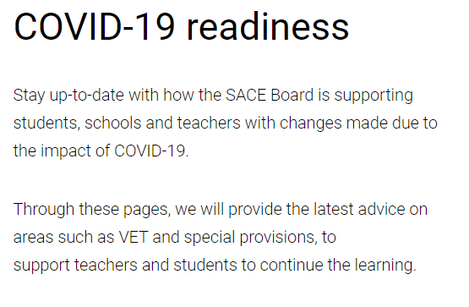
Notes:
Purpose: to provide you with information on SP and reminders as we move to the end of the year. On the screen a range of information and communications to support schools in understanding and applying SP
As you are aware Eligibility based on disability( in learning, medical) misadventure (beyond student's control) personal circumstances (family needs e.g. caring for elderly parent...) SP APPLIED ON A CASE BY CASE BASIS
For discussion about individual cases, please contact the SACE board
Feb 2020 communication reminded schools of SP resources on the website including
A video animation ,Information about eligibility, how to apply ,resources,FAQs….
And a PLATO online course designed as support for teachers in Special Provisions.
From the term 1 conference you told us that you appreciate the high trust environment , the information about COVID and that schools can make informed decisions about School assessment
Other Key communications
COVID-19 readiness flyer and Portal - Term 2 specifically focused on the assessment requirements of Stage 2 subjects, subject outline changes to 22 subjects and provided statements about using the existing flexibilities within the subject, while still honouring the learning intent and maintaining the cognitive demand of the subject.
Please note: The disruption caused by COVID-19 is not the basis for an individual school to award special provisions.
A reminder: in determining reasonable adjustments in Special provisions, schools should be aware:
Students cannot be exempted from one or more of the learning requirements in a subject
Students cannot be exempted from providing evidence for a whole assessment type
Performance standards cannot be adjusted
Special provisions cannot be used to compensate for learning that has not occurred

Slide 30
Term 3 advice
Online submission-only results and student material
Extension to the due date for external investigations on the grounds of special provisions must be submitted to SACE using Form 31 (Request for external assessment adjustments ) a week before the due date
Students can’t be exempt from doing the external investigation on the basis of special provisions.
School assessment -VMM
Notes:
It's important that schools/teachers only upload results and student material, LAPS as appropriate for online submission
Investigations
At this time of the year you may be thinking about external assessments. Students can’t be exempt from doing the external investigation on the basis of special provisions.
Students should be given every opportunity to complete the assessment before the submission date.
The appropriate adjustment for an investigation is an extension to the due date, schools need to submit the application on form 31 at least one week prior to the due date, not on the due date.
School assessment
Where adjustments have been made to school assessed work, and this work is submitted for moderation, a variation to moderation materials (VMM) needs to be completed. It is embedded in the Schools Online result sheet

Slide 32
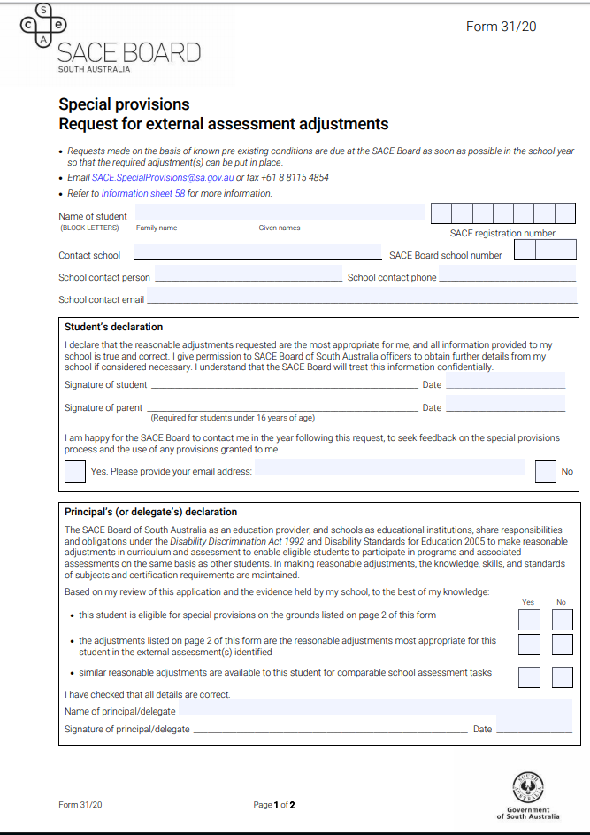
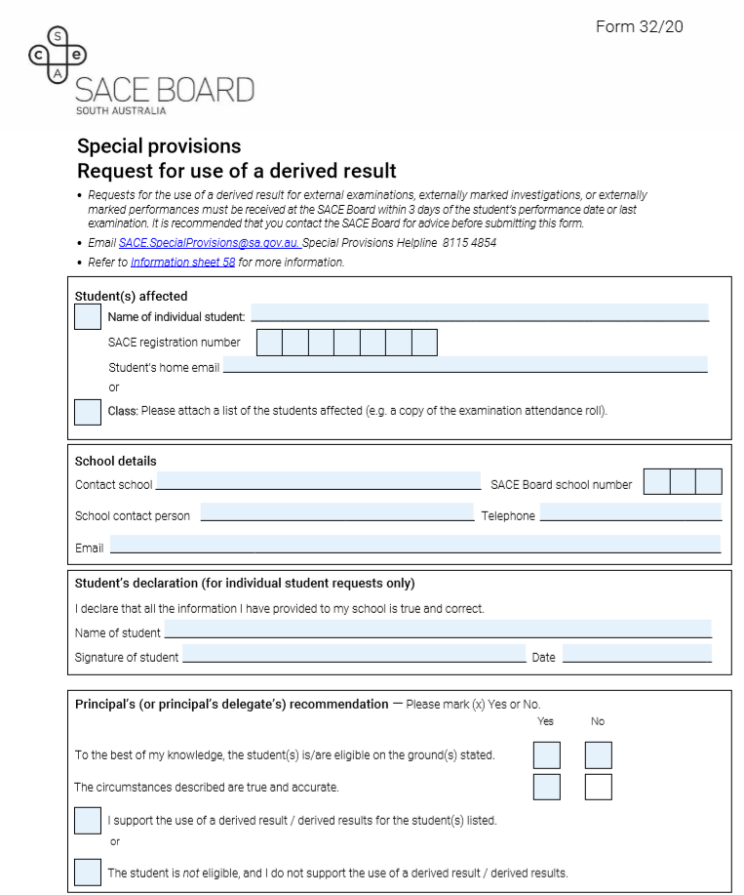
Form 31
Form 32
Notes:
Form 31
If applicable you would probably have already submitted a request for external assessment adjustments. However, if mid-year examinations have highlighted the need for adjustments that affect SACE Board processes such as the need for enlarged font, additional CDs, please complete Form 31 urgently
Form 32 - Use of derived result.
Students may request the use of a derived result for Stage 2 examinations and in some cases performances if they are suffering from a medical condition or a misadventure/personal circumstance and as a consequence:
are unable to attend an examination or a performance
sit an examination or perform in an external assessment while impaired
suffered from the serious illness for 3 or more days immediately before an examination or a performance.
Please submit Form 32 together with all supporting documentation, including medical report, as one completed set of information, within three days of the student’s last exam or performance. It really helps us if you are able to submit all the documentation together rather than sending in different parts separately.
A reminder on the day of the exam you can make decisions at a school level (without SACE Board approval) about reasonable adjustments that don’t affect SACE Board processes, such as rest breaks, extra time, a scribe and separate invigilation.

Slide 33
Application for a Derived Result- Form 32
Examinations
Sent within 3 days of the last examination to askSACE
Detailed invigilator comments required
Make sure that all components are completed
Submitted to SACE.SpecialProvisions@sa.gov.au
Notes:
Examinations: Students are highly advised to sit for the exam as our data indicates that the students do better on the actual result rather than the derived result
Students should not be advised of their predicted result
Form 32 Submitted to SACE.SpecialProvisions@sa.gov.au- no other mechanism is appropriate.
Invigilator requirement 2020 – detailed information on Form 32 as part of Principal's (or delegate's) comment section.
The derived results are moderated statistically from the predicted results and the performance of the student assessment group and where appropriate other evidence. If the group performance (actual results) is at a lower level than predicted by the teacher, the derived result will be lower that the predicted mark and vice versa
Investigations
Only in absolutely extenuating circumstances eg (No possibility of student recovering or being able to complete the investigation)
Teacher will be required to provide evidence of the student's learning on which to base a derived result that includes formative pieces

Slide 34
IMPORTANT REMINDERS
Information Sheet 58
Communication about special provisions to examination centres
Language oral exams are online at the home school
Ineligible grounds
Email: SACE.SpecialProvisions@sa.gov.au
Phone: Special provisions helpline: 8115 4854
Notes:
Information Sheet 58 is the go to place for all aspects of SP
Please note: Communication about special provisions to examination centres.
Where a teaching school has approved special provisions for a student who is attending at a different examination centre – please advise the examination centre of the special provisions approved so that it is not a surprise to them on the day. For example they may need to have separate invigilation., additional CDs ….
In 2020, language oral exams are conducted online at the home school. You should have received early communication about this
Ineligible grounds (a reminder):
Unfamiliarity with the English language
Teacher absence or other teacher-related difficulties
Matters that the student could have avoided (e.g. Misreading an examination timetable, misreading instructions in examinations)
Matters of the student’s own choosing (e.g. Family holiday)
Matters that the school could have avoided (e.g. incorrect enrolment in a subject)
Covid is not the basis for blanket special provisions for the cohort of students, but you know your students best, and where there is an individual student that has some significant eligible issues then reasonable adjustments in the school-based assessment for the individual student may be appropriate.
The special provisions team are available to assist schools and the dedicated helpline will be available from early November.
Wish students the best in their studies as we head towards results release.

Slide 35
July correspondence re VET
Notes:
As many of you know, VET in the SACE is a key flexibility for valuing a diverse range of learning and directly supports support students to thrive
The SACE policy for recognition of VET recognises all VET qualifications and will continue to do so
We are also looking at ways we can enhance recognition options in future (value add to recognising VET)
Some exciting and important work, especially when you consider the year we’ve been having this year
You’ll remember the correspondence that was sent out in July……………………

Slide 36
You CAN Ask That! Ep 2 VET information update)
Notes:
Hopefully you had an opportunity to view Episode 2 of ‘You CAN Ask That’ with our SACE CE - Martin Westwell and SATAC Chief Exec - Stuart Mossman addressing how SACE and SATAC are working together to ensure students are not disadvantaged with SACE completion or University Entry options due to the effects of Covid - 19

Slide 37
VET Results Due Date
2020 VET results are due to be reported to the SACE Board by:
Monday 30 November, 2020
Notes:
This is the deadline date for VET resulting is still working towards – ultimately schools should be entering all results (Except any outstanding Cert III).
Fill in what you have of the Cert III to minimize your work output later
VET Qualification Verification forms and evidence can be provided as early as you like if you have the information prior you do not have to wait until the 30th November date.
Enter results as soon as you have them/Don’t leave until the last minute.

Slide 38
Additional VET result date
For students who cannot complete all required VET or work placement by the 30 November cut off date, for this year there will be an additional opportunity for students to submit completed Certificate III VET results and still have them count towards the ATAR for Round #1 Uni.
Students may therefore use the full month of December and early January to complete any remaining VET or work placement.
.

Slide 39
Additional VET Results Due Date
Additionally completed 2020
Certificate III VET results and evidence
MUST be reported to the SACE Board by:
Friday 8 January, 2021
*Results provided after this date will not be included in the ATAR calculation for consideration into Round 1, 2021 University offers*

Slide 40
VET Results - COVID Impact Cert III
For some students, it may be impossible to complete their Certificate III despite all best efforts to do so eg. because workplaces were closed due to COVID-19 restrictions.
For students in this situation, who still cannot complete their Certificate III due to work placement issues before the main university offer round in January 2021…….
(*the completed Certificate III was expected
to contribute to ATAR calculation)
Notes:
For students who cannot complete their VET or their work placement by the due date, there will be an additional opportunity to submit VET results and still have their completed Certificate III count towards their ATAR before the university first round offers in January 2021. You can provide these earlier if you have them!

Slide 41
VET Results - COVID Impact Cert III
Schools are required to submit evidence regarding:
What learning the student was able to complete?
What learning the student was not able to complete?
Include details outlining the circumstance that made it impossible for the student to complete the qualification
Supporting evidence (such as a letter/email) from the RTO must also be included to verify why the student could not complete.
Due no later than Friday 8 January, 2021
for consideration in Round #1 University offers.
.
Notes:
Read screen

Slide 42
VET Results - COVID Impact
These details must be submitted to the SACE Board and will be considered on an individual case-by-case basis.
A collection of units of competency towards a Certificate III qualification, without the intention and best efforts to complete the qualification will not meet the requirement.
Additionally at least 20 credits of successfully completed training equivalent of 140 nominal hours at Stage 2 level, must be completed for the Certificate III to be included in ATAR calculation.
Notes:
Read screen

Slide 43
VET Results Due Date
2020 VET results are due to be reported to the SACE Board by:
Monday 30 November, 2020
**The VET Qualification Verification
form is also due at the SACE Board by this date.
Notes:
THIS IS THE MAIN VET DATA RESULTS DUE DATE ALL SCHOOLS SHOULD BE WORKING TOWARDS

Slide 44
Notes:
VET Qualification Verification – exemplar
Located through VET reports > VET reports Selection
Encourage you to email ASAP!! askSACE@sa.gov.au
Ensure evidence of qualification completion from the RTO is attached
Just a reminder that you can verify at anytime throughout the year.

Slide 45
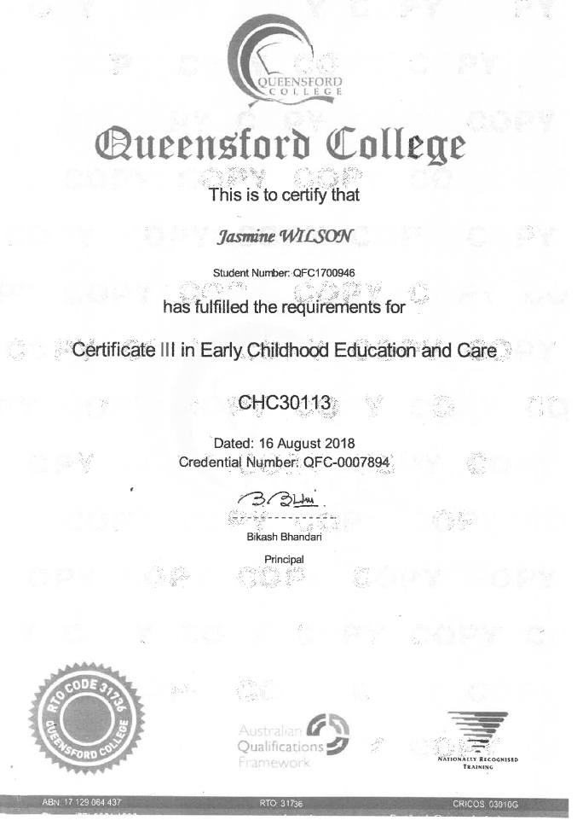
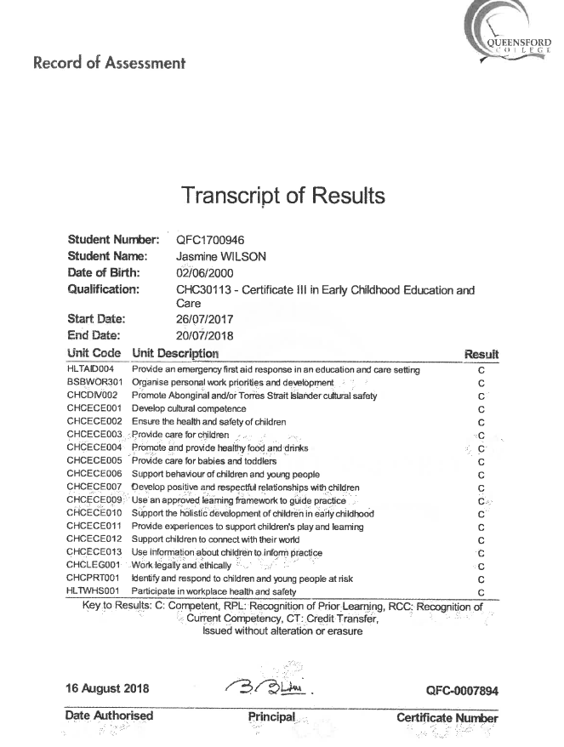
Notes:
Evidence required.

Slide 46
VET Qualification Verification
Acceptable Evidence:
Student Parchment/Certificate of completion
RTO name and code
Qualification name and code
Signed by RTO
Notes:
Acceptable evidence for verification can be:
Student Parchment/Certificate of completion.
Please ensure that the document has RTO name and code, the qualification name and code, and is signed by RTO.
A letter from the RTO on their letterhead stating the student name, and wording similar to “This letter is confirming that (student name) from (student’s school name) has successfully completed the qualification (state name of qualification and qualification code)
(This could be drafted by school and emailed to RTO to help them provide the information you need.)
What is not acceptable?
Academic transcripts or similar with no mention of “Qualification completed” or “Parchment issued”. This is not sufficient.
A result printout from VET broker (not the RTO)
A result printout from the RTO with no comment about successful completion.

Slide 47
VET Qualification Verification
Acceptable Evidence:
Letter from RTO on their letterhead stating student has successfully completed
Student name
School name
Qualification name and code
Signed by RTO
Notes:
Acceptable evidence for verification can be:
Student Parchment/Certificate of completion.
Please ensure that the document has RTO name and code, the qualification name and code, and is signed by RTO.
A letter from the RTO on their letterhead stating the student name, and wording similar to “This letter is confirming that (student name) from (student’s school name) has successfully completed the qualification (state name of qualification and qualification code)
(This could be drafted by school and emailed to RTO to help them provide the information you need.)

Slide 48
VET Qualification Verification
What is NOT acceptable:
Academic transcripts or similar with no mention of “Qualification completed” or “parchment issued”
Result printout from VET broker (not RTO)
Result printout from RTO with no comment about successful completion
Notes:
What is not acceptable?
Academic transcripts or similar with no mention of “Qualification completed” or “Parchment issued”. This is not sufficient.
A result printout from VET broker (not the RTO)
A result printout from the RTO with no comment about successful completion.

Slide 49
COVID Affected - Cert III Completion
DUE Friday 8 January, 2021
What is acceptable:
Student Evidence/Academic Statement of the Cert III units completed to date
Details of incomplete Cert III competencies and circumstances which made it impossible for the student to complete to date.
Supporting letter from RTO (on their letterhead/via email) verifying reason why student has not successfully completed outstanding competencies at this time. Supporting evidence must include:
Student full name
Qualification name and code
Details confirming/verifying reason why competencies missing/incomplete
RTO name and code
Notes:
Evidence assessed on an individual case by case basis.

Slide 50
Additional VET Results FORM
Notes:
Draft document still.
A final will be provided to schools for use with submitting additional Certificate III results post 30th November 2020 cut off date.
Verification Form via schools online is not accessible after 30th November date.

Slide 51
We will still continue to result students for any additional VET completed in the new year - just as we have always done, enabling students the opportunity to complete their SACE at any time over the year.
Notes:
Read screen

Slide 52
Completing the Certificate III
REMINDER:
Students need to negotiate with individual Training Providers about undertaking missing or incomplete competencies to complete their Certificate III training.
All required training and competencies must be formally and successfully completed to be eligible for the full certification to be awarded by an RTO.
Notes:
Remind coordinators to reiterate to students that the missing competency requirements will still need to be undertaken if they wish to complete the full Certificate III qualification.

Slide 53
askSACE@sa.gov.au for all VET enquiries
or phone 08 8115 4700
Louise Johnson: louise.johnson@sa.gov.au
Roanne Berekmeri: roanne.berekmeri@sa.gov.au
Adele Broster: adele.broster@sa.gov.au

Slide 55
Types of commendations
Governor of
South Australia Commendations
Governor of SA Commendation – Excellence Award (approx. 25 commendations)
Governor of SA Commendation – Aboriginal Student SACE Excellence Award (one commendation)
Governor of SA Commendation – Excellence in Modified Subjects Award (one commendation)
Notes:
Reminder about Governor of South Australia commendation awards. Approximately 25 awarded for excellence and these must be through nominations from schools and academic achievement. One award for aboriginal student excellence award and one for excellence in modified subjects award. We spoke about this in detail during semester 1 SACE management conference.

Slide 56
Process
Nominations open at the end of August 2020
Schools will be notified via a Swift Communication
The nomination forms, capability statement, exemplars and the policy are available on the SACE website
Nominations close on Friday 13 November 2020
All schools are encouraged to nominate one student per category whom they believe meet the selection criteria
Any questions to Karen Collins: karen.collins@sa.gov.au or ring 8115 4775.
Notes:
Nominations opens end of august and closes 13 November. You will get a swift communication shortly. Forms, capability statements and exemplars are available on the SACE website. All schools are encouraged to nominate a student . Enquiries to Karen Collins.

Slide 57
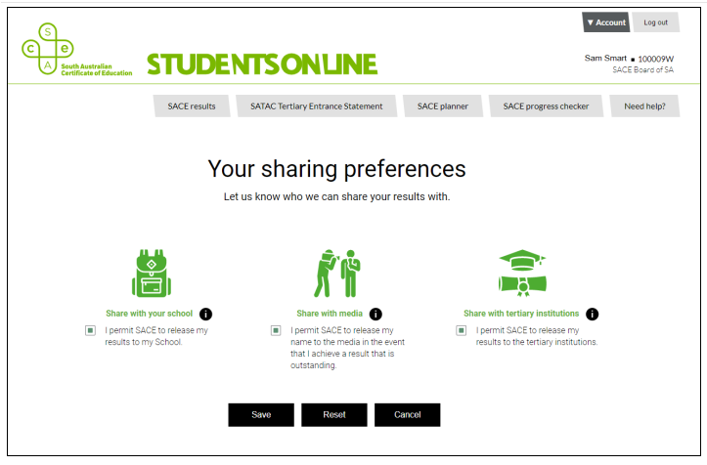
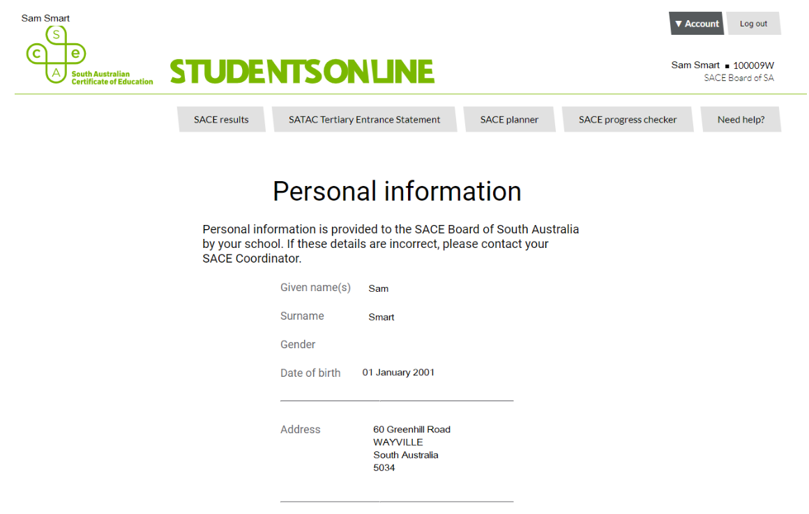
Student’s certificates
Correct address details in students online
Notes:
A special request to all leaders and SACE coordinators to ask students to check their address details in student’s online “account” section and notify the school to change this if incorrect before examination start. Their certificates are sent to the address recorded and we get phone calls and return envelopes relating to this during January.

Slide 58
Subject implementation
Plato courses
Implementation meetings
Professional associations
2021 new subject outlines start
Stage 2 Economics
Stage 2 Dance
Stage 2 Drama
Stage 1 and Stage 2 Nutrition
Stage 1 and Stage 2 Health and Wellbeing
Stage 1 and Stage 2 Politics, Power and People
Stage 1 and Stage 2 Legal Studies
Scoping and redrafting is underway on the following subjects:
Community Studies
Religion Studies
Workplace Practices
Notes:
Subject renewal
In May and June respectively, the SACE Board accredited the Politics, Power and People (replacing Australian and International Politics), and renewed Stage 1 and Stage 2 Legal Studies subject outlines for teaching in 2021.
Consultation on the Stage 1 and Stage 2 renewed Psychology subject outline closed on 14 July. Feedback has been collated, and the subject outline will be presented to the Board for accreditation in late August. It is anticipated that Stage 1 Psychology will be taught in 2021, and Stage 2 Psychology in 2022.
Implementation activities for the subjects listed on screen, to be taught in 2021, are currently being planned for delivery later this term:
We will notify teachers of these subjects through the usual communication channels.

Slide 59
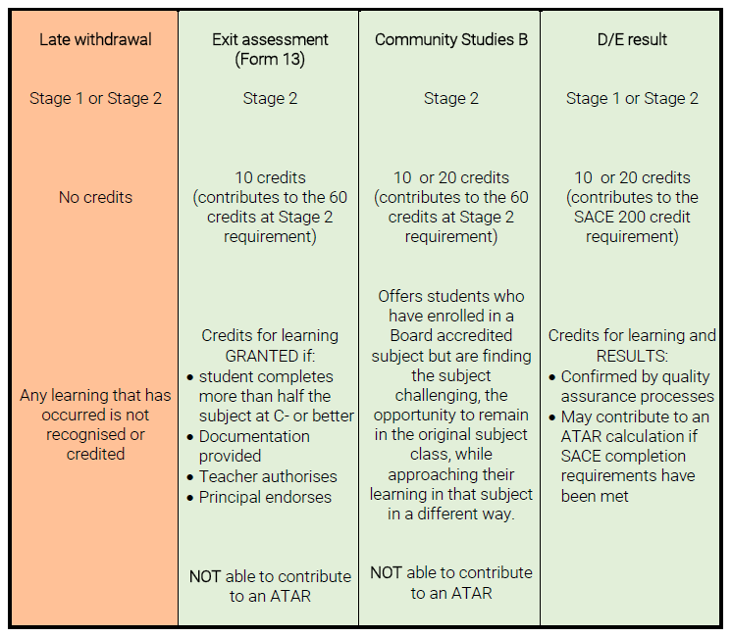
CREDIT FOR LEARNING
It is important that students receive credit for the learning they undertake in SACE subjects.
The table compares late withdrawal of a student’s subject enrolment with three alternative options that may provide some credit for the student’s learning:
Exit assessment
Community Studies B
Submission of D and E Grades
Notes:
It is important that students receive credit for the learning they undertake in SACE subjects.
For a range of reasons, teachers may believe that if a student is achieving poor results for their assessments, it is in the student's best interest to be withdrawn from the subject. However, individual teachers may not always be aware that a D or E achievement may support a student’s SACE completion.
It is important schools understand that no credit can be provided when students are withdrawn from a subject. Supporting a student who is not engaging to demonstrate some evidence of the performance standards in a subject may mean the difference between completing and not completing the SACE for that student.
The table compares late withdrawal of a student’s subject enrolment with three alternative options that may provide some credit .
Exit Assessment
An exit assessment can be granted for a student withdrawing from 20-credit Stage 2 subjects in the second half of the year or who have made a subject adjustment as a result of counselling after enrolments have closed and when:
the student has completed at least half of the learning program and associated assessments on the LAP
the student has achieved at least a C- result for the assessments that have been completed
the school applies for an exit assessment (Form 13) and provides the approved LAP, indicating the tasks that have been completed at a C- level or better on the Assessment Overview
the teacher authorizes the exit and the principal endorses it.
Evidence of student learning that validates the exit assessment must be retained in the school for 12 months for SACE Board auditing purposes.
A Stage 2 exit assessment can contribute to the 60 credits of Stage 2 subjects that students require for SACE completion.
Community Studies B
Students will be able to enrol in a 10-credit or a 20-credit subject, in up to three fields of study:
Humanities and the Community
STEM and the Community
Interdisciplinary Learning and the Community
Community Studies B can contribute to the 60 credits of Stage 2 subjects that students require for SACE completion.
Submission of D and E grades –
Another option for ensuring a student receives credit for learning in SACE subjects is submitting results in the D and E grades. The performance standards in each subject describe the qualities of learning in the D and E grades. While this learning is not high, it is a level of achievement none-the-less. A student with results in the D and E grade bands has at least demonstrated attempted or limited learning at Stage 1 or 2 and should receive credit where they have demonstrated learning at this level.
D and E grade results can contribute to the 200 credits required for SACE completion but cannot be used to meet any of the compulsory requirements, including the 60 credits required at Stage 2.

Slide 61
Notes:
This month, the SACE Board launched its Strategic Plan 2020 – 2023 and its vision for 21st century thriving learners.
The Strategic Plan is radically different and is centred on the concept that the learning entitlement of every student is to 'thrive'.
So to begin the conversation with the community about why this is the learning entitlement of every student, we decided to present the Strategic Plan as an interactive Launchpad, full of videos, ideas, even a podcast, to talk about why 'thrive' is the educational education imperative of the 21st century – and to introduce the six elements of a 'thriving learner'.

Slide 62
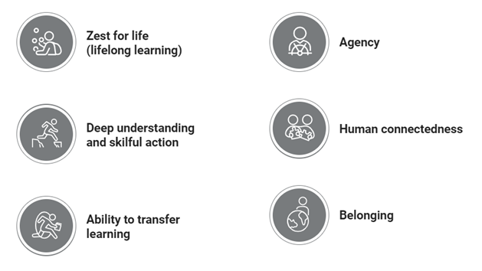
Notes:
Here are the six elements.
We believe that to thrive means that you have a sense and a demonstration of these attributes.
It is our purpose as a curriculum and assessment authority to shape education so that students can develop these attributes – and, in turn, can thrive throughout the rest of their lives.

Slide 63
Notes:
We purposely haven’t provided a strict definition of what these elements mean. We have done this on purpose so as to not limit the possibilities of what they mean to you at your school and in your context.
Instead, we are calling our for examples. We want you to show us what agency means at your school, or what deep understanding and skillful action looks like.
They can also be examples outside of school as well, because the concept of 'thrive' is very much about developing the whole person.

Slide 64
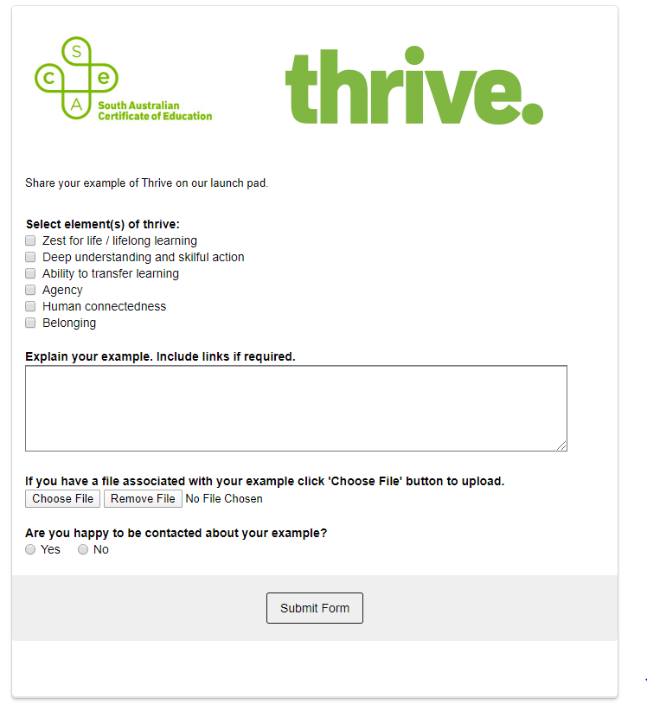
Notes:
On the Launchpad, we created a form whereby you can send through examples of the elements in action, whether it be a video, a piece of student work, or some other asset that you believe helps to describe an element of Thrive.
It would be fantastic for the Launchpad to become a two-way conversation, to help us all to identify, develop and celebrate a 21st thriving learner.

Slide 65
Bringing 'thrive' to life
Notes:
Bringing the elements of thrive to life will happen through the subjects, and in particular through the recommendations of the SACE Review, with projects already underway on measuring capabilities, starting with personal enterprise, and rejuvenating the PLP and the research project – as well as beginning the work to create a learner profile, a key recommendation of the national Shergold Review into senior secondary education and pathways.
To be successful, we need to partner with schools, to co-construct and co-design solutions.
And we need to support teachers through change. To do this, we introduce Prescient....

Slide 66
prescient.edu.au
Notes:
The SACE Board/We are excited to launch its new professional learning service – Prescient.
(Next slide)

Slide 67
Prescient is a network of educators who are committed to delivering transformative professional learning. We share ideas, problem-solve and empower teachers in their vital role as change agents.
prescient.edu.au
Notes:
Prescient key messages
- Prescient builds on the solid foundations of the IEA to offer professional learning with a focus on assessment AND pedagogy.
Prescient will connect educators across all sectors and levels of teaching with the latest thinking and ideas through professional learning events and services.
Prescient will deliver professional learning that empowers teachers to be forward thinking, ready for change, and will-equipped to support their students to be thriving, 21st Century learners.
Prescient will support teachers in their vital role as change agents.
Professional learning
Offering a diverse range of courses and professional learning events designed to keep educators abreast of the most current trends and teaching practices, Prescient will also connect educators with experts, leaders in the field and other teachers.
(Next slide)

Slide 68
Prescient courses
Assessment for Educators (AES)
Certified Educational Assessors (CEA)
prescient.edu.au
Notes:
Prescient courses
Prescient works with individual educators and groups of teachers in schools to enhance and further develop their expertise in assessment. Backed by solid research, our structured courses, the Certified Educational Assessors and the Assessment for Educators courses, are designed and delivered by teachers, for teachers.
Assessment for Educators
The AES course is designed to support a whole-school commitment to reflecting on, evaluating, and improving existing assessment practices to improve student outcomes. The course is targeted at school-wide, onsite delivery and is tailored to suit the context of each school.
Certified Educational Assessor
The CEA course is designed for individual educators who are seeking to strengthen their knowledge and expertise in assessment practice. Successful completion of the course provides recognition as a Certified Educational Assessor.
More information about these courses is available on the prescient website.
(Next slide)

Slide 69
What’s on
Upcoming professional learning
02 Sept
Feedback for impact
11 Sept
Building stronger analysis in science
18 Sept
Using video to enable active learning
04 Nov
Drama expert panel – creating a company
Notes:
In addition to the structured professional learning courses, Prescient offers professional learning events. There are currently 4 scheduled events, with more coming.
2 September – Feedback for impact - which is sold out.
11 September – Building stronger analysis in science – which is also sold out.
18 September – Using video to enable active learning
This full-day face-to-face workshop is designed for teachers who are keen to develop skills and strategies to engage their students in active learning through the use of video.
The workshop is interactive, practical and hands-on with participants using their own devices to create their videos.
4 November – Drama expert panel – creating a company
Three drama industry experts will share their experiences about creating and growing a theatre company during this online discussion panel. To support teachers in their teaching of the new Stage 1 and 2 Drama subject outlines, our panelists will discuss the ideation, realisation, and development of a thriving company. Following the discussion, the panelists will address questions from participants(Next slide)

Slide 70
For more information contact:
prescient@sa.gov.au
prescient.edu.au
Notes:
Forging new pathways, supporting teachers in an ever-evolving landscape, Prescient will empower educators to drive the future of education.
Contact us for more information on how we can help teachers to be well prepared to support their students to be thriving, 21st century learners.

Slide 71
Resources:
https://www.sace.sa.edu.au/events/management-conferences
Notes:
These Power point slides will be uploaded to the events section of the SACE website for you to use and share at your school site. The recording will be placed on the COVID 19 mini site.
The ask SACE team are your first point of call with any schools online and student online queries.
Specific subject related questions please contact the respective curriculum and assessment officer.
Thank you for your participation today.

