Slide 1
Integration of Australian Curriculum Mathematics Implementation Workshops
Term 3, 2015

Slide 2
Mathematics Subjects
Stage 1 subjects 2016 | Stage 2 subjects 2017
Mathematics | Specialist Mathematics
 | Mathematical Methods
General Mathematics | General Mathematics
Essential Mathematics | Essential Mathematics

Slide 3
Stage 1 Mathematics Subjects
Current Stage 1 subjects | Stage 1 subjects from 2016
Mathematics | Mathematics
Mathematical Applications | General Mathematics
Mathematical Pathways | Essential Mathematics
Numeracy for Work and Community Life

Slide 4
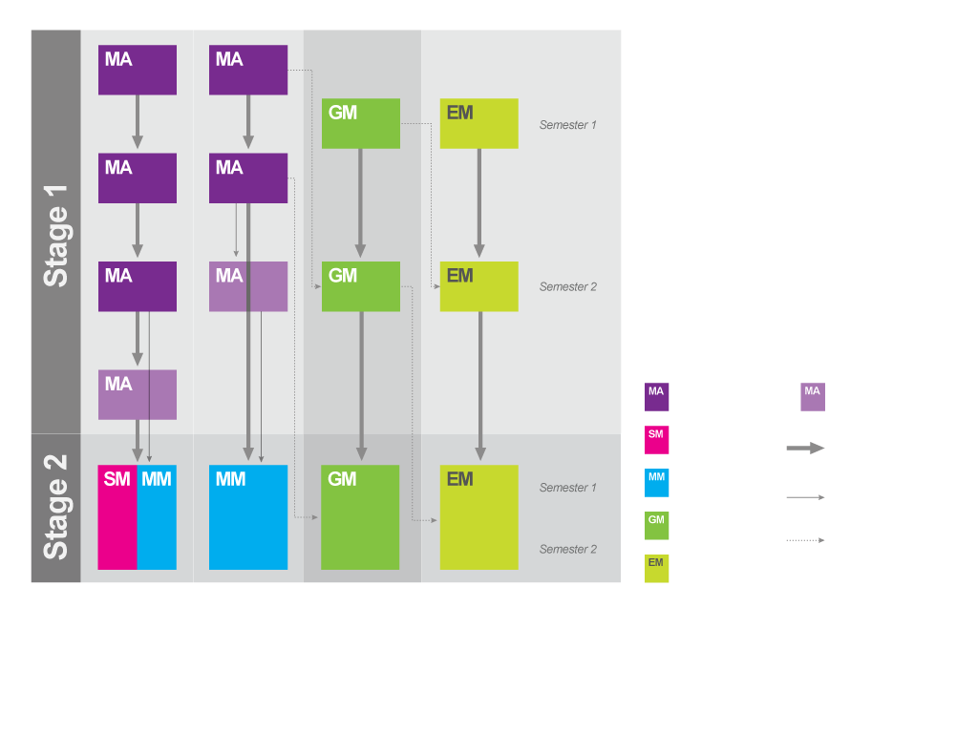
Pathway Options

Slide 5
Capabilities
Integrated Australian Curriculum capabilities
Literacy
Numeracy*
Information and communication technology capability*
Critical and creative thinking*
Personal and social capability
Ethical understanding
Intercultural understanding

Slide 6
SACE Numeracy Requirement
10 credits from a range of mathematics subjects at Stage 1 or Stage 2
A minimum C grade* in these Board-accredited subjects will meet the SACE numeracy requirement:
Mathematics (Stage 1)
General Mathematics (Stage 1)
Essential Mathematics (Stage 1)
any Stage 2 mathematics subject.
* At Stage 2 a C grade is C+, C, or C-

Slide 7
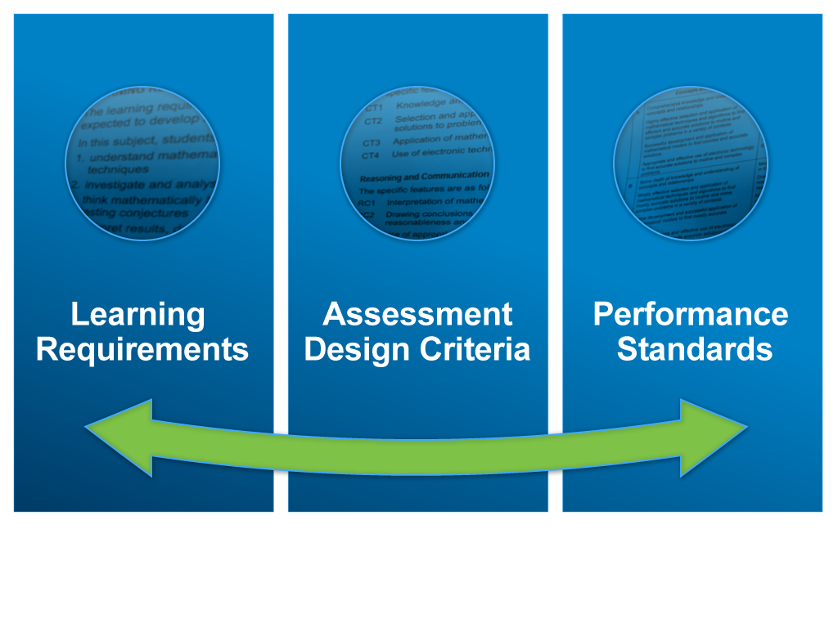

Slide 8
Assessment Scope and Requirements
Assessment at Stage 1 is school based
10-credit subject – four assessments
AT1: Skills and Applications Tasks – at least two
AT2: Mathematical Investigations / Folio – at least one
20-credit subject – eight assessments
AT1: Skills and Applications Tasks – at least four
AT2: Mathematical Investigations / Folio – at least two
Each assessment type – weighting of at least 20%

Slide 9
Assessment
Assessment Design Criteria
Concepts and Techniques
Reasoning and Communication
Specific Features
Performance Standards

Slide 11
Subject: Stage 1 Mathematics (1MAM)
Foundation for further study
Stage 2 Mathematical Methods
Stage 2 Specialist Mathematics
Stage 2 prepares students for entry to tertiary courses requiring a more specialised background in mathematics
Retains the current flexibility at Stage 1
12 topics
Topics 1 to 6 pre Stage 2 Mathematical Methods
Topics 1 to 12 pre Stage 2 Mathematical Methods and Stage 2 Specialist Mathematics

Slide 12
10A Content
Although it is advantageous for students to study Australian Curriculum 10 and 10A in Year 10, the 10A curriculum per se is not a prerequisite for the study of Stage 1 Mathematics.
The essential aspects of 10A are included in the subject outlines.

Slide 13
Pathway Options

Slide 14
Subject: Stage 1 General Mathematics (1MGM)
Applies mathematical skills to practical problem-solving.
Stage 2 prepares students for entry to tertiary courses requiring a non-specialised background in mathematics.

Slide 15
Stage 1 General Mathematics Programming Flexibilities
Choice of subtopics
10-credit subject – students study a selection of subtopics from at least three topics
20-credit subject – students study a selection of subtopics from at least six topics
Open topic
Flexibility for teachers to design programs to meet the needs and interests of their students
Relevant to local context
Comparable standard to other topics in the subject outline

Slide 16
Subject: Stage 1 Essential Mathematics (1MEM)
For students:
seeking to meet the SACE numeracy requirement
planning careers in a range of trades or vocational pathways.
Emphasis on:
practical problem solving
everyday and workplace contexts
flexible and resourceful programming.
Some students may complete Stage 1 Essential Mathematics to fulfill the numeracy requirement while others intend to continue to Stage 2 Essential Mathematics.

Slide 17
Stage 1 Essential Mathematics Programming Flexibilities
Choice of subtopics
10-credit subject – students study a selection of subtopics from at least three topics
20-credit subject – students study a selection of subtopics from at least six topics
Open topic
Flexibility for teachers to design programs to meet the needs and interests of their students
Relevant to local context
Comparable standard to other topics in the subject outline

Slide 18
Stage 1 Essential Mathematics Assessment Type 1: Skills and Applications Tasks
Presented in different formats
Assessment conditions may vary
Flexibility in the style and the time allocated to complete the task
The use of electronic technology and notes is at the discretion of the teacher

Slide 19
Stage 1 Essential Mathematics Assessment Type 2: Folio
Variety of forms
Length can vary; no more than 6 A4 pages if written, or the equivalent in multimodal form
‘Report format’ not prescribed

Slide 20
Focus Questions
Which subjects may be offered in your school context?
How might these subjects be programmed into the timetable?
How might teaching a cohort with a pathway to a specific Stage 2 subject impact your program for Stage 1?
What opportunities do you see for renewing your teaching programs?
Might an Open Topic be appropriate for your context?

Slide 21
4 Phases of Quality Assurance

Slide 22
Quality Assurance

Slide 23
Learning and Assessment Plans
Simplified form
a cover sheet and the assessment overview page
some pre-approved plans available from website
example LAPs

Slide 24
Focus Questions
Could you use a pre-approved learning and assessment plan (LAP)?
How might you adapt a pre-approved LAP?
How might you adapt current tasks that are still appropriate in the redeveloped subject outline?

Slide 25
Quality Assurance

Slide 26
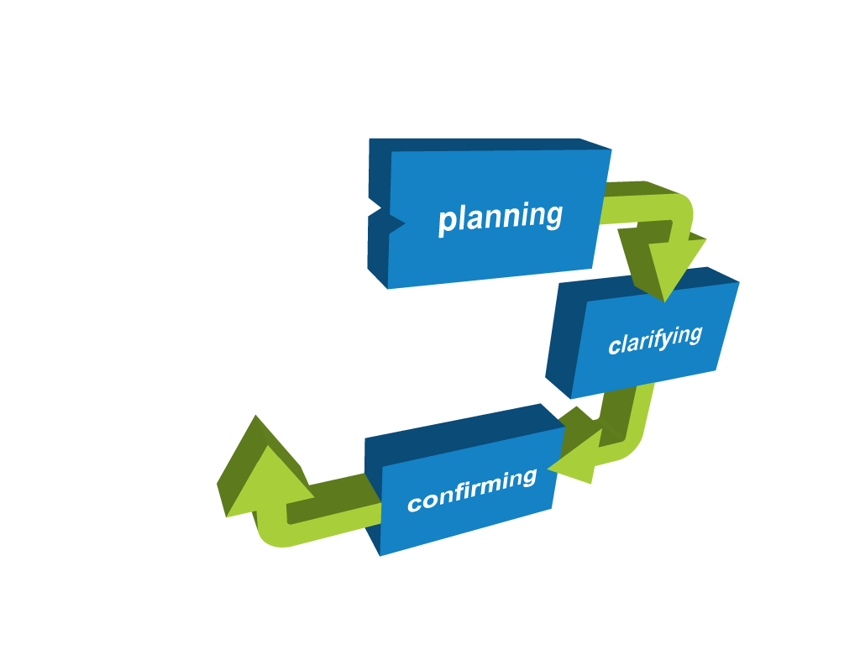
Quality Assurance

Slide 27
Moderation of Stage 1 mathematics subjects
3 year cycle
Online benchmark samples will be available in Term 1
Opt-in provision

Slide 28
Quality Assurance

Slide 29
Transition Arrangements Stage 1 mathematics subjects
Students who have not yet reached C standard in 2015
Pending – result against 2015 subject outline in 2016, identified as 2015 results on ROA
OR
Enrol in 2016 subject, result against 2016 subject outline

Slide 30
Stage 2 Mathematics Subjects in 2017
Specialist Mathematics
Mathematical Methods
General Mathematics
Essential Mathematics

Slide 31
Stage 2 Mathematics Subjects
Current Stage 2 subjects | Stage 2 subjects from 2017
Specialist Mathematics | Specialist Mathematics
Mathematical Studies | Mathematical Methods
Mathematical Methods
Mathematical Applications | General Mathematics
Mathematical Pathways | Essential Mathematics

Slide 32
Stage 2 Mathematics Subjects 2017: Assessment
School Assessment (70%)
Assessment Type 1: Skills and Applications Tasks
Equivalent of 1 SAT without the use of a calculator or notes
Assessment Type 2: Mathematical Investigation/Folio
External Assessment (30%)
Assessment Type 3: Examination (30%)
Calculators and notes allowed for entire examination

Slide 33
Stage 2 External Assessment Graphics Calculators
Criteria for approval
Approved for 2016 for external examinations – 3 additional calculators
Casio fx-CG20AU
Texas Instruments – TI 84 Plus C – silver edition
Texas Instruments – TI 84 Plus CE
Information sheet – ‘Specifications for use of approved calculators, stencils, and computers’

Slide 34
What’s next?
School planning – subjects
Your planning
familiarise yourself with the subject outline
teaching program
learning and assessment plan
tasks

