Slide 1
Design, Technology and Engineering implementation
Joy Cresp

Slide 2
Summary of process
2018
Subject renewal
Research
2019
Implementation
Website pre-edited subject outline
2020
Teaching and resulting
New website
Reference group
Writers
Public consultation
Board approval
University - ATAR
PLATO course
PLATO social
face to face workshops
PLATO clarifying
Resources

Slide 3
Quality Curriculum Key Performance Indicators
The principles of subject renewal set out in the SACE Subject Renewal Policy are:
quality learning
engagement
innovation
quality assessment
manageability
From these principles, five features of quality learning form the KPI focus areas of:
Growth in capabilities
Conceptual and contextual learning
Transformative learning
Relevant, engaging learning
Collaborative learning

Slide 4

Subject Renewal Advisory group addressed these questions…..
Will students want to select, learn and engage with this subject?
Will teachers want to teach this subject?
Will schools offer this subject?
Will this subject lead to entrepreneurship, employment opportunities and
life long learning?
How will this subject develop responsible citizens?

Slide 5
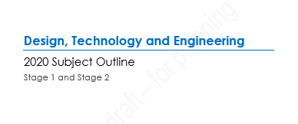
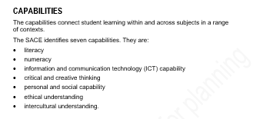
Subject outline specifics
Stage 1: 100% school assessment
Stage 2: 30% external assessment & 70% school assessment
Structure of subject outline
    capabilities
    learning requirements
    content
    assessment
Maximum of 3 assessment types

Slide 6
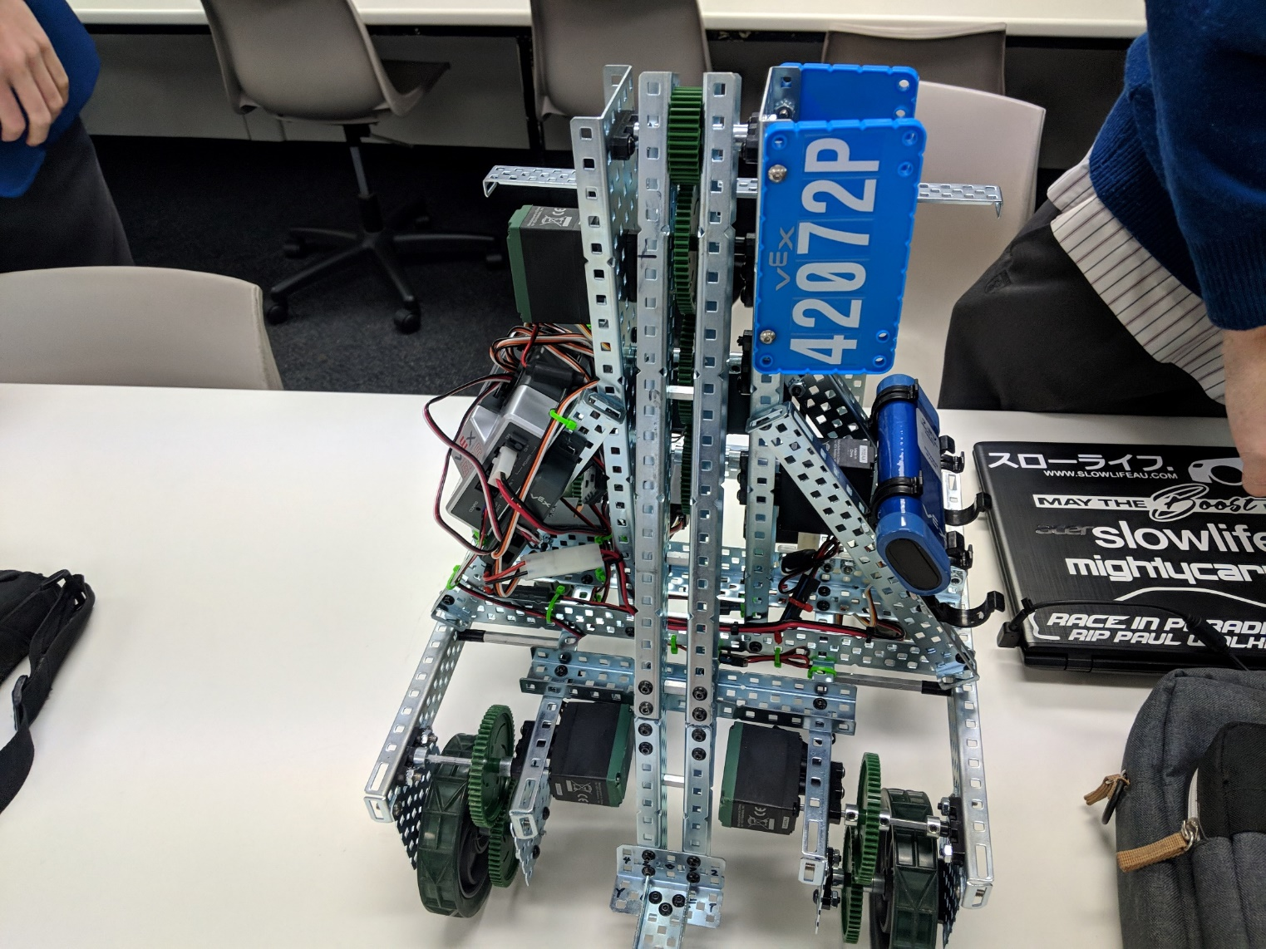
New Name!
Design, Technology and Engineering
New contexts
Digital Communication Solutions
Industry and Entrepreneurial Solutions
Material Solutions
Robotic and Electronic Systems

Slide 7
SACE Completion
To complete the SACE, students can do all or any of different DT&E codes.
Stage 1 - students can do multiples of all codes without any penalty.
Stage 2 - SACE completion
60 credits with a passing grade of C- or higher could be made up of three of the four new codes in DT&E if a student wished.
It is possible for a student to do all four codes in Stage 2
What if :
‘If a student undertakes two Stage 2 courses using the same code….
i.e. two x 2MRS20 – Materials Solution… one in wood and the other in fabrics,’
they would be precluded for SACE Completion
only one lot of 20 credits is used in achieving SACE completion
however both Stage 2 results are recorded on the students record of achievement

Slide 8
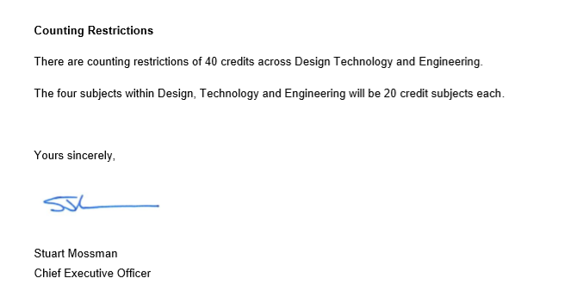
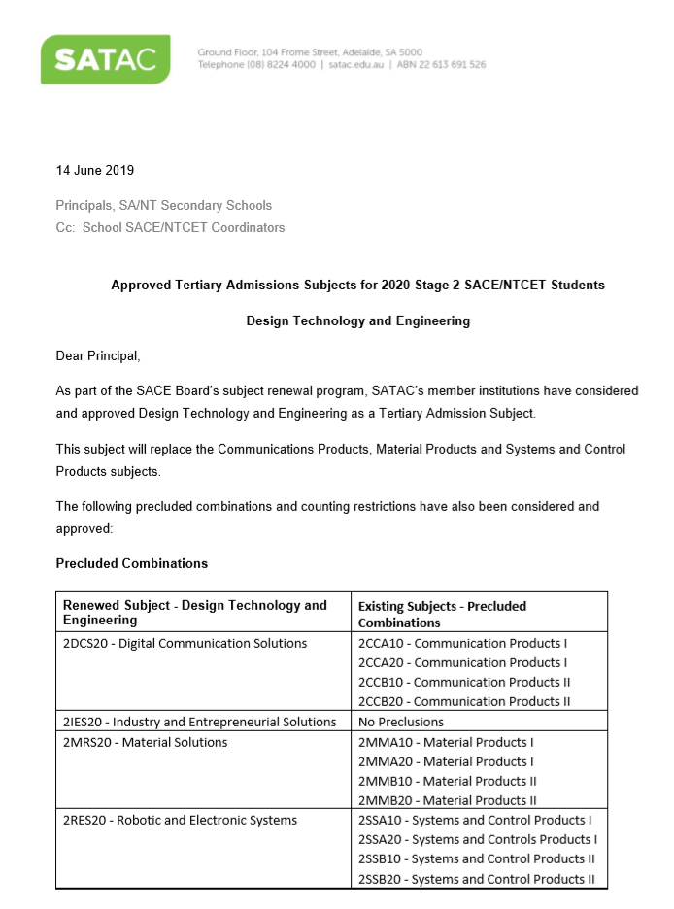
ATAR
Counting restrictions - 40 credits can be used and must come from different codes
If a student undertakes two courses using the same code at Stage 2 i.e. two x 2MRS20 – Materials solution… one in wood and the other in fabrics,
then they would be precluded for the ATAR.
Only the highest result gets used in calculating an ATAR.

Slide 9
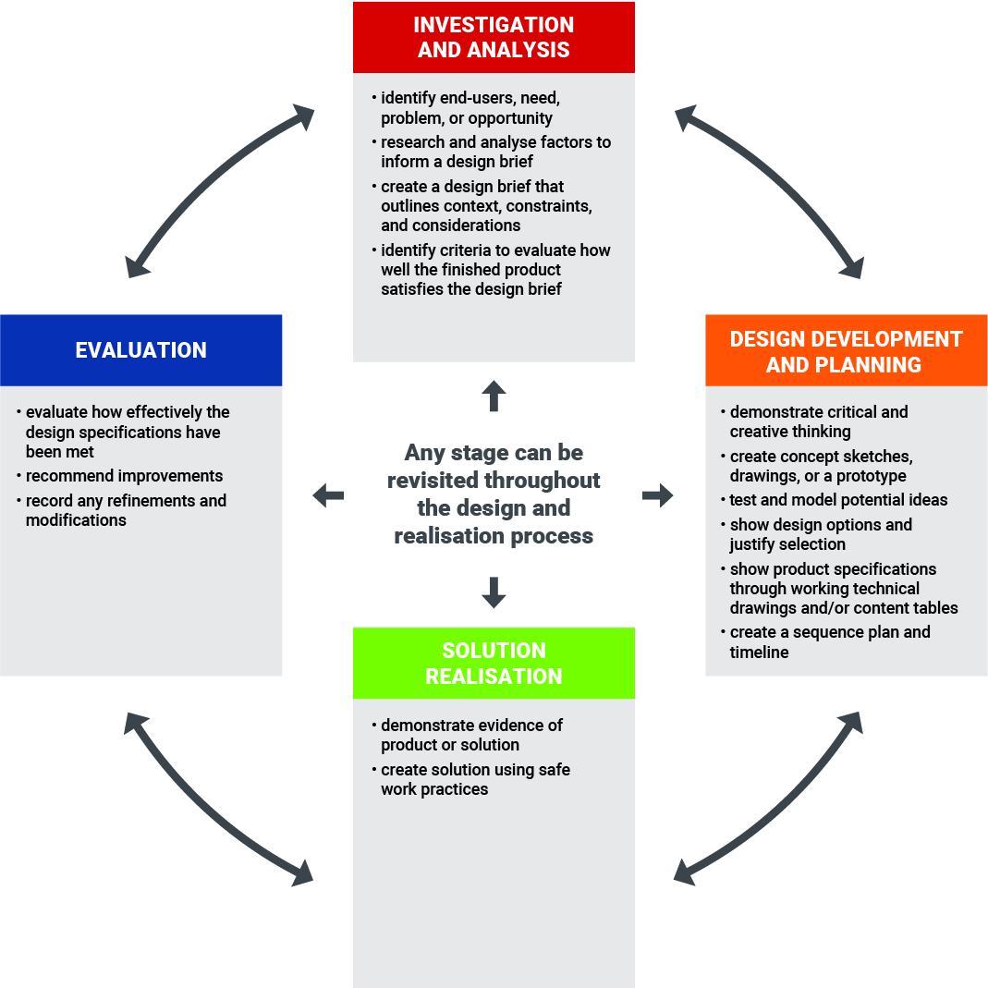
New Framework
Design and realisation process
Refer to the teaching and learning strategies that explain this model.

Slide 10
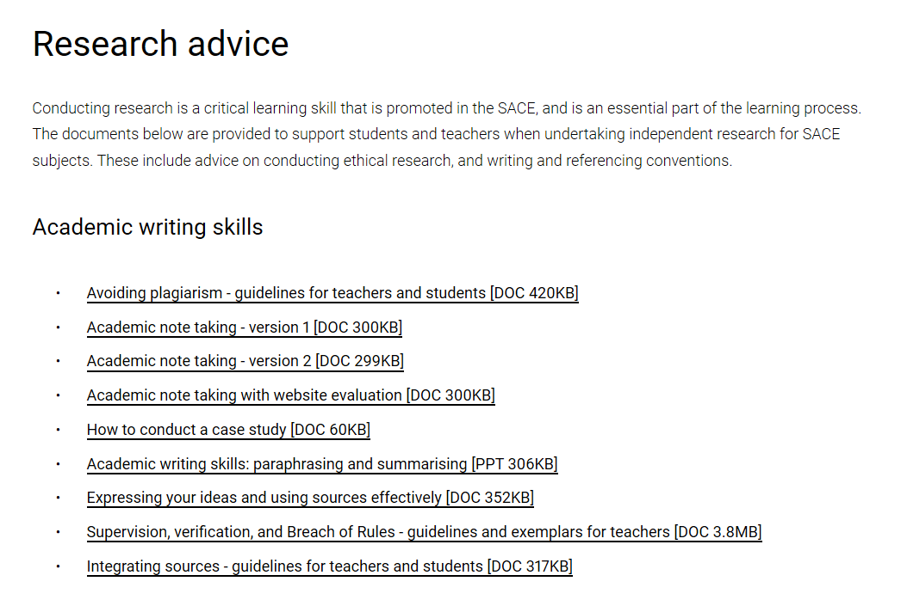
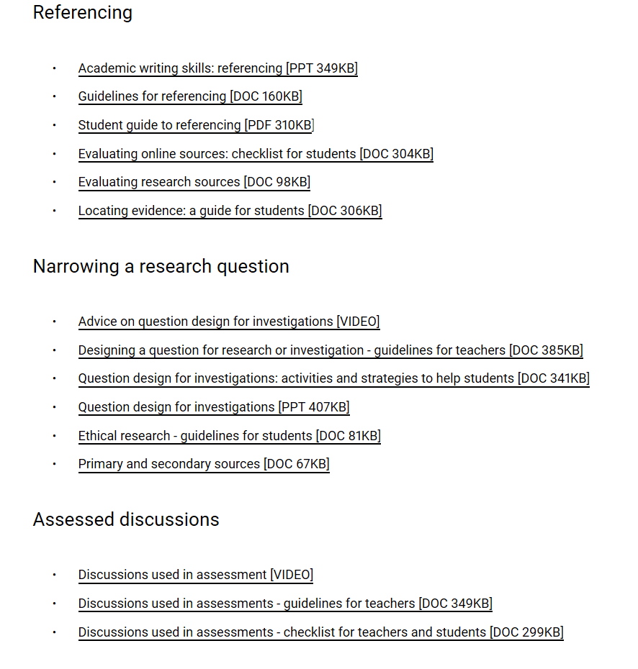
Resources
Glossary of terms
Poster set - Design and Realisation Process
Creative thinking resource contributed by Sandy Walker (Flinders University)
Ethical investigation and research
DATTA ( Design and Technology Teachers Association)

Slide 11
Learning Requirements
In this subject, students engage in the Design and Realisation Process and are expected to:
Stage 1 | Stage 2
review design features, processes, materials, and production techniques and apply creative thinking to the design of a solution plan and develop design concepts and communicate potential features of - and solutions to - a problem or challenge apply knowledge and understanding of skills, engineering procedures, and techniques using technology to realise the solution evaluate processes used in design development and solution realisation research and discuss ethical, legal, economic and/or sustainability issues related to technology, materials selected, processes used and/or solution design. | investigate and analyse design features, processes, materials, and production techniques and apply creative thinking to the design of a solution plan, develop and test design concepts and communicate potential features of - and solutions to - a problem or challenge apply knowledge and understanding of skills, processes, engineering procedures, and techniques using technology to realise the solution evaluate the solution with reference to the design brief and reflect on processes used in design development and realisation analyse ethical, legal, economic and/or sustainability issues related to technology, materials selected, processes used and/or solution design.
Progression to higher levels of skills , knowledge and application of learning.

Slide 12
Assessment Design Criteria & Specific Features
Stage 1 | Stage 2
Investigation and Analysis The specific features are as follows: I1 Review the design features of products, processes, materials, systems and/or production techniques. I2 Research and discuss ethical, legal, economic and/or sustainability issues related to a solution. Design Development and Planning The specific features are as follows: D1 Communicate design concepts using technical language. D2 Plan and develop design concepts and procedures. Production The specific features are as follows: P1 Application of skills, processes, procedures and techniques to create a solution. P2 Development of solutions to technical problems that arise during the solution realisation. Evaluation The specific features are as follows: E1 Evaluation of the solution features, realisation process and/or response to issues | Investigation and Analysis The specific features are as follows: I1 Analyse the design features of products, processes, materials, systems and/or production techniques. I2 Analyse ethical, legal, economic and/or sustainability issues related to a solution. Design Development and Planning The specific features are as follows: D1 Communicate design concepts using technical language and visual representations. D2 Plan, develop, test and validate concepts and procedures. Production The specific features are as follows: P1 Application of skills, processes, procedures and techniques to create a solution. P2 Development of solutions to technical problems or recommendations for improvement. Evaluation The specific features are as follows: E1 Evaluation of the solution features, realisation process and/or response to issues

Slide 13
Stage1 | Assessment Type 1: Specialised Skills Task | Assessment Type 2: Design Process and Solution
Credit Three assessments Each assessment type should have a weighting of at least 20 % | Students undertake two specialised skills tasks Evidence for each task presented should be completed in multimodal form to a maximum of three minutes | Students undertake one Design process and solution task consisting of two parts; Part 1- Design development Part 2- Solution realisation The evidence for the design development should be a maximum of 1000 words if written or 6 minutes of recorded oral communication, or the equivalent in multimodal form. The evidence for the solution realisation should be a maximum of 500 words if written or 3 minutes of recorded oral communication, or the equivalent in multimodal form.
20 credit Up to six assessments Each assessment type should have a weighting of at least 20 % | Students undertake two or more specialised skills tasks Evidence for each task presented should be completed in multimodal form to a maximum of three minutes | For a 20-credit subject, students create one or more design process and solution tasks. For a 20 credit subject, the combined evidence for Assessment Type 2 should be a maximum of 3000 words if written or a maximum of 18 minutes of recorded oral communication, or the equivalent in multimodal form.

Slide 14
Stage 1 Assessment Description
Stage 1 | Assessment Type 1: Specialised Skills Task | Assessment Type 2: Design Process and Solution
Assessment description | Students develop knowledge and skills through specialised skills tasks. They apply the skills, processes and techniques in the related context. This informs the design development for a solution in Assessment Type 2. Students evaluate and assess the development of their own skills in this assessment task. They review how these processes and techniques may influence their solution. Students and teachers negotiate whether it would be appropriate to demonstrate these processes and techniques in a single session, or over a more extended period of time. This assessment could consist of one activity or a series of activities | Part 1 - Design development Students show evidence of key design phases of investigation and analysis, design development and planning. This could be completed individually or as part of a collaborative task. Part 2 - Solution realisation Students create and evaluate the solution. The student provides evidence of the solution in the form of images or a video recording and evaluates the completed solution. Students should evaluate how well the requirements of the design brief have been met including what worked well, what did not go according to plan, and what was learnt. Students consider possible modifications to improve the outcome, and discuss how the solution is to be used.

Slide 15
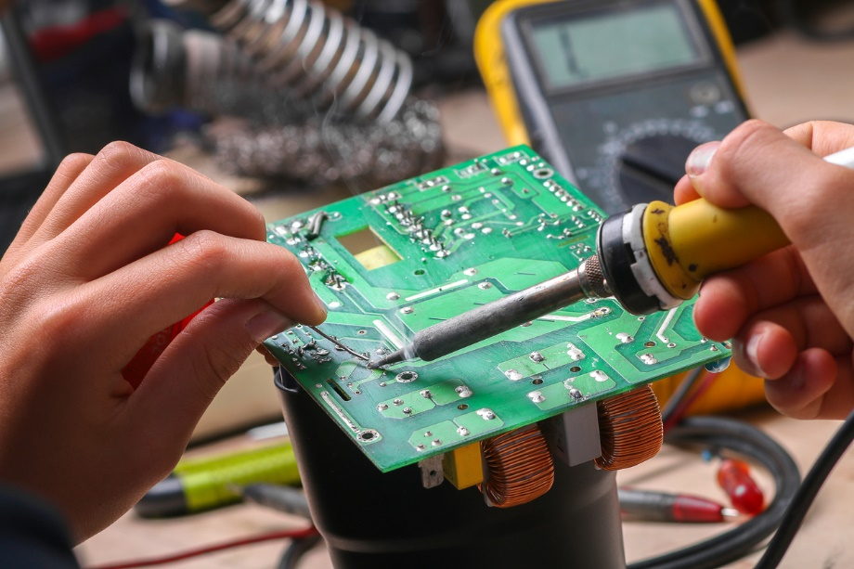




Forms of evidence

Slide 16
Stage 2
School Assessment
Assessment Type | Number of tasks | Evidence | Assessment Design Criteria
AT1: Specialised Skills Task (20%) | two | Evidence for this assessment type should be provided in multimodal form to a maximum of 6 minutes, 1000 words in written form or a combination of these. | Production Evaluation
AT2: Design Process and Solution (50%) | One (up to three sections) | The task(s) should be up to a total maximum of 2000 words or the equivalent in multimodal form where 6 minutes is equivalent to 1000 words. The task must showcase and evaluate the solution or product. | Investigation and Analysis Design Development and Planning Production Evaluation
External assessment
AT3: Resource Study (30%) | One (comprising of two parts) | Part1: Resource investigation (I1 & D2) Part 2: Issues exploration (I2 & E1) The Resource Study should be presented in written or multimodal form or a combination of both. It should be up to a maximum of 2000 words if written or the equivalent in multimodal form, where 1000 words is equivalent to 6 minutes. | Investigation and Analysis Design Development and Planning (D2) Evaluation

Slide 17
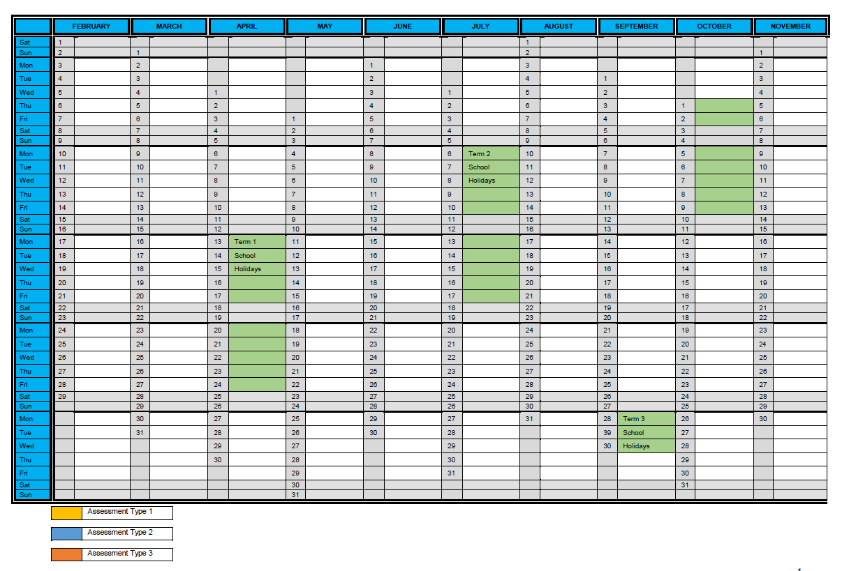
Sequencing of tasks example
Sequence | Assignment | SACE Requirements | Performance standards
1 | AT2 Investigate | 200 words or 1-minute multimodal equivalent | I 1
2 | AT2 Design, develop and plan | 800 words or 5-minute multimodal equivalent | D 1,2
3 | AT3 part 1 Resource investigation | 1000 words written 6-minute multimodal equivalent | I 1 D 2
4 | AT1 Skills task A | Product record and 500 word written evaluation or 3-minute multimodal equivalent | P 1 E 1
5 | AT3 part 2 Issues Exploration | 1000 words written or 6-minute multimodal equivalent | I 2 E 1
6 | AT1 Skills Task B | Product record and 500 word written evaluation or 3-minute multimodal equivalent | P 1 E 1
7 | AT2 Produce & Evaluate | Product record (500 words) and 500 word written evaluation or 3-minute multimodal equivalent | P 1,2 E 1

Slide 18


Slide 19

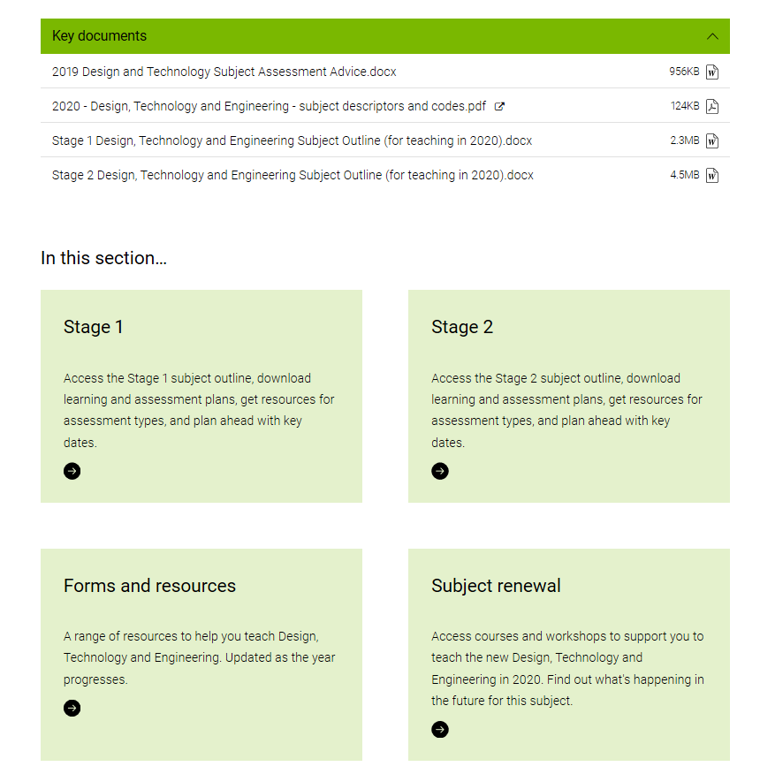
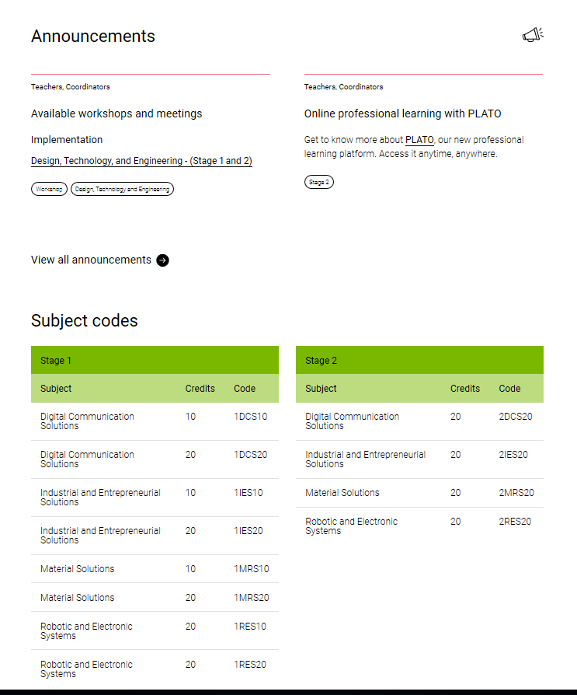
New website

Slide 20
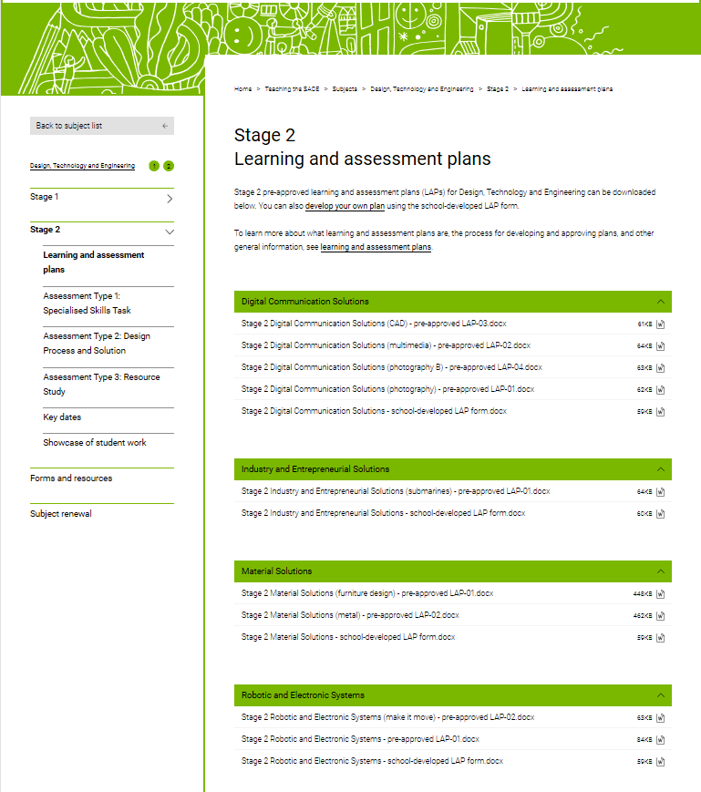
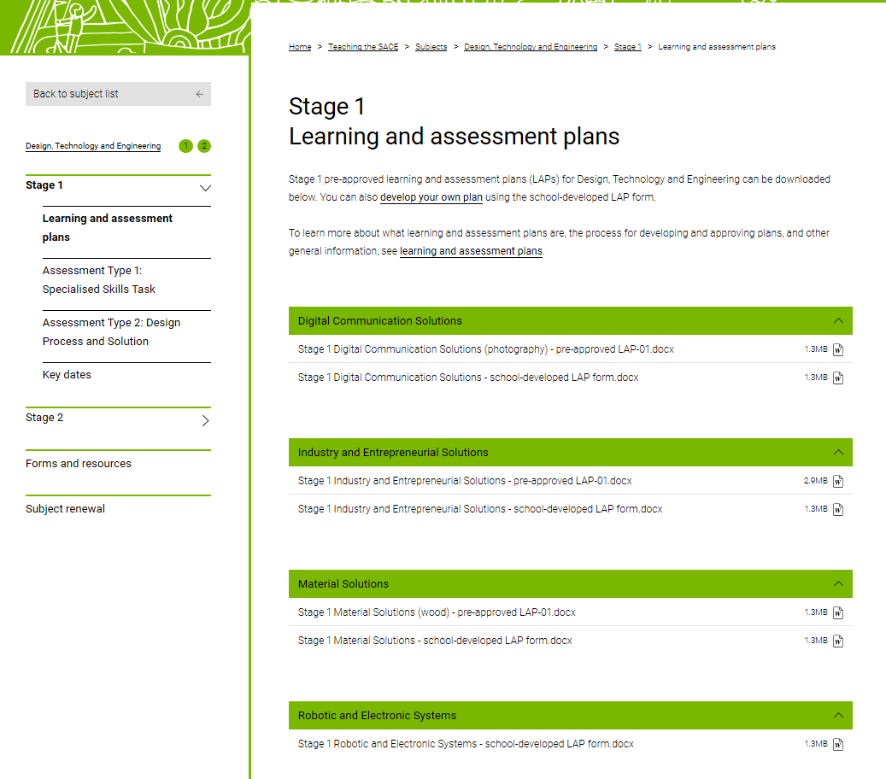
LAPS

Slide 21
Both Stage 1 and Stage 2
Design, Technology and Engineering contexts/ codes/ subject outline will commence in 2020
Are you ready?

Slide 22


Slide 23
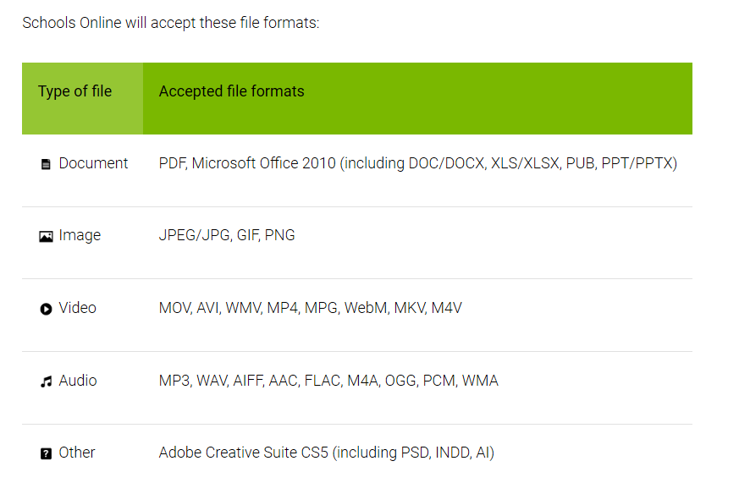
Schools Online - processes and procedure

Slide 24
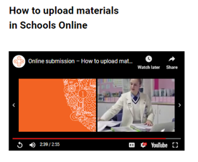
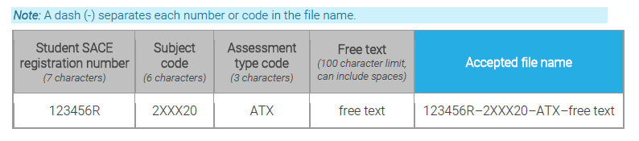
Schools online
Submission of results
https://www.sace.sa.edu.au/teaching/resulting/online-submission
Tasks submitted electronically
Standard file naming protocol:

Slide 25
Schools online
Results sheets
Key Dates
Stage 1 DT&E all codes
Stage 2 DT&E all codes…. Results and Up load student work
  school assessment per assessment type
  external assessment
Moderation
All A+ student work for each assessment type
Nominated student work for each grade level and assessment type
Shaded performance standard record
Information sheet 50
All student external assessment work- (clean copy)
Teacher is first marker
score out of 30
Information sheet 51
Student materials

Slide 26


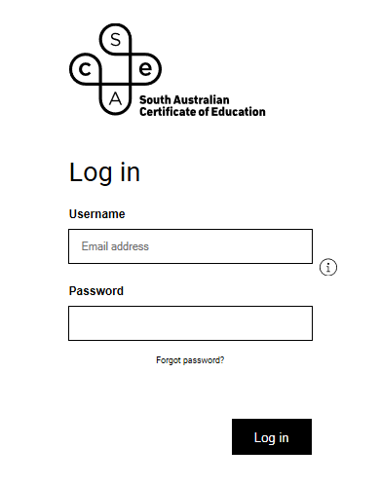
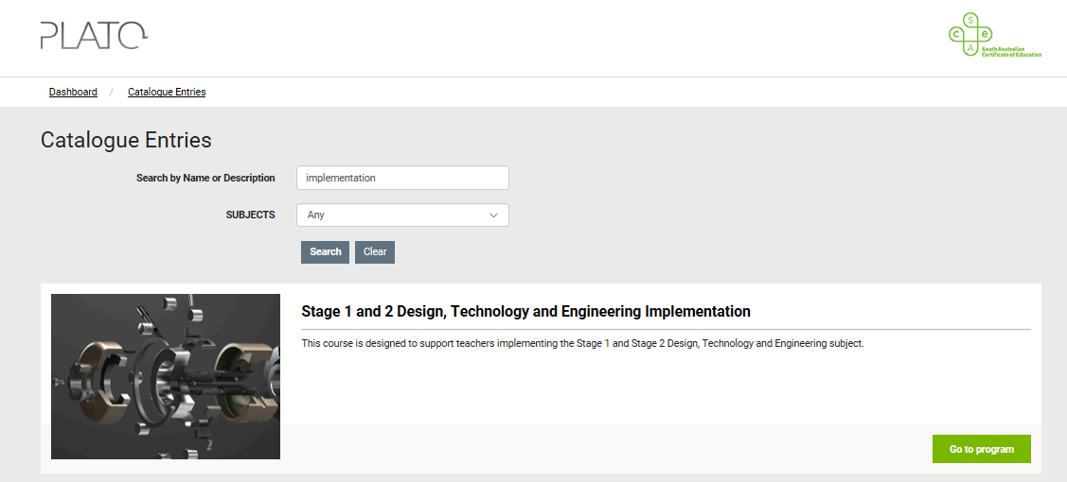
PLATO

Slide 27
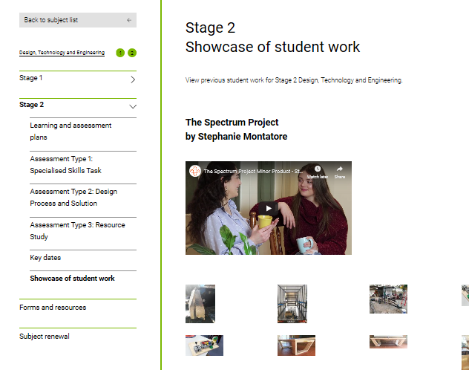
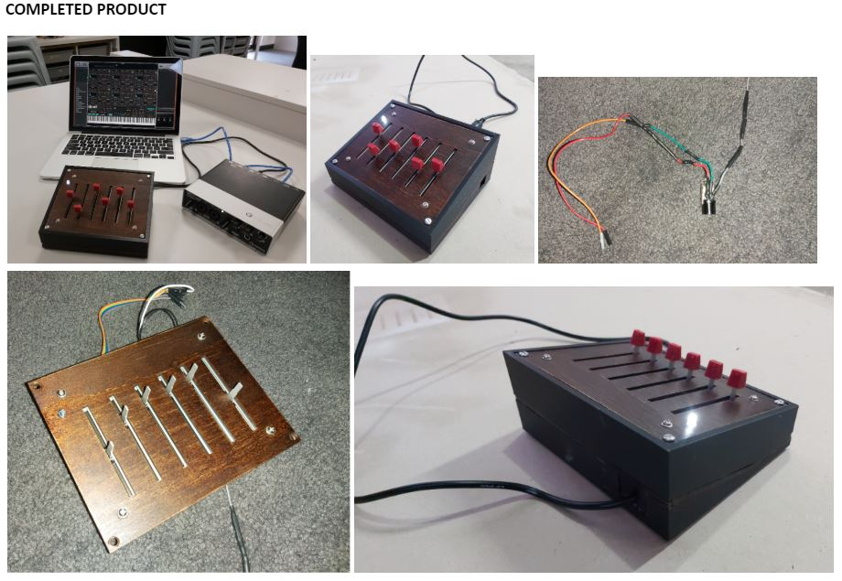

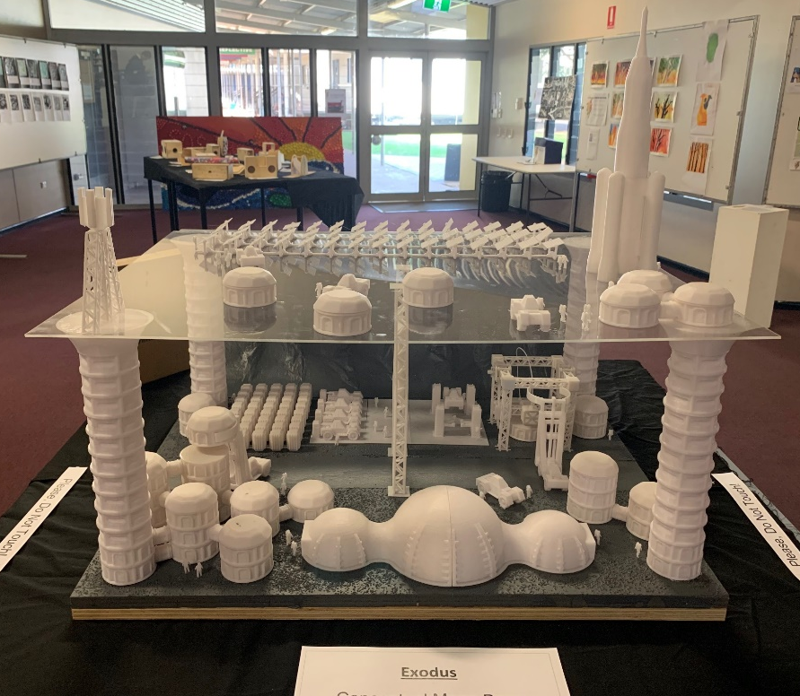
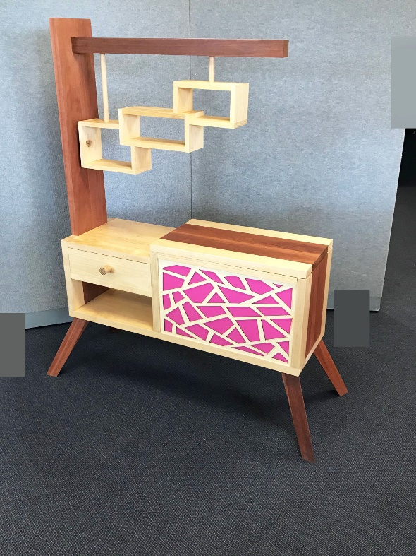
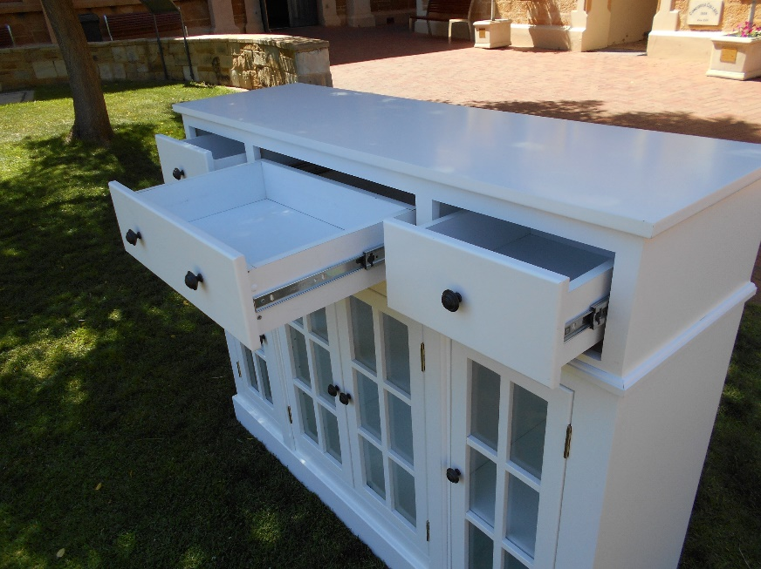
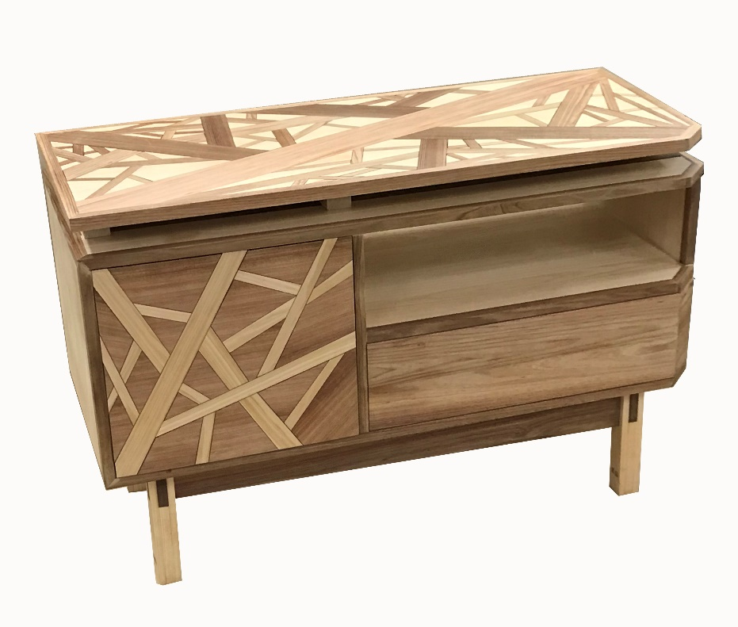

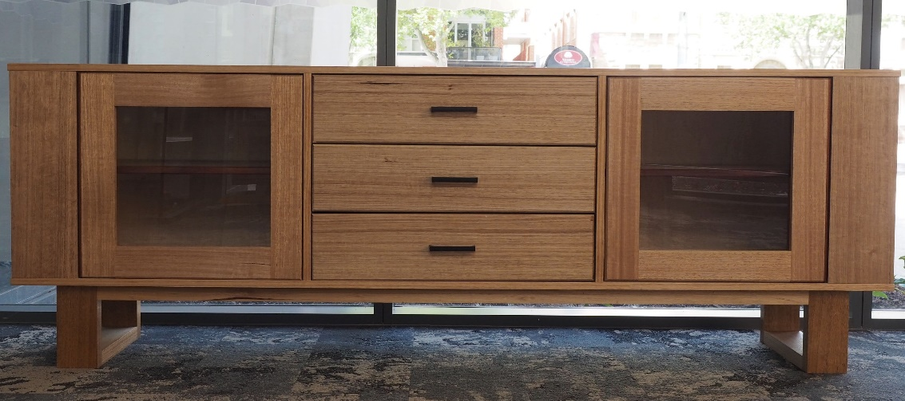

Slide 28
What next?
  Become familiar with the subject outline
  Polish or modify a pre-approved LAP (with the addendum) or design you own
  Develop new and interesting tasks or adapt exemplar tasks
  Finalise a teaching program
  Keep checking the website

Slide 29



