Slide 1
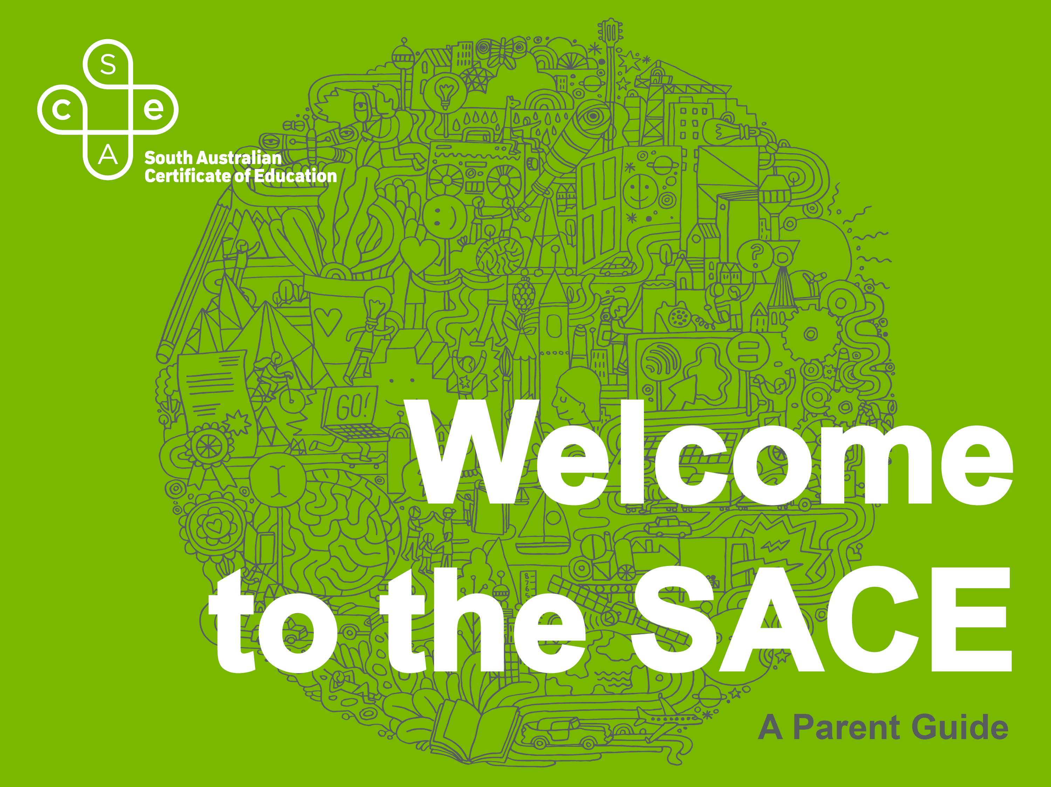

Slide 2

Welcome
to the SACE
Internationally recognised qualification
Designed to develop students’ capabilities
Skills needed to be successful in the 21st century
Flexible timeframe and choice of subjects
Notes:
An internationally recognised qualification for life designed to help develop your capabilities.
Designed to develop your skills and knowledge to live, work and participate successfully in an ever-changing society.
Offer you the flexibility to choose your subjects and complete the qualification in a timeframe that suits you and your lifestyle.
You will be a successful learner, a confident and creative individual and an active and informed citizen.
Ready to succeed in further education, training or the workforce.

Slide 3
7 capabilities are embedded into SACE subjects.
Literacy
Numeracy
Information and Communication Technology
Critical and Creative Thinking
Personal and Social
Ethical Understanding
Intercultural Understanding
Notes:
Student develop 7 key personal capabilities that equip you to live and work successfully in the 21st century.
Literacy: Develop skills to understand and interpret a variety of texts and people in a range of different situations and countries.
Numeracy: Gain knowledge to interpret information and solve problems through working with numbers, problem solve, and think logically.
Information and Communication Technology: Learn how to use current and emerging technologies and understand their impact on society and the workplace.
Critical and Creative Thinking: Learn to think broadly and deeply using reason, logic, imagination, and innovation to analyse complex topics.
Personal and Social: Learn to be aware of your own and others emotional, mental, and spiritual wellbeing.
Ethical Understanding: Develop a deep understanding of ethical, cultural, social, and environmental issues and how to manage them.
Intercultural Understanding: Learn about your own values, languages, beliefs, and morals, and those of others to develop empathy, respect, and responsibility.

Slide 4

The SACE journey
C-
Grade
200
credits
Essential Subjects
Year 10
Year 11
Year 12
Personal Learning
Plan
Stage 1
Stage 2
Stage 2 - 60
credit subjects
Notes:
Starts with Exploring Identities and Futures (EIF) in Year 10 before generally completing Stage 1 in Year 11 and Stage 2 in Year 12 (this can vary between schools and students).
To complete the qualification, you will need to complete the following:
200 credits
undertake a few compulsory subjects.
achieve a grade of C- (or better) for their Stage 2, 60 credit selected subjects.

Slide 5
Building
credits
THE ESSENTIALS
10 Credits
Exploring Identities and Futures at Stage 1
20 Credits
English subjects at Stage 1 or Stage 2
(literacy requirement)
10 Credits
Mathematics subjects at Stage 1 or Stage 2
(numeracy requirement)
10 Credits
Activating Identities and Futures at Stage 2
50 Credits
Notes:
The 200 credits will be made up by the following:
A few compulsory subjects (50 credits):
10 credits for Exploring Identities and Futures at Stage 1
20 credits chosen from a range of English subjects at Stage 1 or Stage 2 (literacy requirement)
10 credits chosen from a range of mathematics subjects at Stage 1 or Stage 2 (numeracy requirement)
10 credits for the Activating Identities and Futures at Stage 2
Most 10 credit subjects are studied over one semester and most 20 credit subjects are studied over two semesters.

Slide 6
Building
credits
CHOOSING YOUR OWN
90
credits
60
credits
+
Stage 1 or Stage 2 subjects
of their choice
Stage 2 subjects
of their choice
Notes:
You will need to successfully complete 90 credits, gained through additional Stage 1 or Stage 2 subjects or Board-recognised courses (such as VET or community learning). You can choose the subjects or courses that you would like to study to gain the remaining 90 credits.
The remaining 60 credits needs to be gained through Stage 2 subjects. You can choose these subjects, but they have to be worth at least 60 credits in total.

Slide 7
Different types
of learners
COMBINE
Combine study and part time work,
a traineeship or school-based apprenticeship.
COURSES
SACE subjects
Community learning
University
TAFE studies
TRAINING
Vocation education and training (VET) (available at
Stage 1 and 2)
LEARN
Learn in and outside the classroom.
Notes:
The SACE is flexible, and caters for learning both in and outside school.
Students can combine study and part time work, a traineeship or school-based apprenticeship.
Students can receive credits for a wide range of activities and training:
SACE subjects
Vocation education and training (VET)
Community learning
University and TAFE studies
VET options are available at both Stage 1 and Stage 2 and include wide range of industry areas, including construction, automotive, electro technology, hospitality, community services, and health and information technology.
You can find a range of Stage 1 and 2 subjects offered, vocational education and training (VET) courses plus other options on the SACE website.

Slide 8
Year 10
WHAT IS EIF?
The SACE journey
starts with Exploring Identities
and Futures (EIF)
10-credit Stage 1 subject,
requiring at least a
C grade.
Provides the opportunity to explore areas of personal value and interest.
You'll have more say over what and how you learn.
Prepares you for a different way of thinking and learning in senior school.
Encourages connections with other people at school or in your community.
Build skills and capabilities that you will need to be successful after school.
Notes:
The SACE journey starts with Exploring Identities and Futures (EIF).
What is Exploring Identities and Futures (EIF)?
• a 10-credit Stage 1 subject
• provides the opportunity to explore areas of personal value and interest
• you'll have more say over what and how you learn
• prepares you for a different way of thinking and learning in senior school
• encourages connections with other people at school or in your community
• build skills and capabilities that you will need to be successful after school
• you will need to achieve at least a C grade.

Slide 9
Choosing subjects
What am I interested in?
FIND OUT MORE
about credits and choosing subjects on the SACE website.
sace.sa.edu.au
What am I good at?
What sort of job, or types of work, will help me follow my interests?
What subjects do I need to study to follow my chosen career pathway?
What I hope to gain from my studies?
What have I learned during my EIF course?
Notes:
Think about:
What am I interested in?
What am I good at?
What sort of job, or types of work, will help me follow my interests?
What subjects do I need to study to follow my chosen career pathway?
What do I hope to gain from my studies?
What have I learned during Exploring Identities and Futures?
TIP – try and choose subjects that will open doors to a range of careers within their area of interest
This will provide greater flexibility if you want to change or modify your choice in the future.
You can find out more about credits and choosing subjects, or see the full list of Stage 1 and Stage 2 subjects on the SACE website.

Slide 10
Modified subjects
FIND OUT MORE
about modified subjects on the SACE website.
sace.sa.edu.au
Modified subjects are available at both Stage 1 and 2 for students with identified intellectual disabilities.
A student studying a modified subject will gain credits towards the SACE but not graded for the subject. A successful achievement is recorded as ‘Completed’.
Modified subjects studied will be listed on your SACE certificate.
Notes:
SACE Board offers modified subjects at both Stage 1 and 2 for students with identified intellectual disabilities.
A student studying a modified subject will gain credits towards the SACE but not graded for the subject, instead successful achievement is recorded as ‘Completed’.
Any modified subjects a student has studied will be listed on their SACE certificate.

Slide 11
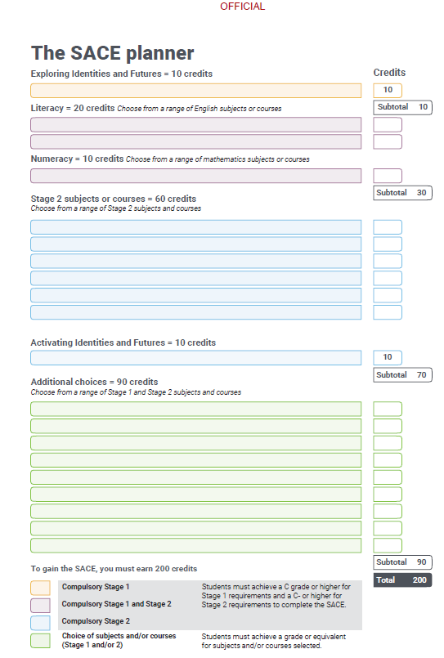
TIP
When choosing Stage 2
subjects, keep in mind any
subjects that are required for
university courses you
may be interested in.
Notes:
Our SACE Planner which outlines the requirements can help you with your subject selection.
TIP: When choosing Stage 2 subjects, keep in mind any subjects that are required for university courses you may be interested in.

Slide 12
Making sure
it’s fair
PERFORMANCE
STANDARDS
STAGE 2
Shared responsibility between our school and the SACE Board.
STANDARDS
Used by teachers to decide how well a student has demonstrated their learning
GRADING
A to E for Stage 1
A+ to E– for Stage 2
STAGE 1
School assessed
Notes:
Student work in the SACE is assessed through the use of performance standards. SACE subjects are school-assessed at Stage 1. The responsibility for assessment at Stage 2 is shared between schools and the SACE Board.
Teachers and assessors use the performance standards to decide how well a student has demonstrated his or her learning.
The performance standards, which are provided in each subject outline, describe in detail the level of achievement required to obtain a grade:
from A to E for Stage 1
from A+ to E– for Stage 2.

Slide 13
Planning for
Year 11
COMPULSORY
REQUIREMENTS
At least 2 semesters
of English
At least 1 semester
of Maths
20 credits
10 credits
Notes:
Year 11 is when most students begin a full year of Stage 1 SACE study.
There are two compulsory requirements to be completed in Stage 1, these are usually achieved in Year 11:
at least two semesters of one or more English subjects (20 credits)
at least one semester of a mathematics subject (10 credits)

Slide 14
Planning for
Year 12
Activating Identities and Futures is the only compulsory Stage 2 subject.
One semester (10 credit), requiring at least a C grade.
Many schools offer this to students in Year 11.
Notes:
There is one compulsory subject in Stage 2 — Activating Identities and Futures.
Activating Identities and Futures is a compulsory Stage 2 subject
It is a one semester, 10 credit subject.
Often completed in Year 11; however some schools offer this to students in Year 12.

Slide 15
WHAT IS ACTIVATING IDENTITIES AND FUTURES?
Students explore ideas related to an area of personal interest through a process of self-directed inquiry.
Using your own approach, behaviours and emotions to progress learning.
Understanding how you think and learn in different situations.
Exploiting your strengths and identifying areas for improvement.
Stopping and thinking about your own work.
Revealing and sharing your thinking.
Notes:
What is Activating Identities and Futures?
Students explore ideas related to an area of personal interest through a process of self-directed inquiry.
• using your own approach, behaviours and emotions to progress learning
• understanding how you think and learn in different situations
• exploiting your strengths and identifying areas for improvement
• stopping and thinking about your own work
• revealing and sharing your thinking

Slide 16
Last step of
the SACE
journey
SATAC
Provides students
access to their Australian Tertiary Admissions Ranking (ATAR), and/or
TAFE SA Selection
Score.
RESULTS
Final results for all completed SACE subjects are provided at the end of Stage 2.
ACCESS TO RESULTS
These grades are available in Students Online on the SACE website.
sace.sa.edu.au
Notes:
At the end of Stage 2, you will receive your final results for all SACE subjects that you have completed, these grades are available in Students Online on the SACE website.
For eligible students, on the same day, the South Australian Tertiary Admissions Centre (SATAC) will release your Australian Tertiary Entrance Rank (ATAR) which you can use to apply for university.

Slide 17
What if something
happens during the
SACE journey?
Reasonable adjustments can be made to the curriculum and assessment that positively enable eligible students to demonstrate the required knowledge, skills and standards of Stage 1 and Stage 2 subjects.
Notes:
Special provisions are reasonable adjustments in curriculum and assessment that positively enable eligible students to demonstrate the required knowledge, skills and standards of Stage 1 and Stage 2 subjects.
The SACE Board and schools work in partnership to ensure special provisions are available to eligible students for both Stage 1 and Stage 2 school assessment and Stage 2 external assessments.
Approval for special provisions is based on information from
the eligible student,
teachers and other school staff,
and independent evidence from professionals or community members
Special provisions may be granted on a short-term or long-term basis, depending on the grounds for eligibility and a student’s particular circumstances.

Slide 18
After
SACE
UNIVERSITY
Completed the SACE with at least 90 credits at Stage 2
Gained a university aggregate and an ATAR
Met any prerequisite subject requirements for chosen university course
Complied with rules regarding subject combinations and counting restrictions
Application for entry to university courses is made through the South Australian Tertiary Admissions Centre (SATAC).
Notes:
Achieving the SACE is important if you wants to study at TAFE or university, but there are also other pathways after secondary school. The SACE also offers the flexibility to move smoothly from high school to employment.
University pathways
Successful completion of the SACE is the most common way for students to gain entry to local and international universities.
To be eligible to apply for university, South Australian students must have:
completed the SACE with at least 90 credits at Stage 2
gained a university aggregate and an ATAR
met any prerequisite subject requirements for their chosen university course
complied with rules regarding subject combinations and counting restrictions
Application for entry to university courses is made through the South Australian Tertiary Admissions Centre (SATAC). More information is available on the SATAC website www.satac.edu.au.

Slide 19
WHAT IS AN ATAR?
Australian Tertiary Admissions Rank issued by SATAC and used by universities to select students for courses.
Ranks a student’s overall achievement compared with all students.
Ranges from 0 to 99.95
The score is calculated from your 90 credit, Stage 2 results.
Notes:
What is an ATAR?
An Australian Tertiary Admissions Rank is used by universities to select students for courses.
It measures a student’s overall achievement compared with all students nationally and ranges from 0 to 99.95
The score is calculated from your 90 credit, Stage 2 results.

Slide 20
After
SACE
TAFE
You will be issued with a TAFE SA Selection Score which gains you entry to most TAFE SA courses.
It prepares you for employment in professional, para-professional, technical
and trade careers.
Entry requirements may vary depending on the level of the qualification.
Details of these requirements and a list of all the courses offered by TAFE
can be found at tafesa.edu.au
Notes:
TAFE pathways
TAFE SA campuses offer courses to prepare you for employment in professional, para-professional, technical and trade careers.
Completing the SACE will provide you with a TAFE SA Selection Score that you can use to enter most TAFE SA courses. Entry requirements may vary depending on the level of the qualification.
Details of these requirements and a list of all the courses offered by TAFE can be found on the TAFE website.

Slide 21
After
SACE
EMPLOYMENT
AND TRAINING
Complete the SACE while training in an industry area through a recognised vocational education and training (VET) course or an Australian School-based Apprenticeship.
Get a head start on their career.
Choose from a wide range of industry areas
You can find a list of VET courses on the SACE website sace.sa.edu.au.
Notes:
Employment and training
The SACE offers the flexibility to move smoothly from high school to employment. You can choose to complete the SACE while training in an industry area through a recognised vocational education and training (VET) course or an Australian School-based Apprenticeship.
VET courses can count towards your SACE at both Stage 1 and Stage 2. This means you can be working towards, or may even have gained, a VET qualification by the time you finish the SACE – giving you a head start on your career.
You can choose from a wide range of industry areas, including construction, automotive, electro technology, hospitality, community services, and health and information technology.
You can find a list of VET courses on the SACE website www.sace.sa.edu.au.

Slide 22
Need more
?
Information
OUR SCHOOL
Here to help, offer advice and information on the subjects being offered
Help you select subjects that suit your interests and plans
Advise you about the best subjects to take to prepare for your preferred tertiary education course or area of employment
Advise you on vocational education and training (VET) options available to you, through our school or a registered training organisation (RTO).
Notes:
Our school
Our school’s SACE coordinator, teachers and other school leaders are here to help and can:
offer advice and information on the subjects being offered
help you select subjects that suit your interests and plans
advise you about the best subjects to take to prepare for your preferred tertiary education course or area of employment
advise you on vocational education and training (VET) options available to you, through our school or a registered training organisation (RTO).

Slide 23
Need more
?
Information
THE SACE BOARD
sace.sa.edu.au
1300 322 920
askSACE@sa.gov.au
Notes:
If you are looking for ways to further support your child through their SACE journey, more information can be found under ‘studying the SACE’ on the SACE website.
Alternatively you can contact the askSACE team.

Slide 24


