Slide 1
Integration of Australian Curriculum
Stage 1 Science
Implementation Workshops
Term 3, 2016
Notes:
Welcome
Introductions – presenters and other SACE colleagues present
Sign-in, evacuation and housekeeping

Slide 2

Subject Renewal - Why?
Australian Curriculum
Learning and Assessment are changing

Slide 3

Subject Renewal
Capabilities
Content
Skills
Guiding Principles
Quality Learning
Engaging
Innovative
Quality Assessment
Manageability

Slide 4
Stage 1 Science Subjects
Stage 1 subjects 2017 | Stage 2 subjects 2018
Biology | Biology
Chemistry | Chemistry
Earth and Environmental Science | Earth and Environmental Science
Physics | Physics

Slide 5
Stage 1 Science Subjects
Pathway options Stage 1 subjects | Stage 2 subjects from 2018
Biology | Biology
Chemistry | Chemistry
Earth and Environmental Science | Earth and Environmental Science Physics
Physics

Slide 6

Capabilities
I can work collaboratively and safely
I am literate and numerate
I can analyse and devise solutions
I can use technology to create a new way of thinking
I am open-minded
I can make ethical and responsible decisions
I am capable
Notes:
We will provide an overview of elements of the subject outline, which are applicable to all Stage 1 science subjects.

Slide 7

Capabilities
Integrated Australian Curriculum General Capabilities
  Literacy
  Numeracy
  Information and communication technology capability
  Critical and creative thinking
  Personal and social capability
  Ethical understanding
  Intercultural understanding

Slide 8
General Capabilities
For example:
Critical and creative thinking
analysing and interpreting from different perspectives, develop logical conclusions, devising imaginative solutions, envisaging consequences, significance of creative thinking on the development of biological knowledge and applications.
Personal and social capability
importance on health and well-being, personally and globally, taking initiative, working collaboratively, planning effectively, following procedures effectively safely, gauging the impact of biology in society.
Ethical understanding
considering the implications of investigations, making ethical decisions based on an understanding of biological principles, need to plan for the future, protect and sustain the biosphere, responsible participation in social, political, economic, and legal decision-making.

Slide 9
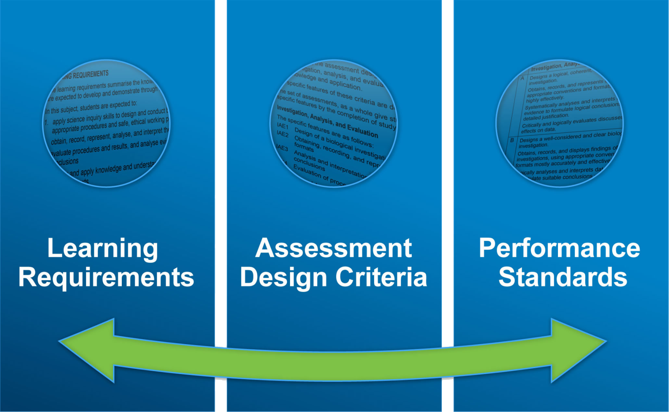
Capabilities

Slide 10
Learning Requirements
apply science inquiry skills to design and conduct biological investigations, using appropriate procedures and safe, ethical working practices
obtain, record, represent, analyse, and interpret the results of biological investigations
evaluate procedures and results, and analyse evidence to formulate and justify conclusions
develop and apply knowledge and understanding of biological concepts in new and familiar contexts
explore and understand science as a human endeavour
communicate knowledge and understanding of biological concepts, using appropriate terms, conventions, and representations.

Slide 11
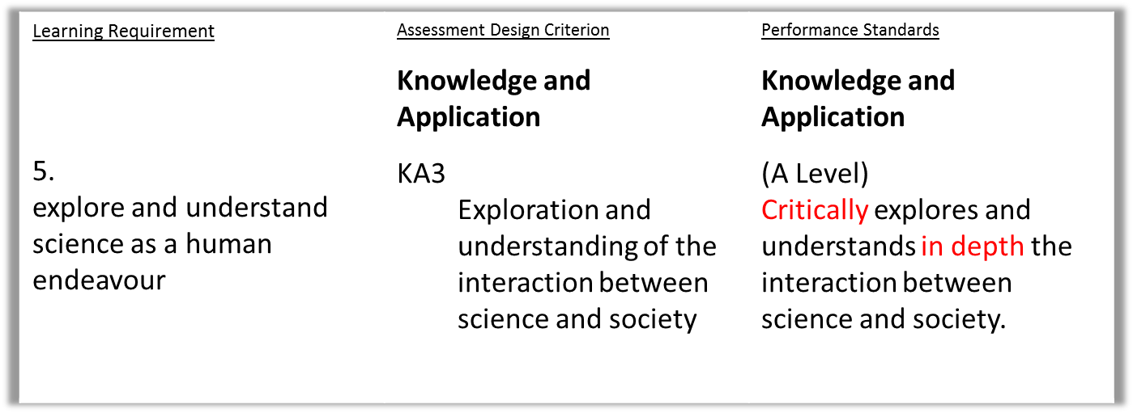
Learning Requirements to Performance Standards
Capabilities that are a focus for Learning Requirement 5:
Personal and social capability
Ethical understanding

Slide 12
Subject Outline Structure
  Columns: What is the difference between the two?

Slide 13


Subject Outline Structure
  Symbols
  What do they mean?
  possible teaching and learning strategy
  possible science inquiry activity
  possible focus on science as a human endeavour
  ⬧

Slide 14

Science Inquiry Skills

Slide 15
Science Inquiry Skills

Slide 16
Science Inquiry Skills
Discussion questions
  What is familiar?
  What is new?
  What are the implications for your teaching and assessment?

Slide 17
Science as a Human Endeavour
1. Communication and Collaboration
global enterprise, clear communication, international conventions, and review and verification of results, international collaboration
2. Development
development …. wide range of evidence, many sources, across disciplines, New technologies improve the efficiency , modify or replace models, theories, and processes.
3. Influence
advances …in one field can influence and be influenced by other areas of STEM, acceptance and use …influenced by social, economic, cultural, and ethical
4. Application and Limitation
scientists ..solutions, discoveries, design action for sustainability, evaluate economic, social, cultural, and environmental impacts, offer explanations, make predictions, beneficial or unexpected consequences; evaluation of risk, opportunities for innovation, informs public debate influenced by public debate; limit possible conclusions.

Slide 18
Science as a Human Endeavour
Lincoln Minerals gains initial approval for graphite mine north of Port Lincoln
The Eyre Peninsula is poised to become the nation's leading source for graphite — a mineral vital to the expansion of the renewable energy industry — after a project was given approval by the South Australian Government.
………… graphite which might eventually be used for a $1.2 billion solar energy power plant at Port Augusta planned by Solarstor.

Slide 19
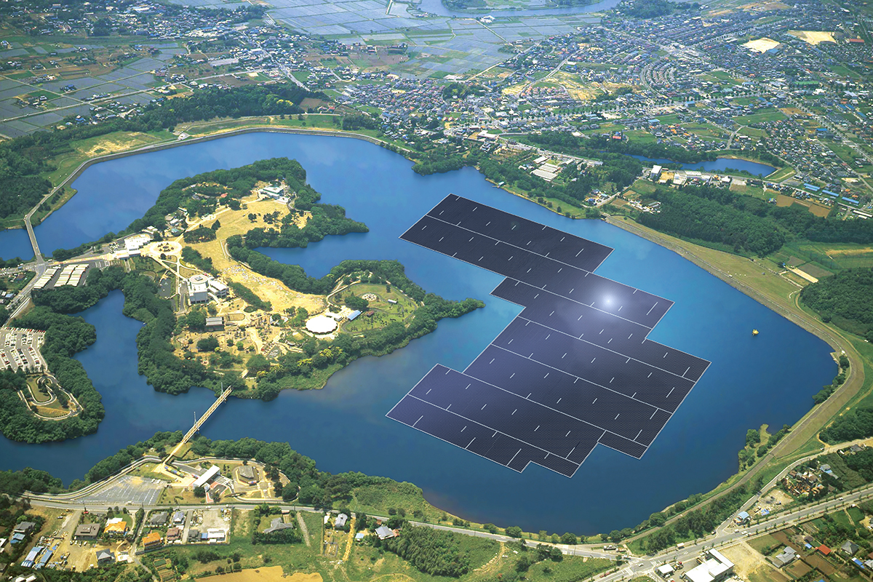
Proposed floating solar power plant on the Yamakura Dam reservoir
How can I see
Science as a Human Endeavour
being integrated into my program?

Slide 20
How can I see
Science as a Human Endeavour
being integrated into my program?

Slide 21
Stage 1 Biology
(1BGY)
4 topics
Retains flexibility at Stage 1
Choose the topic combination (at least 2 per semester)
Choose the order
Choose the content appropriate to the cohort
Choose the length
Choose the contexts
Recommended to include Topic 1 if only able to offer a single semester.

Slide 22
Stage 1 Chemistry
(1CEM)
6 topics
Retains flexibility at Stage 1
Choose the topic combination (at least 3 per semester)
Choose the order
Choose the content appropriate to the cohort
Choose the length
Choose the contexts
Refer to table showing Stage 2 links

Slide 23
Stage 1 Earth and Environmental Science
(1EES)
6 topics
Retains flexibility at Stage 1
Choose the topic combination (at least 2 per semester)
Choose the order
Choose the content appropriate to the cohort
Choose the length
Choose the contexts

Slide 24
Stage 1 Physics
(1PYI)
6 topics
Retains flexibility at Stage 1
Choose the topic combination (at least 3 per semester)
Choose the order
Choose the content appropriate to the cohort
Choose the length
Choose the contexts
Refer to the table showing Stage 2 links

Slide 25

Focus Questions
What ideas do you have for renewing your teaching programs?
How can you make use of the flexibility in creating a program for your students?

Slide 26
Assessment Scope and Requirements
Assessment at Stage 1 is school based
10-credit subject – four assessments
AT1: Investigations Folio
- at least one practical investigation
- one Science as a Human Endeavour investigation
AT2: Skills and Applications Tasks – at least one
20-credit subject – eight assessments
AT1: Investigations Folio
- at least two practical investigations
- two Science as a Human Endeavour investigations
AT2: Skills and Applications Tasks – at least two
Each assessment type – weighting of at least 20%
Include the opportunity for collaboration

Slide 27
Stage 1 Science
Assessment Type 1: Investigations Folio
Practical investigation(s)
Deconstruct a problem
Opportunity to design investigation for which the outcome is uncertain
Collaboration and manipulation of apparatus
Science as a Human Endeavour investigation

Slide 28
Stage 1 Science
Assessment Type 2: Skills and Applications Tasks
Under direct supervision – what does this mean??
What are the options for SATs?
Appropriate for the cohort

Slide 29
Assessment
  Assessment Design Criteria
    Investigation, Analysis, and Evaluation
    Knowledge and Application
  Specific Features
      What is new or different?
      What is ‘missing’?
  Performance Standards

Slide 30
Performance Standards
  C = C
  2016 2017

Slide 31

Quality Assurance
Quality Assurance
planning

Slide 32
Learning and Assessment Plans
Simplified form with a cover sheet and the assessment overview page
Some pre-approved plans available from website
Examples of LAPs

Slide 33
Programs
  Themes
  Contexts

Slide 34
Focus Questions
Could you use a pre-approved learning and assessment plan (LAP)?
How might you adapt a pre-approved LAP?
What ideas do you have for new tasks?

Slide 35
Quality Assurance
Quality Assurance
planning
improving
clarifying
confirming

Slide 36
Stage 2 Science Subjects in 2018
  Biology
  Chemistry
  Earth and Environmental Science
  Physics

Slide 37
Assessment Stage 2 Science Subjects 2018
School Assessment (70%)
  Assessment Type 1: Investigations Folio
  Assessment Type 2: Skills and Applications Tasks
External Assessment (30%)
  Assessment Type 3: Examination (2 ½ hours) or
  Earth Systems Study

Slide 38
What’s next?
School planning – subjects to be offered
Your planning involves:
  familiarising yourself with the subject outline
  developing a teaching program
  selecting a pre-approved or DIY learning and assessment plan
  gathering and developing SHE resources
  developing new and interesting tasks

Slide 39
Best wishes for
Stage 1 Science
Implementation
2017
Contact us if you have questions or suggestions for resources.

