Slide 1
New to teaching MATHEMATICAL METHODS
MARCH 2021

Slide 2
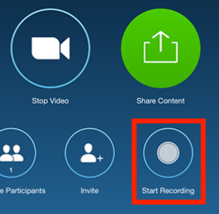
Zoom meeting requests
Please keep your speaker on mute.
Please use the chat tool to ask specific questions that you would like addressed during the teleconference.

Slide 3
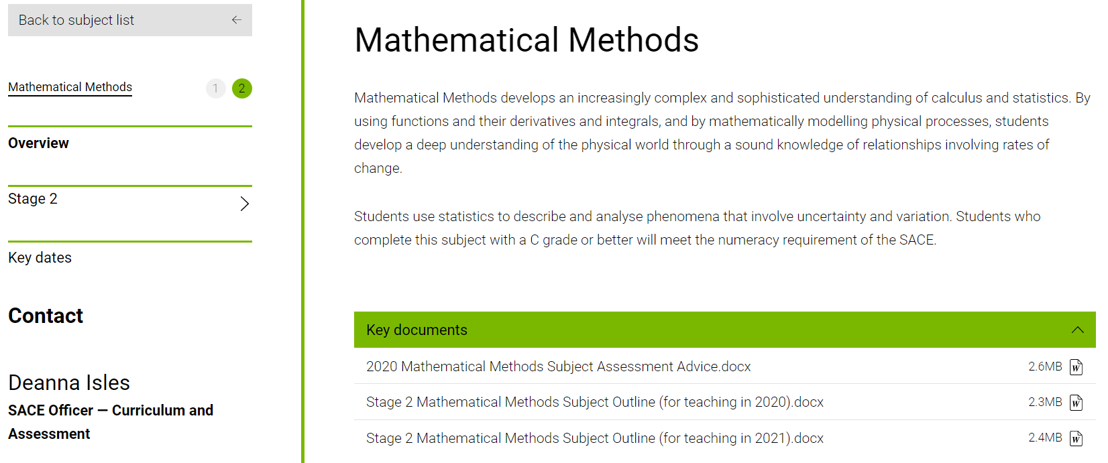
Key sources of support – Subject webpage

Slide 4
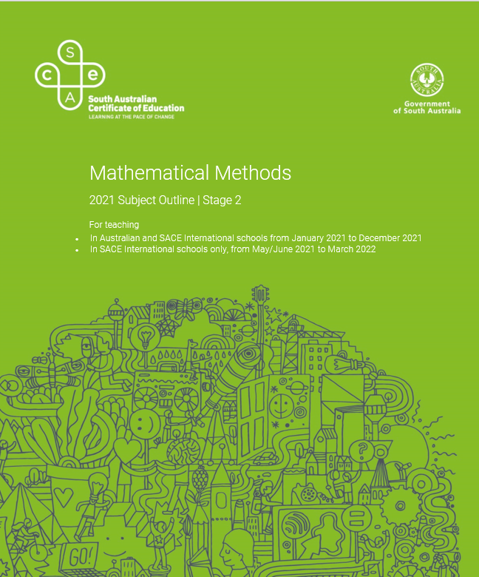
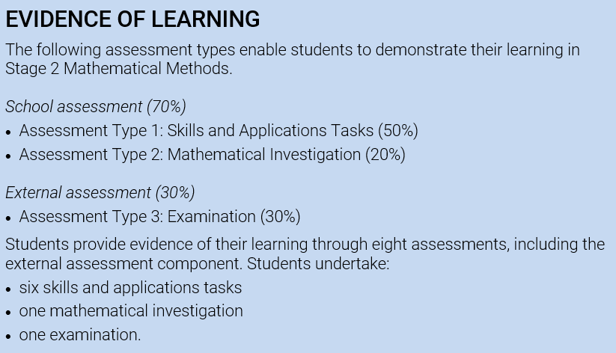
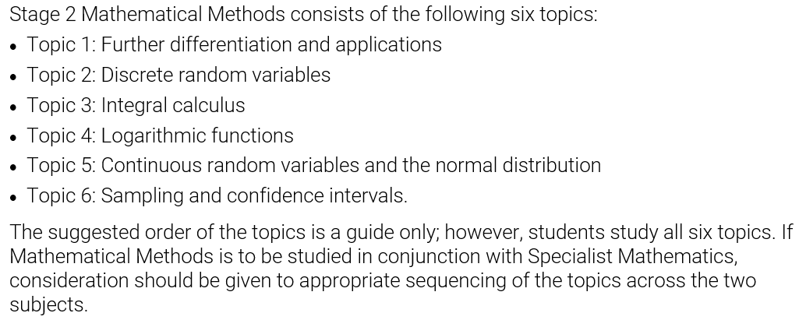
Current subject outline
The most important tool for teaching Mathematical Methods

Slide 5
Assessment Type 1: Skills and Applications Tasks (50%)
Skills and applications tasks must be completed under the direct supervision of the teacher.
Students complete six skills and applications tasks.
The equivalent of one skills and applications task must be undertaken without a calculator or notes.
In the remaining skills and applications tasks:
electronic technology as per approved calculator guidelines
up to one A4 sheet of handwritten notes (on one side only)

Slide 6
Assessment Type 2: Mathematical Investigation (20%)
One Mathematical Investigation:
The evidence for each investigation, excluding bibliography and appendices if used, must be a maximum of fifteen A4 pages if written, or the equivalent in multimodal form.
Students complete one task
The maximum page limits are for single-sided A4 pages with minimum font size 10.
Page reduction, such as two A4 pages reduced to fit on one A4 page, is not acceptable.
Conclusions, interpretations and/or arguments that are required for the assessment must be presented in the folio task, and not in an appendix. Appendices are used only to support the folio task, and do not form part of the assessment decision.

Slide 7
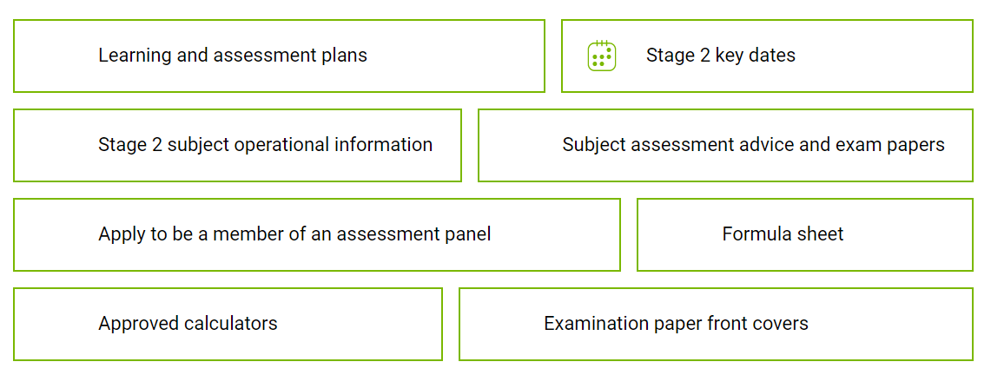
Range of different resources accessible

Slide 8

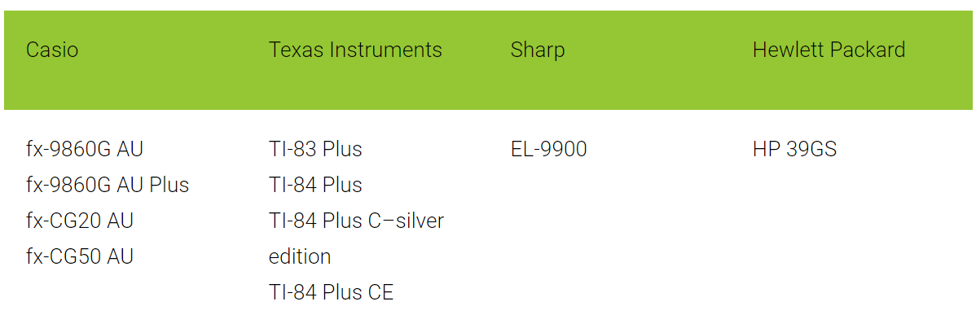
Approved scientific calculators
Any scientific calculator, except those with an external memory source (USB jack or SD card slot), may be used.
All students are required to clear the memory of their scientific calculators.
General conditions for the use of approved calculators
Students must provide their own calculators or be allocated a calculator by the SACE coordinator.
For mathematics subjects, students may bring into the examination room:
two approved graphics calculators
OR
one scientific calculator and one approved graphics calculator.

Slide 9
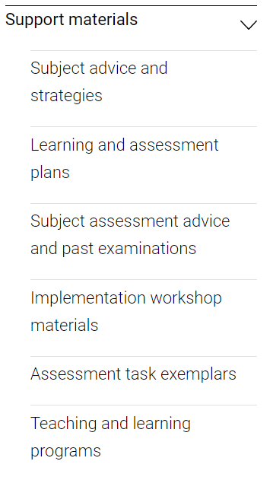
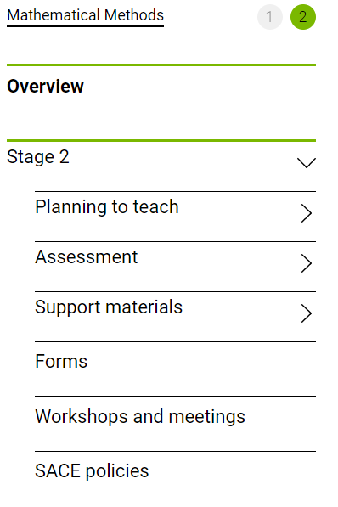

Slide 10
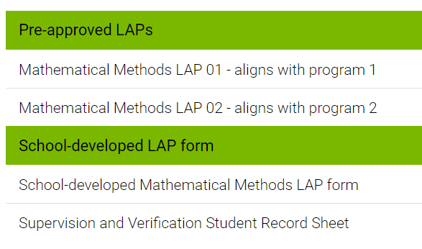
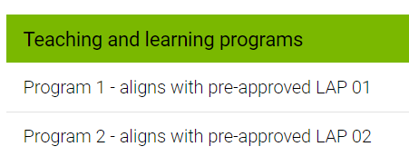
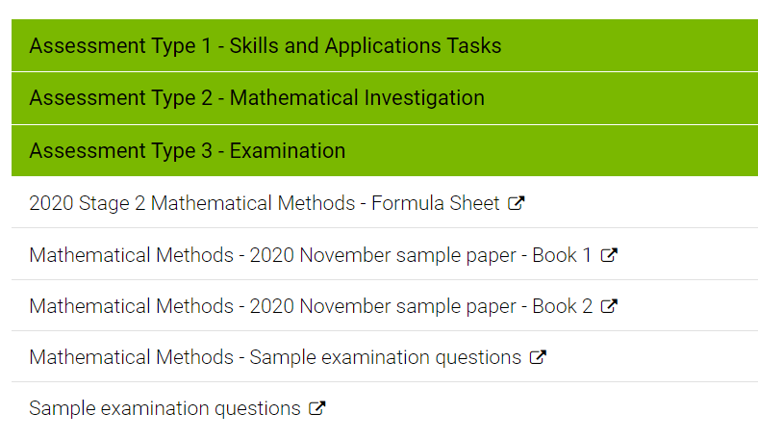
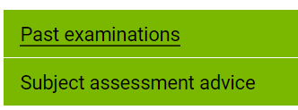
Subject assessment advice
and past examinations

Slide 11

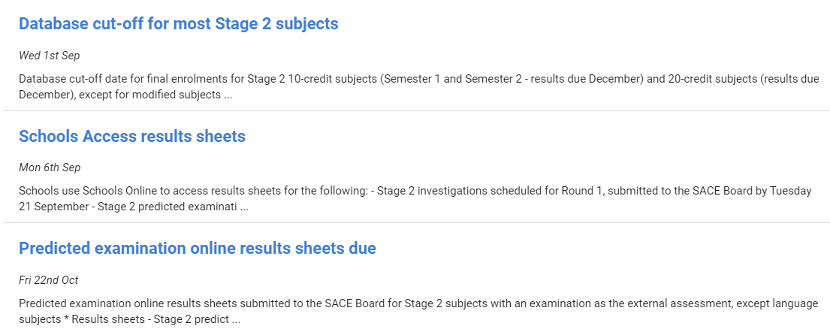
IMPORTANT DATES

Slide 12
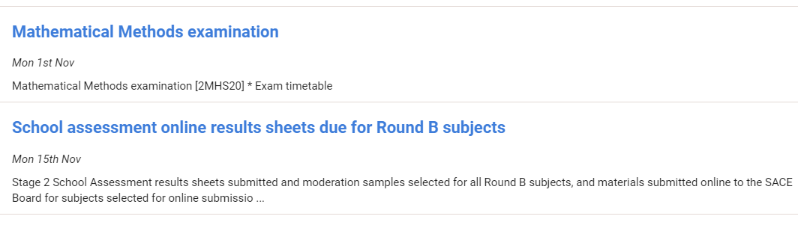
IMPORTANT DATES

Slide 13
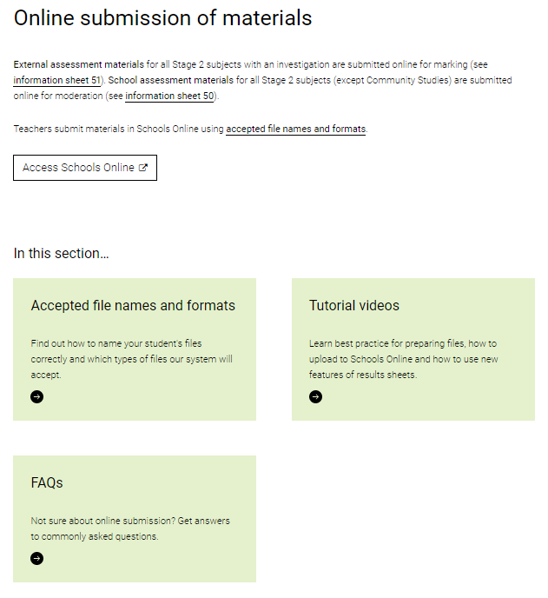

MODERATION
School Assessment

Slide 14
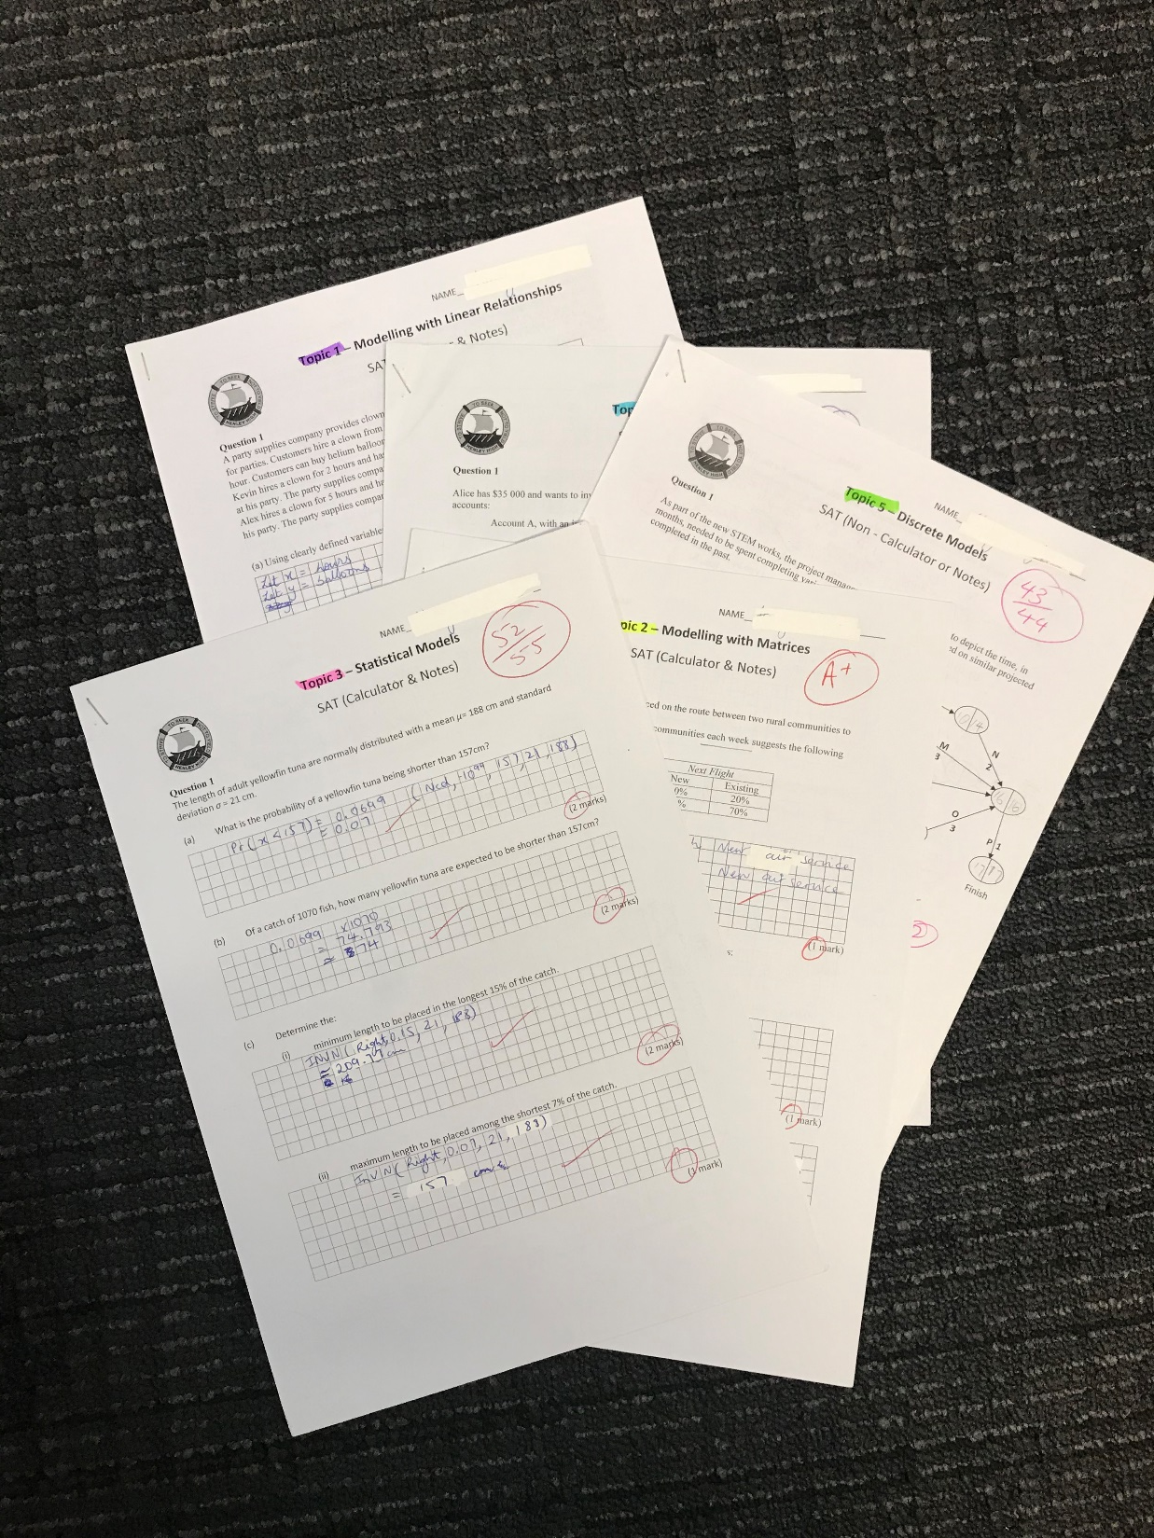
=1
Multiple individual documents are not required to be scanned and uploaded separately for any assessment type for a student in the sample
Notes:
The set of SAT responses for each individual student in the sample can be scanned as one single document.
Where there are multiple investigations, they can also be scanned as a single document.

Slide 15
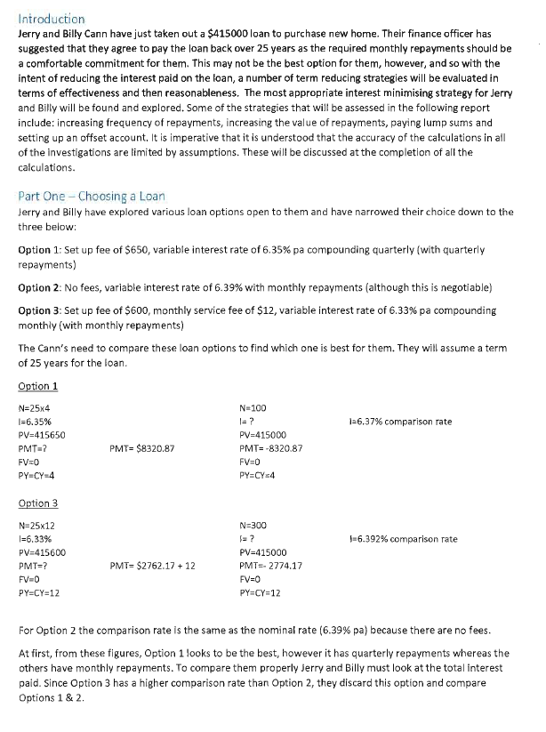
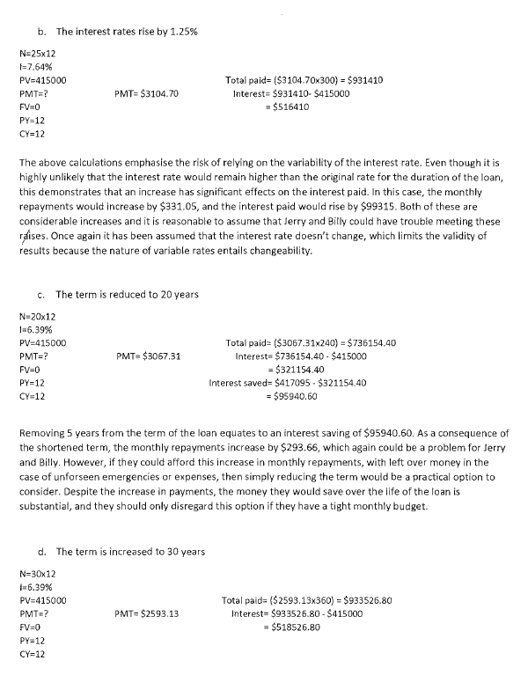
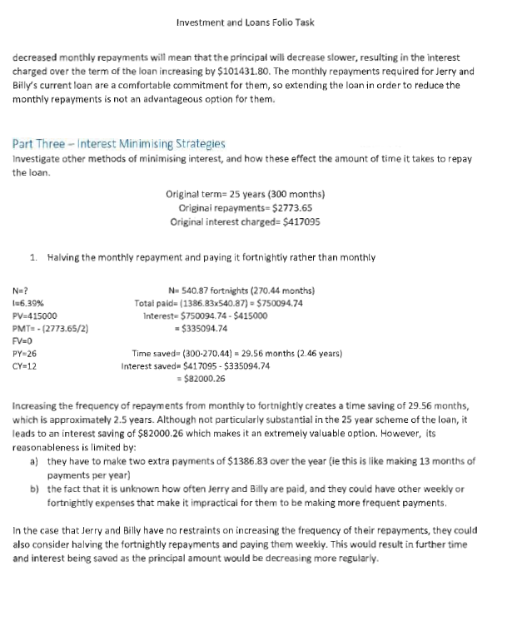
Moderation is a process of confirmation
The correctness of mathematical computations is a key indicator for the moderator to confirm standards indicated by the teacher against the performance standards.
All materials submitted for moderation must have clear evidence of the level of correctness of all mathematical computations carried out by the student.
All mathematical calculations
must be marked
Notes:
Where there are multiple investigations, they can also be scanned as a single document.

Slide 16
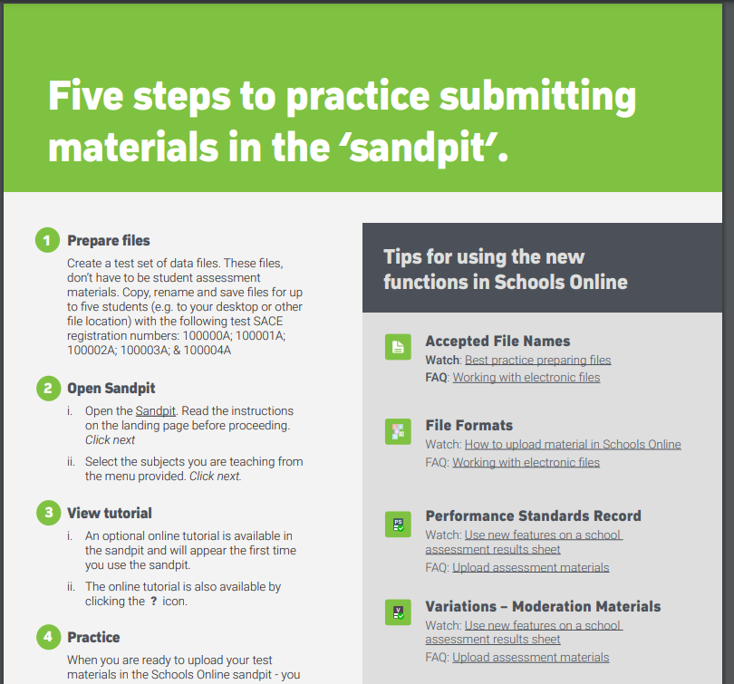

Slide 17

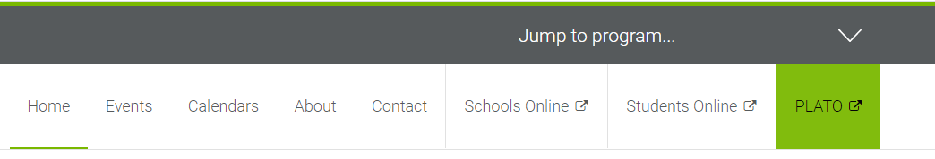
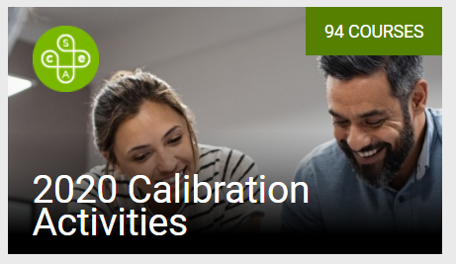
PLATO

Slide 18
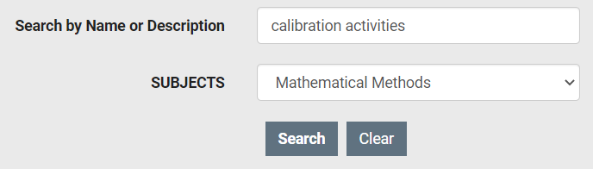
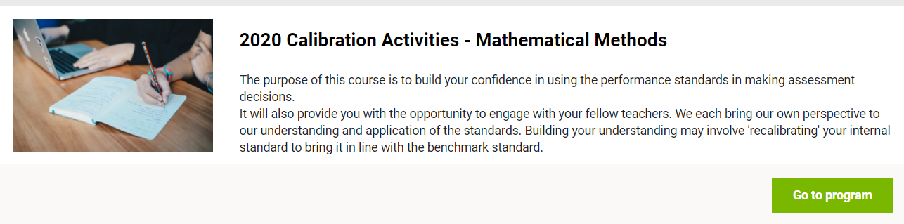

Slide 19
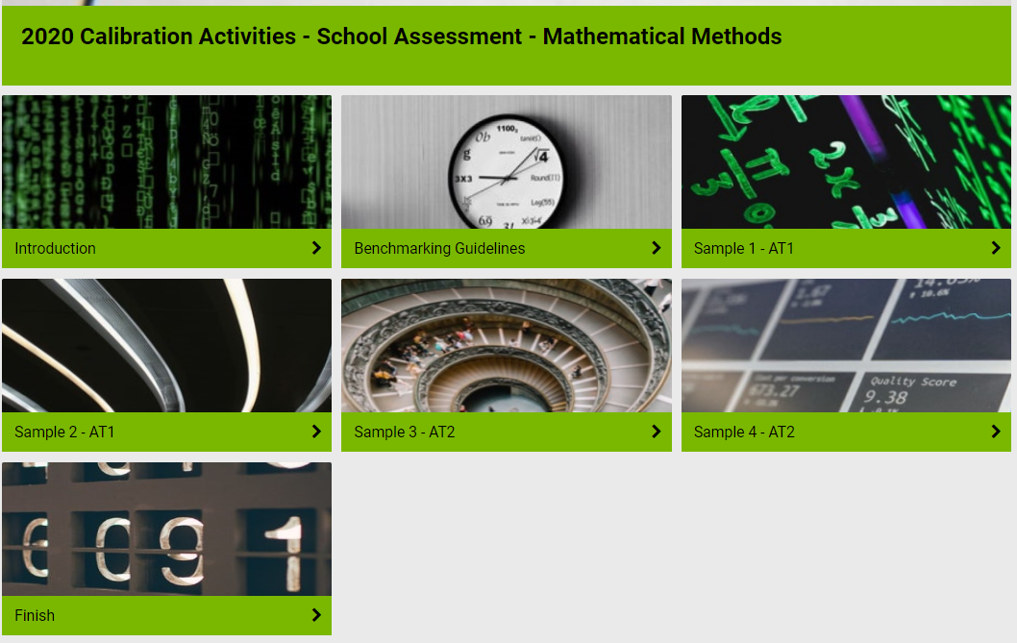

Slide 20

Tips from a
Lead Practitioner

Slide 21


