Slide 1
Direction of the SACE in 2019 and beyond
View Direction of the SACE in 2019 and beyond
Notes:
‘Direction of SACE’ video ( you tube), celebrating successes of 2018 and communication for 2019.

Slide 2
SACE Management Conference
2019 SEMESTER 1
Notes:
Welcome
Introductions
Facilities
Emergency procedures

Slide 3
Acknowledgement to Country
View Acknowledgement to Country video

Slide 4
Notes:
Thank you all for attending todays conference. Thank you for the wonderful job you all do as SACE coordinators or Leaders in your school. Your continued support and contribution is greatly valued.
Summarize key points of the ‘Directions of SACE’ video
New CEO
Subject renewal
Professional learning
Electronic exams
online moderation
flexibilities of the SACE

Slide 5
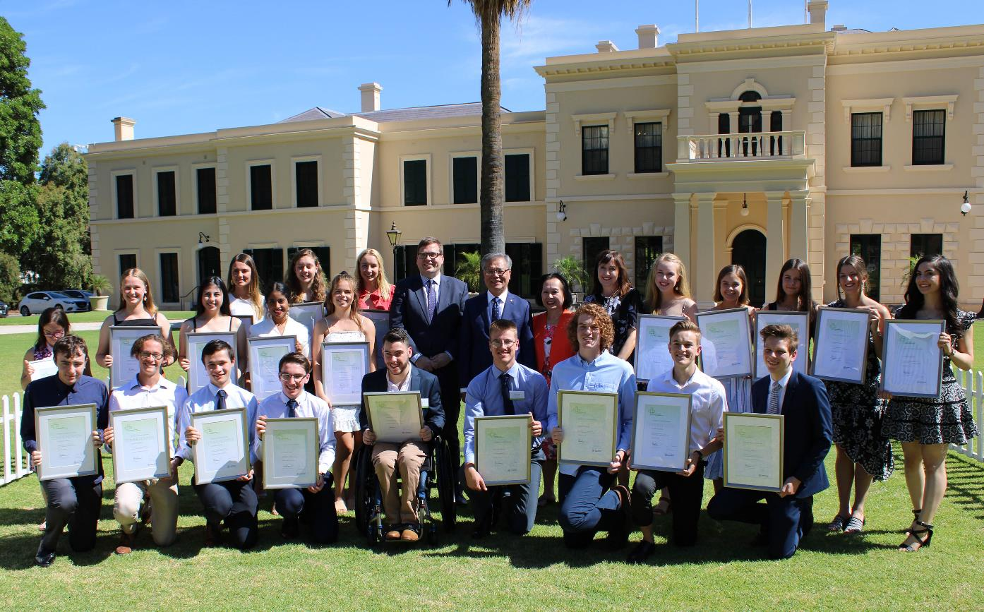
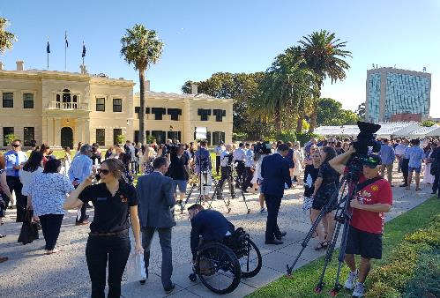
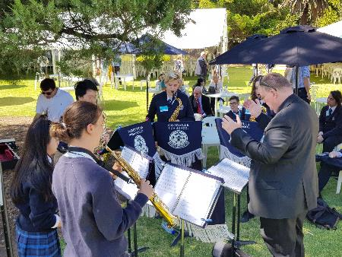
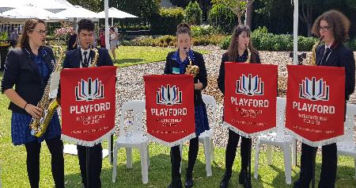
Notes:
Images from the merit ceremony held on Tuesday 5 February at Government House.

Slide 6
Reflections on 2018
Notable achievements from the Class of 2018 include:
97.4% of Year 12 students, enrolled as of October 2018, successfully completed their SACE.
3840 students in country South Australia completed their SACE.
42.4% of SACE completers included VET in their studies.
364 Aboriginal students completed their SACE.
The number of students with an intellectual disability who completed their SACE (with one or more modified subjects) increased to 239 this year.

Slide 7
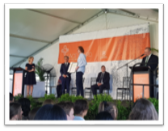
New Targets
PLP enrolment to SACE Completion (South Australia)
TOTAL COHORT: 78.2 %
(assuming 3 year SACE - PLP in 2016 and SACE Completion in 2018)
ABORIGINAL STUDENT COHORT: 55.7%
Notes:
2018 also marks the first time that SACE completion data includes the proportion of students who started their Personal Learning Plan (PLP) and completed their SACE over a three-year period from Years 10 to 12.
This new measurement is an open and transparent way to track SACE completion and will help the Government, SACE Board and the education sector identify strategies to improve the number of students completing their SACE.
This additional way to measure SACE completion will provide invaluable information that will assist in increasing the number of students completing their SACE.
This year a total of 78.2% of students who started their PLP in 2016 went on to complete their SACE.
This year a total of 55.7% of Aboriginal students who started their PLP in 2016 went on to complete their SACE.
For the first time, more than half of Aboriginal students who started their PLP are going on to complete their SACE and more students than ever before are achieving an ATAR score or TAFE selection score.
For the first time, more than half of Aboriginal students who started their PLP are going on to complete their SACE and more students than ever before are achieving an ATAR score or TAFE selection score.

Slide 8
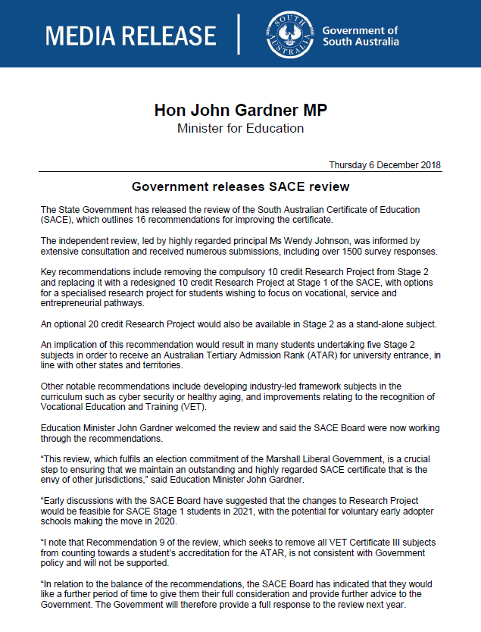
SACE Stage 2 Review
Notes:
As you all know, a review of Stage 2 of the SACE was commissioned by the new Liberal government last year, and was conducted by Wendy Johnson, Principal of Glenunga International High School.
The original terms of reference were:
The number of Stage 2 subjects required to be undertaken by students
The compulsory requirement of the Research Project, whether it should continue to account for 10 credits at Stage 2 and what improvements might be made, with specific reference to entrepreneurial education; and
The role of Vocation Education and Training (VET) in the SACE, including what improvements can be made and how entrepreneurial education might be incorporated into VET pathways.
The Minister released the report in December last year – there are 16 recommendations – 13 relate directly to the terms of reference, and a further 3 relate to issues from the Review processes for consideration by the SACE Board.
Recommendations 1-4 focus on the Research Project, and suggest removing the compulsory 10-credit Research Project from Stage 2 and replacing it with a redesigned 10-credit Research Project at Stage 1, with options for a specialized research project for students wishing to focus on vocational , service and entrepreneurial pathways, and an optional 20-credit Stage 2 option.
At this point, there is no specific information to share about timelines and operational implications, although it is noted that in the Minister’s initial Media Release he said that “Early discussions with the SACE Board have suggested that the changes to Research Project would be feasible for SACE Stage 1 students in 2021, with the potential for voluntary early adopter schools making the move in 2020.
So, it is currently with the Board and Minister, and as more information becomes available Martin Westwall as Chief Executive will be communicating to Principals, Schools Leaders and the community about any changes.
It is worth noting though, in his Media Release at the time, the Minister noted that recommendation 9, which seeks to remove all VET Certificate III subjects from counting towards a student’s accreditation for the ATAR, is not consistent with Government policy and will not be supported – great news as this reflects the flexibilities within our SACE and the diversity of ways in which young people make meaning of their learning.

Slide 9
Sharing Your Success
Discuss at your table school stories of success
Notes:
Table discussion about sharing your successes for 2018. Allow table talk of 5 minutes and 5 minutes to share with room

Slide 11
Andreas Schleicher
Visiting Director of Education and Skills, OECD
A/Professor
Sandra Milligan
Assessment Research Centre, University of Melbourne
Professor Martin Westwell
Chief Executive, SACE Board of SA
Notes:
Page 3 of booklet
The 2019 IEA Conference will be held at the Adelaide Convention Centre on Monday, 1 April 2019.
The theme for this year's conference is: EDUCATING FOR THE FUTURE – Reframing rigour, validity and fairness for student success in the 21st century.
Some of the presenters include:
Andreas Schleicher, visiting Director of Education and Skills from the OECD, France
Associate Professor Sandra Milligan, Director, Assessment Research Centre, University of Melbourne
Professor Martin Westwell.
We invite you purchase tickets at the Earlybird price of $190 by 28 February and come along to hear from the experts as they:
challenge you on reconceptualising student achievement through the integration of the General Capabilities in curriculum and assessment; and
explore ways to recognise and evidence the capabilities that will transform the way we prepare students for the future.
For more information, including what each of the presenters will discuss and to purchase tickets go to the IEA's website: www. Iea.sa.edu.au

Slide 12
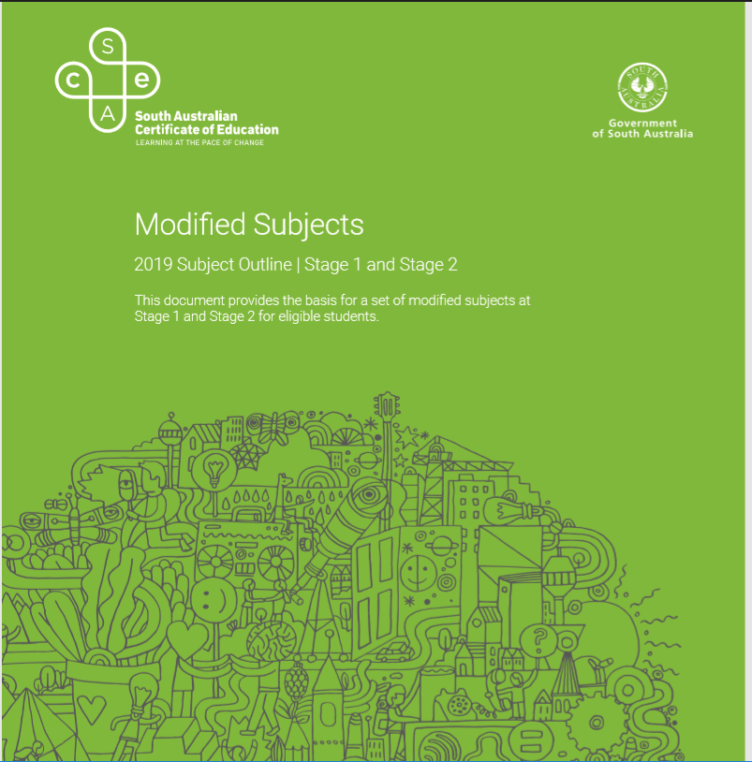
Modified Subjects
Key Changes
Eligibility has been broadened:
includes adaptive behaviour
Imputing of disability
Schools make decisions about eligibility in consultation with students and their parents/carers
Notes:
The Modified subjects policy was reviewed in 2018 and the new policy is implemented this year.
Changes to the policy have been made in accordance with the Disability Discrimination Act and The Disability Standards for Education.
On the basis of this review key changes to the policy was approved by our Board for 2019
The main changes are about who is eligible and who determines eligibility
Prior to 2019 eligibility was for students with significant impairment in intellectual functioning associated with their disability
These students will continue to be eligible but the criteria have been broadened to include students with significant impairment in adaptive behaviours associated with their disability who may or may not have significant impairment in their intellectual functioning as well
Schools now have the professional responsibility for identifying and recording adjustments made for students with disability on for the Nationally Consistent Collection of Data on School Students with Disability (NCCD)
Recognising the role and expertise of schools in exercising professional judgement in relation to students with disability – decisions about eligibility for Modified Subjects will rest with schools rather than sectors from 2019 – sectors can still provide support to schools in relation to making such decisions but the SACE Board will no longer require sectors to confirm eligibility
Decisions about eligibility and enrolment in modified subjects are made in consultation with, and have the consent of, students and their parents/carers

Slide 13
Considerations
Students are entitled to the highest level of SACE achievement.
Eligibility must be evidence based:
students with a significant disability
students whose needs cannot be addressed by reasonable adjustments under Special provisions policy
evidence shows that the student cannot meet the C-/C standard of the SACE
NCCD adjustments at the extensive (some substantive) level.
Notes:
Students with disability:
are entitled to the highest level of SACE achievement possible
should not have their curriculum offerings and post school pathways restricted by automatically being enrolled in Modified subjects.
Eligibility will be based on evidence kept by the school that:
Shows the student has a disability. A formal diagnosis of severe intellectual disability is no longer the critical determining evidence.
reasonable adjustments available via Special Provisions do not sufficiently address the learning needs of the student
the student is unable to meet the performance standards at a C/C- level in SACE subjects with the use of special provisions
the student is or will be recorded on the school’s NCCD records as requiring extensive or substantial adjustments – for this last criteria schools need to have sufficient and adequate documented written evidence of adjustment(s) having been provided over the minimum period of 10 consecutive or non-consecutive weeks in the preceding 12 months as per the NCCD reporting requirements.
Implications for the student’s needs and pathway are taken into consideration in making decision about enrolment.
Eligible students can complete their SACE using all modified subjects or a combination of modified subjects, other subjects in the SACE, and/or flexible options such as Community Studies, VET, and Recognized Learning.
Each student’s needs will be individual. SACE certification will state that the student has completed the SACE using one or more modified subject.
Regular review and monitoring of student progress in consultation with teachers, the student and parent/carer is best practice.

Slide 14
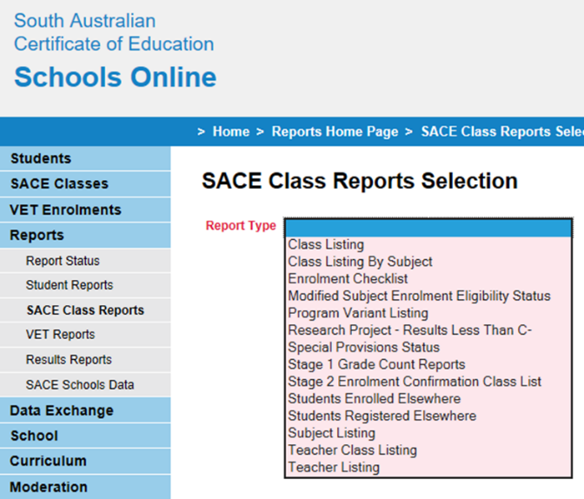
New Schools Online Report
Notes:
A new report has been developed named ‘Modified Subject Enrolment Status.
This report is provided to assist you in the management and monitoring of students enrolled in modified subjects.

Slide 15
PLATO Course
Notes:
A link to this course will be sent to all SACE Coordinators. Please ensure this is communicated to all teachers of modified subject in your school.
The aim of this course is to provide teachers a comprehensive overview of modified subjects, particularly for teachers new to this area.
Much of this information is also available on the SACE website.
A significant focus is on new eligibility guidelines however it also covers a range of aspects of teaching modified subjects including:
Planning
Learning and Assessment Plans
Personal Learning Goals
Assessment
Evidence of Learning
Clarifying
Review
FAQs

Slide 16
Support materials
Support and advice available:
• Information Sheet 17
• Frequently Asked Questions
• Eligibility Flowchart
• Optional school-use eligibility form
• Subject Outline
Sharon Morrison: SACE Officer Curriculum and Assessment
Adele Solomon
Notes:
Support materials for modified eligibility have been listed in your booklet today. We have included a copy of the eligibility flow chart as a quick reference. A very proud Adele Solomon shown here, received the Governor of South Australia commendation – excellence in Modified SACE award 2018. Please contact Sharon Morrison if you require further details.

Slide 17
Modified FAQs
Can you answer the following questions? Discuss at your table.
Should all students with disabilities be enrolled in Modified Subjects?
What is the difference between special provisions and Modified Subjects?
How are Modified Subjects quality assured?
Notes:
Answers
1. No. Most students with disability are able to meet the C-/C standard of the SACE with adjustments made using the Special Provisions in Curriculum and Assessment Policy. Each student should be considered on a case-by-case basis according to their needs.
2. Adjustments under the Special Provisions in Curriculum and Assessment Policy, are reasonable adjustments in curriculum and assessment that enable eligible students to participate in SACE curriculum and assessment on the same basis as other students. Adjustments might, for example, include; extension of a deadline, additional time for a test or examination, an adjustment to font size or paper colour or the use of assistive technology. The knowledge, skills and standards of subjects are maintained.
Modified Subjects is intended for the small group of students with disabilities whose learning needs cannot be sufficiently addressed through the flexibilities of SACE subjects and/or with reasonable adjustments under the Special Provisions in Curriculum and Assessment Policy. Personal learning goals and a focus on the development of capabilities are the basis for learning and assessment in Modified Subjects, rather than learning requirements and performance standards as for other SACE subjects. Results of Modified Subjects are reported as 'completed' or 'not completed' rather than A to E or A+ to E-.
3. Modified subjects that meet the compulsory requirements of the SACE are subject to a review process which confirms that students have met their learning goals.
Results are reported on the Record of Achievement and SACE certificate, along with the following statement: 'This student has fulfilled the requirements of this qualification using one or more modified subject'.

Slide 18
PLATO
PLATO
2019

Slide 19
Equity of Access
Celebrating our success 2018
7902 completed courses in South Australia
726 completed courses in the Northern Territory
132 completed courses in SACE International Schools
Updated Version 10
Notes:
We must thank SACE Coordinators for their support and encouragement of PLATO. You have championed the transition from F2F clarifying to online learning and in the process contributed to the equity of access to high quality professional learning for SACE teachers.
Thank you for providing the time and support to your teachers and for reinforcing the importance of ongoing clarification of standards and providing quality discussion for new and inexperienced teachers.
These numbers are for course completed across all available courses (clarifying, benchmarking, special provisions etc)

Slide 20
Notes:
When logging on to the PLATO site now you are taken to a new simpler DASHBOARD ACCESS
Simpler buttons/tabs
Top right hand corner (green tab) displays how many courses are available.
Dynamic filter ability
Will only show the currently available courses
Therefore this dashboard will continually evolve and be updated with tiles and new programs as they are created and become relevant at the time of year
Self enrolment method
Also coordinators can access reports along top bar to identify teachers who have started or in progress with a PLATO course or those that are finished.
Individual teachers can access the report to identify their professional learning hours.

Slide 21
Clarifying
2018 Clarifying courses are currently live and will remain so for Term 1, 2019
NEW 2019 Clarifying courses will become live for Term 2, 2019
Notes:
Clarifying courses from 2018 will remain live and accessible to all enroll in and complete or refer too for Term 1, 2019.
2019 Clarifying course are currently being created by subject officers and will be uploaded and accessible at the beginning of Term 2.
It is worth nothing that there are a number of subjects which are being taught in 2019 for the first time and therefore do not currently have student exemplars, however, subject officers will be working closely with schools and encouraging teachers to become involved with our new PLATO SOCIAL

Slide 22
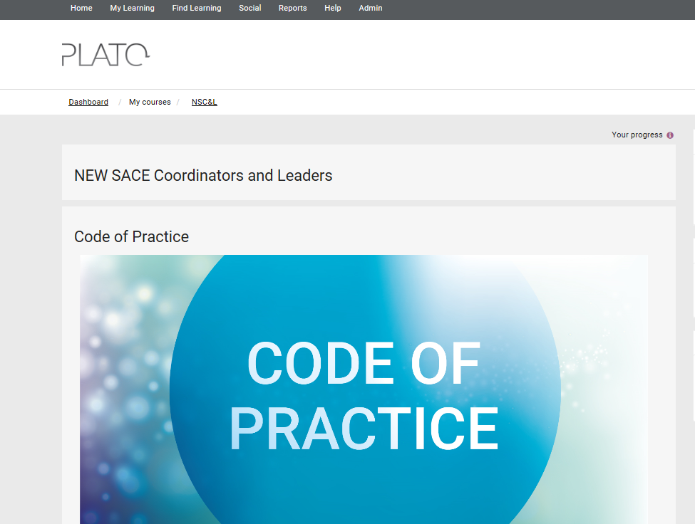
New PLATO Courses
Teachers New to the SACE
New SACE Coordinators and Leaders
Modified Subjects
Notes:
We are in the process of developing these courses to be released in a phased approach throughout Term 1 – we will communicate when they go live. Modified subjects and New SACE coordinators and leaders PLATO courses are live now

Slide 23
Quality Assurance Panels
New opportunities to identify potential panelists
Selection criteria
experience and expertise in senior secondary education
knowledge of the relevant subject outline
relevant qualifications, current or recent studies
teaching experience at senior secondary or tertiary level in the relevant subject
Notes:
All teachers are currently eligible to submit an expression of interest to be ‘in the pool’ for the range of quality assurance assessment panels for the SACE Board.
The website currently lists the criteria above as some of the requirements for our selection of panel members.
The PLATO data will provide us with a new opportunity to identify high-quality panelists that we may contact to consider being on our QA panels.

Slide 24
Additional Enhancements
PLATO SOCIAL
Notes:
One of the new enhancements for 2019 is the introduction of PLATO Social
What is PLATO Social?
Play video in slide

Slide 25
PLATO Social
PLATO Social works alongside PLATO Learn
Intuitive platform to connect with others in your subject area:
Collaborate
Blog
Contribute and share ideas, work on creating them together
Create new tasks, gather feedback, remix and share
Social networking
Asking questions
Notes:
Importance of social networking
Closed environment – only teachers who can access PLATO
Soft launch especially with new subjects

Slide 26
PLATO Social
Notes:
Pages are currently being created by staff and will be accessible.

Slide 27
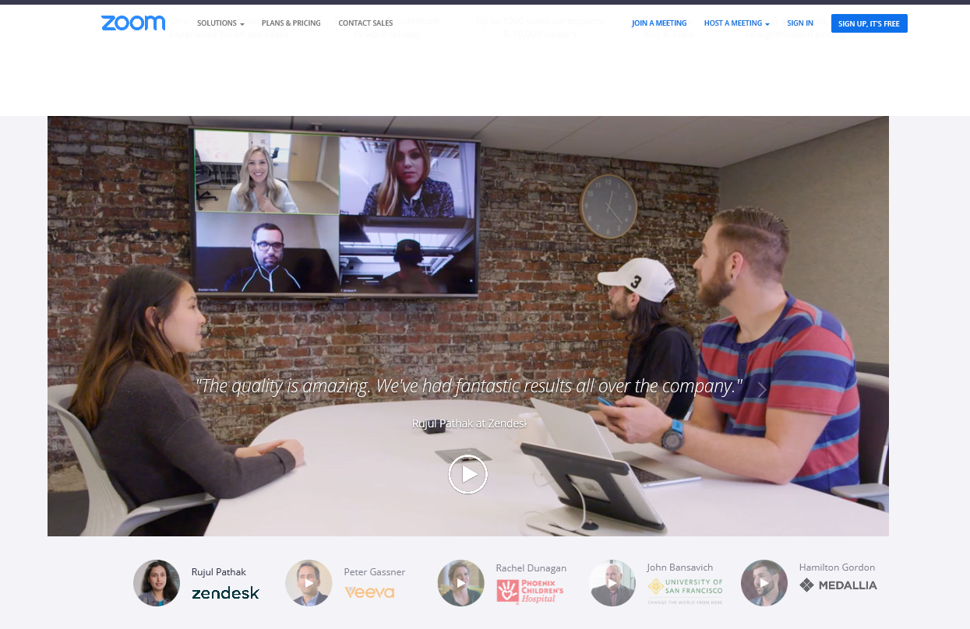
Video Conferencing Application
Notes:
New video conferencing software
Use on our phones, computers, iPads etc
Up to 100 people link in at a time
Better quality/ functionality for lower band width
Meetings, Webinars, breakout rooms (up to 50 rooms each with up to 200 participants),
Video tutorials available
Live training
Ability to record all meetings/webinars

Slide 28
SACE Coordinators
What we would like you to keep doing in your school:
Utilise the Progress Reports to track staff progress
Encouraging staff to use and refer to the exemplars for calibration with “in school moderation”
Allocating some time for staff to complete the Clarifying training, whether it be in lieu of a staff meeting or as part of a Professional Development Day.
Notes:
We must thank SACE Coordinators for their support and encouragement of PLATO. You have championed the transition from F2F clarifying to online learning and in the process contributed to the equity of access to high quality professional learning for SACE teachers.
Thank you for providing the time and support to your teachers and for reinforcing the importance of ongoing clarification of standards and providing quality discussion for new and inexperienced teachers.

Slide 29
Activity
How have you supported staff to access PLATO courses in your school?
Ideas and feedback to be recorded on sheets on each table
Notes:
Activity: How have you supported staff to access PLATO courses in your school? (5 mins) Recording on table doc and share 1 example with room

Slide 31
Subject Renewal Schedule
Notes:
This is a draft schedule and subject to change as needs change. Refer to page 6 of booklet
For example it may change in response to the review outcomes.
Encourage teachers to be involved, for example in the online consultation for each subject.
Page 5 shows new subjects this year and those that are being implemented in 2019 to be delivered in 2020

Slide 32
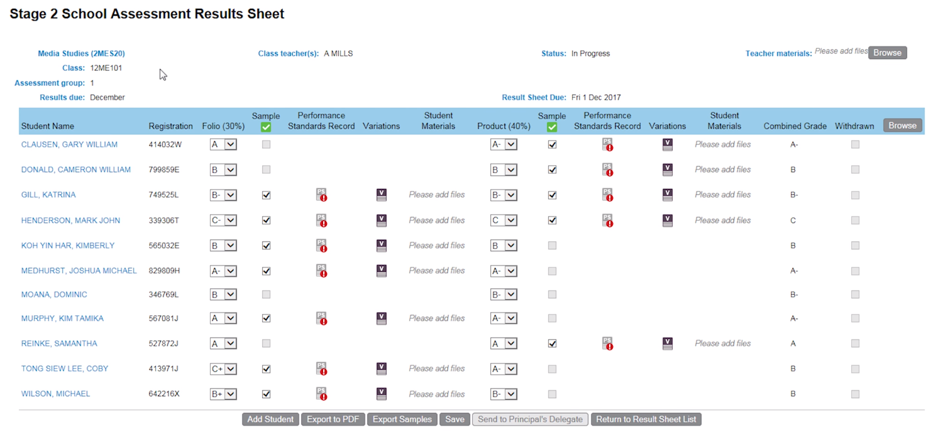
Online submission
Notes:
Online submission of student materials
This image will look very familiar to many of you – it’s a results sheet in Schools Online where submission of materials needs to be uploaded. So teachers of online subjects in 2018 had to enter a grade for each assessment type, then upload the student materials for the corresponding assessment type.
Looking back, online submission was successful for 15 subjects in 2018
For most subjects, this was the school assessed component, as well as the externally assessed investigation (although for some subjects it was not the entire subject i.e. Community Studies only submitted their external online).
This year in 2019, more than 25 additional subjects will be submitted online in 2019 – so those the 15 that were online last year, and 25 new ones. Please refer to the list in your booklet.
Again, for most subjects both the school assessed component and the externally assessed investigation will be submitted online, although for a handful of subjects it is one component or the other.
This list is published on the SACE website – go to TEACHING/RESULTING/ONLINE-SUBMISSION www.sace.sa.edu.au/teaching/resulting/online-submission/subjects
Also, the advice about preparing and packaging materials on each subject’s minisite also contains this information
Teachers of these online submission subjects will receive similar communications directly from the SACE Board as last year’s online submission teachers did, and just to recap a few of the key messages which you can share to support teachers in your schools: (Flick through the next few slides quickly…)

Slide 33
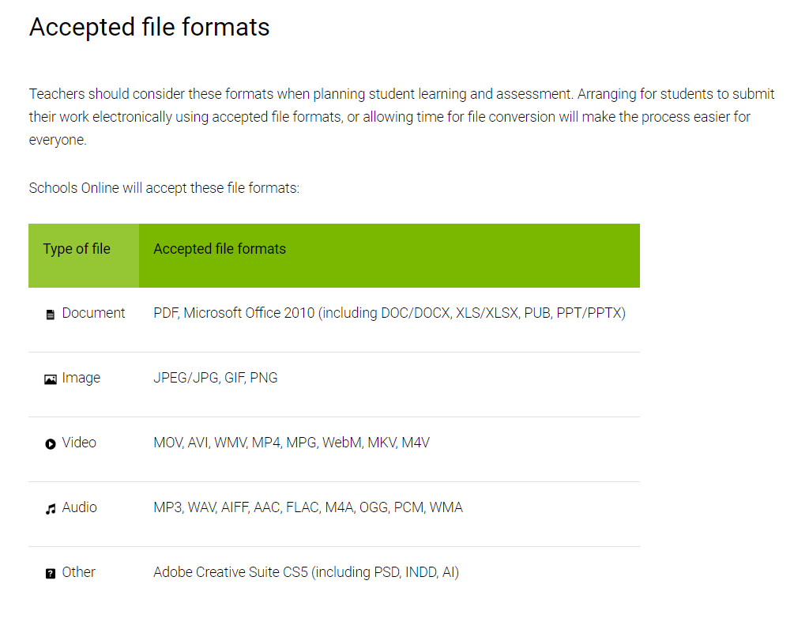
Notes:
The accepted file formats
PDFs were widely used – can sometimes be useful to keep formatting etc. Instructions re how to convert documents to PDFs will be added to the website.

Slide 34
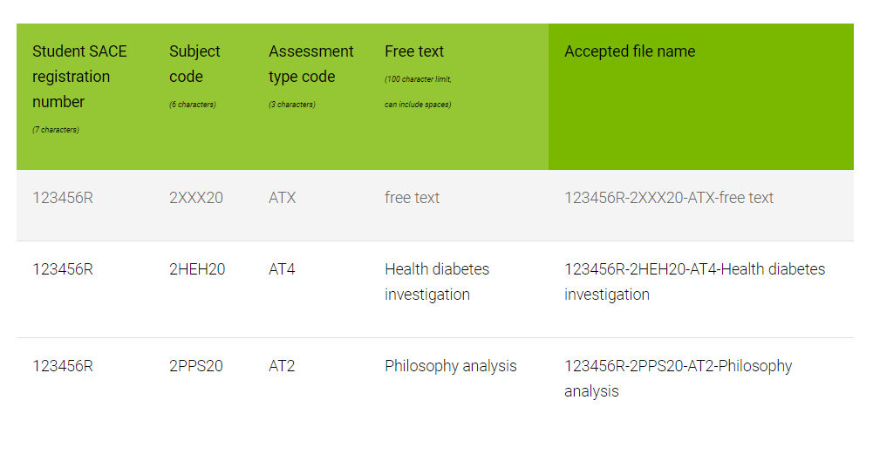
www.sace.sa.edu.au/teaching/resulting/online-submission/accepted-file-names-and-formats
Notes:
The accepted file names, or naming conventions, are really important – if this is not done in the specified format then there are uploading issues, and the file(s) will need to be re-named.
We know that there were some frustrations by some teachers last year, but many reported that they spent less time uploading than they did packaging materials for the white bags in the past.
So, please re-iterate these accepted file names to teachers and explain its importance
Some schools asked students to submit their work with this file naming format.
Refer to anecdotal stories
one teacher said that she read out the file name to the class and one student saved their work with ‘eightyone’(81) instead of AT1.
Another teacher wrote up on the board and expected students to write in their own free text, but students actually saved the filename with the words ‘free text’ in them.

Slide 35
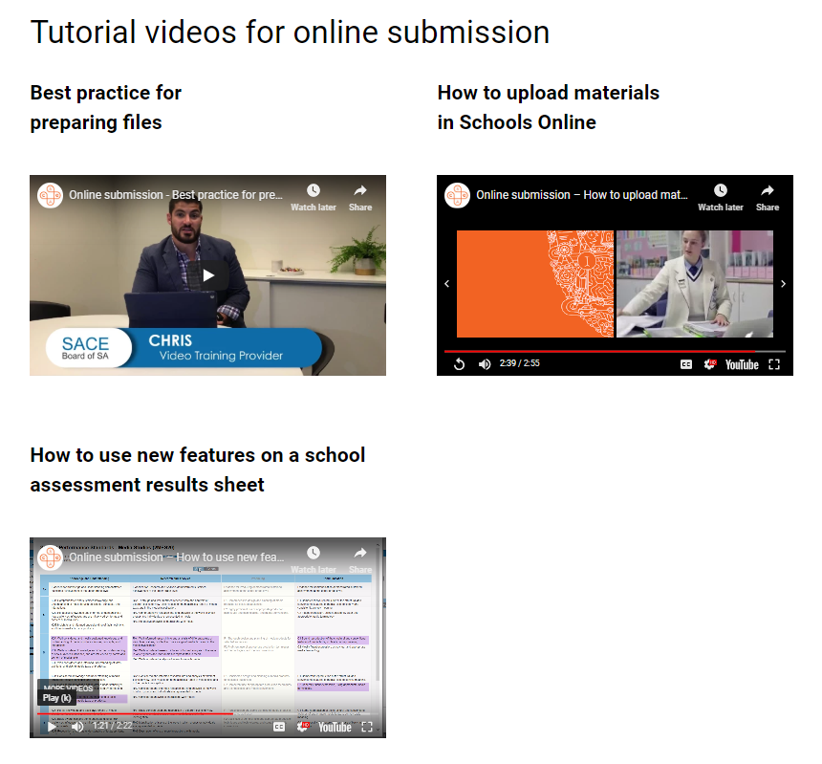
www.sace.sa.edu.au/teaching/resulting/online-submission/tutorials
Notes:
The other information to share with teachers is the tutorial videos which you can see on the screen here.
For moderation, a really important one is the third one – how to use the new features on a school assessment result sheet.
This video explains the purpose of the new Performance Standards Record, or PSR (click).

Slide 36
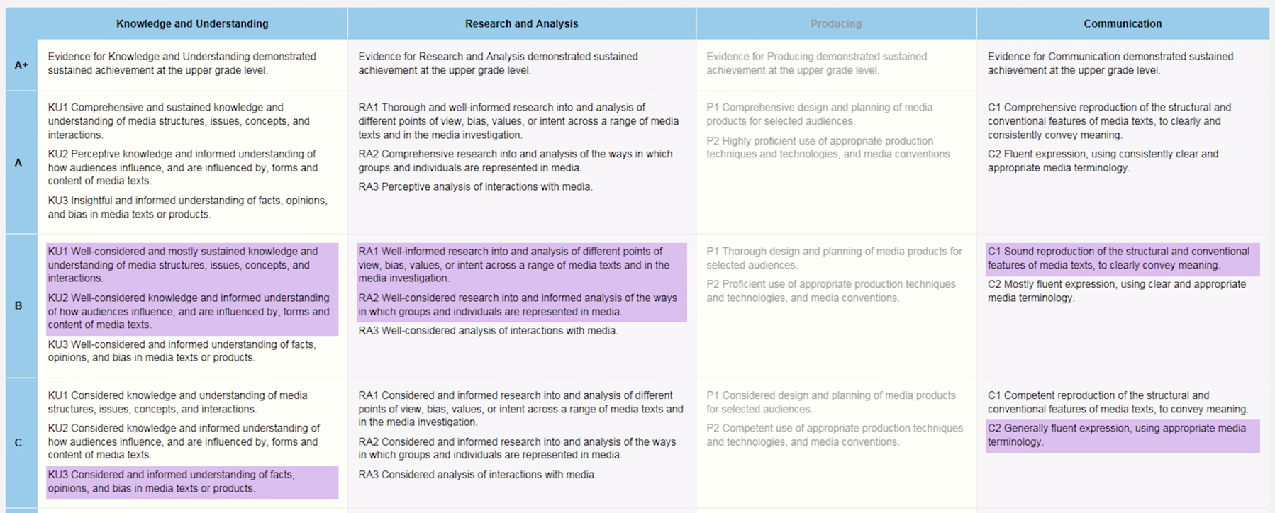
Notes:
The PSR needs to be completed by the teacher for each student in the sample by selecting the specific features assessed in the task.
The selection of specific features is really important because if there is an adjustment to the grade as a result of moderation, then the PSR provides the basis for feedback to the teacher and school - you would have seen that the moderation reports in Schools Online for the online subjects look quite different to the feedback for the paper subjects – a PSR is available and shows purple as the teacher’s original assessment decision, and yellow as the final moderation outcome.
If not all specific features are not shaded as per the task, then the feedback is not meaningful.
Also last year we noticed that some teachers selected different specific features for different students who did the same task – so inconsistencies in what was assessed and in the feedback for different grade levels.

Slide 37
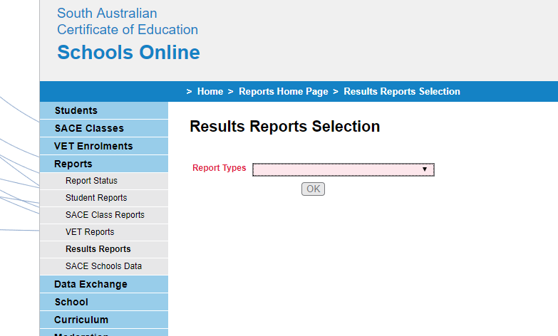
Notes:
Moderation feedback can be obtained from two reports in Schools Online
Go to Results Reports then in the drop down menu select:
Stage 2 Moderation Feedback Report for paper subjects (these reports are in a word processed PDF – see next slide)
Stage 2 Moderation Summary Report for online subjects (these are dynamic reports that are automatically generated – see slide after next!)

Slide 38
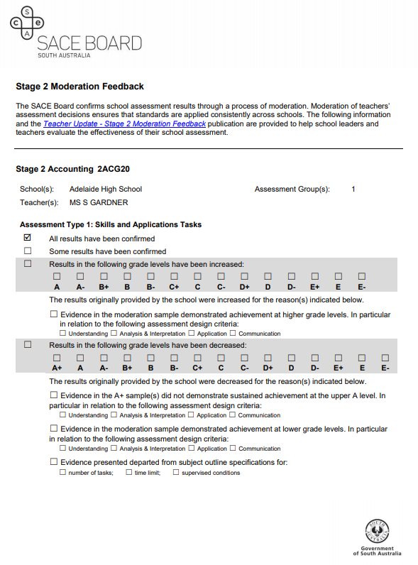
Paper subjects: Moderation feedback reports
Notes:
Example of Stage 2 Moderation Feedback Report for paper subjects – our administration team actually enter the data in to these reports!

Slide 39
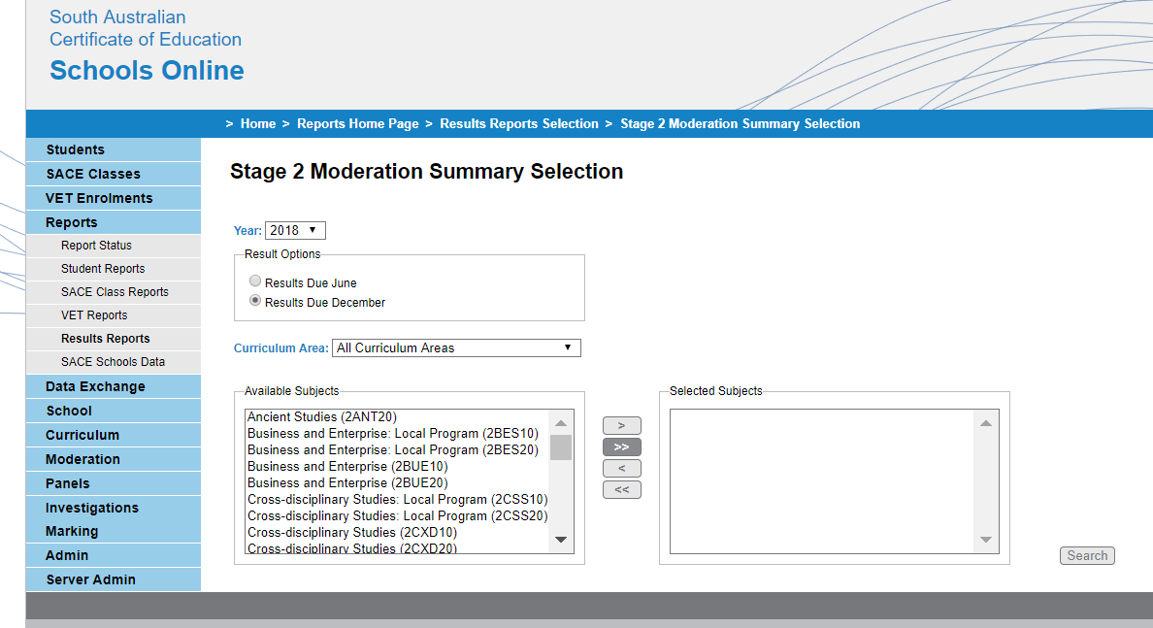
Online subjects: Moderation Summary Reports
Notes:
To view moderation feedback for online subjects, from the drop down menu select Stage 2 Moderation Summary Report, then select your subject and search (select all subjects to get a report for all online subjects at your school)

Slide 40
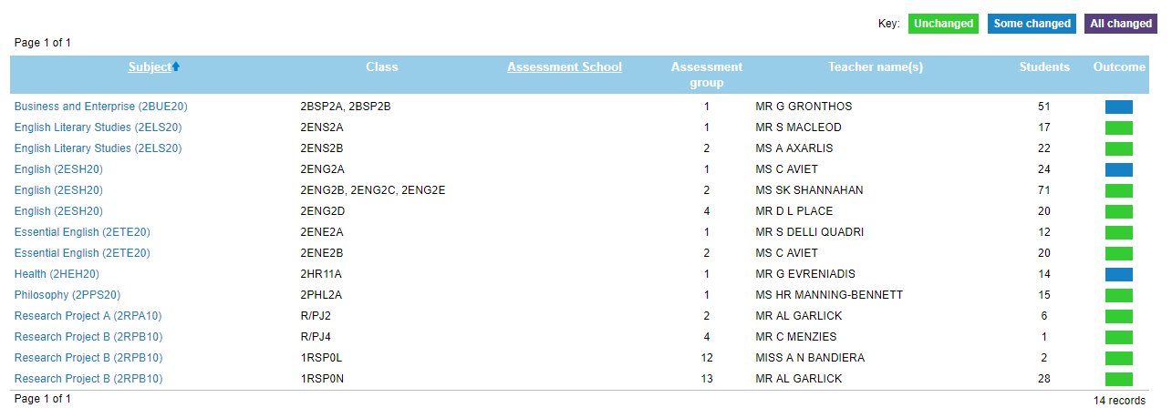
Notes:
Your initial report will look like this – a list of all online subjects at your school.
The columns with class details, teacher name etc will be populated
There is a visual indicator/key of green, blue and purple
Select the blue subject link (Click next slide)

Slide 41
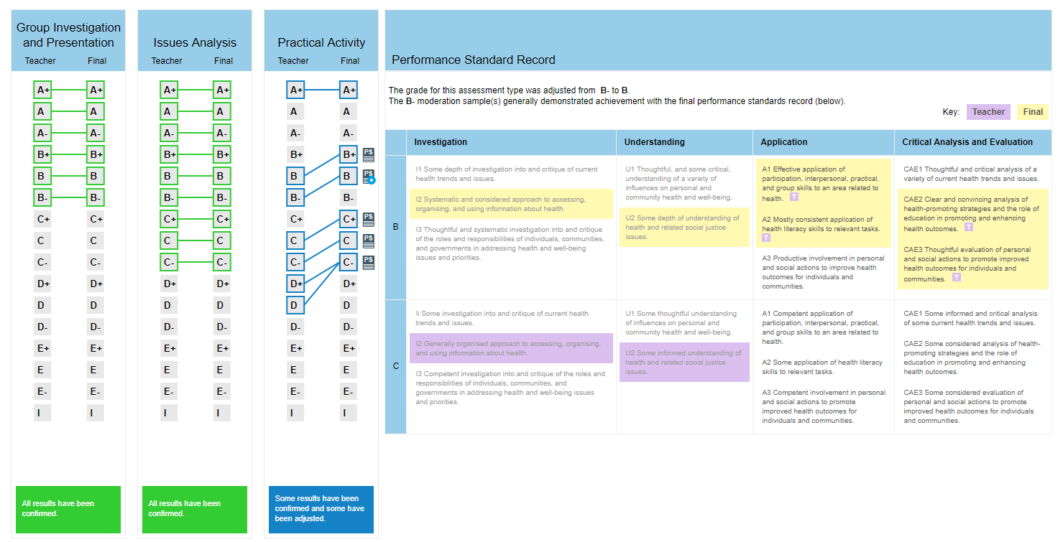
Notes:
Once you have selected the blue subject link you will see the details of the moderation outcome for that subject.
In this example, AT1 & AT2 are green so are confirmed, AT3 has had some changes so is blue.
If you click on the PS icon next to it, can see the reasons for the adjustment.
Purple = teacher’s original shading on the Performance Standards Record (PSR)
Yellow = final moderation outcome.
Therefore in this example we can see that the teacher originally said B- and shaded mostly B with I2 and U2 in C band. Moderation outcome is B band for all specific features, therefore reflecting the moderation outcome of B.

Slide 42
Notes:
The other key learning from online submission, particularly moderation, was that not all tasks were uploaded.
So, if an assessment type for required three tasks, only one was uploaded, therefore moderation couldn’t proceed, and we had to get the Results Sheet opened back up and contact the school to reload the missing materials.
It’s important to be aware that the system doesn’t know how many files the student used to complete their evidence, so it will accept a single file.
As the year goes on, we’ll be communicating these messages to teachers, but we’re sharing them now so you’re aware of them.
ACTIVITY - IF TIME PERMITS:
What were your school’s and teacher’s experiences of online submission – for instance, for Research Project?
How can you use the teachers from subject’s last year to be change champions supporting those teachers for whom online submission will be new this year?

Slide 43
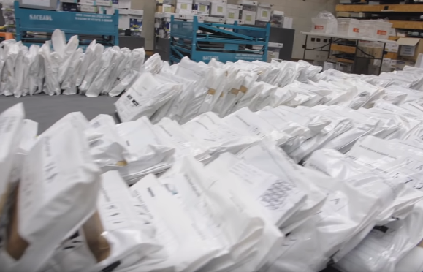
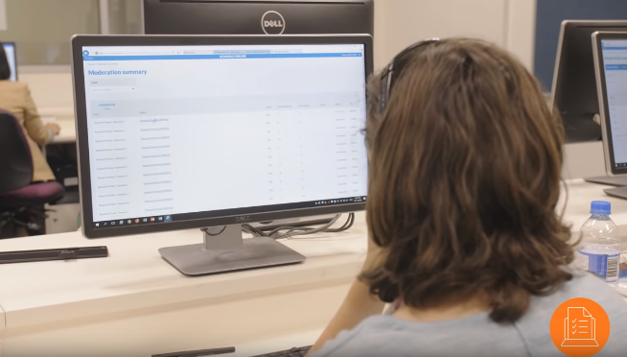
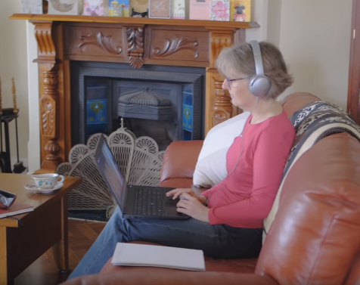
Moderation
There are now three forms of moderation:﻿
Paper moderation at Mawson Lakes
Online moderation at Mawson Lakes
Online dispersed moderation
Notes:
An update about moderation - in 2018 there were three forms of moderation:
Paper moderation at Mawson Lakes
Online moderation at Mawson Lakes
Online dispersed moderation﻿
Many of your are familiar with moderation at Mawson Lakes, or Magill as it used to be. Moderators were given a TRT to reimburse teachers for their time out of school.
In the dispersed model, moderators are paid directly by the SACE Board so it’s expected that they conduct this work out after school hours, keeping their ‘day job’ free for schools – for example, planning that takes place at the end of the year etc.
In 2018 three subjects were moderated using a dispersed model – this worked successfully, and valuable feedback from these moderators has been used as the basis for further system improvements.
In 2019 it is our intention to disperse more subjects, and the details of which subjects will be communicated closer to the end of the year.
Regardless of the moderation format, all of the moderation processes a based on the same principles and purposes – to review student results issued by schools to ensure fair, valid and reliable results.
This headset of ‘review’ is really important, so including task sheets and ensuring student work is marked is crucial. In some subjects, including in the Maths area, some student work was not marked, which meant moderators did not know the basis of the teacher’s assessment decision and had to mark work first before moderating.

Slide 44
Electronic exams
View Electronic exams video
Notes:
Video – 2.27
Highlights the achievement of ELS exam in 2018.
Note: e-exams in 2019:
English Literary Studies,
Psychology,
Modern History

Slide 45
Electronic Exams 2019
Learning from 2018 – The Wisdom of the ELS SACE Coordinators;
What worked for you in your school and what would you repeat in 2019?
What would you do differently in 2019?
What were your major learning points?
What will be the Impact of additional subjects?
Questions from the ‘new’ SACE Coordinators of 2019;
What are your five top questions?
What do you believe will be your major challenges?
What have you heard about the 2018 experience – good and bad?
Notes:
Need to learn from 2018 ELS SACE Coordinators – 5 minutes table talk, 5 minute feedback
What worked really well and needs to be replicated
What can be improved
Impact of more subjects
Questions from 2019 ‘new’ SACE Coordinators – 5 minutes

Slide 46
Electronic Exams 2019
Next steps?
We will support you and your school
Can the Electronic Examination experienced SACE Coordinators become Change Champions within the school communities?
Major points you want follow up on
Notes:
Strategies for moving forward – 5 minutes
What are the major points the project team needs to follow up to support the SACE Coordinators – 5 minutes max

Slide 47
Special Provisions
View Special Provisions video
Notes:
A new video animation explaining how special provisions can support students has been created with student and parent information sessions in mind.
The video can be accessed via the Coordinating the SACE section of the SACE website under Marking toolkit.

Slide 48
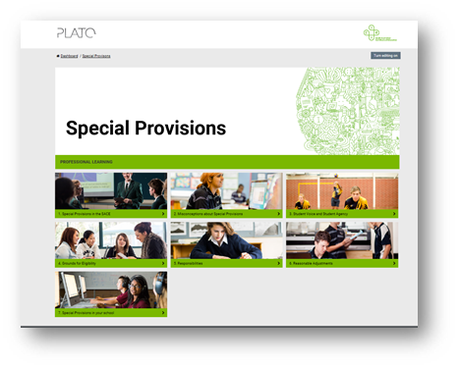
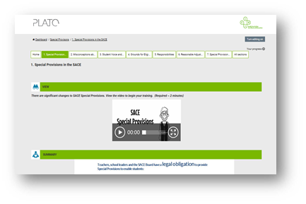
Special Provisions
• Policy
﻿
• Roles and responsibilities of schools and the SACE Board
• Form 31- Request for external assessment adjustments
Notes:
A quick refresh now we have had one year of implementing the revised special provisions policy.
Schools are responsible for identifying and implementing reasonable adjustments that can be managed within the school context.
•Requirement that decisions about reasonable adjustments involve consultation with the student (or an associate of the student, such as a relative or carer) and consider the effect of the adjustment on the student’s participation, achievement and independence
• a reminder that special provisions can't be a substitute for learning that hasn't occurred and that a whole assessment task cannot be removed. If for example there is only one task in an assessment type, this cannot be removed. If there are for example 4 tasks possibly one or two may be removed.
•Reasonable adjustments may vary from subject to subject and assessment to assessment according to the eligible student’s choice (flexibility, student choice)

Slide 49
Special Provisions
Advice
Phone: 8115 4700
Email: SACE.SpecialProvisions@sa.gov.au
• Reduced papers
• Communication between schools – home school and exam location
• Instructions on the administration of approved Special Provisions
Notes:
The special provisions team are available to assist schools including policy requirements, resources that can assist and the range of provisions that can help.
It is recommended that schools contact the special provisions team as early in the year as possible in the case of significant conditions and complex situations.
Reduced papers – please note there has been a change to Form 31 in relation to requests for adjustments to examination length, please contact the SACE Board to discuss before requesting a reduced paper adjustment.
Where a school has approved special provisions for a student and the student is sitting the exam at another location that the home school who approved the special provisions advises the exam location school as there may need to be things put in place such as additional invigilators if separate invigilation has been approved and in the case of language exams extra CD’s are required in this situation.
Instructions for the administration of approved special provisions are available on the special provisions mini-site, each invigilator should be familiar with these instruction for the relevant provision(s) approved.
Please note the instructions in relation to the use of a word processor and specifically how the examination answers should be printed and checked by both the student and invigilator, initialed by both and then the invigilator attaches the pages of printout to the relevant question in the answer booklet.

Slide 50
Special Provisions - Resources
• Model of good practice
• Case studies
• School processes checklist
• Spreadsheet for record keeping
• Online professional learning course (PLATO)
Notes:
A number of resources have been developed to support the understanding and management of the Special Provisions policy in schools. These resources can all be accessed via the Special Provisions mini-site.
Resources include:
•Model of good practice – checklist for schools from students beginning SACE to enrolment in Stage 2 examinable subjects
•Case studies- examples of actual cases
•A checklist has been adapted from Nationally Consistent Collection of Data on Schools Students with Disability resources to support schools to establish and monitor the continuity and consistency of special provisions provided for students
•An Excel spreadsheet is available to support schools to track and record adjustments for student with special provisions. Use of the spreadsheet is optional and schools may have their own processes in place that they would prefer to use. There is a copy of a blank spreadsheet and a populated example spreadsheet available on the mini-site
•An online professional learning course is available in PLATO. The course is primarily designed for teachers.
The special provisions policy and Information Sheet 58 can also be found on the special provisions mini-site.

Slide 52
Stage 1 Planning Support
The aim of these workshops is to further teacher understanding of performance standards in relation to LAPs and task design.
Personal Learning Plan, Monday 4 March
English and mathematics subjects, Wednesday 6 March
Stage 1 and Stage 2 Modified Subjects Planning Support,
Tuesday 26 February
All workshops are held from 4 – 6 pm at the SACE Board.
Bookings available online.

Slide 53
Calculators in Stage 2 Exams
Information sheet 49
Notes:
On the SACE Board website there is a document outlining the specifications and conditions of use of approved graphics and scientific calculators in external examinations.
https://www.sace.sa.edu.au/coordinating/admin/information-sheets/49
Schools need to be familiar with the approved calculator list and ensure that students are equipped and familiar with the functions of an approved graphics calculator for the mathematics examinations.
For mathematics subjects, students may bring two calculators into an examination. This may be two approved graphics calculators or one scientific calculator and one approved graphics calculator into the examination room. Scientific calculators cannot have an external memory source (e.g. USB jack or SD card slot), and students will be required to clear any memory on the scientific calculator.

Slide 55
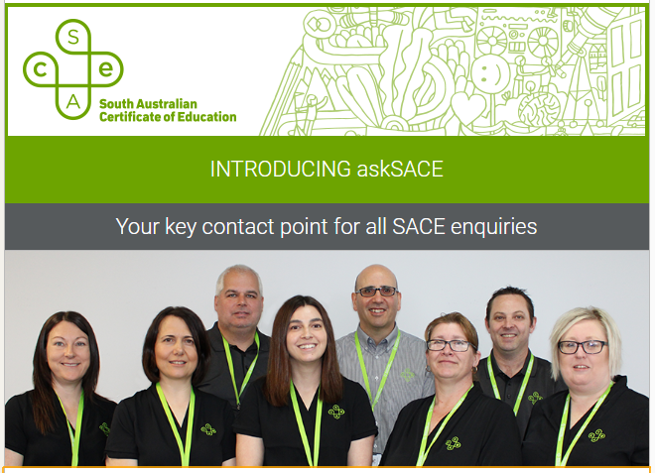
Ask SACE
One phone number – 8115 4700
One email – askSACE@sa.gov.au
Notes:
SACE enquiries new phone line ( assessment operation team)
You are still able to contact the curriculum and assessment officer directly using the information from the subject mini-site.

Slide 56
Data packs
Your schools data pack is provided for you to take away and consider in preparation and planning for 2019.
Included is
Moderation issues
Exceptional circumstances
Results enquiry
2018
2018
2018
Notes:
Consider what you could do to support students and teachers regarding these identified data last year.

Slide 57
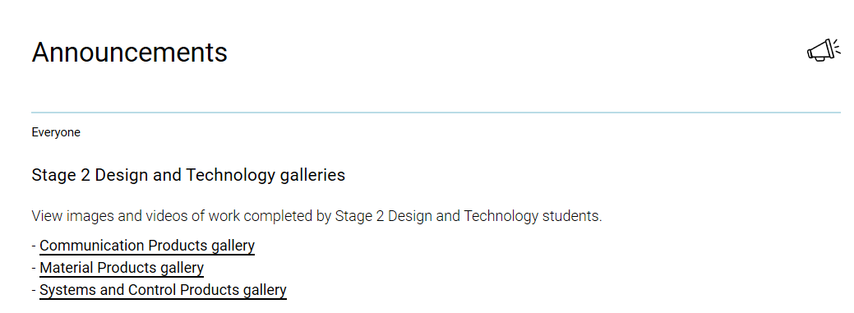
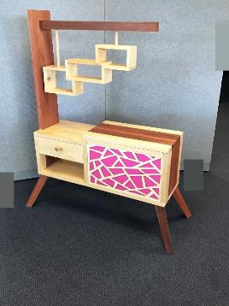
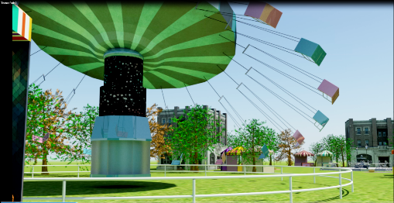
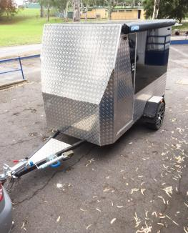
Notes:
A gallery for showcasing student work completed in Design and Technology courses was created at the end of 2018 ready to provide student and teachers with ideas.

Slide 58
SACE Art Show
Tuesday 19th March – Tuesday 16th April 2019
Mon to Friday 9am – 4pm
Sat 10am – 4pm
TAFE SA Light Square Gallery
Adelaide College of the Arts
30 Light Square
School bookings online via the SACE website OR phone Nicola Otto directly on 8115 54714

