Slide 1
Integration of Australian Curriculum
Stage 2 Science
Implementation Workshops
Term 2, 2017
Notes:
For timing see Stage 2 Workshop Overview A601707
Welcome
Introductions – presenters and other SACE colleagues present
Sign-in, evacuation and housekeeping

Slide 2
Program
  Overview of subject outlines
  Assessment overview
  Task design and programing
  Learning and assessment plans
  External assessment
  E-assessment
Notes:
Welcome
Introductions – presenters and other SACE colleagues present
Find out who has been to a Stage 1 Implementation workshop or are teaching Stage 1 to gauge the depth necessary to discuss new aspects of the subject outline.
Sign-in, evacuation and housekeeping
Structure of today’s workshop – the focus on Stage 2
to inform you about the changes in the overall structure of the science subjects and provide an opportunity for questions to be answered
to encourage you to think about what this means for your teaching of science subjects in Stage 2 2018.
The implementation workshops will include:
an overview of the new science subjects (Biology, Chemistry, Earth and Environmental Science, Physics) – subject outlines and content overview
the assessment requirements of each subject
task design – focus on what is new or different, including the examination or Earth Systems Study
opportunity to consider programming
provide sample materials to assist in planning
an overview of the learning and assessment plans
possible directions in onscreen assessment.
NOT CONTENT SASTA workshops in Term 3
Note: Fedback sheets on your table. Please use them during the workshop and give them to us before you go.

Slide 3

Subject renewal
Reference group
Writing teams
Focus group
Online consultation
Revision based on feedback
Accreditation, Recognition and Certification Committee
SACE Board approved
Notes:
(keep brief – already heard at Stage 1 workshops)
How we got to this point:
Integration of the Australian Curriculum with SACE subjects – received state government funding – work began 2015
Process:
established a reference group of Science teachers who are experienced markers and moderators, members of the standards leadership teams, and representatives from the tertiary sector
from the reference groups teams of writers were established
consulted with focus groups (comprising more experienced teachers)
online consultation for 6 weeks earlier in 2016 – including consultation and feedback from SACE International schools, leaders and teachers
based on the consultation feedback, a number of recommended changes were made to the subject outlines; the reference group provided advice on revisions based on online consultation
SACE Board approved documents May 2016
draft subject outlines provided online for planning purposes.

Slide 4
SACE Board Guiding Principles for Subject Renewal
Quality Learning
Engaging
Innovative
Quality Assessment
Manageability
Notes:
Quality Learning – contemporary and international in outlook.
Engaging – interesting, for a diverse range of learners with a diverse range of needs, relevant. Not compulsory to study a science.
Innovative – forward thinking, imaginative, use of IT
Quality Assessment – diversity in assessment, fit for purpose
Manageability – for schools and students – in terms of workload, with a view to the future and electronic assessment in the future (moderation of school assessment and external assessment)

Slide 5
Stage 2 Science Subjects
Stage 1 subjects 2017 | Stage 2 subjects 2018
Agriculture and Horticulture | Agricultural Production Agricultural Systems
Biology | Biology
Chemistry | Chemistry
Earth and Environmental Science | Earth and Environmental Science
Physics | Physics
Notes:
This slide shows the Australian curriculum subjects that have been accredited by the Board.
At Stage 1 (2017): Biology, Chemistry, Earth and Environmental Science (replacing Geology), and Physics.
At Stage 2 (2018): Biology, Chemistry, Earth and Environmental Science (replacing Geology), and Physics.
These are the only subjects we are discussing today.
Also note that renewal of Scientific Studies is underway; Nutrition and Psychology in the near future.

Slide 6
ATAR and Preclusions
  All 2018 Stage 2 science subjects are eligible to contribute to ATAR
  No precluded combinations between new subjects but some with ‘old’
  SATAC website:
  http://www.satac.edu.au/documents/sacentcet_newlyaccreditedsubjects_2018.pdf
Notes:
All the 2017 Stage 2 science subjects are Tertiary Admissions Subjects (TAS), and are thus eligible to contribute to an ATAR.
Preclusions between new and historical subjects:
e.g. BIG and BGY
Counting restrictions with historical Ag subjects
See the full list on the SATAC website which includes the historical/previous subjects. The SATAC page has a table of precluded combinations and counting restrictions.

Slide 7

I can work collaboratively and safely
What is a capable student?
I am literate and numerate
I can analyse and devise solutions
I can use technology to create a new way of thinking
I am open-minded
I can make ethical and responsible decisions
I am capable
Notes:
Consider the student from 2020.
may have seen this slide last year in Stage 1 workshop
What do we want them to be telling us after studying one of the science subjects?
These capabilities underpin the new subjects and are built into the teaching and assessment of the subjects

Slide 8
Relationship between AC and SACE
  Capabilities
  Three strands:
  Science Understanding (SU)
  Science Inquiry Skills (SIS)
  Science as a Human Endeavour (SHE)
Notes:
Take care with resources labelled Australian Curriculum.
Don’t just download documents from ACARA website
As indicated, Capabilities take a key focus
Three strands woven together
SU has some content from AC but also other concepts that are important for students, not isolated into separate units, ordered in way different way – but teachers can choose to re-order
SIS to focus clearly and actively on critical thinking
SHE is broader in the way it places science in society and replaces Human Awareness or issues

Slide 9
Capabilities
Integrated Australian Curriculum General Capabilities
  Literacy
  Numeracy
  Information and communication technology capability
  Critical and creative thinking
  Personal and social capability
  Ethical understanding
  Intercultural understanding
Notes:
All SACE subjects will have these 7 capabilities integrated by 2020 as they go through renewal.
Refer to the subject outlines you have brought with you today.
You are likely to be familiar with them as teaching using the AC has been happening in B-10 for some years now.
The seven Australian Curriculum General Capabilities have a brief description provided highlighting how students may develop each capability through the study of each of the sciences. Some of the opportunities to develop and extend students’ capabilities have also been highlighted in the topic introductions and other aspects of the content, including suggested contexts.
The role of the capabilities in the subject outline has been enhanced.
In the current subject outlines, the focus of the capabilities has been on learning and communication however, in these subject outlines, all the capabilities are covered to some degree but Critical and creative thinking (SIS) and Personal and social capability and Ethical Understanding (SHE) are particularly significant.
Capabilities – in all subject outlines begin on page 3.
Not going to revisit as discussed them in Stage 1 workshops

Slide 10
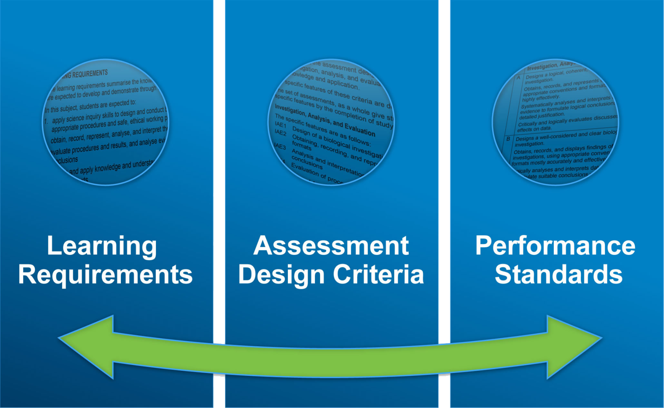
Subject Framework
Capabilities
Notes:
We will provide an overview of elements of the subject outline, which are applicable to all Stage 2 science subjects.
The redeveloped subjects retain the same basic structure as the current SACE subject outlines for all subjects, with capabilities, LRs, ADCs, PS etc so the structure of the subject outlines would be familiar to you.
The learning requirements continue to have the same purpose; they describe the essential elements of the subject. They summarise the knowledge, skills, and understandings that students are expected to develop and demonstrate through learning in the subject.
As is the current subject outline, the Assessment Design Criteria are based on the Learning Requirements, and the levels of achievement are described by the Performance Standards. The capabilities are woven throughout.

Slide 11
Learning Requirements
apply science inquiry skills to design and conduct biological investigations, using appropriate procedures and safe, ethical working practices
obtain, record, represent, analyse, and interpret the results of biological investigations
evaluate procedures and results, and analyse evidence to formulate and justify conclusions
develop and apply knowledge and understanding of biological concepts in new and familiar contexts
explore and understand science as a human endeavour
communicate knowledge and understanding of biological concepts, using appropriate terms, conventions, and representations.
Notes:
Run through these very briefly
And those who are teaching Stage 1 will be familiar with all these

Slide 12
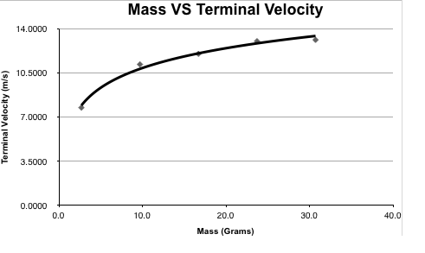
Science Inquiry Skills
Differences:
  Left hand column is assessable
  Deconstruct a problem
  Factors controlled (how & why), might not be able to be controlled
  Primary/secondary data – numerical, visual, descriptive
  Interpolation/extrapolation
Notes:
Page 5 of booklet
Review new emphases
Students need practice in deconstructing a problem e.g. how often should you wash your bath towel?
Qs probably don’t have a single answer
Should talk in class about how ideas could be tested without having to formally design an investigation but may discuss a design as a group to get in practice
Potential for Qs in the exam
Factors to be controlled: may be presented in table form
Consider the range of different types of data
Distinguish between data that can be extrapolated or not e.g. mass vs terminal graph if extrapolated might show an ‘object’ with 0 mass

Slide 13
Science Inquiry Skills
Differences:
  Left hand column is assessable
  Deconstruct a problem
  Factors controlled (how & why), might not be able to be controlled
  Primary/secondary data – numerical, visual, descriptive
  Interpolation/extrapolation
  Sources of uncertainty
  Limitations of conclusions
Notes:
Uncertainty: specific discussion of errors and their impact on results and hence on the quality of the conclusion. Students need to avoid generic responses.
Limitations: consider the limitation of the conclusion in the light of the limited investigation undertaken and range of errors

Slide 14

Science Inquiry Skills
What are the implications for teaching?
Notes:
Refocus onto the skills in LHS
Discussion time 15 mins - maybe
Examples of ways to enhance student’s knowledge and application of these on RHS
Explicit teaching of language
Integrate into the teaching of the content
Give opportunities to use the language e.g. in deconstructing a problem

Slide 15
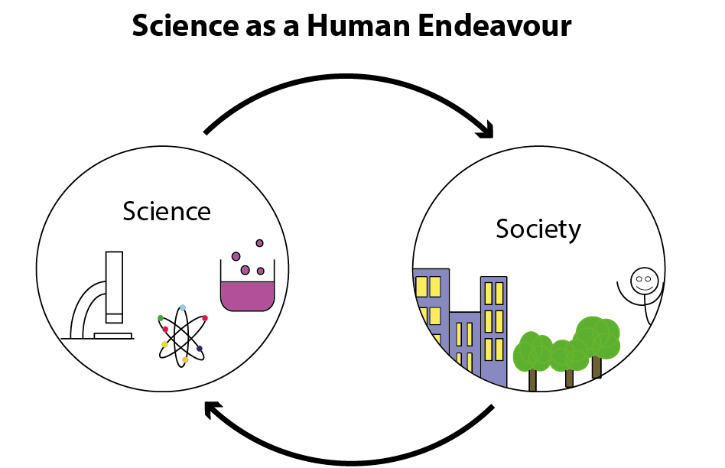
Notes:
Stress that our interpretation of SHE is the interaction between science and society.
This is a two-way interaction
Note:
R – 10 is largely historical, one-off she discussion using ACARA curriculum.
In SACE , SHE has been broadened.
Turn to page 7 in booklet

Slide 16
Science as a Human Endeavour
Key Concepts:
Communication and Collaboration
Development
Influence
Application and Limitation
Integrated into the teaching program
Explore and understand the interaction between science and society
Notes:
Was covered in Stage 1 w/shops.
Review key concepts etc.
Explicit teaching of the concepts
Just because this only takes 1½ pages at the front of the subject outline doesn’t mean you only need to spend one lesson on it.
Students MUST be able to tell you about each of the key concepts – not just from memory but be able to explain what they mean and discuss examples. They need to be able to recognise how and where they apply in specific contexts.
They should be encouraged to bring specific examples e.g. from newspaper/magazine cutting or from online sites. It is more than just history!!

Slide 17
Science as a Human Endeavour
Carbon nanotube transistors outperform silicon for first time ever
Laser labels
Agbot
Notes:
Consider one example of science as a human endeavour that could be integrated in a class discussion – probably AGBOT.
Talk about how this shows influence, interaction, government, universities, industry, biology, chemistry, EES, physics etc
Talk about how articles can be used to do the same sort of thing.
Then handout yellow page with mention of copyright issues and re-collection of pages.

Slide 18
Focus questions
What approach could I use to integrate
Science as a Human Endeavour
into my teaching program?
Where do I find resources?
Notes:
Discussion
Brainstorm around the table – what approach has been used in Stage 1?
New resources discovered?
Don’t go into assessment task at this point.
Note: 10 minutes
Notes for Discussion (pointers for teachers to think about
Consider the use of the person symbols.
Local, contemporary examples during teaching program
Use SHE as a context for teaching – can come back to this later in the workshop
No need to get feedback from teachers
Need to take their thoughts back to school and develop ideas further
Resources Handouts – if you can’t find anything here you’re not really trying!

Slide 19
Science Understanding
  Difference between the two columns
Notes:
Subject Outline: BIG page 14, CME page 13, EES page 13, PYS page13.
In the current subject outline, the Stage 2 content is divided into two columns: Key Ideas and Intended Student Learning. This is what teachers used as the basis of their teaching and is the basis for writing the Stage 2 examination.
These 2 columns have been amalgamated into a single column on the LEFT HAND SIDE called Science Understanding but effectively still show the key idea with an elaboration of what students need to know/be able to do/understand in the dot points underneath.
This column will serve the same purpose as the previous two columns – the basis for a teaching, learning and assessment program and now they are shown in both Stage 1 and Stage 2.
The writing of the examination for Stage 2 is based on the Science Understanding and Science Inquiry Skills in the LH column and SHE concepts.
The column on the RHS is used to provide suggestions of contexts for activities. These draw out all three strands, and include examples of innovative strategies.
Note these are ONLY suggestions – we could not fit them all in.
As it says in the subject outline (these are)…………..provided as a guide only.
They are neither comprehensive nor exclusive. Teachers may select from these or choose to use others.
Explain Symbols
Cogs - possible teaching and learning strategy
indicates a possible activity to develop Science Inquiry Skills
Human figure - indicates a possible Science as a Human Endeavour context
You may have other ideas and suggestions – good – if you are happy to share these ideas with other teachers, please email them to the SACE Officer as we are developing further support materials.
We will come back to each of these as appropriate.

Slide 20
Science Understanding
Topics (and maybe subtopics)
Left hand side is examinable
Key idea and intended student learning
Right hand side – Possible
Symbols thread SIS & SHE strands through SU
Choose the order and context
Students study all topics
Note italics in RH column
Notes:
Refer to topic overview in booklet beginning page 8
Important to use current subject outline and teach what is there not what you think is there!!
There has been some rearrangement, refinement, and clarification since the draft document.
Note that the topics have not been designed to be of equivalent length – it is anticipated that some topics will need a greater allocation of time than others.
RHS might give some indication as to depth
The suggested order of the topics is a guide only; however, students study all topics. The topics can be sequenced to suit individual cohorts of students.
Note:
Anything in italics in RHS references concepts in Stage 1 or in other Stage 2 topics

Slide 21
Focus Questions
What does the content include?
How has the content changed for Stage 2?
How can the content be sequenced?
Could I use or adapt a sample program?
Notes:
Opportunity for table discussion
Must make the point that content includes SU, SIS and SHE
A closer look at content – need subject outlines to look at detail of content
How has the content changed at Stage 2?
In/out from current subject outline (refer new subject outline)
Supporting documents for reference Presenters need to have supporting docs highlighting Ins and Outs
Mention Stage 1 as necessary – reference documents for presenters
Look at sample programs
Programs – weekly breakdown to assist with planning – a couple of types of timetabling.
How can the content be sequenced?
Teacher choice
All topics
Could I use or adapt a sample program?

Slide 22
  Assessment:
  Assessment Design Criteria
    Investigation, Analysis, and Evaluation
    Knowledge and Application
Notes:
(Very brief – did this in Stage 1 workshop)
Now 2 instead of 4
Same ADC across all four subjects.
Names of ADC consistent Stage 1 and Stage 2.
Easier to ensure that both ADCs are addressed in each assessment type.

Slide 23
Assessment:
Specific Features
  What are the changes?
  Manipulative skills & collaboration may be assessed in IAE2
  Current I2 reorganised
  Conventions of and representations in communication in KA4
  Conventions & representation of data in IAE2
  Justifying a conclusion in IAE3
  Effect on data IAE4
  Explore and understand the interaction between science and society - KA3
Notes:
Very brief – did this in Stage 1 workshop
Refer to page 12 in booklet
Feedback on the specific features has been positive. Could ask how people are finding them in Stage 1.
clear and easy to use.
Same ADC across all four subjects.
Names of ADC consistent Stage 1 and Stage 2.
Each specific feature should be addressed at least once in the learning and assessment program.
(Anything not numerical about data is in KA4)

Slide 24
  Assessment:
  Performance Standards
A level
Critically………..logically……….depth…..highly effectively…..coherently……
C level
Generally clear….some analysis….generally effectively
E level
Attempts to….limited accuracy…..
Notes:
(Very brief – did this in Stage 1 workshop)
Refer to page 13 - 16 in booklet
Descriptors familiar – note key descriptors

Slide 25
Performance Standards
  C- = C-
  2017 2018
Notes:
Standards should not change.
Reiterate: have compared work that has previously been assessed using current PS and then with new PS – result is the same grade
Not making it harder for students to pass

Slide 26
Assessment Scope and Requirements
8 assessments including external
School Assessment (70%)
  Assessment Type 1: Investigations Folio (30%)
  Assessment Type 2: Skills and Applications Tasks (40%)
  At least one task should involve collaborative work
External Assessment (30%)
  Assessment Type 3: Examination (2 hours) or
  Earth Systems Study
Notes:
Implementation Booklet Page 11 to show assessment overview
Change in number of tasks in line with Board’s requirement to reduce assessment
All Stage 2 subjects in the SACE continue to have a school assessment component (70%) and an external assessment component (30%).
Change in weighting for AT1 and AT2 based on teacher feedback
(Look at structure of exam later)

Slide 27
Assessment Scope and Requirements
Agriculture: 7 assessments including external
School Assessment (70%)
  Assessment Type 1: Agricultural Reports (30%)
  Assessment Type 2: Applications (40%)
  At least one task should involve collaborative work
External Assessment (30%)
  Assessment Type 3:
    Production Investigation (Agricultural Production)
    or
    Experimental Investigation (Agricultural Systems)
Notes:
Implementation Booklet Page 11 to show assessment overview
Change in number of tasks in line with Board’s requirement to reduce assessment
All Stage 2 subjects in the SACE continue to have a school assessment component (70%) and an external assessment component (30%).
Change in weighting for AT1 and AT2 based on teacher feedback
(Look at structure of exam later)

Slide 28
Assessment Type 1:
Investigations Folio
At least two practical investigations
Investigate a question for which the outcome is uncertain*
Deconstruct a problem*
Specifications for a report
Maximum word count 1500
Note: Sections outside word count are still assessable.
Notes:
What you can’t do (routine recipe prac - these should be formative) vs what is suitable
Examples of deconstructing a problem
A maximum word count for practical reports would assist students to be more concise in their reporting, as well as reducing the amount of assessment.
Sections in and out of the word count
The exclusion of:
Materials
Method
Safety
results
from the word count enables students to provide sufficient detail where this is appropriate for these sections of the report and not be disadvantaged. (checked against previously assessed tasks and this word count allows for the achievement of A grade)
Read subject outline – carefully and often
Use index of workshop book to find example to look at

Slide 29
Assessment Type 1:
Investigations Folio
One investigation with focus on Science as a Human Endeavour in which students …explore and understand
Introduction
Explanation of interaction between science and society
Relevant science
Impact
Conclusion
Citations
Max word count 1500 words (no source evaluation)
Notes:
Emphasis that this is NOT an issues investigation by another name.
Emphasis is not on the science alone, must show evidence of exploring and understanding the interaction between science and society by linking clearly to key concepts. Emphasis is on SHE supported by science
Introduction 100 - 150
Explanation of interaction between science and society 500
Relevant science 300 - 500
Impact 200
Conclusion with justification 150 - 200
Parts of the investigation report are specified.
Exploration could be ‘free choice’, directed into a general area by the teacher, all the same in the class (But this is not recommended)
Note – no source evaluation required so effectively an increase in word count

Slide 30
Focus Questions:
Investigations Folio
What is the impact of the practical report structure?
How will word count affect student reports?
Where does ‘deconstruct a problem’ fit?
What will your SHE task look like?
Notes:
Use index to locate examples for your subject
Consider these questions are you look at them.
What is the impact of the prac report structure?
Teach specific concepts and language and what goes where
How will word count affect student reports?
Perhaps guidelines to distribute words efficiently e.g. tables for factors controlled/why/how
Where does ‘deconstruct a problem’ fit?
Before or after a prac
What will a SHE task look like?
Variable but must show evidence of exploring and understanding the interaction between science and society.
Look at examples of tasks in the booklet – use index to locate your subject.

Slide 31
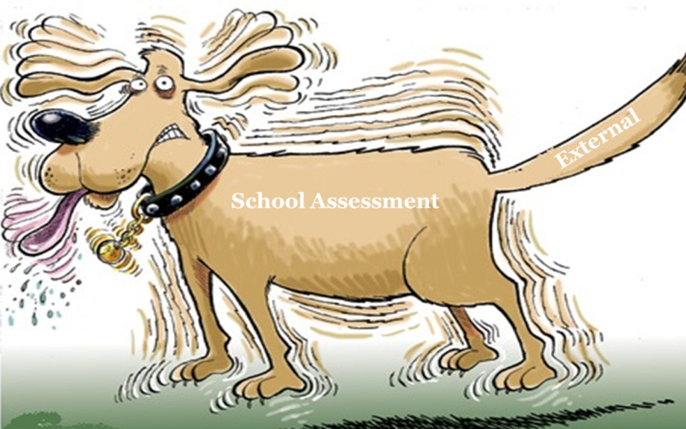
Assessment Type 2:
Skills and Applications Tasks
At least three under direct teacher supervision
Supervised tasks max 90 mins
Do not have to be tests
Notes:
The (maximum) number of assessment tasks has reduced in 2018.
This change has been directed by the Board:
Is deemed sufficient to provide evidence of the standard for SACE purposes
considers the assessment demands on students undertaking a full-time load
enables students to have more time for learning
(Less assessment = more time for learning).
allows more time to prepare for the assessment tasks that they do have.
Fewer assessments:
Should include content that is representative of the topics (not necessarily every single concept!)
Can provide the opportunity for valid assessment decisions.
It is not necessary to have a large number of assessments to ensure validity
The purpose of assessment is not to check on coverage of topics.
It is not blanket coverage.
Teachers may wish to consider other opportunities in their teaching and assessment program for providing feedback to students, traditionally viewed as formative assessment opportunities.
Time limit for SATs has been introduced for the same kinds of reasons as a word count limit.
AT2: Skills and Applications Tasks are intended to be as open and flexible as possible. Can consider tasks with oral or practical component.
Non-test SATs must have sufficient rigor.
We will look at more examples later.
Don’t let external assessment tail wag the school assessment dog

Slide 32
Assessment Type Options
AT 1 (30%) | AT 2 (40%) | Total School Assessment (70%)
2 practicals 1 SHE task | 4 SATs | 7 tasks
3 practicals 1 SHE task | 3 SATs | 7 tasks
Notes:
Only one choice
Extra practical or extra SAT
Look at examples of SATs in Implementation Booklet

Slide 33
Frequently Asked Questions:
Skills and Applications Tasks
Can I do more tests?
Can I do more tests and select the best ones for moderation?
Can I do test part a, part b etc?
Do the SATs need to cover all the content?
Can I adapt current tasks that are still appropriate in the redeveloped subject outline?
Could I adapt a sample SAT?
Should I assess SHE in SATs?
Should there be ‘deconstructing a problem’ in SATs?
What about a mid-year or trial exam?
What other SATs are acceptable?
Notes:
Discussion time
Can I do more tests?
Max number of summative is 4 but Yes – formative
Can I do test part a, part b etc?
NO – each part done on a different day would constitute a test
Do the SATs need to cover all the content?
No – blanket coverage is not required – representative coverage can show broad K & U
Can I adapt current tasks that are still appropriate in the redeveloped subject outline?
Yes – but ensure that the content is current and Refocus on specific features and performance standards
Could I adapt a sample SAT?
Certainly
Should I assess SHE in SATs?
Probably a good idea
Should there be ‘deconstructing a problem’ in SATs?
Would encourage that option
What other SATs are acceptable?
All sorts of possibilities
What about a mid-year or trial exam?
Does not have to be summative but if it is, then must fit in specifications of LAP
Could form part of the evidence you use for the predicted examination mark

Slide 34

Assessment Type 3:
Earth Systems Study
Quality Assurance
One fieldwork investigation linked to a Stage 2 topic
Individual investigation proposal with rationale
Individual report with analysis of information in terms of the interactions of two or more Earth systems
2000 words
Notes:
fieldwork investigation into a particular local environmental issue, concern, initiative, or successful undertaking
Students develop a research question, then design, plan, undertake, and report on a field-based extended investigation to answer the question. The investigation must include collection and analysis of both primary and secondary data.
Students may modify their proposal in response to teacher feedback before they undertake their investigation.
— IAE1, IAE2, IAE3, and IAE4 — KA1 and KA4

Slide 35
Assessment Type 3:
Examination
Quality Assurance
2 hours
LHS of SIS, SU
SHE key concepts
Formulae sheets new (Chemistry) or updated (Physics)
Dictionaries and calculators as currently permitted
Notes:
Highlight key points
Then need to pause and distribute sample exams and teachers spend time looking at them.
One subject per person??
Other people at school? Coming to an implementation workshop? They will be going up online.

Slide 36
Assessment Type 3:
Quality Assurance
Examinations (or Earth Field Study)
Focus questions:
What are the differences?
How does this affect your work
with students?
Notes:
Discussion questions/comments here about the differences in the exam
e.g.
1. two booklets – approx equal in marks
SHE questions
Deconstruct questions
ER differences
Mark distribution across questions
If time, get teachers to answer SHE question then provide examples of answers otherwise provide Handout
Note comments on back page of exams
More open ended questions
SHE questions
2 books divided down the middle
Location of questions, marks for SHE or ER not prescribed

Slide 37
Quality Assurance
Quality Assurance
planning
Notes:
This phase is crucial to the development of appropriate programs and assessment tasks for students as teachers become familiar with the requirements of the subject outline.
Think about the sequencing.
(Note that fewer assessment tasks give more opportunity for teaching and deeper learning.)
Preparation of Learning and Assessment Plan – next slide

Slide 38
Learning and Assessment Plans
Simplified form with cover sheet and assessment overview page
Pre-approved plans available from website
Notes:
Pages 17 in implementation booklet is template for newly simplified LAP: concise cover sheet and the assessment overview page. No requirement for context/cohort description, programming description or capabilities.
New step in the process for approvals:
In 2018, schools will have the option of using pre-approved or school-developed learning and assessment plans (LAPs), or a combination of these two options.
Examples in Implementation Booklet: Use index to find you subject.
You can either:
Use a pre-approved LAP with or without addendum
Create a school-developed LAP or
use a combination of the above.
Pre-approved assessment plans for the science subjects will be available online.
Additional information in the frequently asked questions document which will be available on the SACE website (pre-approved, and general questions). It is currently found on Stage 1 page and will be updated for Stage 2 2018

Slide 39
LAP FAQs
Can I use a pre-approved learning and assessment plan (LAP)?
Can I make changes to a pre-approved LAP?
Can I develop my own LAP?
What about LAP submission?
Notes:
Can I use a pre-approved learning and assessment plan (LAP)?
YES
Can I make changes to a pre-approved LAP?
YES
Can I develop my own LAP?
YES
What about LAP submission?
The landscape is changing WRT LAP submission and approval in 2018. Your SACE Coordinator will provide advice about this next year. Contact the SACE officer for advice.

Slide 40
Quality Assurance
Quality Assurance
planning
improving
clarifying
confirming
Notes:
Clarifying
The change in performance standards does not change the quality of work expected at each grade. Work that is graded at C using the current performance standards should also be graded at C using the new performance standards. Support materials, including annotated samples of student work as well as tasks, will be progressively uploaded onto the SACE minisite.
Clarifying activities in 2018
Confirming
External moderation still take place with changes applicable to all other subjects – viz submission, sample selection
Improving
SACE Board provides chief supervisors report

Slide 41
Feedback: Stage 1 & Stage 2
  Lois.Ey@sa.gov.au
  Robyn.Pillans@sa.gov.au
  Kathy.Adams@sa.gov.au
Notes:
At any time, but in writing now:
Stage 1: Feedback related to content, assessment, LAPs
Stage 2: Feedback about content, exemplar examination e.g. length
Hand in feedback.
Any relevant to Stage 2 will be considered and may be used to prepare final version available in Term 4.
Please check website

Slide 42
SACE e-Assessment
  e-clarifying/Learning
  e-moderation
  e-submission of student work
  e-marking
  e-examinations
Notes:
Work is happening in all of these areas but timeframes for science subjects are yet to be confirmed.

Slide 43

What’s next?
School planning – subjects to be offered
Your planning involves:
  familiarising yourself with the subject outline
  developing a teaching program
  selecting a pre-approved or DIY learning and assessment plan
  gathering and developing SHE resources
  developing new and interesting tasks
Notes:
Your planning
becoming familiar with the learning scope (content) of the subject outline
Developing a teaching program – plan your summative tasks at the same time You will have to prepare new practical tasks
Decide on a learning and assessment plan, use of pre-approved?
Looking for SIS and SHE opportunities within the teaching program
SHE resources e.g CSIRO, RiAus, newspapers, Cosmos etc
Preparing tasks –Use materials which will be progressively available on the website to support your planning

Slide 44
Best wishes for
Stage 2 Science
Implementation
2018
Contact us if you have questions or suggestions for resources.
Notes:
Thank you for giving up your valuable time to come and engage with the new subject outline documents.
Feedback forms
Attendance certificates, add your name, subject, number of hours which will probably include other time that you spend discussing the changes etc. with others.

