Slide 1
SACE Management Conversations 2021
Notes:
Housekeeping
Please ensure you have registered for your SACE Conversation sessions. Point to the wall. * This should be done when people registered.
We won’t be having a communal break so if you would like a coffee or tea then please help yourself at any time.

Slide 2
Acknowledgement of country
Notes:
Acknowledgement of country

Slide 3
Agenda
Welcome
Thrive roadmap
Thrive – our approach to change
Thrive project updates
Introduction to SACE management conversations
Break
Round 1 SACE management conversations
Round 2 SACE management conversations
Close
Notes:
Today’s agenda is in two parts
Understand it’s information giving – now multiple forms of information dissemination (Launchpad, Q&A session, Toolkit)
Moving to conversations building on collaborative partnerships
Part 1 will be to introduce you to our strategic work
Part 2 will be engage in conversations with peers about SACE Management topics

Slide 4
Education Roadmap - indicative
2020
2021
2022
2023
Discovery
Phase 2 Release
Learner Profile
Buy or Build
Requirements
Build & Prototype
Phase 1 Release
Methodology
Review and Refine
Capabilities
Personal Enterprise
Suite of Capabilities
Validation and Piloting
Judgements
Concept Proposal
Aboriginal Cultural Competency
Nature of Evidence
Recognition Pilot
Evidence in Language
Community Engagement
Phase 1 Release
Notes:
Broad overview of Strategic priorities that will bring Thrive to life
This is just framing, creating awareness and desire. You will have lots of questions (no operational – as we don’t know yet!), can you save them (bigger picture, conceptual questions) until the end.

Slide 5
Education Roadmap
2020
2021
2022
2023
Exploring complexity of VET
Recognition in the SACE
Policy Review
Recognition and VET
Enhance VETRR
Microcredentials
Policy Implementation
Launch new VETRR
Discovery
New Subjects available for Teaching
Review and Refine
PLP and RP
Conceptual Frame
Transition Arrangements
Prototyping
Large Scale Implementation
Validation and Piloting
Dimensions of Learning Transfer
Transfer
Discovery
Better Assessment
Pilot
Enhance and extend
Prototyping for Exams
Phase 1 Release
Familiarisation

Slide 6
SACE Responsive Implementation
Implement
Preparing the whole system
Pilot
Wider scale, fine tuning tests with stakeholders across varied contexts
Prototype
Multiple small scale, fine tuning tests with external network
Discover
Socialising ideas, hunches and theories. Internal + CF
De-risk here
not here
Notes:
Our approach to change involves learning our way forward towards implementation.

Slide 7
Involving stakeholders in all that we do
Communicate
emotional and rational narrative for Thrive
Collaborate
partner with school leaders, teachers, and students for advice and innovation in prototyping, piloting and testing new policies and practices
Notes:
Our plan for engaging stakeholders has two streams. The 1st is communicating broadly the narrative for thriving learners. The 2ns is about collaborating with schools. We are establishing a SACE Change Network of schools interested in collaborating with the SACE Board.

Slide 8
What?
a representative network of teachers and school leaders who are willing to partner with SACE project teams
a partnership that involves testing changes and learning its way forward before final policies are implemented across all schools
Why?
SACE’s reputation as authority (broadly) does not position it to experiment
Working with school leaders who will commit

Slide 9
Bringing thrive to life... starting with
Notes:
I’d like to hand to some of our project team members to introduce the projects and our work with schools. Again we will provide copies of slides after the event. We will take a few questions after project updates

Slide 10
Learner profile Design and Develop
Phase 1 (2021/22)

Slide 11
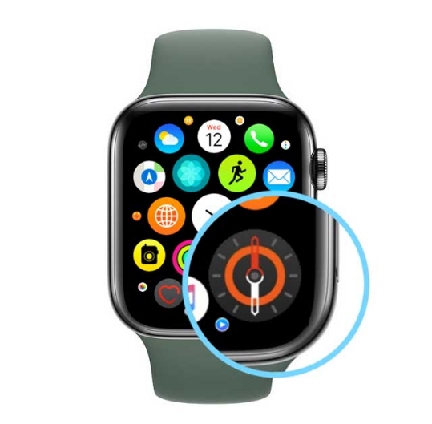
How will a Learner Profile drive:
Zest for lifelong learning?
Deep understanding and skilful action?
Transfer of..?
Belonging to..?
Interconnected with..?
Agency in life?

Slide 14
Phase 1 (2021/22):
Capabilities
Notes:
Guidebooks!

Slide 15
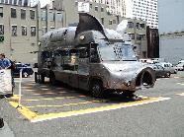
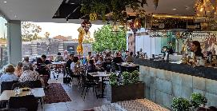
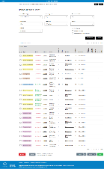
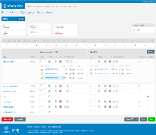
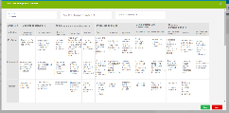
Is it all teachers and all capabilities?
What’s the workflow and key functions?
Who will aggregate & warrant the data?
What data is
shared & how?

Slide 16
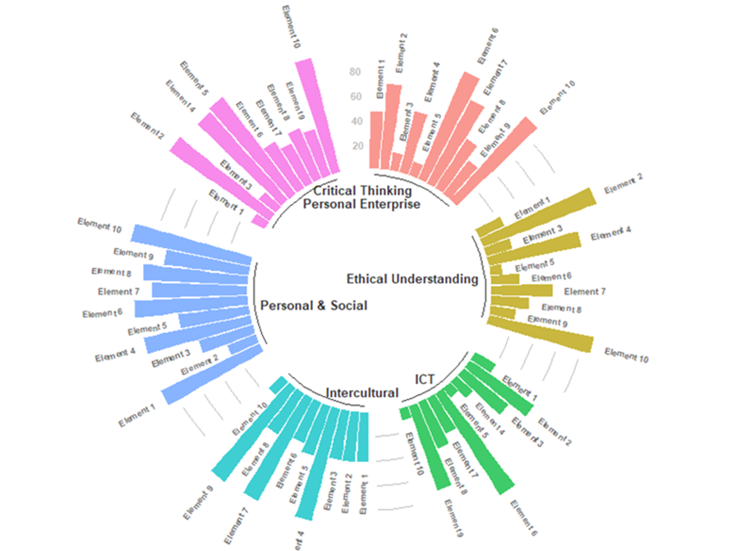
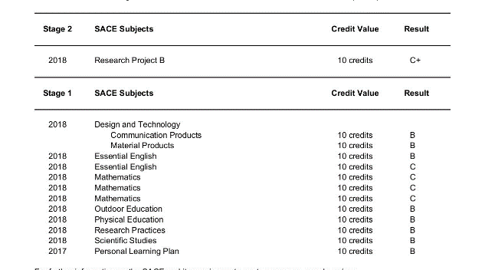
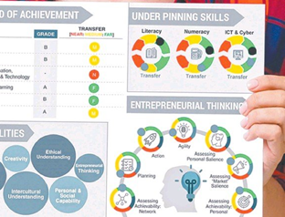

Slide 17
Capabilities Project
The Capabilities Project, responds directly to “…the promise to every student that they will finish their school experience with evidence of their own unique ability to thrive” (SACE 2020).
The learning entitlement of every student is that “…regardless of where they live or what school they attend, every young person should be recognized through a learning system that helps them flourish” (Milligan et al, 2020).

Slide 18
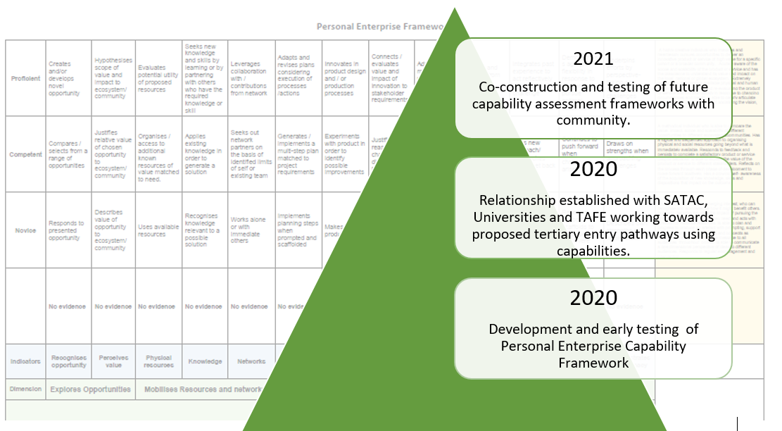

Slide 19
We need you….
Co-construction of future capability assessment frameworks
What are the capabilities students are entitled to develop ?
What observable behaviours are associated with each capability?
How will current assessment enable the development and recognition of capabilities?
What would need to evolve in future curriculum and assessment to enhance development and recognition of capabilities?
Testing and validation of Capability assessment frameworks as assessment tools
What form will evidence take?
How valid and reliable will the judgements across capabilities be?
Who will make the judgements?
How will the judgements aggregate?
Who will warrant the evidence?
Is the tool simple and usable?
Capabilities project 2022 Pilot : Capabili2022 Pilot : Capability entry into Pre-specified tertiary pathways for registered students. KEY ACTIVITIES 2021: Identification of Capabilities students are entitled to develop in order to THRIVE Co-construction of Capability Assessment Frameworks with the Community Testing and validation of Capability assessment frameworks as assessment tools with the community Pilot Capability Tertiary entry pathway 2022 ty entry into Pre-specified tertiary pathways for registered students. Capabilities project 2022 Pilot : Capability entry into Pre-specified tertiary pathways for registered students. KEY ACTIVITIES 2021: Identification of Capabilities students are entitled to develop in order to THRIVE Co-construction of Capability Assessment Frameworks with the Community Testing and validation of Capability assessment frameworks as assessment tools with the community Pilot Capability Tertiary entry pathway 2022 KEY ACTIVITIES 2021: Identification of Capabilities students are entitled to develop in order to THRIVE Co-construction of Capability Assessment Frameworks with the Community Testing and validation of Capability assessment frameworks as assessment tools with the community Pilot Capability Tertiary entry pathway 2022

Slide 20
Aboriginal Education
Project Overview
Enable Aboriginal Students to provide evidence of learning in language
Recognition of significant learning on or about country by Aboriginal students

Slide 21
Aboriginal Education
What we’d like to test & learn
How do we ensure stakeholder support from Aboriginal communities and the education community?
How do we create a system that raises expectation and avoids soft bigotry?
How do we capture learning?
How do we avoid creating a two-tiered system?

Slide 22
Questions

Slide 23
Recognition of Learning
Communications to insert ‘Connected Qualification’ Image/Banner (refer Deb or Rob)

Slide 24
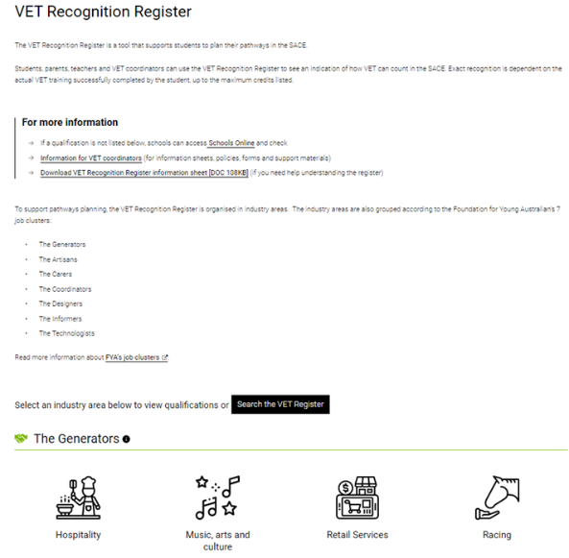

Slide 25
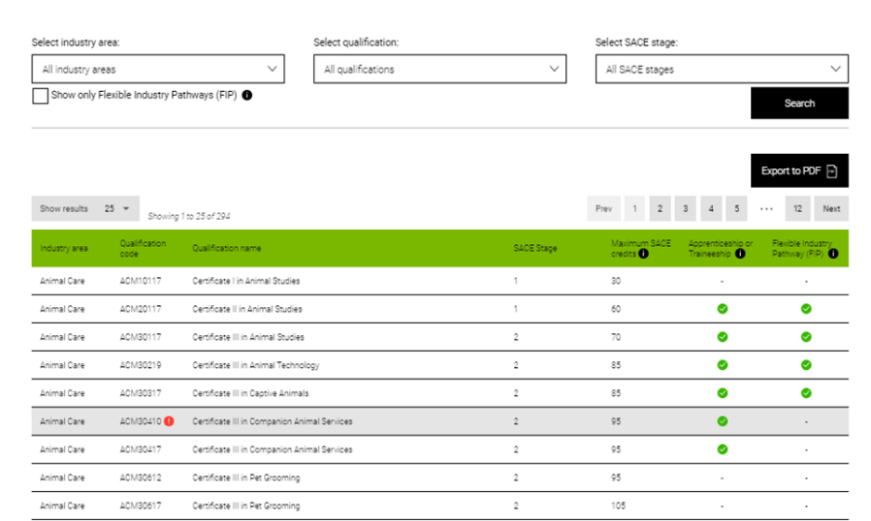

Slide 27
Recognition of Learning
What we hope to explore, trial, learn and progress…
What is the valuable learning students are doing?
What makes the SACE 'the SACE'?
How can our recognition policies be enhanced and expanded?
What does micro-credentialling look like in the SACE?
What systems and processes are needed?

Slide 28
Revitalisation of PLP & RP
Project Overview
Ensure the PLP and RP are anchored in Thrive to deliver on agency, belonging and the learning entitlement of every student
Explicitly link the PLP and RP to deliver on a connected personalised learning journey for each student
Propose changes to the PLP and RP that extend the authenticity, accessibility and manageability for all students
PLP to form the base of each student’s personalised, self-directed learning journey to explore who they want to be and their aspirations for a future they seek or are yet to consider
Enhance the RP to further develop each student’s skills and capabilities in ways that contribute to their well-being by creating something of significance and connects them with others while learning about things that truly interest them

Slide 29
Revitalisation of PLP & RP
What we’d like to test & learn…..
Design and refine a PLP-to-RP narrative as a pathway to Thrive
Name for an enhanced RP that captures the purpose of the subject
Redefine assessment requirements through an exploration and analysis of student evidence
Opportunities and benefits of broadening the RP to incorporate Entrepreneurial and Vocational versions

Slide 30
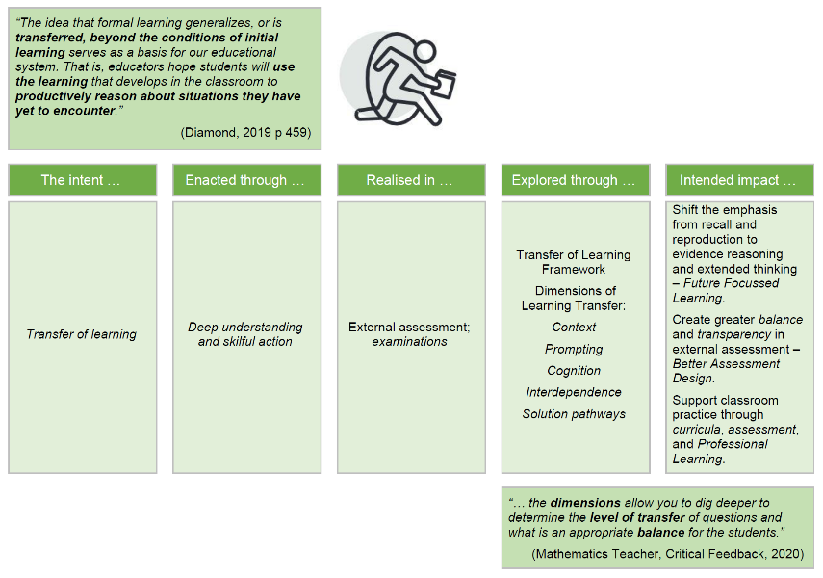
Transfer of Learning

Slide 31
Transfer of Learning
What we hope to explore, trial, learn and progress through the SACE Change Network …
How can assessment support students to transfer learning?
How does transfer of learning manifest in examinations and external assessment?
Do different types of questions elicit different types of transfer?
How can examinations be designed to support all students to evidence transfer of learning?
How can curricula and assessment support teachers to teach for and foster opportunities for transfer of learning?

Slide 32
Questions

Slide 33
SACE management conversations
Notes:
Now for Part 2 will be engage in conversations with peers about SACE Management topics, including:
What story does your school’s data tell you?
Subject Renewal
SACE completion and flexible solutions
Streamlining Online Submission of Materials
Predicted Examination Results
Assessment Schedule

