Slide 1
Psychology Implementation
Science Inquiry Skills
and
Science Understandings

Slide 2
The Three Strands of Science
Replacing Skills and Introduction to Psychology topic
Science inquiry skills
Science as a human endeavour
Science understanding
New
Replacing Key Ideas
Notes:
The topics in Stage 1 Psychology provide the framework for developing integrated programs of learning through which students extend their knowledge, skills, and understanding of the three strands of science.
The Science Inquiry Skills Strand replaces the ‘Skills” and ‘Introduction to Psychology’ topic in the current subject outline.
Science as a Human Endeavour is new to Psychology, but has already been introduced in the suit of other science subjects in the SACE.
Science Understandings replace the Key Ideas section in the current Subject Outline.

Slide 3
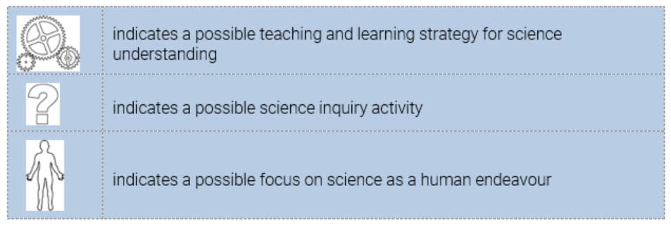
Strands
  Symbols in Subject Outline:
Notes:
The three symbols shown provide an indication of a particular learning opportunity within the content of the Science Understandings. However, there would be many more opportunities for the learning within each of the three strands to be developed throughout the 5 topics that have been fully described, and also the topics that teachers will create for Topic 6 and Topic 7. As teachers become familiar with the content, they will be able to identify further opportunities within their programs.

Slide 4
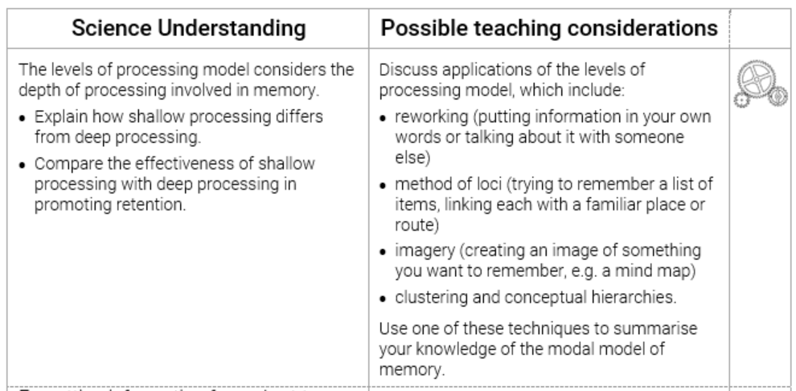
Science Understanding
Notes:
The elaborations of content are shown in two main columns.
Teachers are not required to cover all of the content in the LH column, nor are they required to use all of the possible teaching considerations.
The detail is there to provide accessibility to teachers who may be unfamiliar with the topics.
The icons appearing in the far-right column indicate whether the science understandings lend themselves to instruction, development of SHE or exploration of the Science Inquiry Skills.

Slide 5
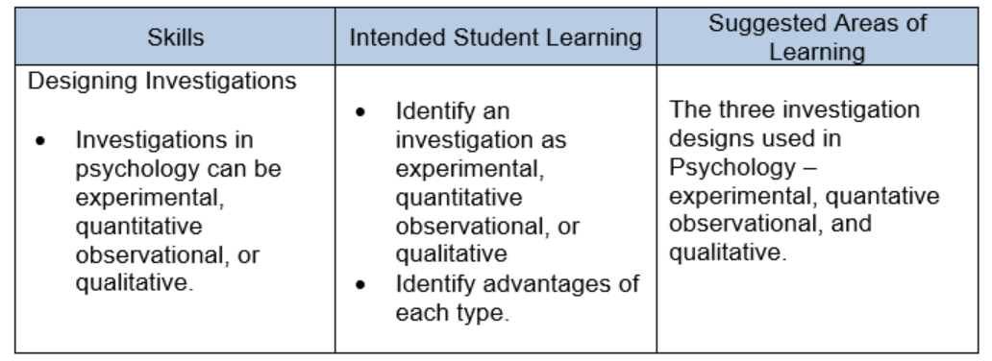
Skills vs Introduction to Psychology
– current subject outline
INTRODUCTION TO PSYCHOLOGY
SKILLS
Notes:
In the 2020 subjects outline, the Introduction to Psychology topic can be presented separately and then referred to in each of the Option topics, or it may be embedded in the other topics.
There is repetition between the information in the Introduction to Psychology topic and the investigation skills.

Slide 6
Science Inquiry Skills – renewed subject outline
Science Inquiry Skills | Possible teaching considerations
Investigations in Psychology can be experimental, observational, or qualitative. Discuss the strengths and weaknesses of using experimental designs in investigating memory Discuss the strengths and weaknesses of using objective and quantitative data when investigating memory. | Identify an investigation as experimental, observational, or qualitative. Discuss advantages and disadvantages of each type of investigation.
Notes:
With the renewed subject outline, there is no stand-alone topic for the Science Inquiry Skills. These skills must now be embedded in the other topics.
In some of the topic outlines, some of these skills are already included.
For example, in the teaching considerations from the Cognitive Psychology topic, students are asked to:
Discuss the strengths and weaknesses of using experimental designs in investigating memory.
Discuss the strengths and weaknesses of using objective and quantitative data when investigating memory.
Science Inquiry Skills begin on page 6 of the renewed Subject Outline, and carry through to page 10.

Slide 7
Science inquiry skills – remapping exercise
Science Inquiry Skills | Science Understanding | Possible Teaching Considerations
The researcher interprets raw data that may be objective or subjective, quantitative or qualitative. Identify some advantages and disadvantages of using these types of data. Results of investigations are presented in a well-organised way to allow them to be readily interpreted. Present results of investigations in appropriate ways, such as: construction of appropriately labelled tables drawing of appropriately labelled graphs. | Forgetting information from short-term memory (STM) can be explained. Use the theory of displacement to explain the forgetting of information for short-term memory. | Students complete the serial position experiment (which can be found at http://faculty.washington.edu/chudler/chmemory.html and: discuss how the results may be used as evidence for the displacement theory of forgetting identify some advantages and disadvantages of using objective data present their results by drawing an appropriately labelled graph.
Notes:
To demonstrate how the Science Inquiry Skills (SIS) could be embedded, one example is shown from the Cognitive Psychology topic.

Slide 8
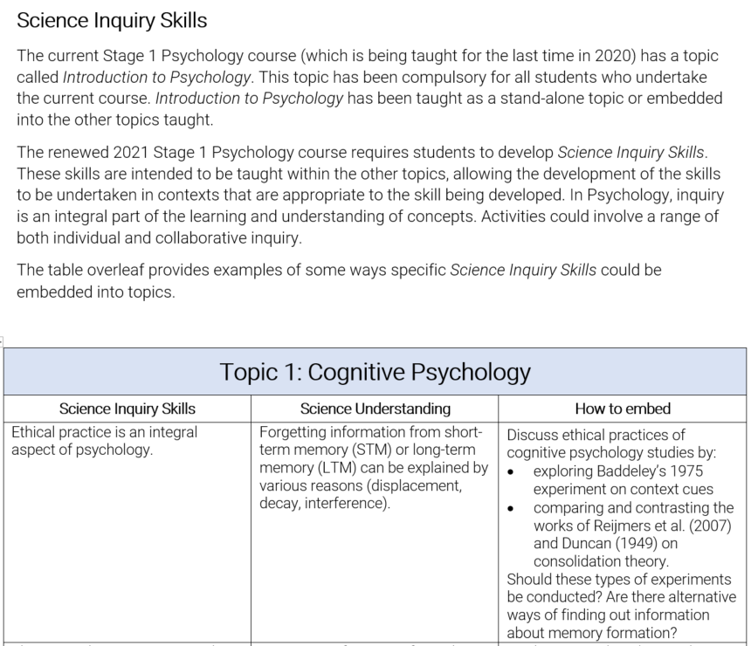
Embedding Science Inquiry Skills into Topics
Notes:
A separate document ‘Embedding science inquiry skills into topics’ shows in greater detail how the SIS could be integrated to other Science Understandings, providing more examples in the Cognitive Psychology topic and also in the Emotion topic.

Slide 9


