Slide 1
SACE Management Conference
2020 Semester 1
A893547
Notes:
Welcome and facilities
Martin Westwell video as per the Standard. Jan/Feb 2020
Acknowledgement to country

Slide 3
Acknowledgement of Country video is available on the SACE website.
A893547
Notes:
Welcome and facilities
Martin Westwell video as per the Standard. Jan/Feb 2020
Acknowledgement to country

Slide 4
Strategic plan…..
coming to an end
Notes:
It has been amazing to look back at the achievements of the last 5 years and how, with your support and partnership, we have been able to achieve the goals from our current Strategic Plan (discuss some briefly). Schools have helped us get here; you are champions of our success and our story, but a long way to go…
It’s exciting to reflect on the past 10 years and especially the achievements of the current Strategic Plan; and reflect on a change that's happened over the last decade for our young people.
We know young people are going to need deep knowledge, they're going need that skillful action but of course that's not enough, but the world is going to be demanding much more than that, that students use their knowledge and skills and collaborate, listen and respond appropriately to other people. That they can use that critical and creative thinking; all of those capabilities that we've been talking about.
We are really looking forward to working with you in this coming year and that work is going to be towards a new SACE certificate that's really reflecting the learner entitlement work we have been doing (Open Workshop)

Slide 5
Notes:
The SACE is not a competition and every student is unique. At all levels of education and in government we're beginning to look beyond the ATAR how we can create a high school certificate that goes beyond our traditional reporting structure of subject grades and replacing it with a learner profile.
You may have seen this example that Martin has been discussing publicly, in the video we were showing when you came in and also published in the Koshland Foundations “Beyond ATAR” report.
This is only an example, an illustration of what might be possible, but there is still so much more work to do to realise this vision – but this is one of the foci of our next Strategic Plan.
So if you look to capture that learner entitlement in the SACE certificate, we're going to have to make some changes, some system changes and we're not afraid to do that, we've shown that working with you we can be successful, things like the Research Project and the electronic exams, but they could only be brought about because of the way that we work with you and our partnerships. And so with these changes come some disruption, but we are looking to you to continue to Champion these changes to ensure the success.
Some other work will be the funding we received from the Minister in relation to the Board’s response to the SACE Review. You may have heard that the Minister has given us $5m to do some work that largely revolves around a review of the Research Project and the PLP – they have been confirmed and will remain as compulsory requirements of the SACE, but will be renewed to allow for different approaches. The work also includes a review into the VET Recognition register and some work on Entrepreneurial thinking in the curriculum.

Slide 6
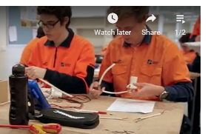
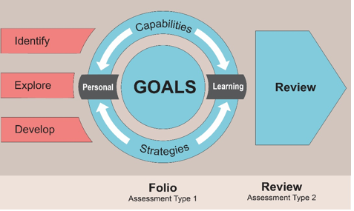
2019 results
43.4% of SACE completers included VET in their studies.
393 Aboriginal students completed the SACE.
296 students completed their SACE with one or more modified subjects.
78.5% of students who started their Personal Learning Plan (PLP) in 2017 completed their SACE over a three-year period.
Notes:
Read total student numbers and country SA student numbers from slide in coloured boxes:
393 Aboriginal students completed the SACE, including 159 from country South Australia – an increase on the 364 Aboriginal students who completed their SACE in 2018. Photo of Mitchell Odegaard (Aboriginal) recipient of the 2019 Governor of South Australia Commendation – Aboriginal Student SACE Excellence Award.
78.5% of students who started their Personal Learning Plan (PLP) in 2017 completed their SACE over a three-year period
43.4% of SACE completers included VET in their studies
A record number of students completed their SACE with one or more modified subjects – 296 this year compared with 239 in 2018.

Slide 7
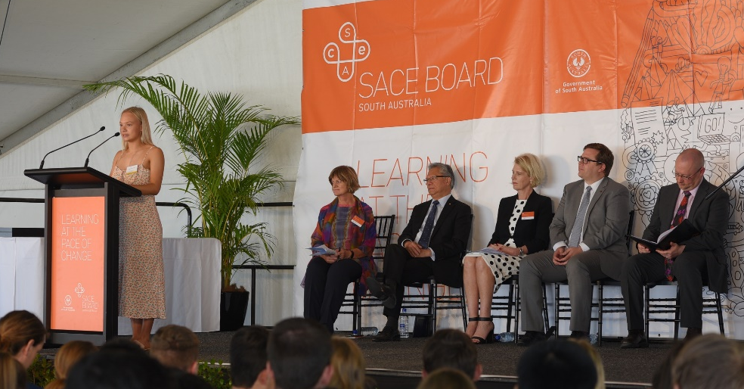
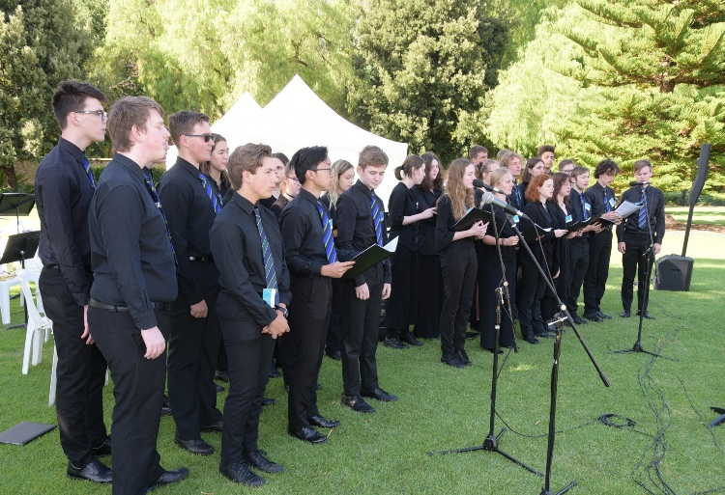
Editor Sunday Mail - Jessica Leo-Kelton.
Notes:
Acknowledge article
Make reference Miaye Rigney – student responder at Merit Ceremony – how she reinforced the idea that SACE is not a competition, discussed the focus of learning is all about building character, you are not your ATAR…and the opportunity, and responsibility our young people have to build the future.

Slide 8
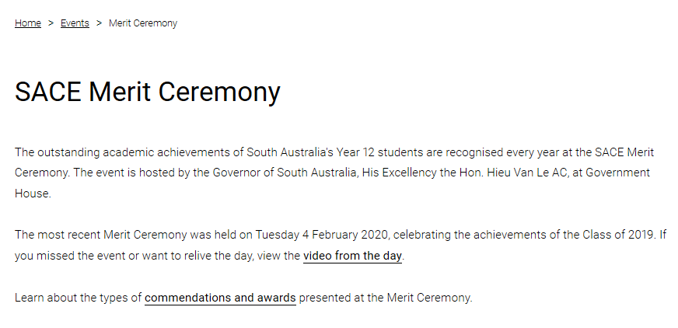
Governor's commendations
Writing applications:
make time for quality application
examples on the website.
Notes:
We are surprised by the number (low) of applications we receive each year, and is some cases, by the quality of the applications. It is so critical we have teachers who advocate and take the time in writing the application, but we want to ensure you do the students justice. The student is required to sign the document and may have input in the application. There is a panel who selects the awards and their decisions are largely based on the evidence you provide in the applications.
There are three categories
Governor of South Australia Commendation – Excellence Award
(This commendation is presented to South Australian students who have demonstrated meritorious achievement in Board-accredited subjects, and who have demonstrated excellence in Board-accredited subjects and the development of one or more SACE capabilities.)
2. Governor of South Australia Commendation – Aboriginal Student SACE Excellence Award
(This commendation is awarded to an Aboriginal student with the best overall performance in the SACE and who has undertaken the majority of their studies in a South Australian school).
3. Governor of South Australia Commendation – Excellence in Modified SACE Award.
(This commendation is awarded to a student with identified intellectual disabilities who has demonstrated outstanding achievement whilst undertaking SACE modified subjects.)

Slide 10
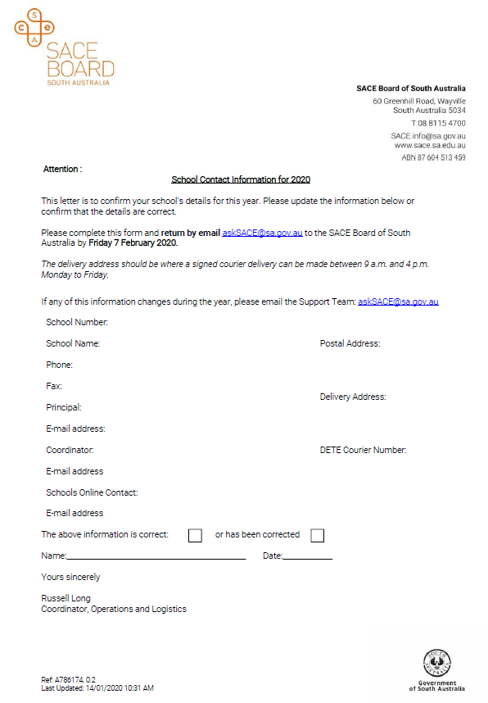
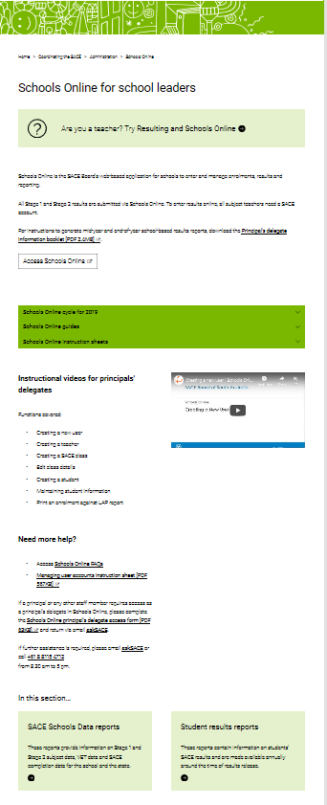
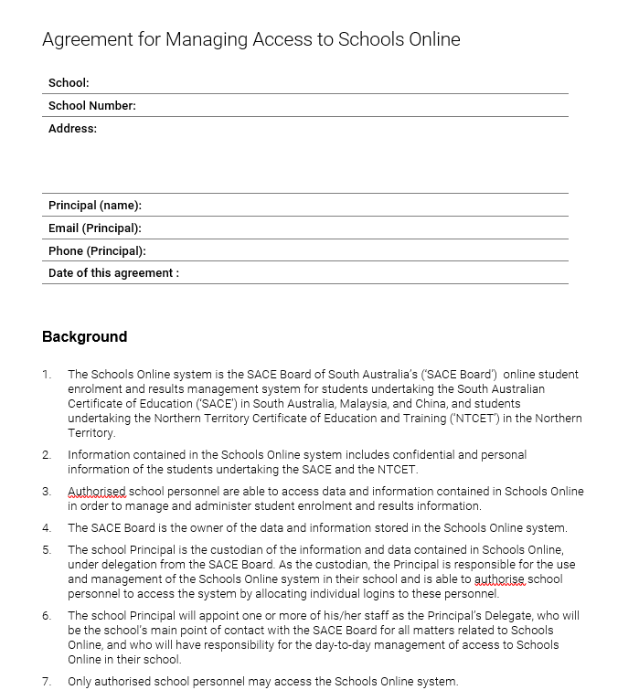
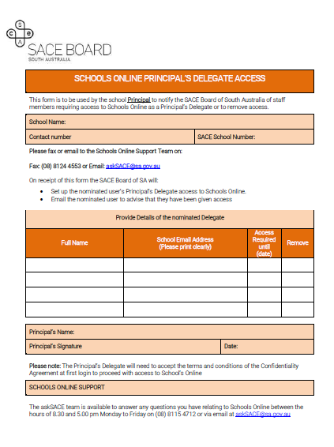
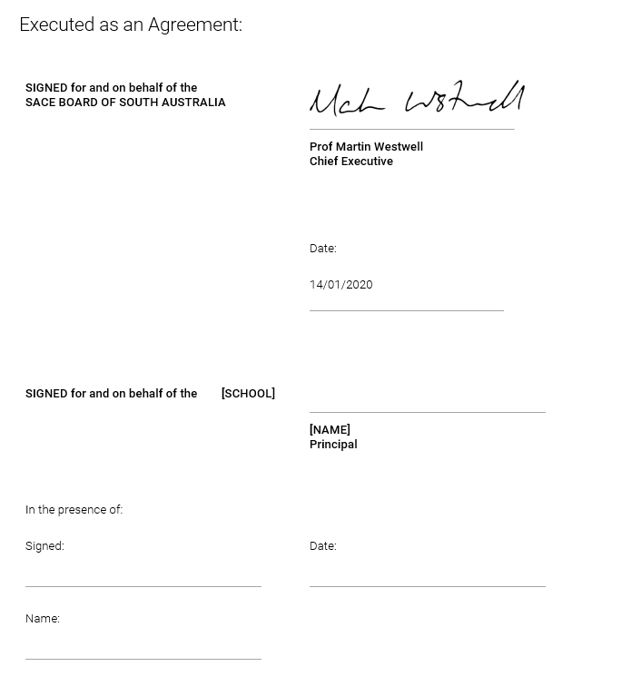
Start of year communication
School contact information
Delegates access
Agreement- schools online
Notes:
Communication is vital between schools and the SACE board. We rely on your expedience to update school contact details. Please be aware that by filling in the contact details form, it does not give you Principals delegate access, you will still need to return the form to get access. Note that it is also required that the agreement to manage Access to Schools online needs to be signed by your principal.
Please remove any delegate who has left your school.
Any questions to askSACE.

Slide 11
Communication
Who receives ‘the Standard’?
Principal
Principal’s delegate
SACE coordinator
Please disseminate to staff.
Emails through swift:
direct to teachers and leaders as required
subject specific.
Notes:
The Standard is sent to principals, delegates and SACE coordinators. These people need to disseminate information to staff. Swift emails to subject teachers are in green and cc to SACE coordinators. As indicated in the January standard, record of achievements (ROA) are not being sent out as hard copy to Stage 1 students. We ask that schools instruct the Stage 1 students to check their results and account details at the start of the year and mid year. Also for Stage 2 students to ensure address details, spelling of name are correct at the end of the year.

Slide 12
Accessing reports
2019
Moderation issues
2019
Exceptional circumstances
2019
Results enquiry
Notes:
SACE school data is requested by most Principals early in the school year to generate reports. Final update of reports are completed once clerical check period has passed.
When results were released on the 17 December you would have had access to the results reports- student results, feedback from moderation. (Please provide the reports about moderation to the respective teachers).
On your way in you collected information about moderation issues, exceptional circumstances and results enquiry. This has been provided for your reference and action to support staff and student for 2020.

Slide 13
Notes:
We’ve now had two years of implementing the revised special provisions policy.
An email was sent to schools on Monday 10 February 2020 reminding schools about the policy, and that schools can make reasonable adjustments to support students who have a disability, or have been affected by misadventure of personal circumstances beyond their control to participate in the SACE.
This is something that all schools, SACE Leaders and hopefully teachers are aware of, but with the heightened focus on the coronavirus it was timely to send this reminder. We had some contact from some schools with students either in Australian in self-quarantine, others have students who have been unable to leave China. In both instances, and of course in other instances, schools can make reasonable adjustments.
Many of you have become familiar with the types of reasonable adjustments that can be managed within the school context, but we’d like to highlight that special provisions can't be a substitute for learning that has not occurred, and that a whole assessment type cannot be removed. If for example there is only one task in an assessment type, this cannot be removed. If there are for example 4 tasks possibly one or two may be removed.
.

Slide 14
Learnings from 2019
External Assessment
Investigations
Examinations and Performances
Forms
31 – application for external assessment adjustments
32 – application for use of derived results
Predicted mark information V received mark per class cohort
Notes:
Learnings from 2019
Firstly focus on external assessment:
If the external assessment is an investigation, this whole task cannot be removed – we did see a bit of this in 2019, and we even saw Form 31 being uploaded in schools online, which meant markers viewed it and in these instances the SACE Board had no prior knowledge of the student’s situation. Important message to communicate to teachers that student’s can’t be exempt from doing the external investigation on the basis of special provisions.
Inappropriate adjustment for an investigation are:
‘reduction in word count’ – word counts for the investigations are ‘maximums’ so reducing word count is not applicable
Reducing the assessment – the criteria and specific features specified in the subject outline for the investigation must all be covered
The appropriate adjustment for an investigation is really an extension to the due date, but as this impacts SACE Board processes, schools need to submit the application at least one week prior to the due date, not on the due date otherwise the result sheet cannot be submitted (nothing for that student).
When it comes to exams and performances, we’ll have some more reminders later in the year, but the big message is we need as many details as possible , particularly school and invigilator comments in completing Form 32. Completion of Form 32 applies to both paper and electronic exams.
Forms for 2020 are near being finalized. – will be some changes.
Noticed some misunderstandings about how to use the form, and which sections were relevant.

Slide 15
Support
Website: www.sace.sa.edu.au/web/special-provisions
Information Sheet 58, FAQs
PLATO:
Phone: 8115 4700
Email: SACE.SpecialProvisions@sa.gov.au
Notes:
So, we’d like to ask you, what feedback do you have?
It has been 2 years since current policy commenced, timely to do a reflection
Spend a little bit of time at tables –
What works? What doesn’t work? What support or information do you need?
Table discussion, one point from each table;
Thank you – during this year we’ll be going deeper into this reflection of the current policy, and may form some focus groups – if interested please email SACE.SpecialProvisions@sa.gov.au
Support for SP available through the avenues on the screens above.

Slide 16
Exceptional circumstances
Schools seeking extension requests or a change to results due to administrative errors can apply for consideration of exceptional circumstances for individual students or an assessment group.
Please phone the SACE Board and provide the following details:
Circumstance
Registration Number(s)
Stage 2 subject
Teacher Name
School Assessment or External Assessment
The askSACE team will email out the specific form to the principal (cc SACE Coordinator).
The completed form must be returned to the SACE Board via the principal’s email, or via the SACE Coordinator (cc the principal), ensuring that the principal has authorised the request, and the ‘Principal’s Verification’ box on the form has been ticked. Once received, the application will be considered as a matter of urgency.
Notes:
The SACE Board schedules submission times and dates for student results and materials for both external
assessments and moderation of the school assessment component.
Schools seeking extension requests or a change to results due to administrative errors can apply for consideration of exceptional circumstances for individual students or an assessment group.
Please phone the SACE Board and provide the following details:
Circumstance
Registration Number(s)
Stage 2 subject
Teacher Name
School Assessment or External Assessment
The askSACE team will email out the specific form to the principal (cc SACE Coordinator).
The completed form must be returned to the SACE Board via the principal’s email, or via the SACE Coordinator (cc the principal), ensuring that the principal has authorised the request, and the ‘Principal’s Verification’ box on the form has been ticked. Once received, the application will be considered as a matter of urgency.
Remember any change of results for Stage 1 is requested/ completed through the clerical check form.

Slide 17
Results enquiry - number of calls
Notes:
Enquiries about VET and recognition are the highest type of call we receive. VET queries are mostly around the non verification of the completed VET certificate and its use in ATAR calculations. We needed to contact schools to provide the SACE board with verification of completed certificate. Contact details during the DEC-Jan Holidays is critical to ensure students can have this verified and if applicable be offered university courses.
Recognition was generally around the IB and University studies. In some instances the application of university studies had not been applied for so held up their results and university offers.
The number of certificate reprints and address changes showed care needed in correct spelling of student names and addresses updated and checked prior to results release. Encourage students to check their details in students online in the account section.
Enquiries about SATAC matters e.g. adjustment factors & scaling were directed to the SATAC website or given SATAC number.

Slide 18
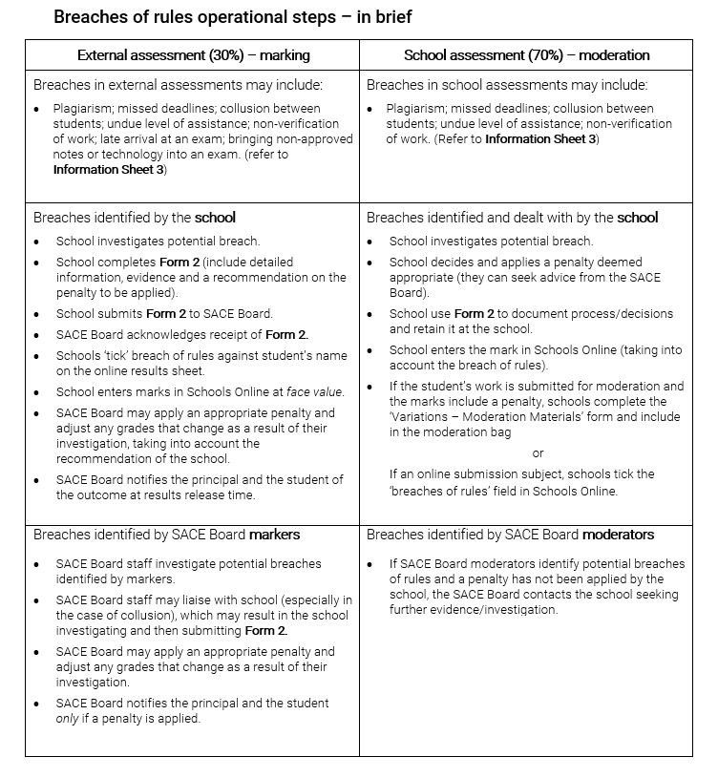
Breaches of rules
Booklet information
Plagiarism
Supervision and verification
Notes:
Your booklet contains BOR operational steps- in brief as a handy reference. Again you are doing a great job in detecting breaches and acting on this in your school. We had fewer breaches that came through both school and external assessment last year.
Continue your work with students so that they understand plagiarism and ask teachers to use the supervision and verification forms to support work that is not directly supervised.

Slide 19
Moderation
Notes:
We would like to acknowledge and thank you all the 2019 subject communities working in the online space, particularly who worked in this space for the first time- it was a significant step in moving forward into the digital space of submitting student work for assessment. Also we would like to acknowledge the paper based subjects for their work in packaging up in the famous white bags.
Also we would like to thank schools in following up with our communication throughout moderation when we did need to contact you through moderation – it is important if a staff is offsite during the period of moderation that someone in the school is able to access the student materials.
The challenges of moderation which were noted throughout the moderation process :
Insufficient materials – this refers to when it was evident that not all assessment tasks for individual students were submitted for the assessment type. So it is important that teachers understand that all assessment tasks in an assessment type need to be submitted – also check that if submitting a video or audio recording that it is work and able to be opened and viewed. This was identified across many subjects as a concern – or that not all parts of an assessment task were submitted for an assessment type.
If for a reason a teacher needs to submit a student sample which does not include all the assessment tasks it is important that the VMM is completed- other wise this is raised as an issue with the need to follow up with schools to clarify .
Incorrect material – this is where work was submitted for example in the wrong assessment type , wrong SACE registration numbers on student work , student work mixed up in the submission
Individual teachers and schools who deleted an entire assessment type from the student learning – in the SACE policy it clearly states that students need to complete assessment task or tasks from each assessment type.
Using outdated assessment tasks ( from previous subject outlines which have been renewed ) which limited student ability to achieve against the performance standards and complete the requirements of the course as outlined in the current year subject outline. .

Slide 20
Stage 2 School Assessment Results Sheet
Notes:
In the School Assessment results sheets, teachers need to enter the grades for all students , click on the sample identified which will result in the performance standard record and variations to moderation ( if necessary )becoming evident to the teacher – both of these forms will need to be completed in the online space and upload student work all in this space.
It was noted that some teachers needed support in completing the VMM which traditional would have been completed in collaboration with yourselves. The VMM must be completed if there is a variation as previously.
The performance standards record will be a new feature to those teachers new to the online submission space which will need to be completed for each assessment type in the school assessment of a subject.
Teachers can upload individual files or move across all the files at once – it would be great to encourage all teachers to be familiar with all the support resources for online submission of materials which we will discuss later with you.
Another strategy with in your school could be at a school or learning area level for staff who have been involved in online submissions to share their experiences with those new to the process.

Slide 21
Performance Standard Record
Notes:
Teachers need to be familiar with the assessment design criteria for each assessment type.
The PSR needs to be completed by the teacher for each student in the sample by selecting the specific features assessed in the task.
The selection of specific features is really important because if there is an adjustment to the grade as a result of moderation, as the PSR provides the basis for feedback to the teacher and school - you would have seen that the moderation reports in Schools Online for the online subjects look quite different to the feedback for the paper subjects – a PSR is available and shows purple as the teacher’s original assessment decision, and yellow as the final moderation outcome.
If not all specific features are not shaded as per the task, then the feedback is not meaningful.
Also last year we noticed that some teachers selected different specific features for different students who did the same task – so inconsistencies in what was assessed and in the feedback for different grade levels.
This does take time for teachers to complete the PSR. Please make them aware of this in school assessment for each assessment type. (Some may have only uploaded an investigation for the external assessment, submitting one file and a grade…. A much quicker process)
The grade and shaded performance standards are the point of truth.

Slide 22
Moderation Summary
Notes:
Assisting your teachers to access and understand the feedback from moderation.
Once you have selected the blue subject link you will see the details of the moderation outcome for that subject.
In this example, AT1 & AT2 are green so are confirmed, AT3 has had some changes so is blue.
If you click on the PS icon next to it, can see the reasons for the adjustment.
Purple = teacher’s original shading on the Performance Standards Record (PSR)
Yellow = final moderation outcome.
Therefore in this example we can see that the teacher originally said B- and shaded mostly B with I2 and U2 in C band. Moderation outcome is B band for all specific features, therefore reflecting the moderation outcome of B.
This is valuable information for teachers to refer on when analyzing their subject assessment result report.
Also later in the year, teachers will be able to access the sandpit which shows the whole process of online submission and have the opportunity to practice before the assessment result sheets open in schools online which will open late March ! Perhaps an excellent professional development activity for all Stage 2 teachers and will support you as SACE Coordinators if all your teachers new to online access this space and understand what needs to be completed – or show the sandpit at a staff meeting so that all the teachers on staff are aware of the online environment.

Slide 23
Online submissions
Notes:
In 2020 , all subjects will be online except for COMMUNITY STUDIES. On each subject mini site there is an announcement titled – Online submission of Stage 2 subjects in 2020.
Please can we ask that you ensure all Stage 2 teachers in your schools are aware all subjects except for Community Studies are online – so there is no surprises – in 2019 – interacted with some teachers who thought they were only online for external assessment – this conversation in regard to school assessment was in late Term 3.
Round table discussion on strategies how to support online submissions of student materials by teachers.
Table group activity : On your table please can we ask that someone would be willing to act as the recorder of your discussion on strategies to support teachers in the online submissions.
There is a hand out for feedback.
15 minute discussion – with a quick feedback of a strategy from each table.

Slide 24
Online submission of materials
Notes:
On the SACE website – there is a range of materials to support teachers in regard to online submission of materials-
The following resources can be found under Teaching the SACE →→Resulting and Schools online →→ Online submissions of materials
This is front page of the online submission of material on the SACE website :
School assessment materials – Information sheet 50 – advice about procedures for completing and submitting school assessment results sheets and online submission of school assessment materials
Access Schools Online button – direct link to Schools Online
Accepted file names and formats – this provides information on how to name your student’s files correctly and which types of files our system will accept – click this link for the relevant screen
Tutorial videos – the videos show best practice for preparing files, how to upload to Schools Online and how to use new features of results sheets
FAQs – This section provides answers to commonly asked questions.
In 2020 there will be targeted communication with the teachers of the subjects new to online submission which has been previous practice.
Again we would like to thank you for all your support in working with all teachers in the online space except for Community Studies teachers who’s student work will be submitted via the white bags.

Slide 25
Notes:
Use our table of codes for subjects and assessment types.
Example of file names for each subject and per assessment type given here.

Slide 26
External assessment – Investigations
check key dates when Result sheets are available
Online submission of student work
When completing external assessment results sheet for investigations – if no evidence is submitted – withdrawn (W) not an E-
(withdrawn on the investigation online result sheet does not withdraw the student from the subject)
Students need to be aware of the implications of being withdrawn from the external assessment
Notes:
When uploading student work, it is important that teachers have not ticked, written comments, grades or attached the performance standard record on or with the work.
Implications of Withdrawing from External result sheet:
- student can still achieve the SACE based on School Assessment result
- however, will have implications for ATAR, as a non-completed external assessment task will result in a zero score effecting ATAR calculations. This also applies when a student with no reason does not sit the exam.

Slide 28
Renewed subjects
Renewed subjects taught for the first time in 2020 include:
Stage 2 Business Innovation
Stage 2 Physical Education
Stage 1 Economics
Stage 1 Dance
Stage 1 Drama
Stage 1 and Stage 2 Design, Technology and Engineering
4 new codes
Preclusions for SACE completion and ATAR
Stage 1 and Stage 2 Australian Languages ­– Additional Language, First Language, and Language Revival
Stage 1 and Stage 2 Outdoor Education.
Check LAPs carefully and correct codes used
Notes:
Check that teachers are using the current subject outline especially for the new renewed subjects listed here
Special note with Design ,Technology and Engineering as they have 4 new codes. Any issue please contact Curriculum and Assessment officer; Joy Cresp.

Slide 29
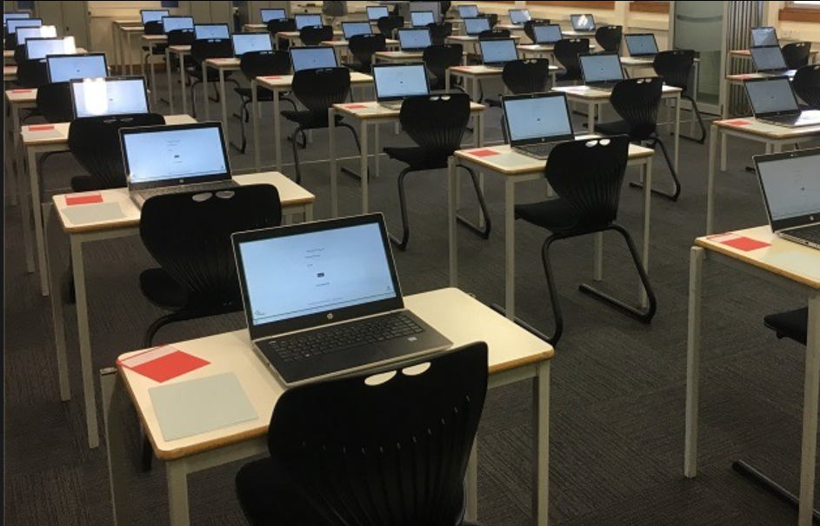
e-exams
Notes:
E-exams are the direction of travel for exams at the SACE Board.
As per last year, we’ll send you direct communications via email.
Support will be provided by the askSACE team throughout the year.
Here’s what you need to know now.
Review of 2019 e-exams
2020 subjects
Readiness Toolkit
Practice window
Familiarisation
Provision of paper materials

Slide 30
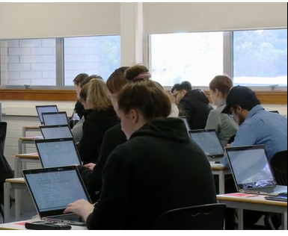
Review of 2019 e-exams
3 subjects
189 schools
5000 students
Continued strong partnership between SACE Board and schools in delivering exams.
Notes:
Last year saw the second successful year of e-exams.
Modern History, English Literary Studies & Psychology all delivered online in SA, NT and Malaysia.
We are continuing the partnership between the SACE Board and schools in delivering exams to students, allowing them to best demonstrate their learning.
Schools have shown us that they are prepared, capable and engaged in the delivery of e-exams. They manage situations on exam day well and, as with traditional paper exams, assist their students when things don’t go to plan.

Slide 31
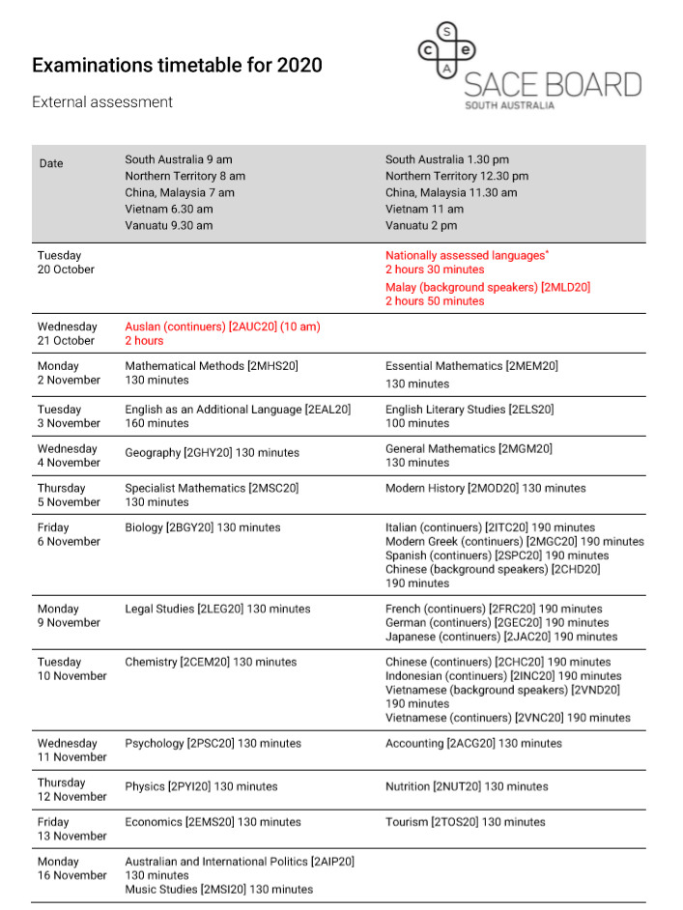
2020 Subjects
Following the successful delivery of three e-exams in 2019, six new subjects will be added in 2020.
Here's the full list:
- Biology
- English Literary Studies
- Geography
- Indonesian (continuers)
- Legal Studies
- Modern History
- Nutrition
- Psychology
- Tourism
Legal Studies exam reduced to 130 minutes in 2020
Notes:
Last year we conducted change impact assessments with teachers, SACE Coordinators and IT staff to help us determine which subjects would move to online exams in 2020.
On the screen in orange are the subjects that will have their first e-exam this year.
In response to feedback from schools, we have factored in e-exam timings into the creation of this year’s exam timetable. There will be one e-exam per day, a combination of morning and afternoon exams. This support schools in preparing facilities and equipment.
The 2020 exam timetable is now available on the SACE website.
We will be working behind the scenes with stakeholders and the community on what’s to come in 2021 and beyond.
Also we will conduct change impact assessments again in 2020 when planning for 2021 subjects.

Slide 32
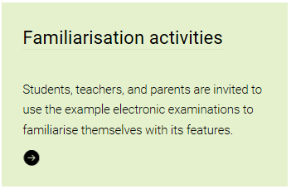
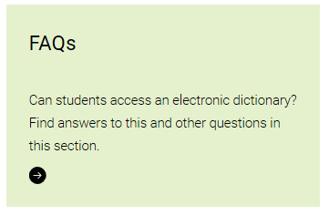
Preparing students for e-exams
A non-subject specific sample exam
Key features document and videos
Subject specific samples of e-exams will be available via subject mini-sites
Notes:
We provide a range of support materials to assist students in preparing for exams, including those offered electronically.
The software itself does not require specific training, but use of these resources helps students feel comfortable with the online delivery of their exams.
We suggest starting off with the non-subject specific sample exam and support materials, including a key features document and instructional videos before moving onto sample exams with subject specific content.
We are currently developing samples for the 6 new subjects joining the e-exams program in 2020. These will likely be based on the 2019 paper-based exams with additional features added to support the move to the online environment. SACE Coordinators and subject teachers will receive direct communications once these resources become available.

Slide 33
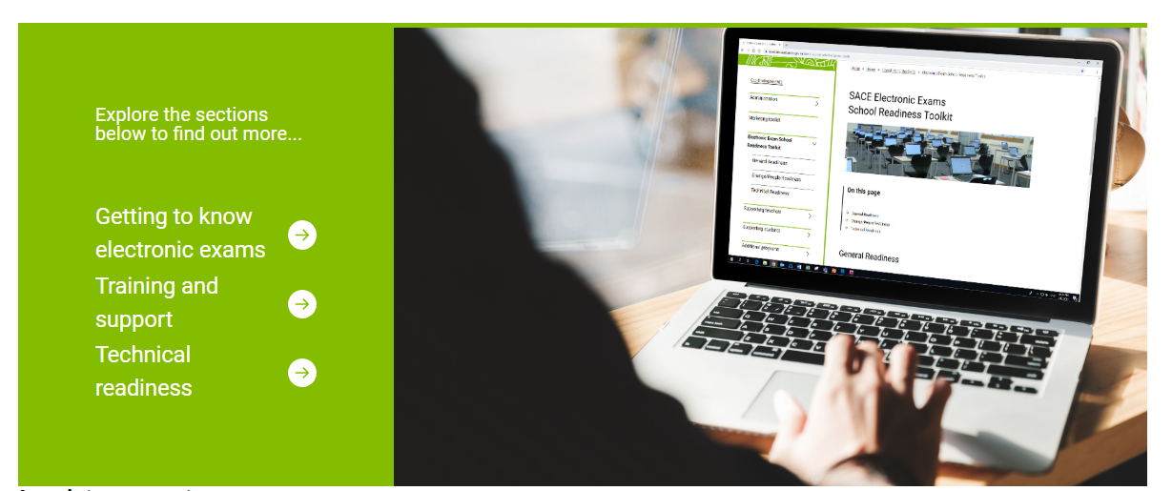
Readiness Toolkit
This toolkit which is currently being developed, will be available in Term 2.
Support in 2020 will reflect the level of experience and expertise of schools
Notes:
In 2020, we’ll be working with schools to support their preparations for electronic exams.
Support in 2020 will reflect the level of experience and expertise of schools
Introducing a readiness toolkit.
Will include access to
technical readiness activities
Training
Support materials
This will allow schools to access readiness activities in alignment with their other technical and training activities.
We’ll be testing this new way of presenting readiness activities will schools later this term before we roll it out in Term 2. In the meantime, these resources are still available via the electronic examinations section of the SACE website.
Teachers and students will access the resources they need via the subject minisites.

Slide 34
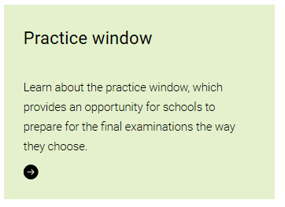
Practice window
Offered during Term 3
Designed to:
- test school readiness
- fit within a single lesson
Non subject specific
Notes:
The last two years schools have told us how much they’ve valued the opportunity to test their school readiness.
In 2020, schools will have access to a new-look ‘practice window’
Available for use during the majority of Term 3 (increasing the time to undertake testing of school readiness)
Is designed to test school readiness
Technical – load and performance, SACE Exam Browser installation
Operational – training,
Has been designed to fit within a single lesson (40-50 minutes)
In response to how schools told us they used the practice window in 2019
Will be non subject specific
In keeping with the purpose of the practice window
We will continue to provide opportunities to prepare students in their subject context

Slide 35
Provision of paper resources
Direction of travel is to deliver e-exams entirely online.
Policies and procedures cover all SACE Board exams, including those delivered electronically.
Notes:
As indicated last year, the direction of travel for electronic exams is to move away from the provision of paper materials.
As we move towards new ways of assessing student learning, including the provision of audio and video sources, providing a paper alternative will prove challenging.
We’re working through the impacts on all stakeholders and will communicate what materials, if any, will be provided to support e-exams in 2020.
While the mode of delivery may be different to a traditional paper exams, the policies and procedures in place to support students, including those for special provisions and misadventure, are the same for e-exams.

Slide 37
Draft Subject Renewal Schedule 2019 – 2022
2019–2020 | 2020–2021 | 2021–2022
Australian and International Politics | Child Studies | Media Studies
Continuers languages | Creative Arts | Society and Culture
Psychology | Research Project | Language and Culture
Nutrition | Visual Arts | Philosophy
Legal Studies | Women’s Studies | Vietnamese (Background Speakers)
 | Religion Studies | Chinese (Background Speakers)
 | Personal Learning Plan | Food and Hospitality
 | Community Studies | Cross-disciplinary Studies
 | Modified Subjects | Tourism
 | Workplace Practices
 | Information Processing and Publishing
Notes:
This is a draft and renewal of subjects may take more or less time depending on the complexity of the changes and factors like the size of the subject, type of assessment and prescribed content.
It is anticipated that Australian and International Politics (with a new name), Legal studies and Psychology will be accredited in May or June this year and implementation workshops will be conducted in terms 3 and/or 4 of this year.
The languages subjects are still under development and the timeline at this stage is uncertain but the very earliest would be Year 11 in 2022. If people have questions they can be directed to Meridie or Danielle.
The Research Project and PLP are being renewed in response to the SACE review. It is intended that they will be taught in 2022 and there will be lots of communication with schools and leaders throughout the renewal process over the next 12 to 18 months with implementation in late 2021.
Other proposed/possible changes include
Women’s studies being rewritten with a Gender Studies focus
Community Studies being rewritten to incorporate an A+ to E- grading rather than the A-E as in the current course
Workplace Practices with various courses that are Industry specific
Note: these changes are all proposed and consultation with stakeholders – especially teachers is vital to the success.

Slide 38
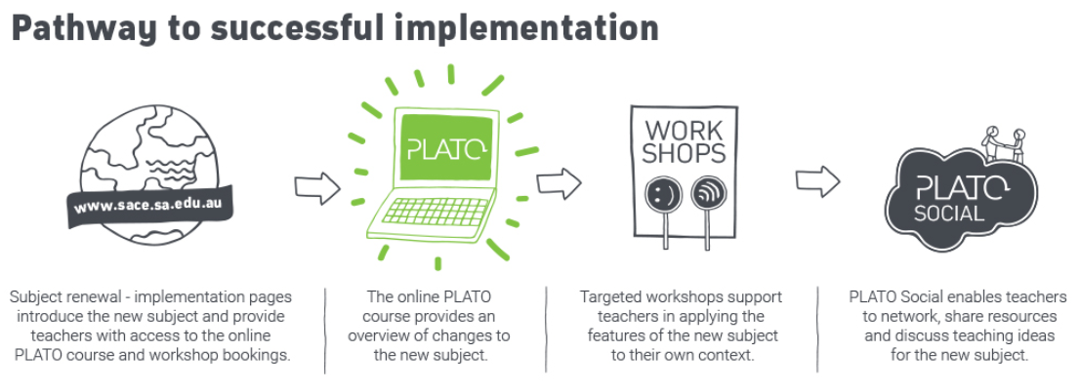
Implementation activities for the following subjects will be advertised on the website as they become available.
Renewed subjects to be taught for the first time in 2021 include:
Stage 2 Dance
Stage 2 Drama
Stage 2 Economics
Stage 1 and Stage 2 Nutrition
Stage 1 and Stage 2 Health and Wellbeing
The SACE Board is renewing Legal Studies, Australian and International Politics, Psychology, and Workplace Practices so they may also be taught in 2021.
Notes:
Subject renewal- consultation with all stakeholders then accredited by. the SACE Board.
PLATO course – released as the first stage of implementation.
Workshops – a range of workshops will be offered.
PLATO social- opportunity for teachers in a closed forum to discuss and share resources
Implementation activities for the following subjects will be advertised on the website as they become available.

Slide 39
Quality Assurance Panels markers and moderators
Notes:
The SACE uses assessment panels to carry out moderation and marking activities needed to quality assure student results, e.g. Markers in exams and investigations, moderators in all subjects (paper, online central and online dispersed)
There will be a movement to more online dispersed moderation over the next few years – think about how this could change the impact on your school.
We are collecting feedback to consider improvements to how we recruit markers and moderators, and how we form and appoint markers and moderators to panels.
We are using seeking your input and ideas to develop our areas for improvement.
There are 3 types of panellist we want to consider.
Potential panellist – those teachers who could be on a panel, but have not expressed interest for some reason, or don’t know how to.
Prospective Panellist – those teachers who have submitted an expression of interest and therefore are in the pool for selection for a panel
Assessment Panellist – those who have been appointed to a panel

Slide 40
Activity
1. Take off your ‘moderator/marker’ hat and keep your school leadership hat on
2. Discuss and identify Positives and Negatives of staff involvement in marker/moderator recruitment and appointment
Notes:
Now ask SACE Coordinators to indicate whether they are a marker or moderator? Acknowledge them and ask for everyone in the room to put on their school leaders hat……not their marker or moderator hat.
When they are wearing their school leader hat now provide feedback sheet (strengths and weaknesses) re marker and moderator recruitment and panel formation. Use an R to identify recruitment points and a F to identify panel formation points,
Facilitation tips:
Provide each table with the feedback sheet – 1 or 2 on each table depending on how they are seated
Ask participants to discuss and capture all suggestions, ideas, and feedback - refer to the guiding questions provided on the next screen
As a facilitator avoid answering questions (simply say ‘great question…note it on the page) or justifying why something is how it is (this is especially true when receiving negative feedback about a process you may be responsible for.
Have tables share ideas and comments if there is time.

Slide 41
Assessment panels – impacts and benefits
Strengths
What are the benefits for staff on assessment panels?
What are the positive impacts on the school?
How does the SACE Board support recruitment and appointment?
What is done well in these processes?
Weaknesses
What are the barriers to staff involvement in assessment panels?
What are the impacts on the school?
What further support is needed from the SACE Board?
What makes it difficult for your school?
What needs to be done better?
Notes:
Leave this screen up to provide guiding questions for Strengths and Weaknesses
Have tables share if there is time

Slide 42
Stage 2 Exam Preparation
Notes:
Professional development for subject teachers that have exams… a new PLATO course
To assist teachers who would like to be involved with panels around subjects that have an exam, we have created a PLATO course to Provide PD
It will also be expected that lead practitioners appointed to setting and vetting of papers complete this as part of their training.

Slide 43
Stage 1 Moderation and Stage 1 and 2 Modified Subjects Review
Schools are advised early in the year of:
Stage 1 compulsory subjects to be moderated in 2020.
Stage 1 compulsory modified subjects to be reviewed in 2020.
Reminders:
Teachers need to be informed of requirements and processes.
Ensure enrolments are in Schools Online by the due date (Wednesday 1st April – results due June).
If enrolments are added after the due date please contact the AskSACE team.
Notes:
Teachers of these subjects need to be informed of requirements and processes
Ensure enrolments are in Schools Online by the due date
If enrolments are added after the due date please contact the AskSACE team as this may impact on moderation and/or review requirements communication

Slide 44
Stage 1 Clarifying 2020
Notes:
New Clarifying courses are being developed for all Stage 1 compulsory subjects and schools leaders – Principals/SACE Coordinators/Curriculum leaders - are encouraged to support teachers in accessing these professional development activities prior to moderation.
Also as part of your in-school clarifying procedures to ensure teachers are on standard.
The courses will be available from week 5 and notification through website announcements
NOTE: There is also a new Clarifying course for Modified Subjects.

Slide 45
Stage 1 Moderation Changes for 2020
Submission of materials
The SACE Board is planning for electronic submission of moderation materials. To be confirmed.
Moderator training
Training and benchmarking activities for participating moderators will be via PLATO enabling moderation to begin earlier. This will also reduce time out of school for moderators.
Timeline
Wherever possible teachers should complete their assessment program in time to participate in the Semester 1 moderation round.
Notes:
Submission of materials
The SACE Board is planning for electronic submission of moderation materials . To be confirmed and you will be notified. WE have used kiteworks and one drive, effectively for remote/isolated and SACEi schools in 2019.
Moderator training
Training for participating moderators will be via PLATO enabling moderation to begin earlier.
This will also reduce time out of school for moderators.
Timeline
Schools that are required to participate in moderation of any subjects should complete their assessment program in time to participate in the Semester 1 moderation round wherever possible. ( encourage completion of moderation in semester 1, should standards not be confirmed, allowing for submission of work semester 2 and schools being able to result students that year)

Slide 46
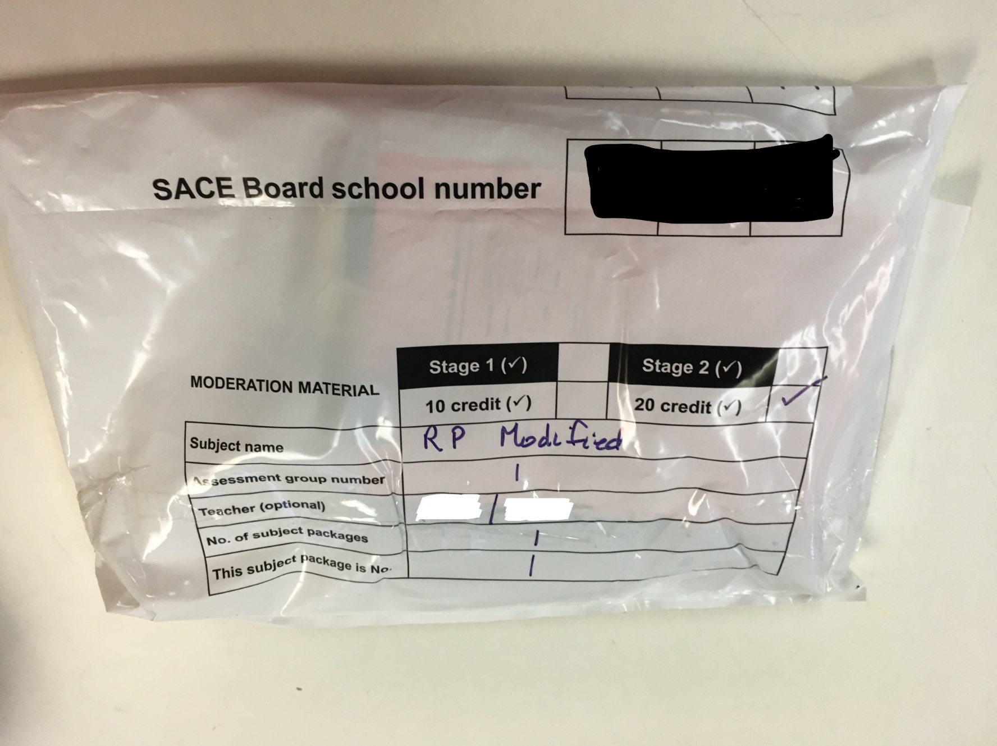
Stage 1 and 2 Modified Subjects Review
Processes for Modified subjects review will remain unchanged for 2020.
Submission will be hardcopy/USB via white bag and courier collection.
Notes:
Changes for 2021 are anticipated.

Slide 47
Issues
Some of the ongoing issues identified in semester 2, 2019:
School samples not received as expected
2 out of 4 tasks submitted with moderation unable to proceed
Missing Stage 1 Moderation Sample Form
Missing Student Description Sheet (Modified subjects)
Ambiguous grade on Moderation Sample Form e.g. C*/D*
Results entered into Schools Online when moderation had not taken place and was requested. These results were removed by Assessment Operations and students pended to 2020.

Slide 48
New PLATO course
Notes:
This should be the first reference provided to teachers new to teaching the SACE – whether it be exit teachers or teachers who have perhaps been teaching in the middle-school for some time.
The purpose of this course is to explain how the SACE works and provide resources on a range of aspects.
In particular, the course aims to support teachers with an understanding of assessment in the SACE and how good assessment practices can support student success.

Slide 49
Teachers new to the SACE
The course covers a range of topics:
Unpacking the subject outline
Learning and assessment plans
Assessment
Task design
Feedback to students
Supervision and verification
Making assessment decisions
Clarifying
Moderation
Notes:
The particular focus is on planning aspects but extends beyond this covering a range of topics:
The relevant SACE Officer: Curriculum is available for further subject specific targeted support.

Slide 50
Plato progress reports
Notes:
Reports can be generated by school leaders to monitor and track staff PD through PLATO reports> course completed in current year. If you require information from 2019 you are able to filter using a search for the year required. They can view PD for whole staff as well as individuals using the filters available.
It will revert back to the current year the next time you view details.

Slide 51
Badges in PLATO
How can I access and view these badges?
Notes:
Play Video on how to access Profile to view awarded badges.

Slide 53
Professional Learning
Notes:
The Institute of Educational Assessors (IEA) is the professional learning service of the SACE Board.
The IEA provides pedagogical and assessment professional learning to educators so that they can support the 21st century learner to thrive at school and beyond.
In February and March the IEA has a number of professional learning opportunities for teachers.

Slide 54
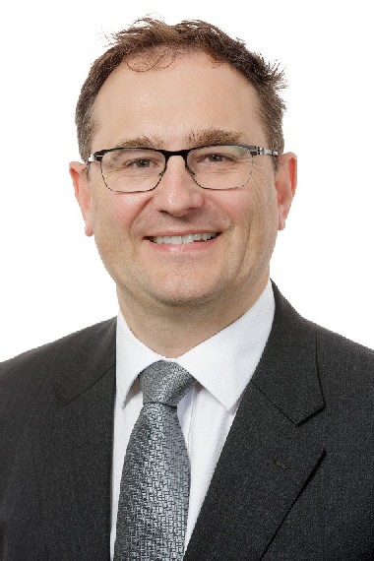
IEA Conference | 25 March
Valerie Hannon
Co-founder, Innovation Unit
Keynote
Dr Peter Goss
School Education Program Director, Grattan Institute
Yasodai Selvakumaran
Top 10 Finalist, 2019 Global Teacher Prize
Notes:
On Wednesday, 25 March the IEA will hold it’s annual conference at the Adelaide Convention Centre.
This year’s theme is Prescient educators: teachers shaping the future.
The IEA Conference 2020 aims to inspire educators to be champions of change and to have the confidence and insight to look ahead at the challenges and opportunities facing education in our transforming world; to be prescient.
Headlining our stellar line-up of local and international speakers will be Valerie Hannon, Co-founder of Innovation Unit who will discuss The Future School and how schools and learning might be reinvented in our transforming world.
Joining her will be Dr Peter Goss, School Education Program Director of Grattan Institute,
Yasodai Selvakumaran, Top 10 Finalist of the 2019 Global Teacher Prize
Karen Schilling, winner of the Credit Union SA Primary School Teacher of the Year award
And Henry Thong, an inspiring and internationally renowned documentary filmmaker and SACE graduate.
Conference flyers are on your tables.

Slide 55
Science workshop | 28 February
Notes:
The IEA teaching and learning workshop for science teachers will be held on Friday 28 February at the SACE Board.
This full-day workshop, presented by Jeremy LeCornu is designed for science teachers who are keen to develop the skills and strategies to maximise opportunities for their students to engage in active learning through the use of video.
Hear from an educator, who is successfully using this approach.
Learn about the technology, planning and tools needed to comprehensively develop and implement active learning through video.
View a range of example videos created by teachers.
And apply your learning to create videos that will support your students to access content easily, engage naturally and achieve deeper learning.

Slide 56
Creative Arts Masterclass | 6 March
Notes:
The next event in the Masterclass series is the Creative Arts Masterclass which will be held on Friday 6 March at the Art Gallery of South Australia.
This full-day masterclass for teachers of Creative Arts will focus on promoting creative approaches to the arts as well as providing new perspectives on pedagogical and assessment practice.
The Creative Arts Masterclass, held during the 2020 Adelaide Biennial of Australian Art, features a keynote presentation from Dr Lisa Slade, Assistant Director, Artistic Programs at the Art Gallery of South Australia, and workshops with Leigh Robb, Curator of the 2020 Adelaide Biennial: Monster Theatres, and James Dodd, innovative artist and educator.
Discover innovative strategies for programming your course and inspiring authentic student-artists
Enrich your teaching skills and practice and deepen your knowledge of the Creative Arts.
Collaborate with renowned artists, colleagues and experienced teachers to ignite your pedagogy and develop innovative learning approaches for your students.

Slide 57
Professional Learning
www.iea.sa.edu.au
SACE.iea@sa.gov.au
08 8115 4713
Notes:
Tickets for all three events are on sale now and are selling fast.
For more information on these events or other professional learning opportunities, including tailored sessions for your school, please check out the IEA website or contact the team via the details on screen.

Slide 58
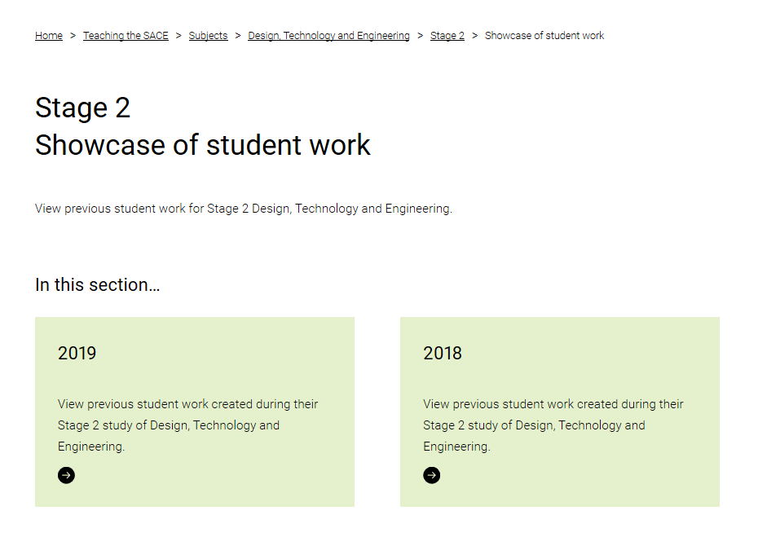
Galleries
Visual Arts: Art and Visual Arts: Design
Design, Technology and Engineering
Notes:
Two galleries exist on the SACE website. Subjects-Visual Arts: Art & Visual Arts: Design and the new Design Technology and Engineering which has 4 subject codes. Each year amazing student work is showcased.
Again the SACE art show is being held . Please refer to website for details.

Slide 59
Website changes
Dance (Stage 1)
Drama (Stage 1)
Economics (Stage 1)
Accounting
Outdoor Education
Design, Technology and Engineering
Australian Languages
Notes:
Some renewed subjects have already had their subject areas streamlined on the website. The subject teachers would have received this email to explain the ease of accessing information.

Slide 60
Our vision for 2020 and beyond video is available on the SACE website.
Notes:
Click/ enter to activate video

Slide 61
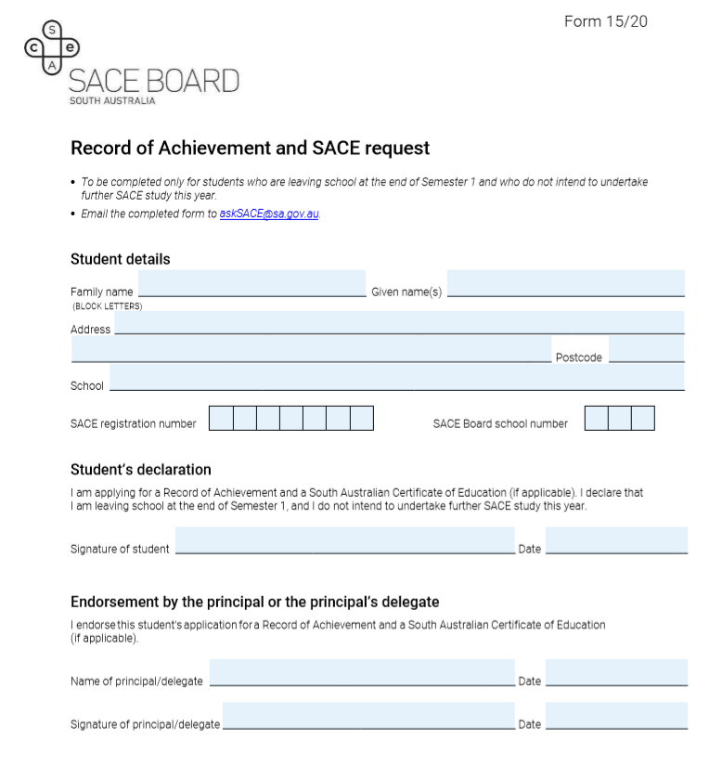
Mid year completion
Due Friday 31 July
Notes:
Just some reminders about mid year completion of SACE by students.
We need to be notified about this by Friday 31 July.
( read bottom line…. Re community studies and arrangements for marking and moderation to occur)

Slide 62
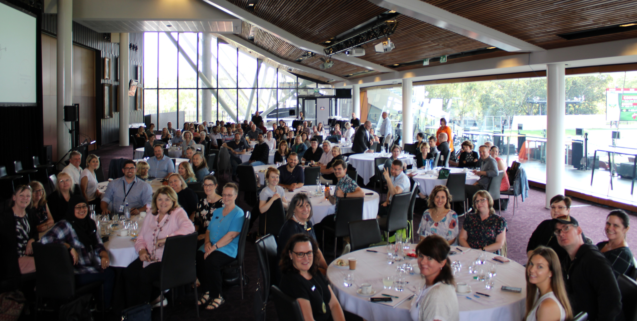
Thank you for your attendance

