Slide 1




Teaching and Learning Leaders conference
September 2025
Summary feedback data

Slide 2
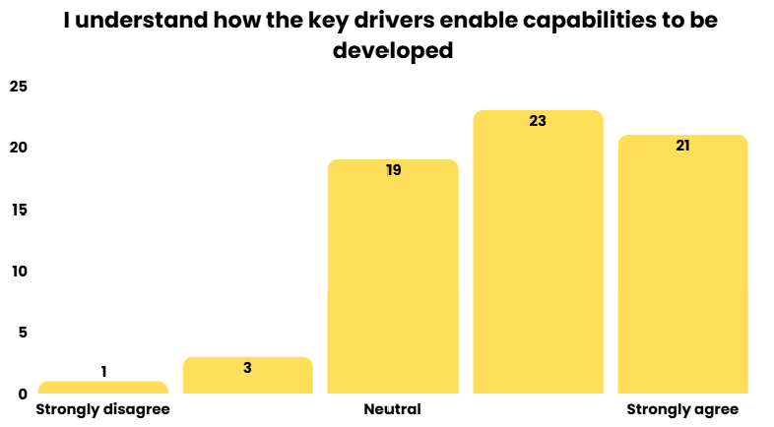
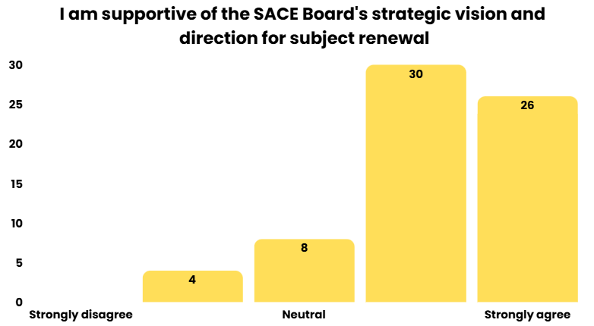
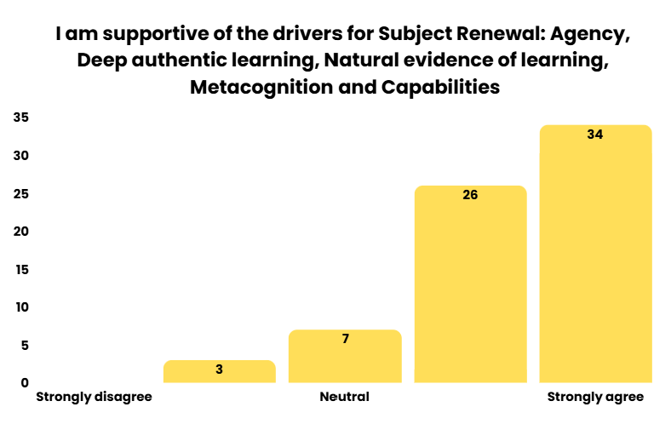

Subject Renewal

Slide 3
Subject Renewal
What resonates?
The real authentic application of NEoL and how students have gravitated to and written feedback (notes on task sheets, journaling). This has positive impacts on metacognition but also combat' of Al.
The initial uncertainty that students express when not feeling as "directed/scaffolded" in a learning activity. How can we intentionally work through with a balance of autonomy and explicit support?
The need to implement student voice/autonomy earlier in their education.
Teaching and Learning programs need time to allow for engagement and development of ideas. Teachers need support to capture varied modes of learning evidence.
I feel the existing flexibilities in SACE mostly provide these opportunities shared already.
For deep authentic learning, more time needs to be spent on content and more time on exploration as well. So topics need to be reduced to allow this.
Valuing reflection and feedback, particularly during the process of learning rather than at the end of learning allowing students to make changes and iterate along the way
It is good to see that we are moving away from task driven teaching to learning and students' involvement where we value the agency.
Appreciated seeing teachers as subject experts given scope to experiment, work with students and refine.
The prevalence and quality of natural evidence of learning in all of the examples given.
Examples of different ways that the drivers can be incorporated into the learning and assessment process from different subjects, and hearing how the students valued agency and transferability
That some teachers are keen to try a new way. That a focus on thriving means that we are working together to help shape happy humans, not vessels that we simply apart knowledge on.

Slide 4
Subject Renewal
How do we (school leaders + SACE) create conditions for teachers to try something different?
Collaborate with other teachers, allow them to get creative
Allow teachers to experiment, take risks and allow them to fail and reflect on the process.
Stop valuing the final grade and placing pressure to achieve all As... place value on the learning by journey and student reflection
Allow opportunities for professional conversations on site and with others externally.
Mentor/ supervision model... having a critical friend to bounce ideas and challenge
Give the opportunity to take risks. To reflect on outcomes and to accept that new approaches are not always perfect and it is ok to try and test and refine

Slide 5
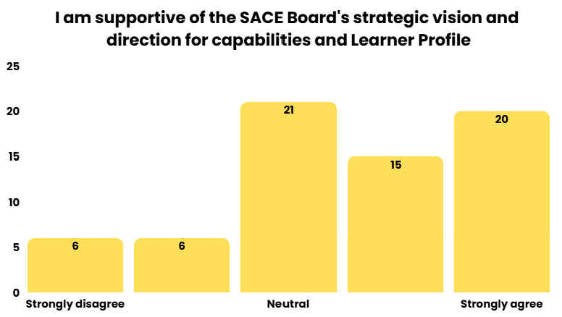
Capabilities and Learner Profile
What resonates?
Capabilities linked to assessment
Aligning the elements and capabilities to our school vision/SLG/SA curriculum
Seeing students speak so confidently about their learning is affirming
Valuing holistic learning and development, with emphasis on student agency
Need further details on what values it holds for students post-school
Equity is going to be a major issue if this is externally assessed
Being able to capture and acknowledge student growth beyond academic achievement
I really value the examples presented and the concept of viewing learning through a capabilities viewpoint.
Linking capabilities to the schools learner and graduate profiles
Students taking ownership of their profile
[School Name] integration of the language of the capabilities with the school values and subjects; currently there are so many values, dispositions, capabilities, learner profiles etc in play!
It is all subjective. Can we actually assess capabilities?

Slide 6
Capabilities and Learner Profile
What would it mean for us (schools + SACE) to lead this in schools?
Staffing and time allocation for conversations and assessments - foreseeing significant increase in teacher workload and pressure on staffing and timetabling
What would be removed to allow space for this?
Building capacity in students and teachers to be able recognise opportunities for developing the capabilities
Concerned about equity - will the disadvantaged be more disadvantaged!
Clarity on what it is and how it works.
Buy-in from University to reduce/remove the ATAR. Otherwise it will always play second fiddle.
Make the capabilities easier for students to deconstruct, and understand.
Need for students to see the purpose and benefit of this, as well as teachers to value it and be consistent
It provides opportunities for us to give recognition of the attributes students possess who don't value or require an ATAR
Time to train teachers and set up internal systems to facilitate the program
Need a universal language that is consistent from younger years
Another mechanism to encourage, teach and develop what we value

