Slide 1
Design, Technology and Engineering
Planning
Term 1 2021

Slide 2
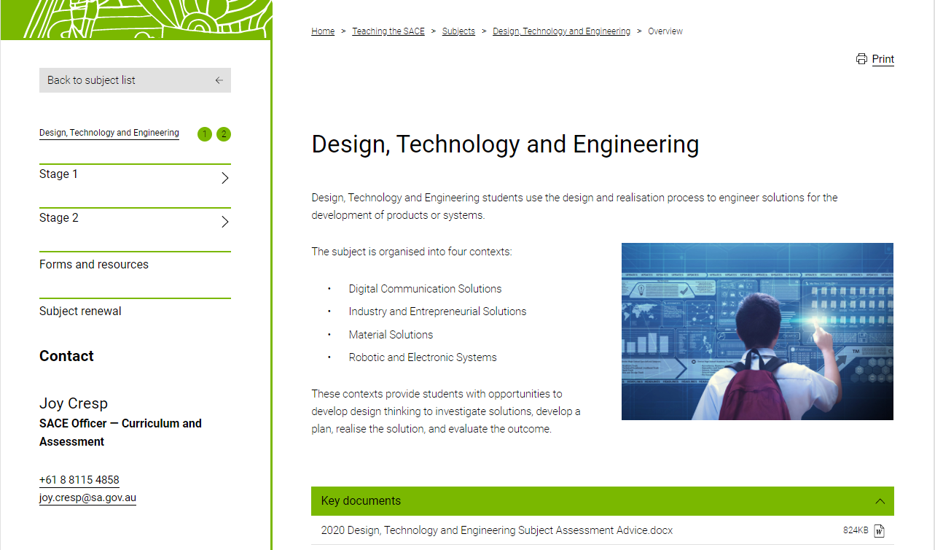

SACE website

Slide 3
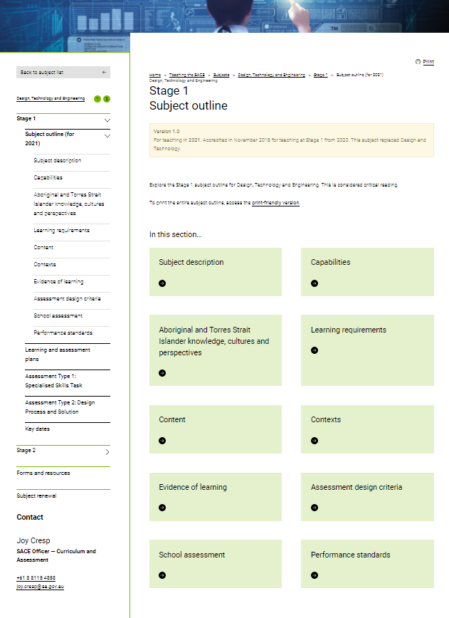
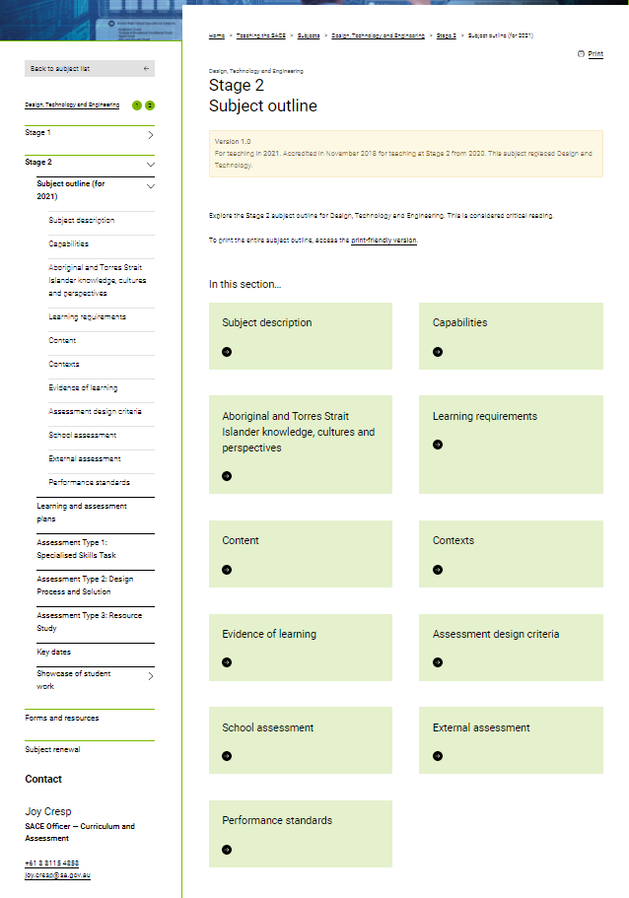
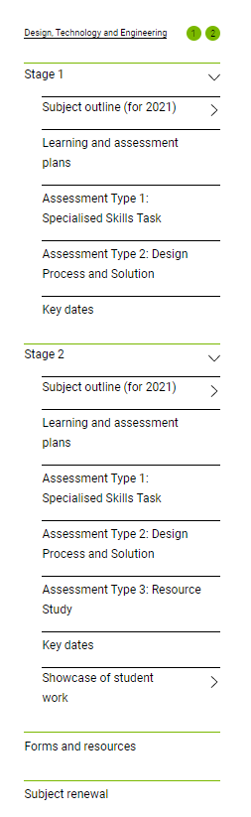

Slide 4
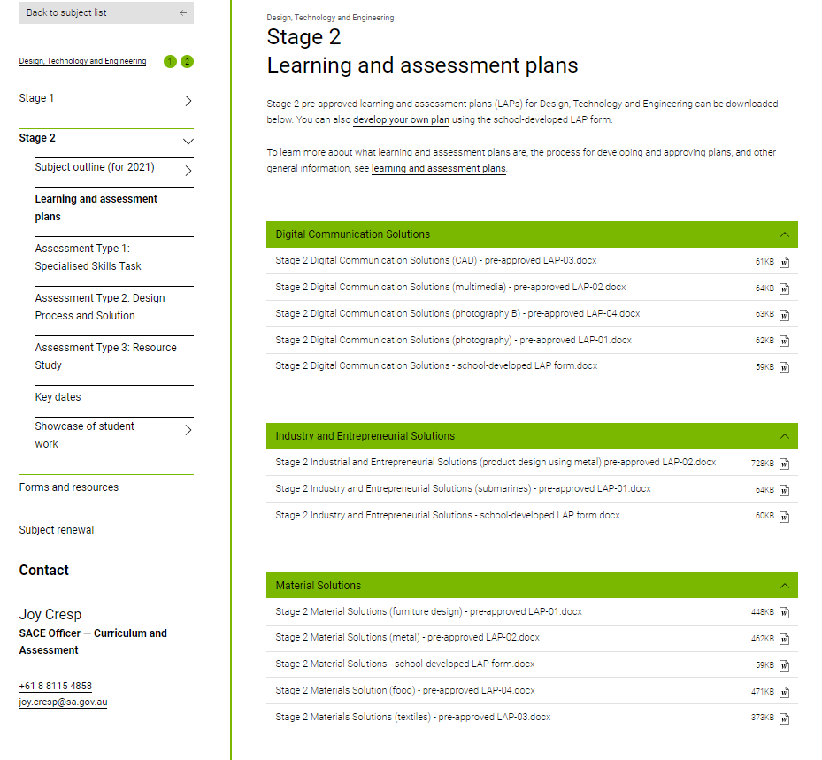
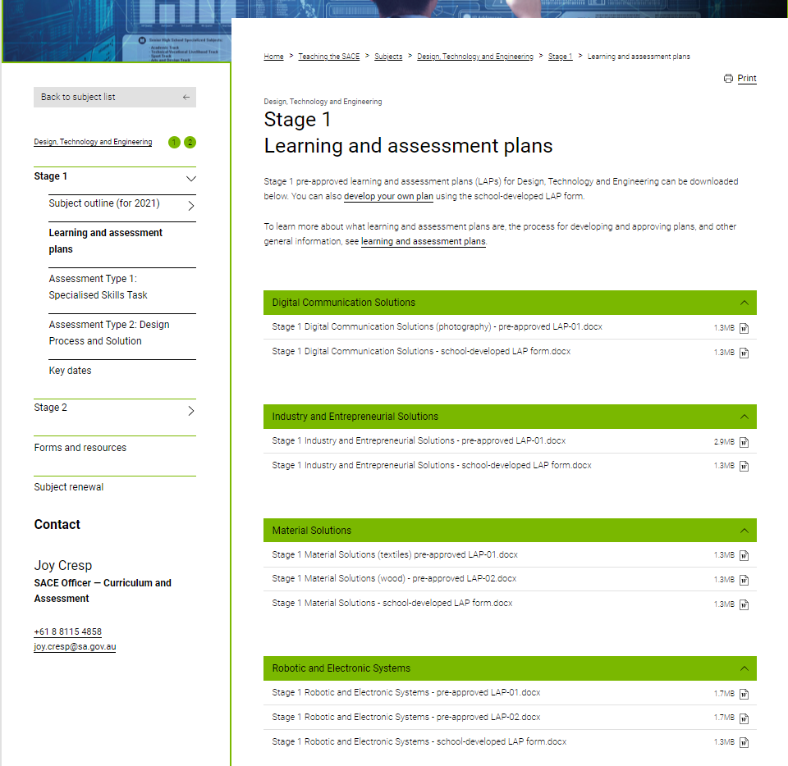

LAPS
Notes:
More Laps are going up.
Preapproved and school developed template available.

Slide 5
Stage1 | Assessment Type 1: Specialised Skills Task | Assessment Type 2: Design Process and Solution
Credit Three assessments Each assessment type should have a weighting of at least 20 % | Students undertake two specialised skills tasks Evidence for each task presented should be completed in multimodal form to a maximum of three minutes | Students undertake one Design process and solution task consisting of two parts; Part 1- Design development Part 2- Solution realisation The evidence for the design development should be a maximum of 1000 words if written or 6 minutes of recorded oral communication, or the equivalent in multimodal form. The evidence for the solution realisation should be a maximum of 500 words if written or 3 minutes of recorded oral communication, or the equivalent in multimodal form.
20 credit Up to six assessments Each assessment type should have a weighting of at least 20 % | Students undertake two or more specialised skills tasks Evidence for each task presented should be completed in multimodal form to a maximum of three minutes | For a 20-credit subject, students create one or more design process and solution tasks. For a 20-credit subject, the combined evidence for Assessment Type 2 should be a maximum of 3000 words if written or a maximum of 18 minutes of recorded oral communication, or the equivalent in multimodal form.
Notes:
Stage 1 has two assessment types- Specialised Skills Task and Design Process and Solution. Remember each assessment type should have a weighting of at last 20 %
You can decide what proportion (%) goes to which assessment type. Please record this on your LAP. Remember 100% school assessment.
Focus on developing skills to support Stage 2 requirements.

Slide 6
Stage 1 Assessment Description
Stage 1 | Assessment Type 1: Specialised Skills Task | Assessment Type 2: Design Process and Solution
Assessment description | Students develop knowledge and skills through specialised skills tasks. They apply the skills, processes and techniques in the related context. This informs the design development for a solution in Assessment Type 2. Students evaluate and assess the development of their own skills in this assessment task. They review how these processes and techniques may influence their solution. Students and teachers negotiate whether it would be appropriate to demonstrate these processes and techniques in a single session, or over a more extended period. This assessment could consist of one activity or a series of activities | Part 1 - Design development Students show evidence of key design phases of investigation and analysis, design development and planning. This could be completed individually or as part of a collaborative task. Part 2 - Solution realisation Students create and evaluate the solution. The student provides evidence of the solution in the form of images or a video recording and evaluates the completed solution. Students should evaluate how well the requirements of the design brief have been met including what worked well, what did not go according to plan, and what was learnt. Students consider possible modifications to improve the outcome and discuss how the solution is to be used.

Slide 7
Stage 2
School Assessment
Assessment Type | Number of tasks | Evidence | Assessment Design Criteria
AT1: Specialised Skills Task (20%) | two | Evidence for this assessment type should be provided in multimodal form to a maximum of 6 minutes, 1000 words in written form or a combination of these. | Production Evaluation
AT2: Design Process and Solution (50%) | One (up to three sections) | The task(s) should be up to a total maximum of 2000 words or the equivalent in multimodal form where 6 minutes is equivalent to 1000 words. The task must showcase and evaluate the solution or product. | Investigation and Analysis Design Development and Planning Production Evaluation
External assessment
AT3: Resource Study (30%) | One (comprising of two parts) | Part1: Resource investigation (I1 & D2) Part 2: Issue's exploration (I2 & E1) The Resource Study should be presented in written or multimodal form or a combination of both. It should be up to a maximum of 2000 words if written or the equivalent in multimodal form, where 1000 words is equivalent to 6 minutes. | Investigation and Analysis Design Development and Planning (D2) Evaluation
Notes:
At Stage 2 the weightings are set for each assessment type. Use these as a guide to determine time required and when to undertake assessment types
As AT2; design process and solution is 50 % consider the students time (approx. 60 hours) in order to complete the product or solution and evidence required.
New subject outline have re-arranged components of previous tasks but …….the new tasks need to align with the new performance standards.
Review adapted sample. Table groups. Discuss
Schedule what it might look like.

Slide 8
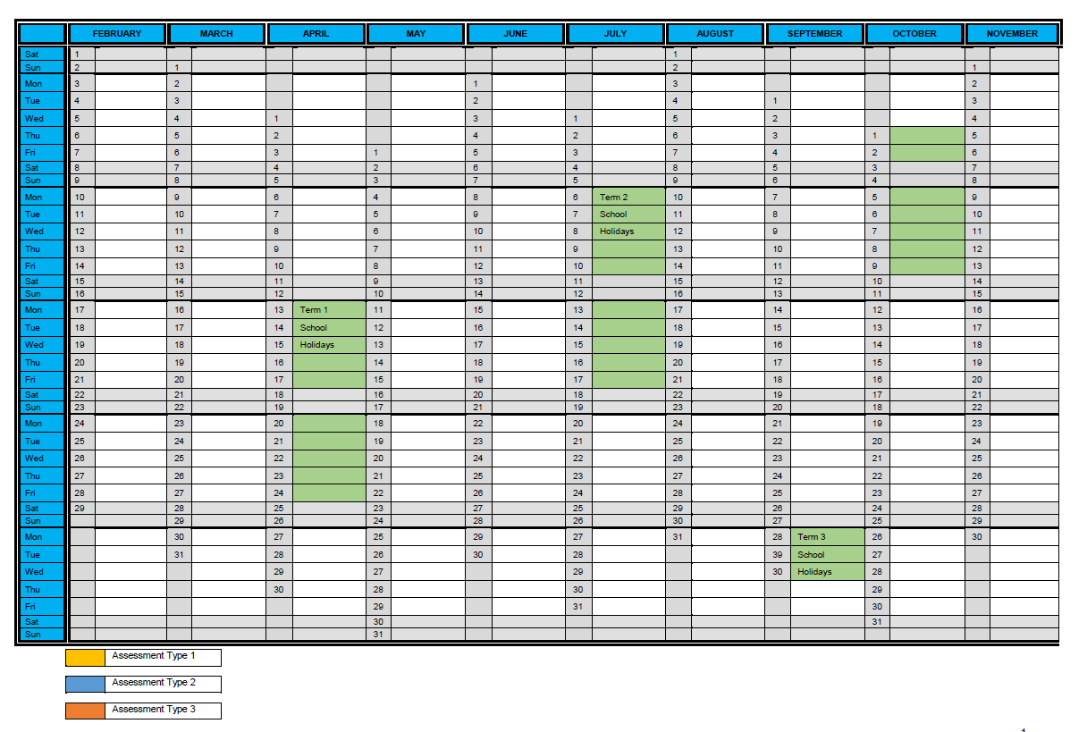
Sequencing of Stage 2 tasks example
Sequence | Assignment | SACE Requirements | Performance standards
1 | AT2 Investigate | 200 words or 1-minute multimodal equivalent | I 1
2 | AT2 Design, develop and plan | 800 words or 5-minute multimodal equivalent | D 1,2
3 | AT3 part 1 Resource investigation | 1000 words written 6-minute multimodal equivalent | I 1 D 2
4 | AT1 Skills task A | Product record and 500 word written evaluation or 3-minute multimodal equivalent | P 1 E 1
5 | AT3 part 2 Issues Exploration | 1000 words written or 6-minute multimodal equivalent | I 2 E 1
6 | AT1 Skills Task B | Product record and 500 word written evaluation or 3-minute multimodal equivalent | P 1 E 1
7 | AT2 Produce & Evaluate | Product record (500 words) and 500 word written evaluation or 3-minute multimodal equivalent | P 1,2 E 1

Slide 9
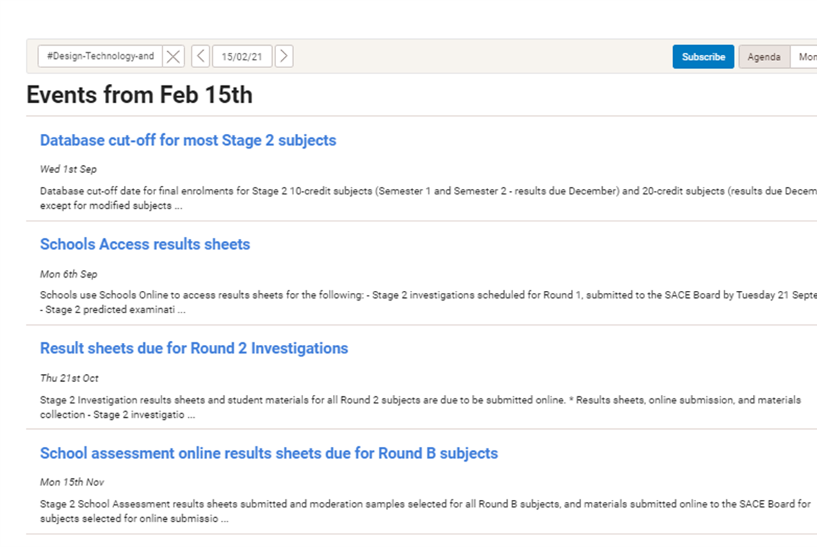
Key dates
Stage 2

Slide 10

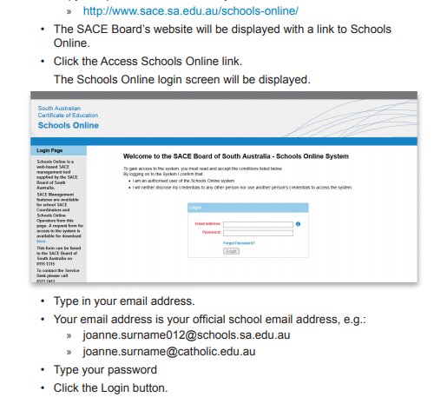

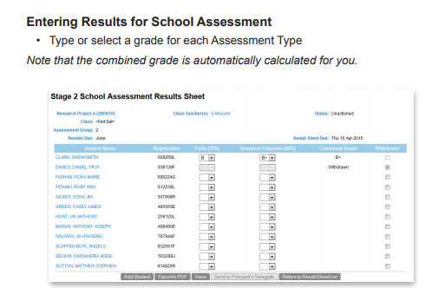
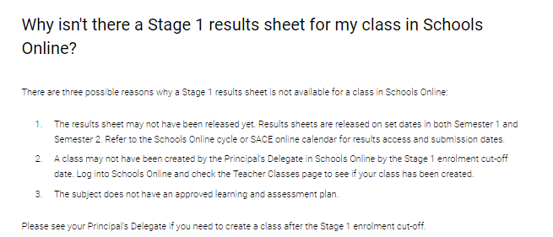
Results sheets
https://www.sace.sa.edu.au/documents/652891/3091266/Teacher+Instruction+Sheet+Booklet.pdf/24fa4323-196d-4f8d-ac0a-d01d590d1e98

Slide 11
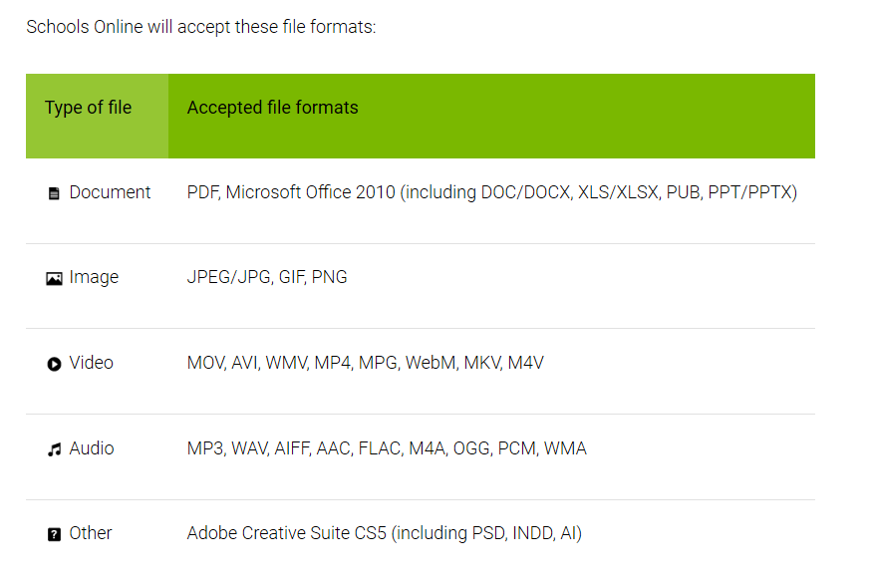
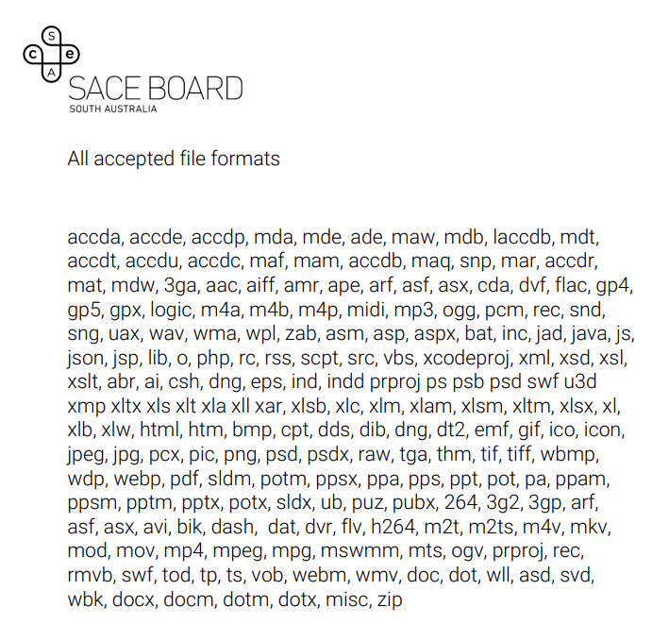
Schools Online - processes and procedure
Notes:
Ensure file types that can be viewed when work is submitted in the external uploading in schools online

Slide 12
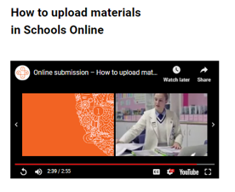
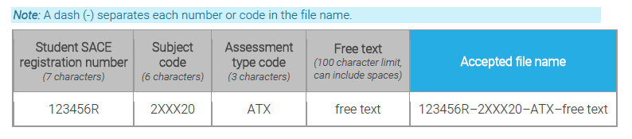
Schools online
Submission of results
https://www.sace.sa.edu.au/teaching/resulting/online-submission
Tasks submitted electronically
Standard file naming protocol:
Notes:
In 2020 both external and school assessment for stage 2 results and student work will be submitted through schools online

Slide 13

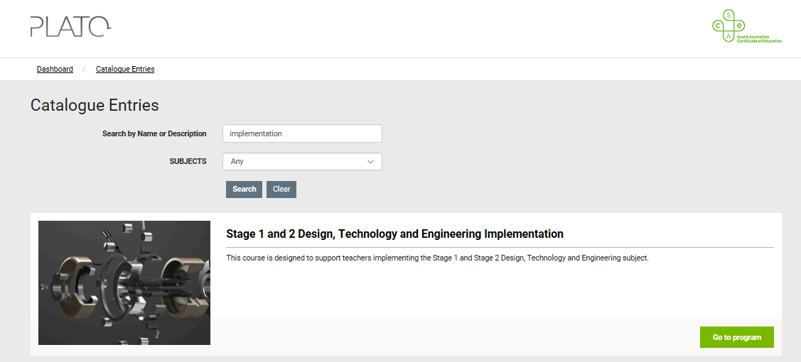

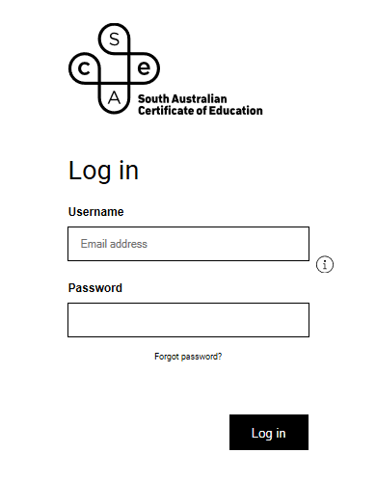

PLATO
New calibration activities for each of the Stage 2 DT&E codes available late April.
Notes:
Accessing PLATO- re special provisions, clarifying courses, ( all have PD certificate)

Slide 14
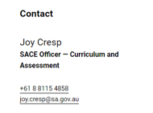
Contact details

