Slide 1
Lessons learnt from the August trial electronic examinations
For school staff administering the
7 November Stage 2 English
Literary Studies electronic
examination

Slide 2
During August and September schools administered an authentic electronic examination to help prepare for the exam on 7 November.
Schools supplied the following feedback. Our responses are provided to assist schools with their preparation for 7 November.

Slide 3
Feedback How much additional time should be provided following a disruption?
Our response
Following a disruption the school can provide additional time for the student to readjust and settle. The amount of time is determined by the school and varies depending on the situation. As a general guideline it is better to provide a student with more than enough time to readjust and settle so it is obvious that the student has been supported to complete their examination following a disruption.
Further information: Protocols for Managing situations on exam day section, pages 36 - 44 of SACE electronic examination instruction guide.

Slide 4
Feedback Can the exam be rescheduled if a whole of school disruption (SEB not working, network outage) occurs before students log into their examination?
Our response
The examination cannot be rescheduled. It is possible that the start time can be delayed. The principal or principal’s delegate needs to contact the SACE Board for approval.
Further information: Protocols for Managing situations on exam day section, page 43 of SACE electronic examination instruction guide.

Slide 5
Feedback When does the 100 minute examination duration commence?
Our response
Each student has their own exam count down timer on their screen. The 100 minute countdown does not commence at the scheduled examination time it commences when the student enters the examination start code and selects ‘Start’.
Invigilators are not required to use the exam room clock to communicate to students about how much time they have remaining.

Slide 6
Feedback Students involved in trial examination situations reported their willingness to wait longer than 15 minutes (this was the time originally recommended in the SACE electronic examination guide) to find a technical solution that avoids completing their examination on paper.
Our response
The SACE electronic examination instruction guide and training materials have been updated:
The suggested time that schools can use to find and implement a technical solution has been extended from 15 minutes to 20 minutes.
Advice that ‘The SACE coordinator or principal’s delegate makes the decision as soon as possible to move to the paper examination’ has been removed.
Further information: Protocols for Managing situations on exam day section, pages 36 - 44 of SACE electronic examination instruction guide.

Slide 7
Feedback Can students move to another device during an examination?
Our response
Yes, for whatever reason if the student needs to move to another device they can use their registration number and password to log back into their examination. Student work is saved online, not on the device and this allows the student to log onto a second device and proceed.
Further information: Protocols for Managing situations on exam day section, page 36 of SACE electronic examination instruction guide.

Slide 8
Feedback Some schools reported that they need more than 15 minutes before the scheduled examination start time to get organised.
Our response
Our instruction guide has been updated and recommends students arrive at the examination venue to be admitted at least 20 minutes before the scheduled start time.
Further information: Protocols section, page 15 of SACE electronic examination instruction guide.

Slide 9
Feedback Some schools asked if training materials will be available in the lead up to 7 November.
Our response
Yes, they have been updated following the August/September trial and are available on the Electronic Exams Website under the Training tab. There are three short Phases to the training and it is recommended refresher training is conducted a week prior to 7 November.
The SACE electronic examination instruction guide and Preparation checklists are also available under the Training tab.

Slide 10
Feedback Some comments following the 7 & 15 August trial examinations indicated that some students using Mac devices had their trial examination experience interrupted.
Our response
The August trial examinations identified some inconsistent behaviour with the SACE Exam Browser for Mac devices. Reconfiguration of the SACE Exam Browser and recent tests in schools have confirmed that the inconsistent behaviour has now been resolved. No changes to the SACE Exam Browser version made available late July will be required.
Students and IT Managers are not required to update the version of the SACE Exam Browser for the 7 November examination.

Slide 11
Feedback Some schools reported that some student’s devices went flat during the examination.
Our response
Our advice is to encourage students to bring a charged device to the examination. If the student’s device does go flat during the examination, simply request that the student logs back in on a charged spare device or charge their own device.

Slide 12
Feedback How often is the students work saved?
Our response
When the student’s device is connected to the internet their work is saved every minute. Invigilators can use the last saved column on the students page to monitor the work is saving.
Further information: Protocols for Managing situations on exam day section, page 40 of SACE electronic examination instruction guide.

Slide 13
Feedback Are Stage 2 English Literary Studies teachers able to invigilate the examination?
Our response
Stage 2 teachers must not invigilate or administer examinations for any subject that they teach.

Slide 14
Feedback A very small number of students experienced a technical issue in the last 20 minutes of the trial exam.
Our response
The timing of the technical issue is unfortunate. Typically, students in the remaining minutes of an examination are not starting their responses to questions, they are finalising and editing their responses. Therefore in this situation the window of time available to find a technical solution has been extended to 40 minutes to encourage schools to find a technical solution that will allow the student to complete their examination electronically.
Further information: Protocols for Managing situations on exam day section, pages 38- 39 of SACE electronic examination instruction guide.

Slide 15
Feedback Some schools highlighted that it would be useful if the amount of used time displayed on the Summary page.
Our response
The amount of used time does not display on the Summary page, However this will be considered for 2019. To view how much time a student has used select the ‘Update’ button for the student and then the ‘Adjustments’ Tab – the amount of exam time used by the student will be in the ‘Used time (min)’ section.
Further information: Protocols for Managing situations on exam day section, page 34 of SACE electronic examination instruction guide.

Slide 16
Feedback Some schools indicated that students finished at different times and that they were uncertain about when to dismiss the group of students.
Our response
Students are not expected to stop writing and submit their exam at exactly the same time. Given that students may enter their start code within a couple of minutes of each other each student’s 100 minute timer will also be expected to time out within a couple of minutes of each other.
For written exams, the exam invigilator may instruct students to stop writing. For electronic examinations this is not required. Exam invigilators should instruct students at the start of the examination to ‘keep your device turned on and wait quietly until you are dismissed’.
Further information: Protocols for Managing situations on exam day section, page 25 of SACE electronic examination instruction guide.

Slide 17
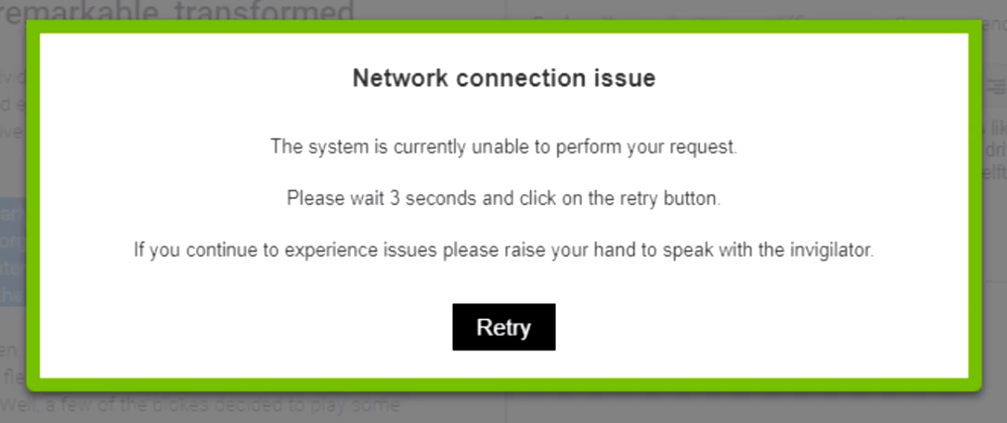
Feedback Can a student lose work?
Our response
The electronic examination system saves students work every 60 seconds. If the student receives the network connection notification (above) and retries their connection successfully the student won’t lose any work.
Warning, if the student ignores the network connection notification and attempts to refresh their browser or restart their device they may lose their progress since the last time the system saved their work.

Slide 18
Feedback Some schools reported that it was not clear when to provide students with the start and exit codes.
Our response
The start code should only be provided when all students have accessed their examination via the SACE Exam Browser and are ready to start.
The start examination instructions to be read out to students highlight that once students have submitted their examination they will be required to enter an exit code; this will be written on the whiteboard after 40 minutes.
Further information: Protocols for Managing situations on exam day section, page 25 of SACE electronic examination instruction guide.

Slide 19
Feedback What are ‘Locked Out, Paused and Abandoned’ status?
Our response
Some schools used the Locked Out, Paused and Abandoned status during the trial examination.
Locked Out, Paused and Abandoned status are used by the SACE Board only and should not be used in schools.
Further information: Protocols section, page 26 of SACE electronic examination instruction guide.

Slide 20
Feedback Some schools organised installation of the SACE Exam Browser just prior to scheduled examination start time.
Our response
To avoid a delay to the scheduled examination start time schools are encouraged to check installation of the SACE Exam Browser on student devices in the days prior to 7 November. If this not possible students should be instructed to arrive at the examination venue and be admitted at least 20 minutes before the scheduled start time to check the installation of the SACE Exam Browser.
Note: No changes to the SACE Exam Browser version made available late July for the August/September trials will be required so students and IT Managers are not required to update the SACE Exam Browser for the 7 November examination.

Slide 21
Feedback What is the recommendation regarding spare devices for students?
Our response
For device issues or breakdowns and as contingency for students not enrolled in the examination at that location, it is recommended that you have a minimum of 2 spare devices available for up to 20 students and 1 additional spare device per 10 additional students.
Further information: Protocols section, page 17 of SACE electronic examination instruction guide.

Slide 22
Feedback Some schools highlighted that students could not open the SACE Exam Browser while other applications were running on the student’s device.
Our response
Students are expected to close any applications running on their device before they open the SACE Exam Browser.
If a student is experiencing difficulty opening the SACE Exam Browser it is worth checking that all other applications have been closed first.

Slide 23
Feedback Managing exam day situations
Our response
The protocols for managing exam day situations have been updated following the trial exam and can be found in Managing situations on exam day pages 36-51.
Schools are encouraged to familiarise themselves with the protocols and the situations they cover so if a situation occurs they know which page to refer to.
Please follow up any exam day situations by reporting them to the SACE Board after your exam on 7 November.

