Slide 1
Notes:
In efforts to launch and understand the new strategic plan, it is important to reflect on the past strategic plan.

Slide 2
Notes:
Previous Strategic Plan - Thrive Framework
Quite conceptual
Reframing the education narrative
Complex
Playing a long game
1. SACE is not a competition – Broaden the definition of success
Students entitled to more than a checklist of knowledge and skill
Move beyond our role of assessing knowledge and skills and cognitive abilities
Alongside and complimentary to
Is the intentional development of capabilities
2. Bring whole student into focus
Develop the whole person
To prosper and flourish is the intentional outcome of education
Finish their schooling experience with evidence of unique abilities

Slide 3
Key Drivers
Notes:
The conversation was prompted and Influenced by:
1.Local, national and international themes in education research
SACE Stage 2 Review
Shergold Review
OECD Education 2030
2.The voice of students themselves
3.External Change forces
•Climate crisis
•Job disruption by robotics: 4th Industrial Revolution
•Artificial intelligence
•More pandemics
•Expansion of knowledge and contestation of knowledge
•Growing inequality, violence and conflict
•Shifted geo-political power relationships
•Assaults on democracy

Slide 4
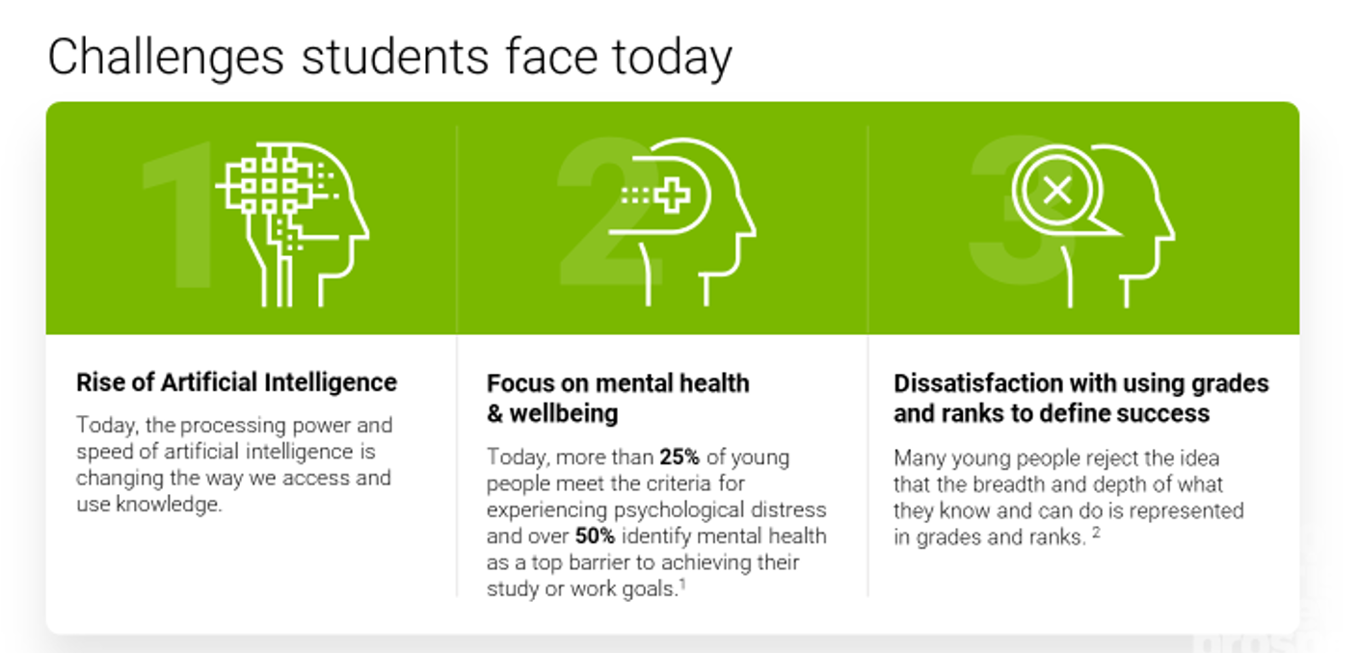

Slide 5
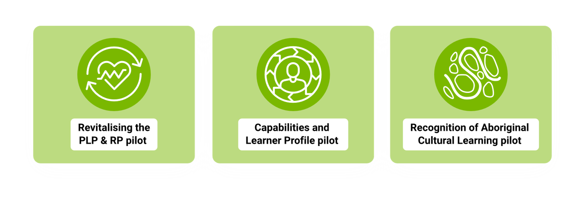
Using ‘thrive’ to reconceptualise curriculum, assessment, quality assurance, recognition and certification
Notes:
Where did we focus our effort in the last strategic plan?
- Three key projects

Slide 6
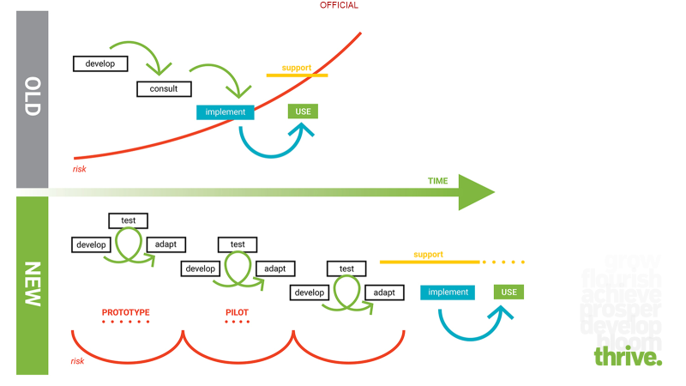
Notes:
- Throughout the last strategic plan, SACE also re-examined how we were collaborating with schools and other stakeholders.
Over the past 3 years we’ve changed our approach to change
OLD
In the past we’ve assumed expertise exists with SACE experts – or groups of experts
2. change is linear and sequential
NEW
assumes expertise exists in the field in schools and that
change requires many adjustments along the way if we are to achieve impact.
we established the SACE Change Network,
risks and assumptions, listening to the experience of schools, to build our evidence base and confidence to IMPLEMENT AND USE

Slide 7
Notes:
* The 204 – 2027 SACE Strategic Plan: Passport to Thrive.
* Ambition is unchanged
- Skills/knowledge no longer enough
- Develop the whole person – their wellbeing matters as much as their academic success
- Content and education is relevant - spark passion, take control of their learning
* Thrive – connects to previous plan - Name and badge that people can use to refer to our strategic plan that supports consistency, relevance and recognition.
* “Passport” emphasis on utility/pathways of the SACE qualification.

Slide 8
Notes:
Creating a qualification that can stand up to the global level of change is crucial if we are to give young people the skills, capabilities, knowledge and understanding they need.

Slide 9
Notes:
Therefore, at its heart, the new SACE Strategic Plan is about giving every learner the capability to:
Open doors
Stretch minds
Strengthen ownership
Embrace perspectives
Share success
- These are an expression of the SACE capabilities that emerged from the past 3 years (capabilities identified on right-hand side of poetic interpretation)

Slide 10
Notes:
SACE is therefore looking to create a qualification for a changing world and is looking to do so by utilizing the power of partnerships (schooling, tertiary institutions and industry).
In regard to a qualification for a changing world, there are three key projects that will be acted upon through this strategic plan. These are…

Slide 14
Notes:
Roadmap
Reinforcing the stages, we are continuing to learn from the way we approached the last strategic plan – it’s impact has been very good, and we want to continue to strengthen our impact
The stages of what we call a roadmap look like this...
These phases can be longer or shorter depending on complexity of change with different communities.
We will go at the pace, ambition and appetite of your community.

Slide 15
Notes:
The Lotus
This is the visual we refer to as the ‘lotus’.
It captures a summary of the strategic plan on one page.

Slide 16
Notes:
The Engine room is a not just a metaphor for the SACE Board internally, it’s also relevant to all our partners and stakeholders.
With a strong engine room we can increase efficiency, strengthen engagement and confidence, and help our teams to collaborate and co-design.
– Systems and processes are solid
– Teachers and leaders are supported through continuity and stability.
That is how we can deliver a passport to thrive to every student.

Slide 17
Notes:
Operational assessment systems
We’ve been listening to our stakeholders about the role they want us to play in realising our new strategy that they can co-own and drive – with us.
And in the engine room, there are three focus areas through assessment systems that a qualification for a changing world will rely upon.

Slide 18
Notes:
Subject renewal
All subjects can now benefit from renewal through the learnings we have embedded from our previous strategy.
This will enable us to focus on:
– Real-world learning that is more relevant to students
– Deep authentic learning
– Capabilities – intentionally designing subjects to create the conditions for capabilities to develop
As we do this we can increase the level of agency - for students and for teachers as well
The role of the teacher is more important than ever and subject renewal will enable teachers to play a greater role in student learning as a responsive mentor, coach or guide - understanding where your student is at in their learning and knowing when to step in with support to allow them to flourish.
This role can’t be replaced by AI or a machine – it’s a human quality that is highly valued.

Slide 19
What are we doing next? A focus on subject renewal
Subject renewal is a process:
Community
Content & Assessment
Capabilities
To co-design subjects with the community.
That will sharpen content and assessment
And intentionally develop capabilities.
Notes:
- It is our ambition to set off every subject on its own subject renewal path starting in 2024.
We're hoping to work with the teaching community to map out a subject renewal road map that takes into account global directions in your subject, the vision and ambition for the future of your subject and consider the pace of change based on the appetite in your community.
We will be listening, working with you, and going as fast or slow as the community allows us.
Each subject has its own unique history and identity, but we are committed to developing new curriculum that:
- Has space for student agency and allow students to take greater control over their learning
- Remove some of the overcrowded curriculum that allows the flexibility for teachers to deep dive into areas of specific interest for them and their cohort and connect the learning to real life relevance and experiences
-To look for opportunities to broaden the range of evidence that students can provide and show their understanding
- And to build in ways where students have an opportunity to think about their learning strategies, understand how they learn and be able to regulate for improvement.

Slide 20
What are we doing next? A focus on subject renewal
Agency
01
The renewed subjects will have space for student agency.
Deep Authentic Learning
02
Students can engage in real life learning.
Natural Evidence of Learning
03
Students will require a broader range of evidence of learning.
Metacognition
04
Students will be required to evaluate their thinking to regulate the way they learn.
Notes:
We are committed to developing new curriculum that:
- Has space for student agency and allow students to take greater control over their learning
- Remove some of the overcrowded curriculum that allows the flexibility for teachers to deep dive into areas of specific interest for them and their cohort and connect the learning to real life relevance and experiences
- To look for opportunities to broaden the range of evidence that students can provide and show their understanding
- End to build in ways where students have an opportunity to think about their learning strategies, understand how they learn and be able to regulate for improvement.

Slide 21
Proposed subject renewal roadmap
Engage and discover
Test and learn
Learn and adapt
Implement and support
Engage all subject communities
Host curriculum forums
Form Subject Renewal Groups
Action subject improvements
Document and assess longer-term ambition
Categorise and prioritise subjects and timelines
Implement Phase 1 subject changes
Test new ideas at Stage 1; including assessment designed for capabilities
Monitor and evaluate Phase 1 changes and implications or Stage2
Implications for external assessment
Implement Phase 2 subject changes
Apply new ideas at Stage 2; including assessment policy
Alignment between school and external assessment
Deliver new subjects for a thriving learner
More room for deep authentic learning
Designed for greater student agency
Greater opportunities for students to develop capabilities
All subjects renewed or transformed to better align to global directions
Subjects more sustainable and meet the needs of students’ diverse backgrounds and future pathways
Notes:
We understand subject communities recently have had/have been calling for renewal
We have been focusing on the strategic projects above to help learn and identify the key drivers that we can take into a next phase of subject renewal
We have a vision to commence subject renewal of all subjects in 2024
We will go on the journey with each subject based on the phases above
We will work with and respond to the community, and the timeline for each subject will be unique to the ambition and appetite of each subject community (we will progress as fast as you and your colleagues allow us to)

Slide 22
First steps: subject improvements for 2025
Overarching principles
flexibility | for teachers to make local decisions based on the needs of their cohort
space | for student agency, authentic learning and development of capabilities
clarity | to remove inconsistencies or ambiguities
consistency | within and across subjects
opportunities | for students to present their learning in varied and novel ways
manageability | for students and teachers and do not require significant change to programming or extensive professional learning
Notes:
Overarching principles for subject improvements.
These will guide decisions regarding the changes proposed for implementation in 2025.

Slide 23
Future aspirations for this subject
01
Change
What one change do you think would make the biggest impact on student learning in your subject?
02
Strength
Strength
What is working well, what part do students love doing?
What is working well, what part do students love doing?
03
Purpose
What is the purpose of the subjects, what do you hope students take away from the studying of this subject?
04
Impact
How do you want students to be different after studying this subject?
05
Missing
What great learning occurs in your subject that isn't valued/assessed in the current Subject Outline?
Notes:
In regards to identifying richer and deeper changes through the subject renewal process, the following questioned have been and will continue to be asked.

Slide 24
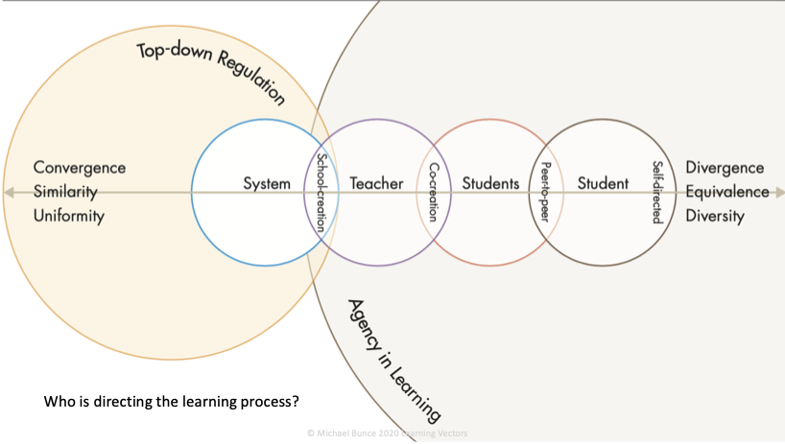
Notes:
Agency is more than voice and choice -
“Student Agency is rooted in the belief that students have the ability and the will to influence positively their own lives and the world around them. Student agency is defined as the capacity to set a goal, reflect and act responsibly to effect change“ (OECD 2030)
“It is about acting rather than being acted upon; shaping rather than being shaped; and making responsible decisions and choices rather than accepting those determined by others”(OECD 2030)
“Having agency means participating in active learning rather than passive learning and trying to work things out for yourself. It's also being willing to experiment, learn, fail, and then try again.” (SACE Strategic Plan 2020-2023)
The degree of agency in learning is often about who is directing the learning process. Whether it is the system, school, or teacher in a model characterized by top-down regulation; or whether students are co-creating with the teacher or co-creating peer to peer; and to what extent students are enabled to self-direct their learning.
Agency might seem tricky, given we are a system.
But all SACE is striving to do is to create a container - the requirements of the subject outline - that you the teacher fill with curriculum. Subject outlines are an artefact of what we explicitly value about a subject. Which is great. We need a level of consensus about that. But it has potential pitfalls too: by nature, it has to exclude. It has to restrict. It has to narrow possibilities. And this can prevent teachers and students from doing, and learning, valuable, discipline relevant things. So we want to include, expand, and broaden possibilities. Yes, there will still be confines, but broader confines within which students can drive their learning, with the outcome potentially being a broader range of ways in which we can see and assess what they’ve learned.
Additionally, we want to work with our subject communities in partnership to enable these opportunities for increased agency, divergence, equivalence and diversity in assessment.

Slide 25
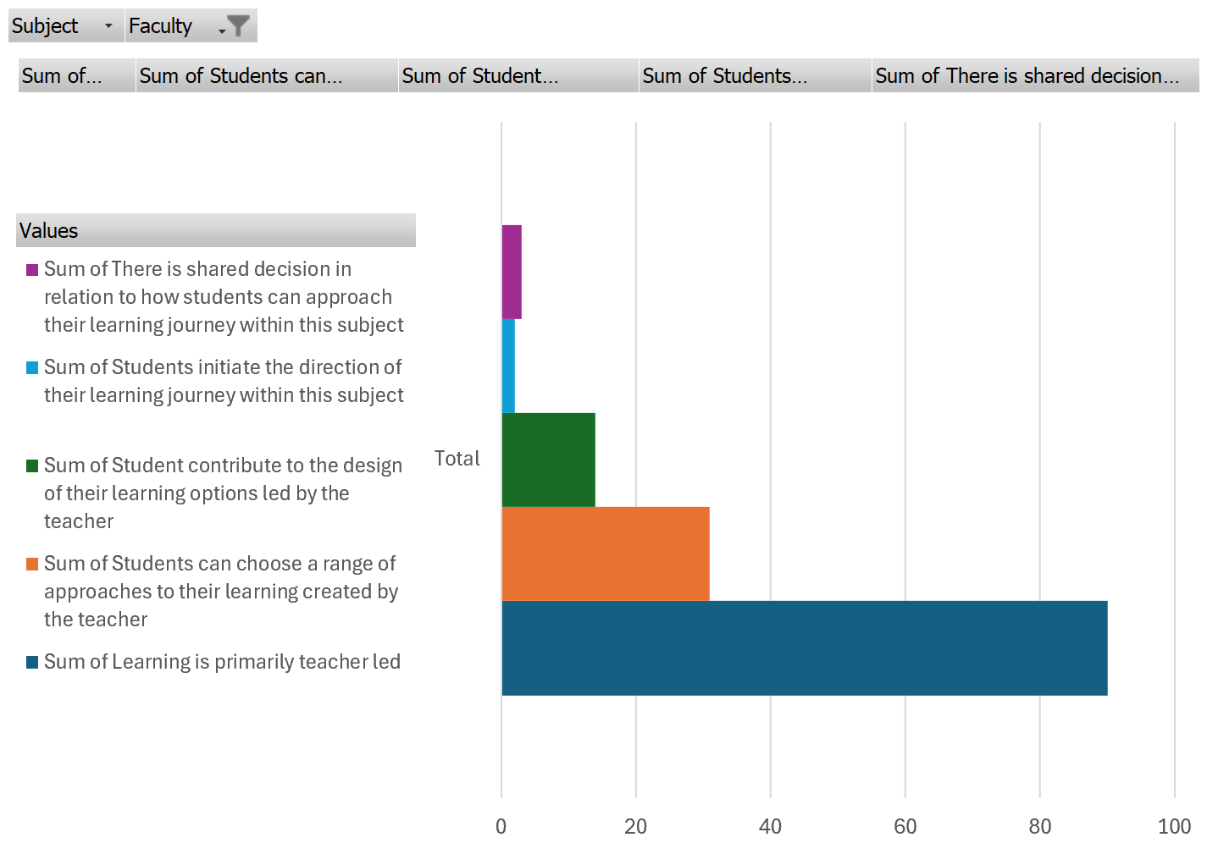
Notes:
This data is a summary of over 650 responses from teachers at curriculum forums across all subjects

Slide 26
To what extent do you have an appetite for change in this subject?
Notes:
The coloured bars each represent a different subject – but we can see some strong support for change, but also acknowledge that some subject feel like they don’t need to change.
Highest are:
Food & Hospitality
Languages
Essential Maths
Drama
Lowest appetite are:
Aboriginal Studies
Philosophy
Health and Wellbeing
Integrated Learning

Slide 27
Notes:
The SACE is acknowledging that we need a new definition of success as we know that young people are learning a lot more than we recognise.
At a technical or practical level – we will continue to validate and refine our capability frameworks.
We will continue to work with pathway providers to ensure the utility or value of the capability data.
This requires teachers to deliberately design teaching and learning opportunities for capabilities to emerge and evolve.

Slide 28
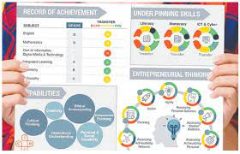
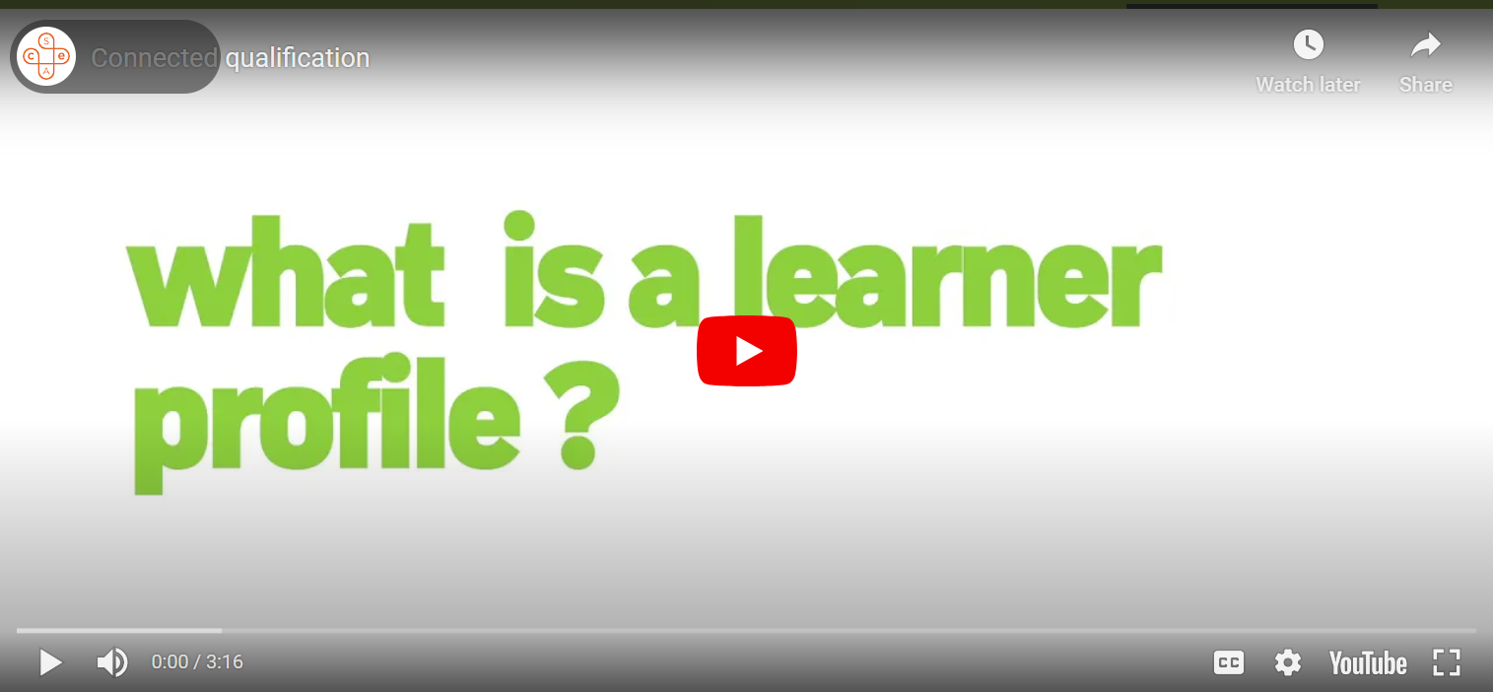
Notes:
The work on capabilities, the learner profile and recognition is not new.
SACE tested an early Learner Profile prototype in 2019.
This supported students, teachers and the community to conceptualise what assessment of capabilities and their visualisation in a Learner Profile might look like.
We also created a ‘Thrive Launchpad’ on our website to create awareness and desire in the community.

Slide 29
Key features of our capability frameworks
Developmental and assessment tool
Generic and transferable across all contexts
Objective
Progressions of observable behaviors
Language: strengths-based verbs
Notes:
The capability frameworks are designed for teachers and students and are:
developmental tools to guide learning, teaching, and assessment
objective measures of observable behaviours and skillful actions
able to capture evidence of capability development across a range of subjects and contexts within and outside of the classroom

Slide 30
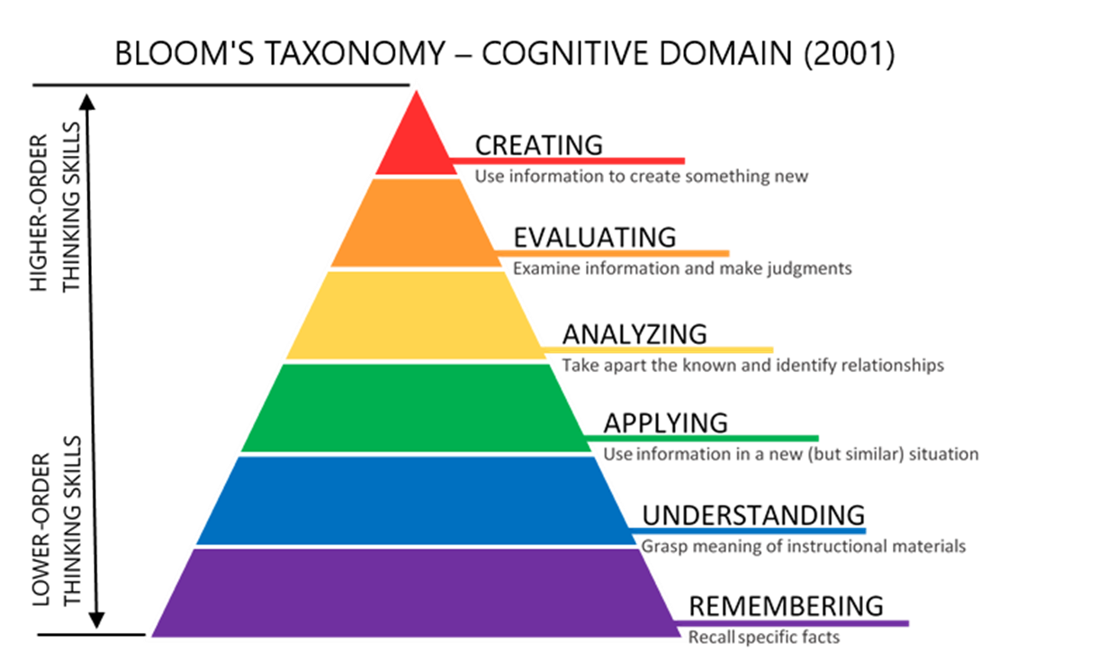
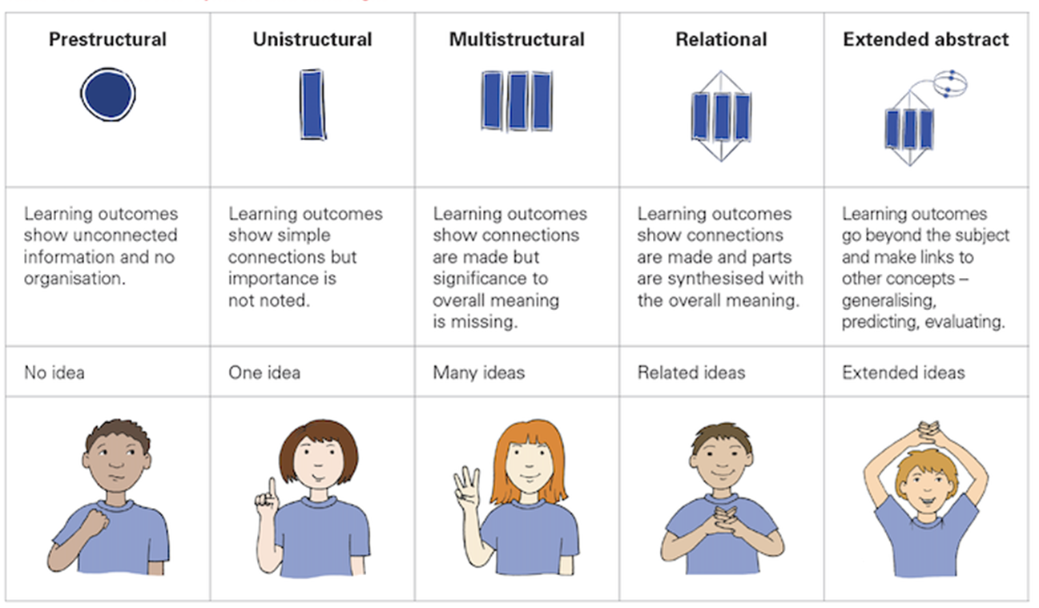
Increasingly complex learning: pilot 1 frameworks
SOLO Taxonomy
Notes:
The frameworks have matured in sophistication and validity over the past three years.
There is an evolution from the initial frameworks built using Bloom’s taxonomy in conjunction with the Structure of Observed Learning Outcome (SOLO) taxonomy.

Slide 31
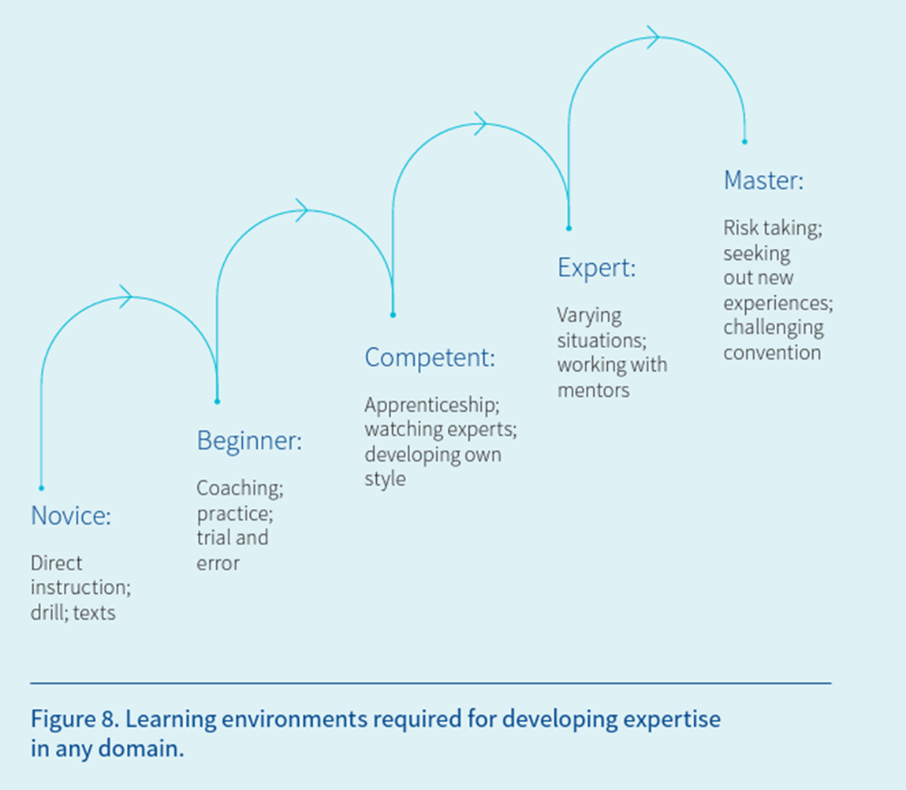
Increasingly complex learning: pilot 2 frameworks
Dreyfus & Dreyfus
SOLO Taxonomy
Milligan, S. K., Luo, R., Hassim, E., & Johnston, J. (2020). Future-proofing students: What they need to know and how to assess and credential them., Melbourne Graduate School of Education, the University of Melbourne, Melbourne. P.33
Notes:
The evolution of the capability frameworks incorporated the work of Dreyfus and Dreyfus in Pilot 2.
This evolution supports the focus and development of students’ competency across the elements in the capabilities.
Incorporating the Dreyfus and Dreyfus model has strengthened the revised capability frameworks and supports flexibility in program design so teachers can create learning environments to engage and inspire their students.

Slide 32
Capabilities alignment
Australian Curriculum General Capabilities | National Research (New Metrics) Complex Competencies | Emergent SACE Pilot Capabilities
Literacy Numeracy ICT |  | Captured in current certificate
Critical and Creative Thinking | Quality Thinking | Quality Thinking
Personal and Social Capability | Character Agency in Learning Collaboration | Self-motivated Learning Personal Enterprise
Ethical Understanding | Acting Ethically | Principled Action
Intercultural Understanding | Active Citizenship | Collective Engagement
 | Communication
Notes:
- We can see that the SACE capabilities in pilot are closely aligned to the Australian Curriculum General Capabilities and the New Metrics Complex Competencies.
- We are ensuring a seamless integration and coherence across educational frameworks. This approach prepares our students to confidently connect with their chosen pathways, equipping them with the skills and mindset essential for success in their future endeavours.

Slide 33
Our partnerships
OFFICIAL
Notes:
- We have strengthened our existing relationships and developed new partnerships.
- We created a formal committee of tertiary institutions (under Terms of Reference) committed to looking at alternate entry pathways.
- There is strong consensus on most valued capabilities across schools and the tertiary sector.
- This Tertiary Advisory Group (TAG) contributed to the development of the elements and the emerging SACE capabilities.
- Each institution proposed valued qualities and skilful actions that led to graduates who were successful at university or TAFE – these aligned to their Graduate Qualities.

Slide 34
Business & Industry Connections
Notes:
Engaging with industry – we also heard that the impact of a learner profile to have value beyond the student, it would need utility and portability for employers.
We created new pacts with industry partners, beginning with the SA Skills Commission and their 7 Industry Skills Councils.
It was clear that capabilities are highly valued in the workforce, and in most cases, over grades and technical skills.
We tested the value and utility of the frameworks with Industry.
We have a SACE presence on Volunteering SA&NT and Student Volunteer Army project working group, which is looking to recognise formal and informal volunteering of students – this is a 2024 pilot with SA Government schools
SEEK support direction of travel as representing value to employers + alignment of SACE capability elements to SEEK Transferrable Skills Checklist
Business SA also are supportive of the project’s intent.

Slide 35
SACE Capabilities in pilot
Collective Engagement
I can be inclusive of ideas, people and perspectives to generate purposeful outcomes.
Personal Enterprise
I can demonstrate initiative, pursue opportunities, produce outcomes of value and ‘get things done’.
Principled Action
I can be responsible for my actions and consider the impact I have. I can learn from my own experiences and the experiences of others and ‘do the right thing’.
Quality Thinking
I am curious about the world around me and use a range of thinking strategies to shape my understanding.
Saturn is the only planet with rings in the entire Solar System
Self Motivated Learning
I can embrace challenges as opportunities and persevere and be active in my own learning.
Notes:
- These are the SACE capabilities in pilot.
- The words in bold are the ‘drivers’ the reflect the essence of the capabilities.

Slide 36
Elements in pilot
Activating curiosity
Adapting
Analysing and reasoning
Being accountable
Being considerate and caring
Being organised
Being reflective
Demonstrating initiative
Demonstrating perseverance
Demonstrating respect
Developing informed opinions
Embracing diversity
Forming relationships
Making contributions
Operating with self-direction
Producing an outcome
Refining strategies
Taking opportunities
Using Feedback
Working with Challenges
Inquiring
Being creative
Notes:
In pilot 2 we tested an elemental model of the capabilities; and these are the elements, or building blocks, of the capabilities.
Elements are the teaching point, and formative point of development and demonstrating them looks different in different contexts. For example, Demonstrating perseverance when working inclusively with other people or ideas looks different to when a student perseveres in their own learning. But the fact that they are persevering is the same in both contexts.

Slide 37
Notes:
We recognise that capabilities and their elements are technical and it is important that teachers have a technical appreciation. We have also learnt that communicating the essence of the capabilities that being valued by the SACE Board and others is important when it comes to supporting students and the broader school communities awareness and desire for capabilities is important. What is offered on screen and in our strategy documents is way to talk about the capabilities to the broader school community.

Slide 38
Our Journey
Notes:
A visual representation of the vision and direction of the ambition of the Board’s Strategic Plan.
This visual representation of student capability development (the Learner Profile) was issued to students in Pilot 1 and students in Pilot 2.
The image encapsulates all the complex work required to realise the vision; including teacher judgement, student agency, capability frameworks, tertiary entrance and employer utility.
The visual is an initial concept that will be further developed or changed in future work.

Slide 39
Participation data: pilot 1, 2022
Start of pilot 1
31 schools
94 teachers
314 students
13 schools
withdrew
2 schools chose to not receiving a learner profile
End of pilot 1
31 schools
16 schools proceeded
68 teachers
216 students completed
Notes:
This is an overview of the number of schools and participants of pilot 1.

Slide 40
Participation data: pilot 2, 2023
42
302
1,202
SATAC
An independent tertiary advisory group
Local and national industry bodies
pilot
schools
pilot participants (leaders, teachers, advocates)
students across Stage 1 and Stage 2
Notes:
In this pilot, we tested:
Inclusion of student evidence from outside the classroom (extra-curricular, personal experience, intentional activities)
Ability of schools to embed capability development and evidencing opportunities within existing structures and programs
Ability of teachers to evidence 5 capabilities and embed opportunities within their classroom
Accessibility and opportunity provided by the capability constructs (equity)
Accessibility and validity of the elemental model (usability of language, fit for purpose/fit for use, identifying opportunities with students)
The types of support students need to successfully demonstrate their capabilities
Fit for purpose QA model

Slide 41
Pilot 3
Resources & Communication
Co-developing resources and communication collateral to capture learnings of pilot schools.
Student Agency
Support Networks
Testing prototypes to support the development of student agency.
Testing the use of support networks to connect to pilot schools
Capability Constructs
Self Assessment &
Formative Use
Testing the validity and accessibility of the capability constructs with diverse student cohorts.
Student focused self assessment and formative use of the capabilities frameworks.
Pilot 3 will focus on…
Quality Assurance
Innovation Learning Design
Testing a fit for purpose quality assurance process provides confidence in the integrity of the certificate.
Capturing teacher practice in innovation learning design creates opportunities for developing capabilities.
Access Future Pathways
Capturing student voice and understanding of the Learner Profile, and its utility to access future pathways including employment.

Slide 42
What we are testing
Self assessement, goal setting and valuing the formative power of the frameworks and the progressions as a developmental as well as an assessment tool.
The structure of formative and summative activities to create opportunities for students to develop and demonstrate capabilities.
Students understand better matching and approach to develop capabilities.
Students feel a shared owenrship of the assesmsent process. Students play an important role in recognition and assessment of capabilities.
Supported and reduced workload for pilot teachers.
01
Formative Power
02
Learning Design
03
Better Matching
04
Student Agency
05
Workload

Slide 43
Capabilities and Learner Profile project
Develop capabilities
Showcase in a Learner Profile
Evidence of knowledge, skills, capabilities that will better match students to post-school pathways
Through:
Subject learning
Extra curricular activities
Personal experience
School activities
Formally recognise
Teacher
Schools
SACE Board
Supports student understanding and development of capabilities in subjects
Support students in identifying opportunities to develop and show their capabilities in extra curricular, personal experience and school activities
Formally recognises and quality assures
Notes:
Through the Capabilities and Learner Profile the SACE Board is piloting ways to showcase and formally recognise not only a student's achievement in their chosen subjects, but also their skills and capabilities. This is an ambitious project, and in it we are testing to see if:
The capabilities students are developing through their subject learning, extra curricular, personal experience and school activities
Can be formally recognised, and then
Showcased in a learner profile, that students can use in whatever post-school pathway they choose.

Slide 44
Notes:
How we will assure quality
The evidence required and produced by students is going to look different to evidence in past,
It won’t be just essays, tests and reports.
Therefore we need a new process for assuring quality can be maintained in a way that is fit-for this purpose.
We need to enhance and update our approach to assessing what young people know and can do through new forms of evidence.
This will lead to greater confidence for our students and the community in terms of integrity of results that are fair, valid and reliable.
We need to build on the high trust we have in teachers’ professional judgement and look for ways to provide more effective feedback.
This means moving quality assurance dates so that we can see how a student progresses and provide feedback in time.

Slide 45
Assuring Quality
Nature of Evidence
How do we define an 'authority'
Trust
Extended verification
Quality assurance that builds capability
Notes:
During the past three years of the SACE Board’s previous strategic plan; the SACE Board gathered some emerging learning about quality assurance across the three key projects.
What emerged were the following key themes:
Nature of Evidence – how can we quality assure a broader range of evidence
How do we define an 'authority’ – for example in the Aboriginal Recognition Project - the Community Elder or Leader is an authority on ceremony and community business
Trust – what level of evidence and trust is required to confirm a teacher’s assessment decisions
Extended verification – what scope is there for ‘raters’ that are not qualified teachers?
Quality assurance that builds capability – how might our process provide professional learning and assurance quality

Slide 46
AIF and EIF Front Loaded Moderation
Builds capability within schools
Strengthens partnership and shared responsibilities
Provides timely actionable feedback
Feedback is relevant and authentic
Broaden the capability within the system Strengthen high trust in teacher professional judgment
Professional learning and quality assurance
Notes:
As an example, we have been exploring a new form of quality assurance that invests resources during the teaching and learning program rather than at the end of the course.
Front loaded moderation has been trialed in EIF and AIF over the past two years and what we have found is that the trail process has been effective in:
Building capability within schools
Strengthening partnership and shared responsibilities
Providing timely actionable feedback
Relevant and authentic Feedback
Broadening the capability within the system Strengthen high trust in teacher professional judgment
Providing Professional learning and quality assurance

Slide 47
Capabilities embedded in Subjects
Recognition of Learning
Stand-alone Capability Judgments
All students undertake SACE subjects, and all subjects will be designed to intentionally develop student capabilities
Align elements of capabilities with subjects that provide natural affordances for capabilities
Deliberately designed curriculum (teaching, learning and assessment) to provide opportunities to develop and evidence capabilities
Student SACE Journey / Learner Profile
Evolution from a Record of Achievement to a Learner Profile
How students equitably develop capabilities through the SACE and have them valued and recognised
All students undertake learning outside of the classroom and outside of school. Students learning is more than a subject grade
Recognition of Aboriginal Cultural Knowledge and Learning
Recognising the capabilities developed when involved in extra-curricular activities
Recognising the capabilities developed when involved in learning outside school
Teachers are well-placed to make judgements on student capability development (relationship + time)
Capability judgements submitted twice a year by raters inside and outside of the classroom.
Capturing a range of contexts
Notes:
This slide conceptualizes how development, recognition and certification of capabilities can be integrated into the learning of the SACE.

