Slide 1
AT2 Creative Connections Composition COMMENTARY

Slide 2
Approach on compositions
This set of compositions explores the boundaries of pop music. The intention was to present two contrasting songs by exploring texture as a technique for storytelling.
“Outlier” focuses on the general ‘pop feel’, while also incorporating harmonic and timbral interest. This song outlines individuality, represented through the empowering lyrics and techniques such as ‘unusual pop instruments,’ e.g. harp and accordion, as well as borrowing chords (Bbm to Eb⁹) in the chorus.
“Soul Eclipse” directly contrasts this, challenging Outlier’s carefree, feel good approach through the textural and harmonic description of ‘bitter-sweet.’ Simplicity in the lyrics also implies the raw mutterings of a lonely and uncertain soul, though both compositions suggest the appreciation of another’s support.

Slide 3
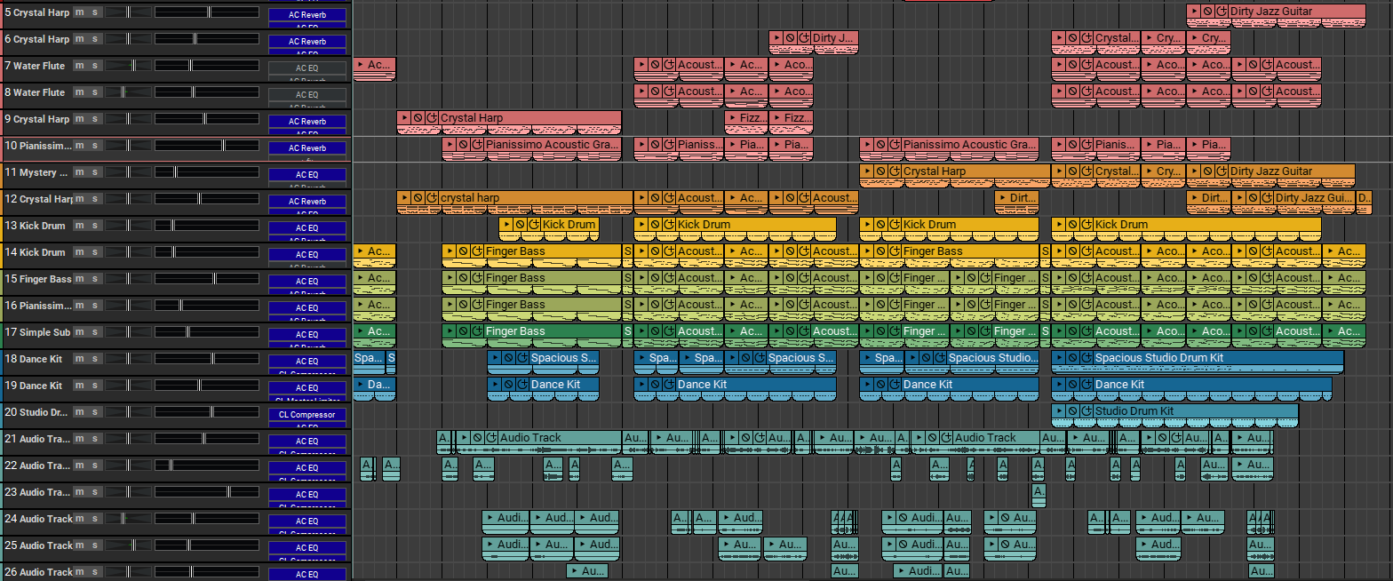
Composition 1
O u t l I e r

Slide 4
Compositional overview
Composer/ lyricist | Student
Length | 2:50
Style | Up-beat pop
Instrumentation | Harp, accordion, voice, piano, synthesiser, percussion, bass guitar.
Key signature | Bb minor
Structure | Intro, verse, chorus, verse, chorus, outro
Tempo | 126 bpm
Time signature | 4/4
Production program | Mixcraft 9 pro studio

Slide 5
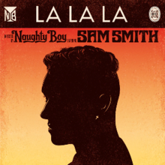
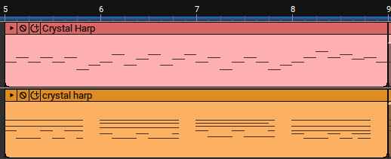

Stylistic influences
This composition generally revolves around current popular music, with a slight laid-back feel. After writing the lyrics and creating the concept of the song, certain timbres and harmonic techniques were used to musically emphasise the ‘individuality’ of the song itself.
The most influential artist in the compositional process was Naughty Boy and Sam Smith and their song, La La La, featuring a harp solo. This inspired the laid-back feel while also demonstrating the concept of ‘standing up for yourself’ through the lyrics.
Harp solo in La La La – Naughty Boy, Sam Smith
Harp solo in Outlier (introduction)

Slide 6
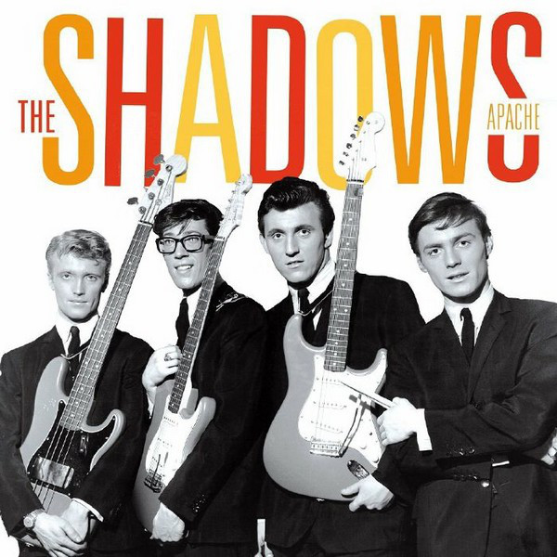
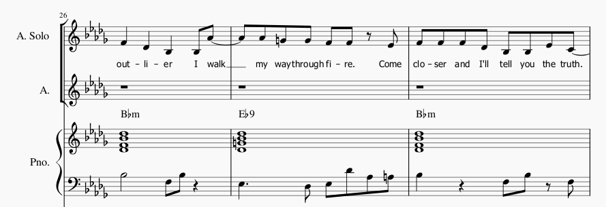
Stylistic influences
Harmonic interest was created by using Ebmin chords in the verses, then Ebmaj9 chords in the choruses, a borrowed IV chord from Bb dorian. This was initially inspired by parts of the Night At The Museum soundtrack, however upon further research, other songs that fit into the (older style) ‘popular music’ category shared this characteristic, e.g. Apache by The Shadows, 1960.
(bars 26-28)
Chord borrowing in Apache, The shadows
Chord borrowing in Outlier (chorus)

Slide 7
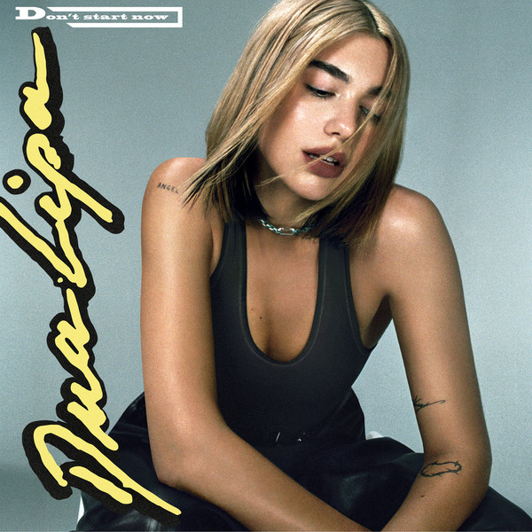
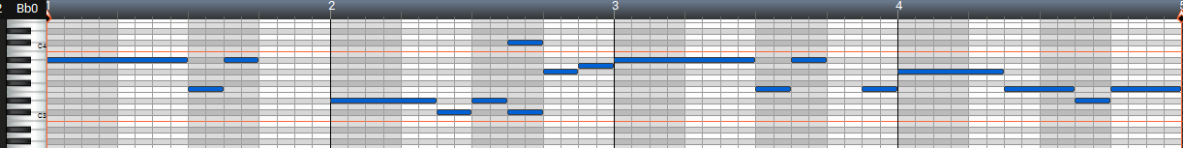
Stylistic influences
The emphasis on bass riffs and developments throughout the composition was heavily influenced by pop artists such as Dua Lipa and her song Don’t Start Now. The consistent repeated bass line through the choruses demonstrates familiarity, while creating interest through developments during verses.
Outlier features a repetitive bass riff which remains constant throughout the choruses almost as a part of the song’s hook. This is also introduced right at the beginning of the song to create the intended sense of familiarity.
Bass line in chorus 2 of Outlier
Don’t Start Now – Dua Lipa bass line in chorus
(bars 63-66)

Slide 8
Structural analysis
Introduction 8 bars | Bass riff from the chorus is introduced with an ‘adlib’ vocal line and a prominent kick drum. Second half (from bar 5) introduces the harp accompanying line as a solo.
Verse 1 16 (+1) Bars | Vocals start along with a sustained bass line as the harp continues. After 4 bars, kick drum enters with harmonising vocals. Kick drum stops in the last 2 bars for an atmospheric pause before the chorus. Last bar is a build up with an accented, syncopated bass solo.
Chorus 1 16 bars | Begins ‘stripped back’ with only main vocals, kick drum and the bass riff (soft chords played in the background by the piano.) percussion develops after first 4 bars. Accompaniment chords and percussion develop again after the next 4 bars.
Bridge 4 bars | Repetitive hook is introduced using the song title multiple times in the lyrics. Vocal harmonies added in second half.

Slide 9
Structural analysis
Verse 2 16 (+1) Bars | Bass has developed with faster rhythms. Accordion plays slow-moving countermelody underneath the vocal harmony layers. Vocal crescendo effect used to lead into chorus.
Chorus 2 16 bars | Edited 8vb vocals used rhythmically underneath the main vocals and add drive. Harp plays developed riff from verses, following the different chord progression. Percussion fully developed with added wood blocks etc.
Bridge 4 bars | New harp riff introduced, using similar rhythms with a different melody. Original hook and vocal harmonies are present.
Outro 8 bars | New harp riff continues with 8vb edited vocals. Drums fade out after 6 bars. Whole song slowly fades out to finish.

Slide 10
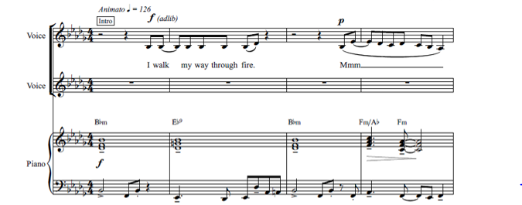
Introduction (1-8)
Bass riff from chorus is introduced right at the beginning along with adlib vocals using lyrics derived from the chorus.
Mood changes in bar 5, chord progression changes to verse chord progression (Bbm, Eb⁹, Bbm, Fm/Ab, Fm)
Harp solo between bars 5 & 8 to lead into the first verse.
(bars 1-4)

Slide 11
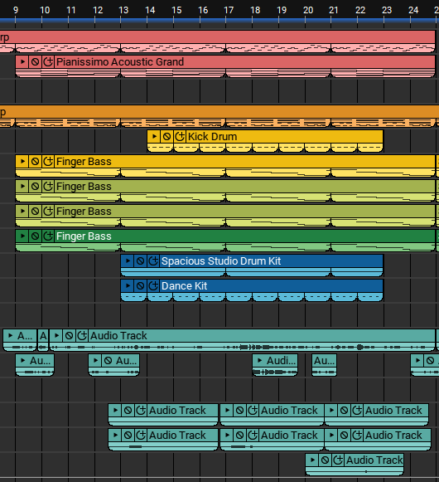
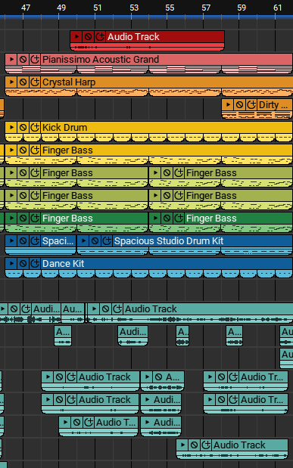
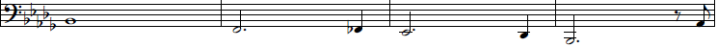
Verses (9-24) & (46-62)
(bars 9-24)
(bars 46-61)
Harp riff continues, solo vocals with manual reverb techniques begin.
At bar 13, vocal harmonies and kick drum enter. Kickdrum stops during the last two bars to ‘pause’ movement.
Repetition in solo vocal melody used in the first half. Second half develops through the introduction of new motives.
Verse 2 includes rhythmic and textural changes through the addition of a heavy kick drum at the start and a slow, subtle countermelodic line (in unison with the bass, excluding passing notes) played by recorded acoustic accordion. Percussion continues to develop throughout this verse.
Bass line develops significantly between verse 1 and verse 2, creating more of a ‘funk’ feel the second time round.

Slide 12
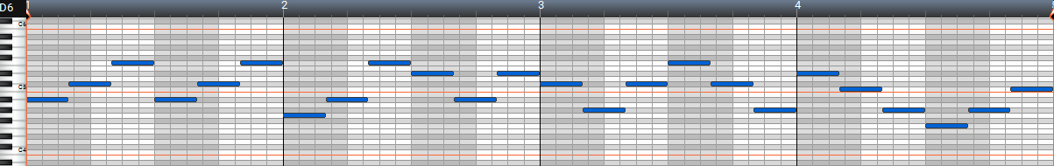
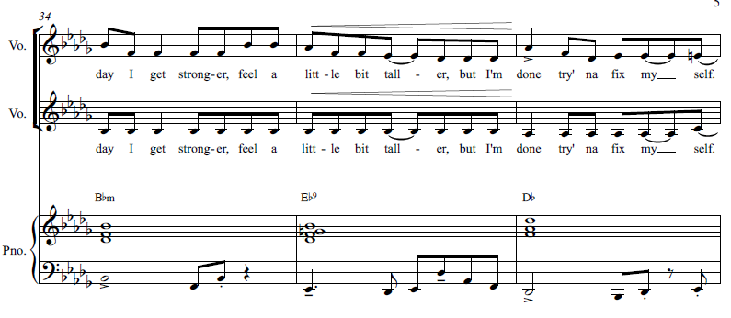
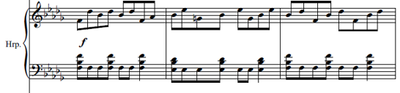
Choruses (25-41) & (63-78)
(bars 25-28)
First chorus begins ‘stripped back’, introducing solo vocals with bass and a kick drum. Layering used over whole chorus to thicken the texture and create interest.
Harp countermelody is played in triplets, causing a polyrhythm feel over the percussion and bass line.
Repetition used again in the first half of the chorus melody, then this develops melodically by moving to a higher pitch and a change in the chord progression:
(Bbm, Eb⁹, Bbm, Fm/Ab, Fm) to (Bbm, Eb⁹, Db, Fm/Ab, Fm)
Chorus 2 begins with a thick, developed texture, with the addition of the original harp solo derived from the verses, altered to suit the new chord progression.
Edited 8vb vocals add an interesting percussive element under the main vocals.
The bass line develops through additional or passing notes to maintain general familiarity.
(bars 34-36)
(bars 63-65)

Slide 13
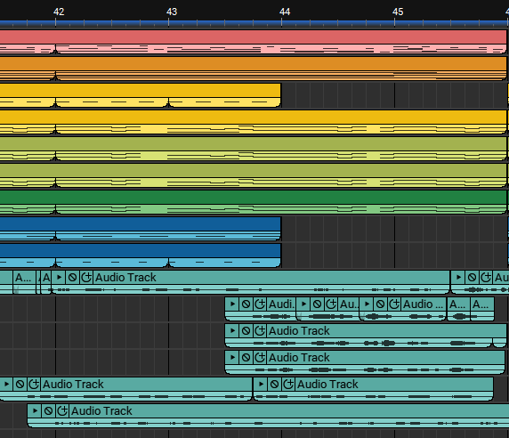
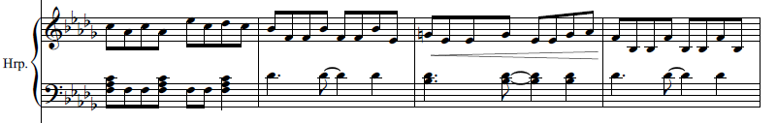
Bridges (42-45) & (79-82)
(bars 42-45)
The bridges act as an extension of the chorus and are the most noticeable ‘hook’ in this song, using techniques such as repetition, layering, and catchy rhythms.
The first half of the phrase displays a single vocal melody, where this develops through layered female backing harmonies and edited percussive vocals in the second half.
Harp introduces a new riff, with a steady rhythmic drive and new motive ideas. (this is more subtle in the first bridge)
(bars 78-81)

Slide 14
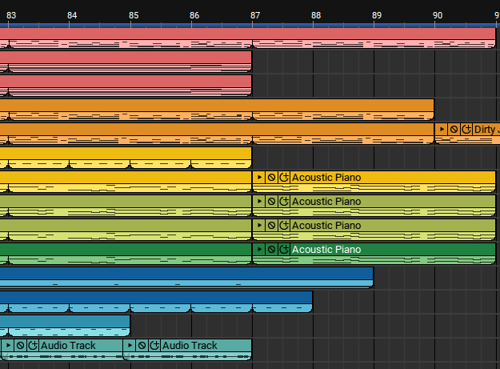
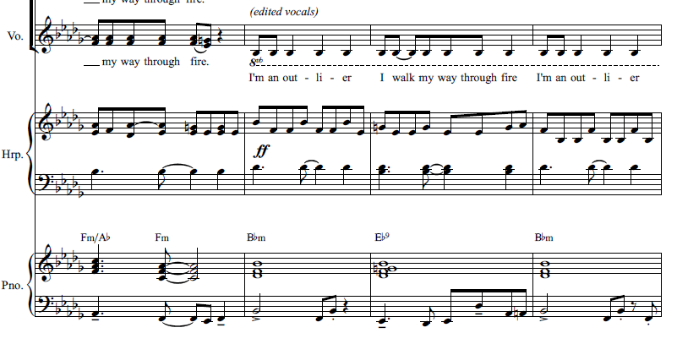
Outro (83-90)
Harp riff introduced in the bridges is carried through to the outro. Melodically, this riff creates a sense of completion through the repetitive notes and constant range of pitch.
Edited 8vb vocals continue (same rhythm as hook in bridges but moved off beat to create a new syncopation effect.)
Last 4 bars feature this new harp solo and the prominent bass line from the chorus once more before fading out along with the percussion.
(bars 82-85)
(bars 83-90)

Slide 15
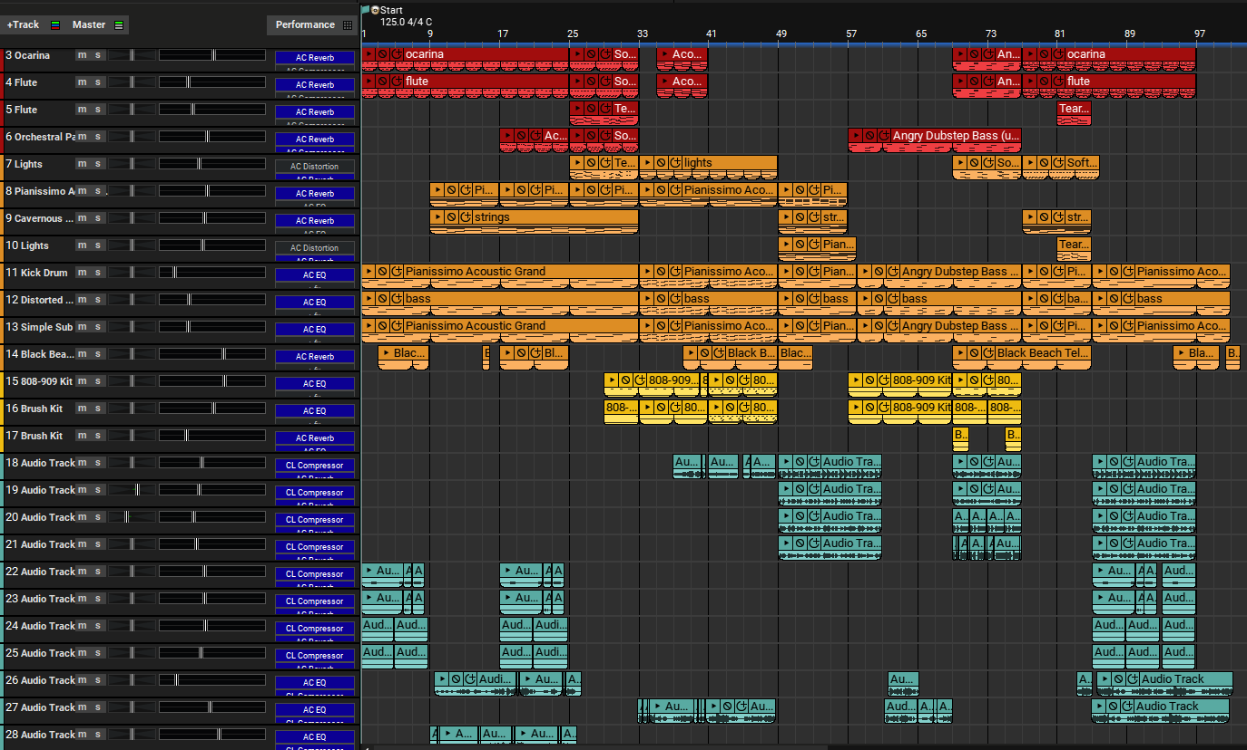
Composition 2 - Soul Eclipse

Slide 16
Compositional overview
Composer/ lyricist | Student
Length | 3:13
Style | Cinematic / eclectic pop
Instrumentation | Voice, flute, synthesisers, bass, piano, string ensemble, percussion, ambiance effects.
Key signature | Ab major
Structure | Introduction, Exposition: Theme 1, bridge, Theme 2 (part 1&2), Development, Recapitulation (Sonata form)
Tempo | 125 bpm (crotchet beats)
Time signature | 2/4
Production program | Mixcraft 9 pro studio

Slide 17
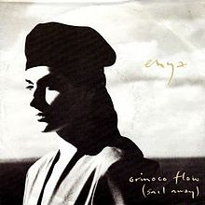
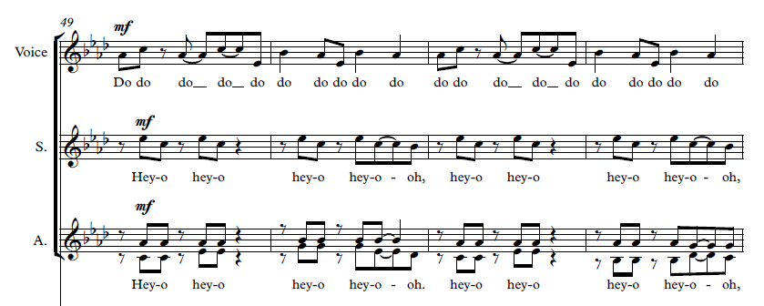
Stylistic influences
“Soul Eclipse” is based on an older and more cinematic approach to popular music with many aspects inspired by artists such as Enya and various movie and game soundtracks. The non-lexical vocable layering and harmonies in the second half of theme 2 are based on musical ideas from Enya’s award winning song, Orinoco Flow.
These were used to show development of emotions as it changes from sounding cheerful and light-hearted the theme, to dramatic uncertainty in the development section due to the harmonic development from major to minor.
Non-lexical vocables in Orinoco flow - Enya
Vocal layers in “Soul Eclipse” theme 2 part 2
Vocal layers in “Soul Eclipse” development
(bars 49-52)

Slide 18
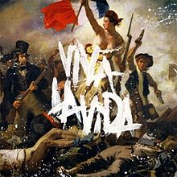
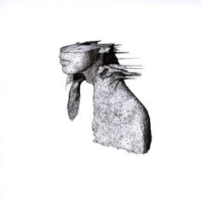
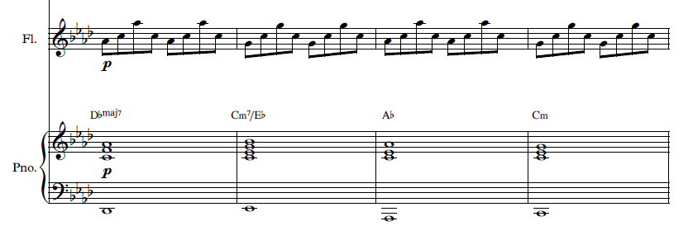
Stylistic influences
The chord progression of this composition was influenced by the thought provoking harmonies and chord progression of Coldplay’s Viva La Vida. The harmonic mood seemed appropriate due to the approach and message of Soul Eclipse, though the chords are not entirely the same.
Another Coldplay song, Clocks, inspired the use of arpeggios in the introduction (flute melody). Lyrically, Soul Eclipse follows many of the same themes including vague passing thoughts, worry, uncertainty, and love.
Viva La Vida chord progression - Coldplay
Clocks ‘arpeggios’ - Coldplay
Soul Eclipse arpeggio melody in introduction
Soul Eclipse chords in introduction
(bars 9-12)

Slide 19
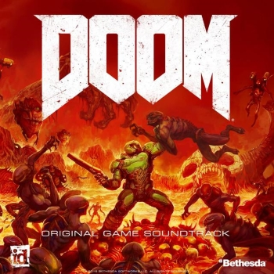
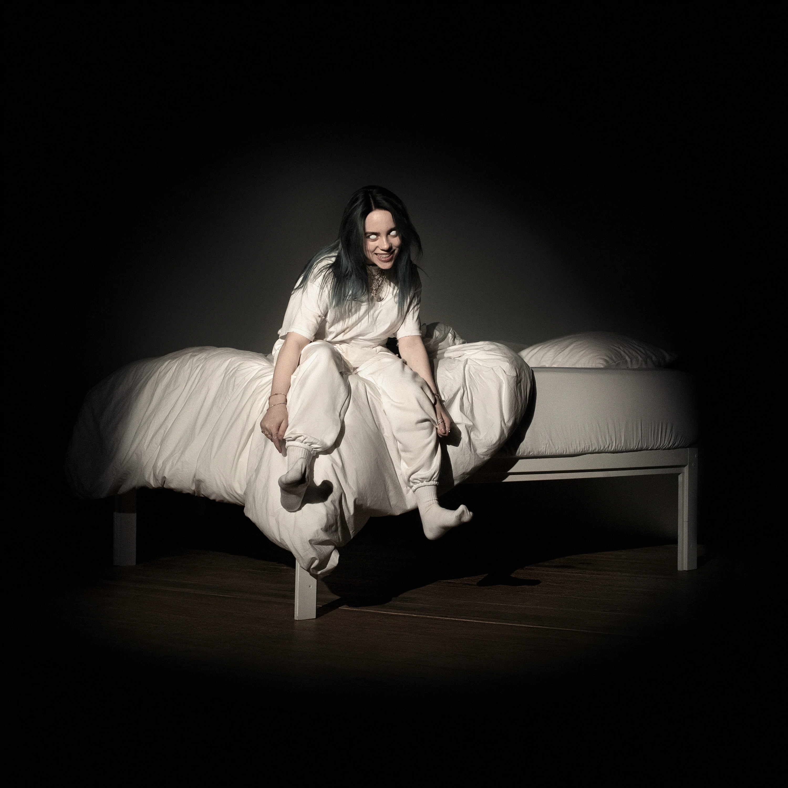
Stylistic influences
The development section creates a fearful and aggressive atmosphere through the use of rough bass synthesisers and darker harmonies. The very prominent diminished fifth in the bassline was influenced by general harmonic dissonance and modulations of the Doom soundtrack (Mick Gordon), as well as the ambiance effects.
This overall tone reflects a change similar to Billie Eilish’s Bad Guy, where at the end of her song, the atmosphere is noticeably darker with whisper-like vocals.
Bad Guy - Billie Eilish final section
Soul Eclipse development section
Doom soundtrack ambiance and bass solos
Soul Eclipse development section – ambiance and bass only

Slide 20
Structural analysis
Introduction 8 bars | Layered vocal harmonies along with flute playing arpeggios and sustained bass enter at the very beginning, setting the atmosphere.
Theme 1 16 Bars | Flute and bass continue with a solo vocal melody and sustained chords played by the piano. Harmonies from the introduction return after 8 bars, underneath the solo vocal. Synthesiser riff fades in over the next few bars as textural development.
Bridge 1 8 bars | New flute melody introduced with the piano chords and bass sustained underneath. Synthesiser subtly plays a developed arpeggio-like countermelody to accompany the flute. Short reverse cymbal and tambourine hit in the last bar of the bridge lead into the second theme.
Theme 2 28 bars | New chord progression introduced. Movement created with simple developed rhythms in piano accompaniment. Second part has multiple layers of vocals, sustained chords in a string ensemble, and an echoey smooth staccato synthesiser to emphasise the first beat of the bar (only piano accompaniment and vocals shown in score)

Slide 21
Structural analysis
Development 24 bars | Each layer of sound begins to change and introduce an eerie atmosphere. First half develops theme 1. Rough synthesiser bass becomes prominent, playing octave jumps, semitones, and diminished 5ths. Accompanying vocals edited an octave up or down, or as whispers. Second half develops theme 2, part 2, layering vocals with harmonies modulated into a minor key. Atmosphere created with sound effects throughout this section.
Bridge 2 8 bars | Strings and bass play sustained chords from theme 2, with countermelodies in an ocarina and synthesiser. After 4 bars, the flute plays the melody introduced in the first bridge.
Recapitulation 16 Bars | Theme 2 parts 1 and 2 are merged together in the recapitulation, as well as the sustained vocal harmonies from theme 1. All parts gradually fade out individually until only vocals are left, followed by a ‘crying’ atmospheric synth.

Slide 22
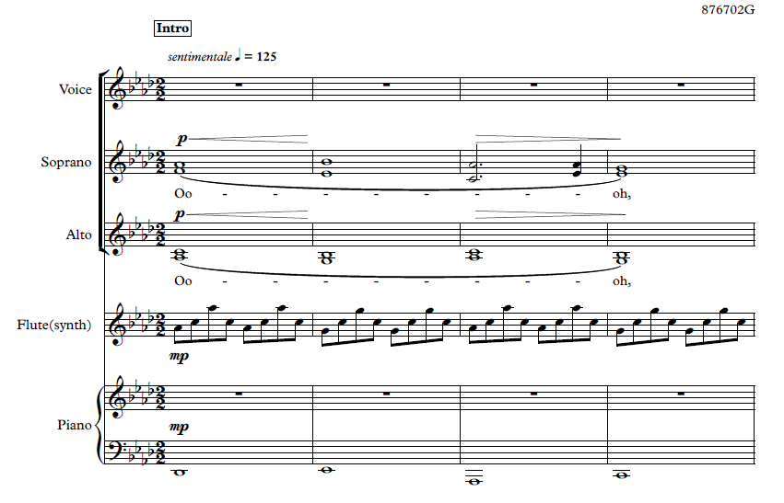
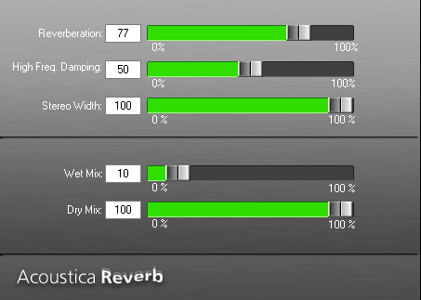
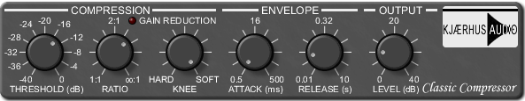
Introduction (1-8)
Atmosphere is set with vocal harmonies singing ‘ooh’ (production harmonies may differ) while following the 8-bar chord progression (Db^{Maj7}, Cm⁷/Eb, Ab, Cm, Db^{Maj7}, Eb, Fm, Abm⁷)
Flute accompanies vocals with ascending and descending arpeggios, creating movement, while bass notes are sustained.
Reverb effects and compressors were used on the vocals to widen the overall sound and surround the listener.
(bars 1-4)

Slide 23
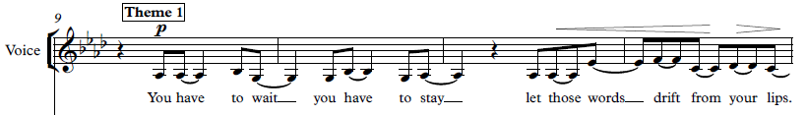
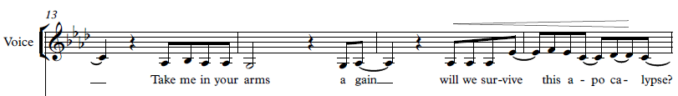
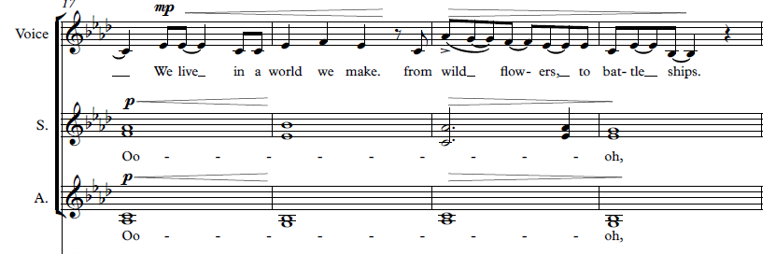
Theme 1 (9-24)
Syncopated rhythms were used for the main vocal melody to create a free speech-like sound.
Repetition is used with slight developments between bars 11-12 and 15-16.
(bars 9-12)
Melody is developed from bar 17 with new melodic ideas, at a higher pitch for emphasis on the lyrics. Vocal harmonies developed from introduction are reintroduced. (chord progression same as introduction)
(bars 17-20)
Last 4 bars vocal melody follows the first 4 bars, bringing back familiarity.

Slide 24
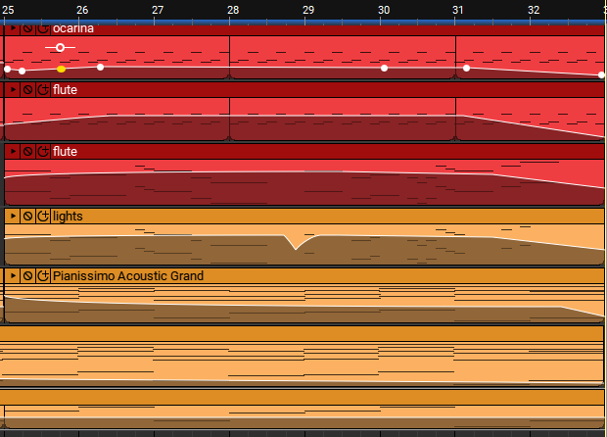
Bridge 1 (25-32)
Chords in accompanying instruments remain sustained as flute plays new melodic line and multiple instruments play subtle countermelodic arpeggios.
Repetition with small developments such as passing notes are used in the short flute melody.
Reverse cymbal and tambourine are used on the very last beat to lead into theme 2.
(bars 25-32)

Slide 25
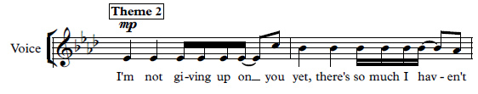
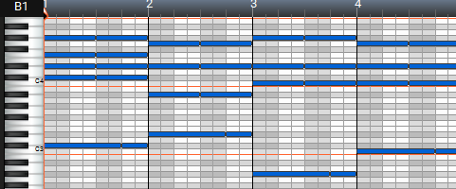
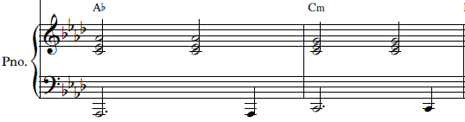
Theme 2 part 1 (33-48)
Rhythms in vocal melody contrast theme 1 by a reduction in syncopation, larger leaps, and at a higher pitch.
Simple percussion is introduced.
8-bar chord progression changed to create a hopeful mood (Db⁺⁹, Eb, Ab, Cm, Dbm⁷, Eb, Fm, Ab)
Piano rhythms developed slightly to create more textural movement.
Sequences used for main vocal melody, as the same 4-bar motive is repeated at alternate pitches with small rhythmic changes.
Vocal melody in the last 2 bars break out of sequence to end the phrase at a higher pitch with a descending line.
(bars 33-34)
(bars 33-36)
(bars 35-36)

Slide 26
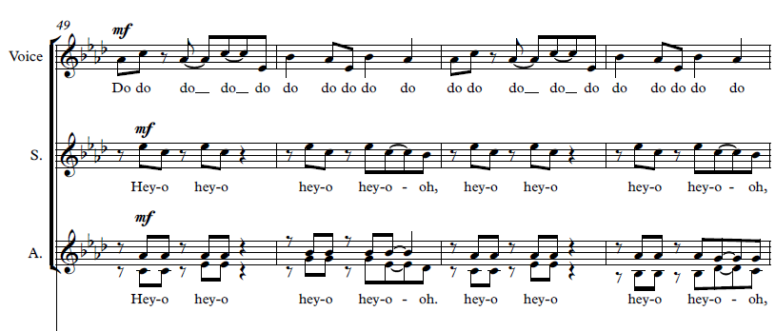
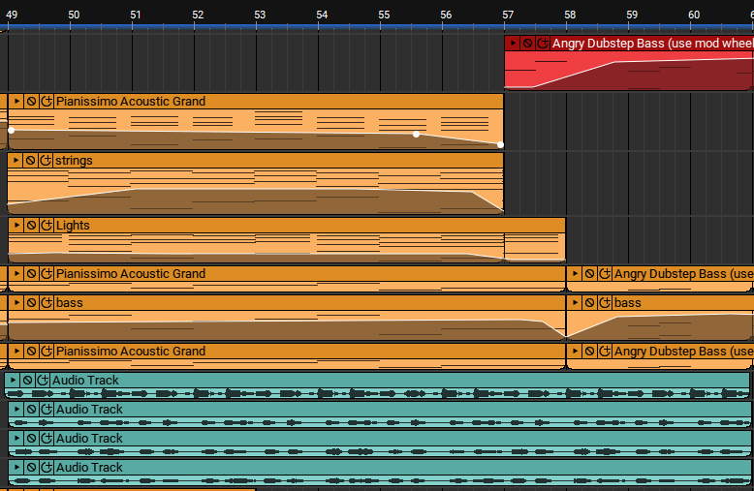
Theme 2 part 2 (49-60)
Non-lexical vocables are used in the layers of vocal harmonies. The main melody sings ‘do, do’ and the backing vocals sing ‘hey-o, hey-oh’ to create textural differences within the layers.
Sustained strings and piano accompany these vocal lines, along with a simple synthesiser and bass line.
Chords remain the same as part 1. Percussion is not present to emphasise the free flowing atmosphere.
Last 2 bars, bass changes to foreshadow the eerie feeling of the development section and blend the two together.
(bars 49-52)
(bars 49-60)

Slide 27
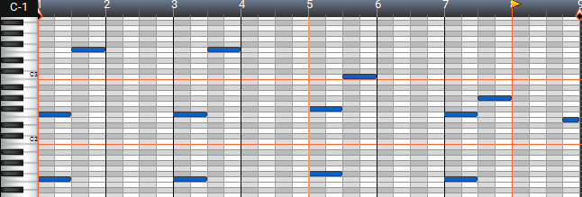
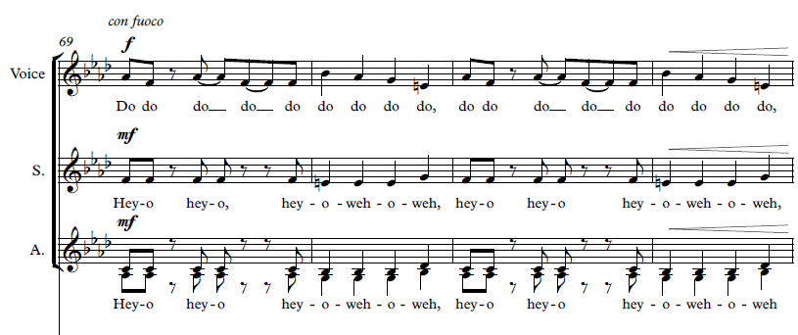
Development (61-76)
Vocals from theme 1 are reintroduced with an underlying rough synth bass playing octaves.
Whisper vocals are layered underneath the melody in bars 65-66, mirroring the lyrics ‘take my breath away again.’
Bass also changes to playing a diminished 5th at this point, creating harmonic tension.
Vocals in bar 68-69 are edited an 8ve above and below to thicken the texture and provide a ‘spooky’ feel.
Layering of the non-lexical vocables from theme 2 part 2 are developed through modulation into F minor and changes are made to some rhythms, most notably in the lead vocals.
(bars 61-68)
(bars 69-72)

Slide 28
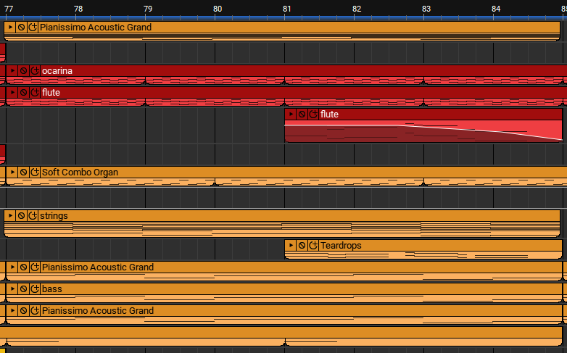
Bridge 2 (77-84)
Majestic sustained strings play chords from theme 2.
Ocarina and synthesisers play soft arpeggio-like accompanying melodies.
Delicate Flute melody from the first bridge enters at bar 81 with added reverb.
Adlib vocals from the development section are retrograded by editing, leading into the recapitulation with a reverse cymbal.
(bars 77-84)

Slide 29
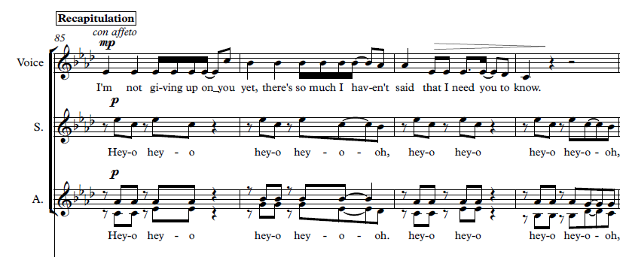
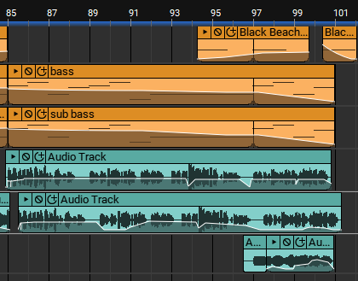
Recapitulation (85-100)
Theme 2 part 1 is reintroduced with theme 2 part 2 non-lexical vocables as backing harmonies, while also mixed with the introductory vocal harmonies (used in theme 1) (not all shown in score)
Sustained bass notes linger underneath vocals alongside soft chords in piano and strings.
Main vocals become solo with only simple bass accompaniment and soft background vocal adlib during the last 4 bars, fading out with ‘crying’ atmospheric sound effects.
(bars 85-88)
(bars 85-100)

