Slide 1
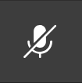



Welcome to the Industry Connections
Subject Implementation 2022
Write a question in the chat for our Q+A session after!
Please mute your microphone
This session will be recorded
If you could work in ANY industry, what would it be and why?
Go to www.menti.com
Type in code 4252 8862
Submit your response!
Notes:
Thank you to those who have helped contribute materials or ideas, including Heathfield, Adelaide Botanic, St Patricks, Department for Education, and a range of others across the school sectors. What we showcase today pools a lot of those ideas together.

Slide 2
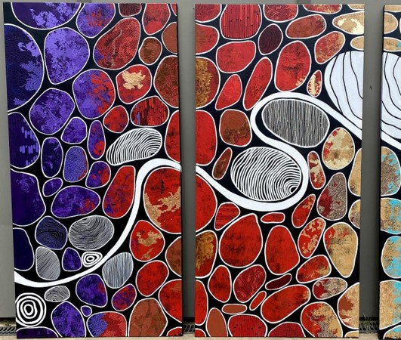
Acknowledgement of Country
We acknowledge that we are coming to you from on the traditional country of the Kaurna people, but many of us are connecting it from different traditional countries. We pay respect to Elders past, present and emerging.
We recognise and respect their cultural heritage, beliefs and relationship with the land. We acknowledge that they are of continuing importance to the Kaurna people living today.
Shared Journey; Own Path , Elizabeth Close 2020
Notes:
The artwork you see before you, Shared Journey; Own Path takes three of the core values that best speak to the aims of the SACE Board with regard to Aboriginal and Torres Strait Islander student success, taken from many conversations.
These core values are Agency; Belonging and Growth. Together these core values form a collective that reflect the student journey for Aboriginal Students towards their SACE. The line that meanders across the triptych represents this student journey. In order to thrive, a student needs to be able to have the agency to strive along their own path, and be able to make connections with those that can give them a sense of belonging and the mentorship to grow. Industry Connections was also created with these core ideas in mind.

Slide 3
Today’s Agenda
Overview of Industry Connections
Subject requirements
The role of VET
Learning and Assessment Plans -
How to make Industry Connections work for you!
Where to find key resources
AT3: The Project
Live Q+A
Please mute your microphone
Write a question in the chat for our Q+A session after!
This session will be recorded
Notes:
Slide outlining the session, further housekeeping
Please ensure you have microphone off
This session will be recorded
If you have any questions throughout the session, please add them through the chat.
We will also provide a bonus Q+A session live from 5:00, and this will also be later published for reference
If you haven’t already, go to menti.com and share your thoughts around the prompt provided

Slide 4

Industry Connections
Industry Connections provides students who have an interest in a particular industry area to develop and apply their skills, knowledge and understandings about that industry, while developing their capabilities and employability skills through an industry-related project.
A student’s interest in a specific Industry is the driving force behind this subject.
Developed with input from identified stakeholders from three sectors, in response to VET for School Students Policy
Will count towards the Stage 2 60 compulsory credits
Will not count towards an ATAR
Notes:
A new Stage 2 subject available as of 2022
Industry Connections has been developed at pace with input from identified stakeholders from three sectors, in response to South Australian VET for School Students Policy. Identified stakeholders in the NT were also consulted.
The subject provides a framework for industry-related learning where VET options may not be accessible, appropriate or available.
Industry Connections does count towards the Stage 2 60 compulsory credits
Industry Connections does not count towards an ATAR
This is a very high level view of the subject, and for more detail some key readings would be the subject outlines and the LAPs we are about to share – at the end of the session I will show where you can access those from.
In term’s of the subject identity, some questions you may have is how this subject fits in with subjects such as Community Connections and Workplace Practices. Well…

Slide 5
 | Workplace Practices | Industry Connections | Community Connections
 | “The World of Work” Learning about work and industry Incorporates theoretical knowledge of industries and workplaces, including government legislation, fair work practices and workers' rights and responsibilities. Focused on development of knowledge and skills of workplaces and workplace culture. | “Industry skills and pathways” Developing skills to get into and be in that industry Project-Based Learning, focusing on the students, their skills and applying their capabilities Focused on development of skills | “Belonging and Personal Identity” Development of learning and knowledge built upon a Stage 2 Subject of student’s choice Community Application
Key People | Teacher Workplace Supervisor | Teacher Industry Professionals and mentors | Teacher Community Mentors and members
Using VET as Evidence | Yes* | No, but may be related | No, but may be related
Conversion from other Subjects | No | No | Yes
Whole-Class focus | Yes | Yes | Yes
Individual Student focus | Yes | Yes | Yes

Slide 6
Industry Connections and VET
The subject provides a framework for industry-related learning where VET options may not be accessible, appropriate or available.
VET is not assessed in Industry Connections and students will not receive VET certification.
Students enrolled in a VET course can not use evidence used in the VET course as evidence in Industry Connections (eg, no ‘double dipping”)
However students may use the subject to learn, explore and refine their skills related to an industry in ways that prepare them and their development for a future pathway in their industry of choice.
Notes:
The subject provides a framework for industry-related learning where VET options may not be accessible, appropriate or available.
VET is not assessed in Industry Connections and students will not receive VET certification, however students may use the subject to learn, explore and refine their skills related to an industry in ways that prepare them and their development for a future pathway in that industry.
In SA, the policy changes to VET means some students may not be able to access VET the same way they did before. In the NT, your VET situation may be different, therefore, you may only need to use Industry Connections to be of relevance to the young person for their interests and pathways, rather than a VET-related Industry Pathway.
The flexibility of this subject gives you the OPTION of using the VET style of learning that students want to do.
This subject allows you to create skill-development opportunities that support career pathway.
Eg - “designed for students interested in an Automotive pathway, but who are unable to undertake a VET Automotive course towards Stage 2 of their SACE. Tasks within this LAP are modelled on the learning within some VET units of competency, but students do not undertake or achieve the VET units.
Evidence from the tasks within this LAP have been designed so that students may choose to use them as evidence at a later date to support their future career and transitions opportunities”

Slide 7


How can Industry Connections work for you?
We’d like to share with you examples that have been designed for:
A whole class approach that incorporates variety of student interest
  Highlighting the flexibility and student agency available in the subject
A whole class with a shared focus
  Highlighting the core principles of Industry Connections
  Applicable to a range of classrooms and contexts
A specific school context or a specific student
  Consider how you could adapt the subject to work for your context or student(s)

Slide 8
Key Words of the Performance Standards
 | Knowledge and Understanding | Application and Connection | Reflection and Consideration
C | Development of some specific knowledge and one or more concepts related to the selected industry focus. Development of one or more skills related to the selected industry focus. | Demonstration of some clear, relevant connections between the industry project, industry specific knowledge and skills, and one or more chosen capabilities. Demonstration of some planning, and organisation to undertake the industry project. Some connection of the benefits and future possibilities of the industry project to the industry and themselves. | Considered reflection on the development of some knowledge, concepts, skills and new understandings related to the selected industry focus. Considered reflection on the development of planning, organisational, problem solving and decision-making skills through their industry project. Some consideration of the development of one or more SACE capabilities using evidence of actions taken.

Slide 9
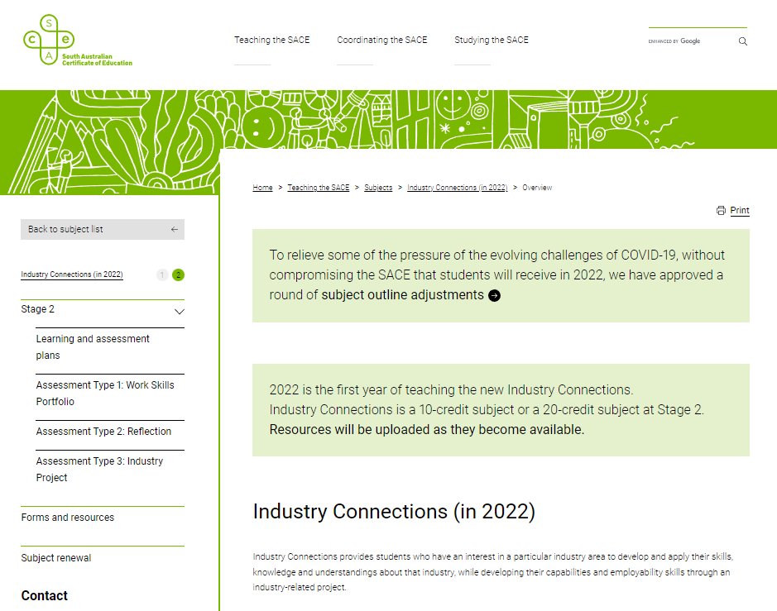
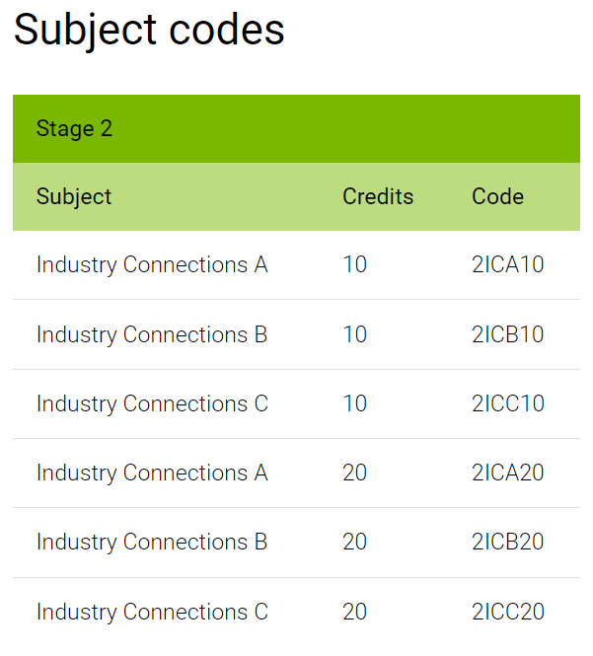
Available Resources
Notes:
There are now a range of resources available to support those implementing Industry Connections, including
Pre-approved Learning and Assessment Plans – these can be adjusted and changed to suit your students and contexts
Example Task Sheets
Additional information can be found in Forms and resources, including last years slides, a planning flowchart, and some ideas on what the AT3: Project can look like

Slide 10
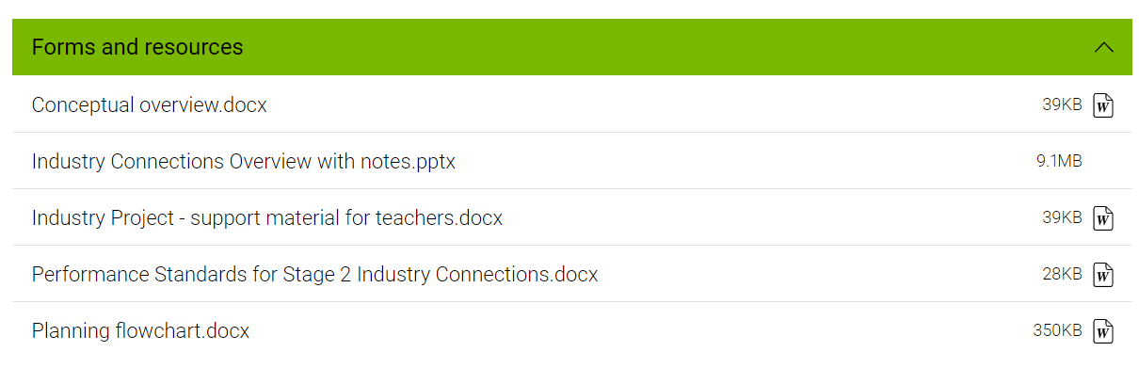

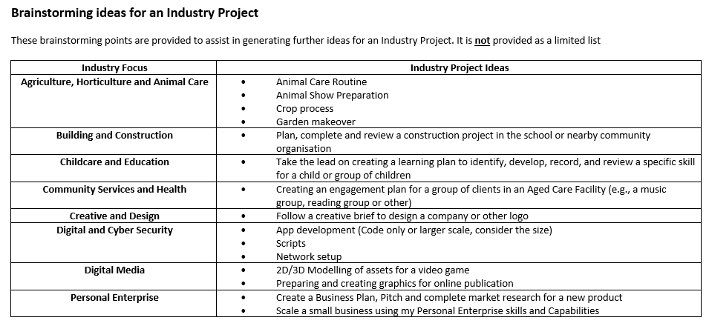
AT3: Industry Project Support
Notes:
This assessment type relies heavily on student interest and choice, which requires a delicate balance of fostering, facilitating with a dash of scaffolding. While a Project should be something that comes from the student authentically, we can appreciate that students and teachers want a picture of what that could look like.
As outlined, we currently have the Industry Project – support material for teachers.docx, which has a range of ideas available (demonstration of document)

Slide 11
Brainstorming Project Ideas!
We want to expand this list!
At the start of the session, we asked “If you could work in ANY industry, what would it be and why?”
Now, what is a project you would love to do in that Industry (or any Industry)? Consider:
A task that would be realistic
A project that would be considered innovative
An inspiring challenge
Go to www.menti.com
Type in code…
Submit your response!
Notes:
We want to expand this list!

Slide 12
What next?
Looking for student exemplars to provide
  Please send any examples to askSACE@sa.gov.au marked “Industry Connections” in the subject line
Looking for Moderators and Markers
  Go to https://www.sace.sa.edu.au/teaching/professional-learning/apply-for-a-panel
Aiming to run more bite-sized seminars on Industry Connections
  Explore AT1: Work Skills Portfolio
  Understanding and being confident with the Performance Standards
Right now: Bonus FAQ! Please stay on the call for a live Q+A
Notes:
Looking for exemplars:
- Facing the classic chicken-egg challenge - wanting to provide exemplars for school use, but need to run the course to be able to complete the exemplars to provide! Please be patient and keep the course principles and performance standards in mind
Moderators + Markers
Looking for interest in those who want to be a marker or moderator. All are welcome to apply, particularly those who are already teaching it, or have a background in Community Connections
Future Seminars:
We know everyone is busy and has been impacted by COVID one way or another, so all these sessions will be short, hour long, and recorded
This is the official end of the seminar, however We’ve received some questions during the session, so you are welcome to stay on the line for a live Q+A, or leave if needed. This recording will be made available, as will any Frequently Asked Questions.

