Slide 1

Industry Connections
New Stage 2 subject in 2022
A1062778
Notes:
Industry Connections is a brand new subject being delivered for the first time in 2022.
Industry Connections is designed as a SACE subject where students can develop and apply their skills about an industry. It is extremely skills and practice focused.
At the same time as practicing and developing these skills, they also develop knowledge and understandings about that industry, as well as their capabilities and employability skills through the undertaking of an industry-related project.

Slide 2
Industry Connections
A new Stage 2 subject to be available from 2022
Developed at pace with input from identified stakeholders from three sectors, in response to VET for School Students Policy
Will count towards the Stage 2 60 compulsory credits
Will not count towards an ATAR
Notes:
Industry Connections has been developed at pace with input from identified stakeholders from three sectors, in response to South Australian VET for School Students Policy. Identified stakeholders in the NT were also consulted.
The subject provides a framework for industry-related learning where VET options may not be accessible, appropriate or available.
VET is not assessed in Industry Connections and students will not receive VET certification, however students may use the subject to learn, explore and refine their skills related to an industry in ways that prepare them and their development for a future pathway in that industry.
Industry Connections does count towards the Stage 2 60 compulsory credits
Industry Connections does not count towards an ATAR

Slide 3
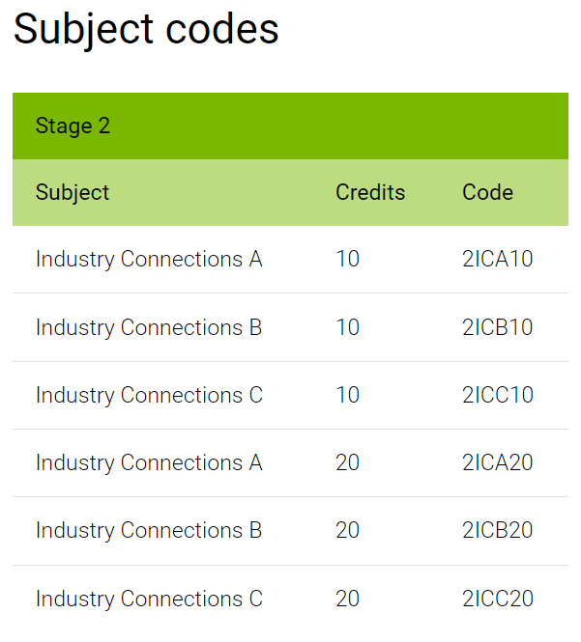
Notes:
There are a range of 10 and 20 credit options.
There is no difference between A, B and C – these are enrolment codes to provide flexibility for individual students to undertake multiple Industry Connections subjects, and for schools regarding administration of multiple programs .
There are preclusions – see slides 13 and 14.

Slide 4
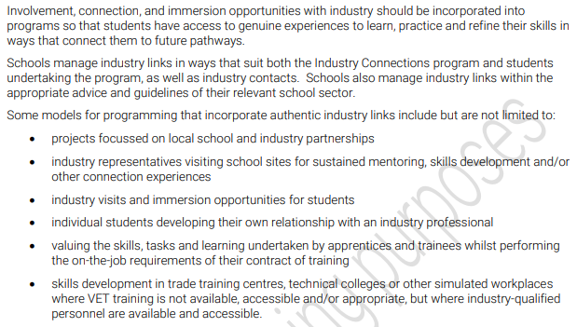
Industry focus, approaches to programming, p6
Notes:
P6 of the Subject Outline provides guidance about determining an Industry focus and various approaches to programming.
Involvement, connection and immersion opportunities in industry should be incorporated – schools manage these at their local level in ways that are relevant to the program

Slide 5
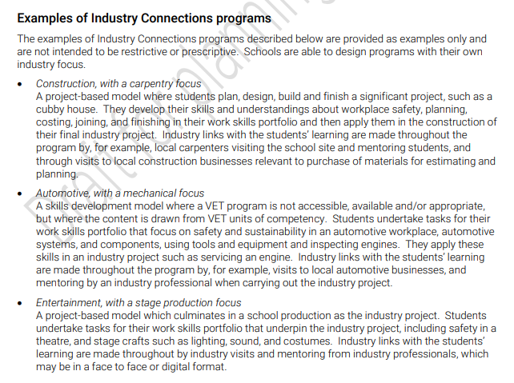
Examples of programs, p6-7
Notes:
P6&7 of the Subject Outline provides examples of programs.
Each program should have an authentic industry focus with authentic industry exposure and immersion.
Often this may be related to a VET industry or an occupation within an industry.

Slide 6
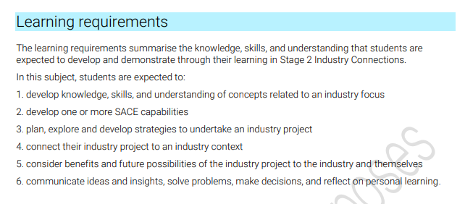
Learning requirements
Notes:
From the subject outline

Slide 7
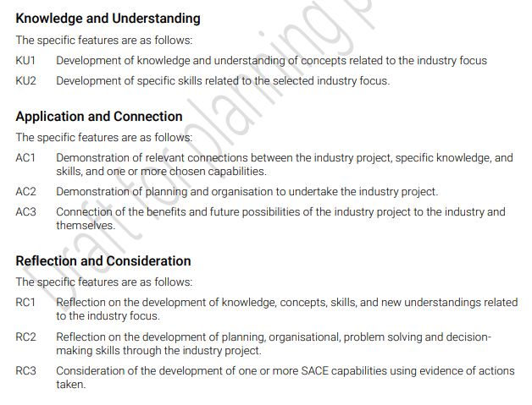
Assessment design criteria
Notes:
From the subject outline

Slide 8
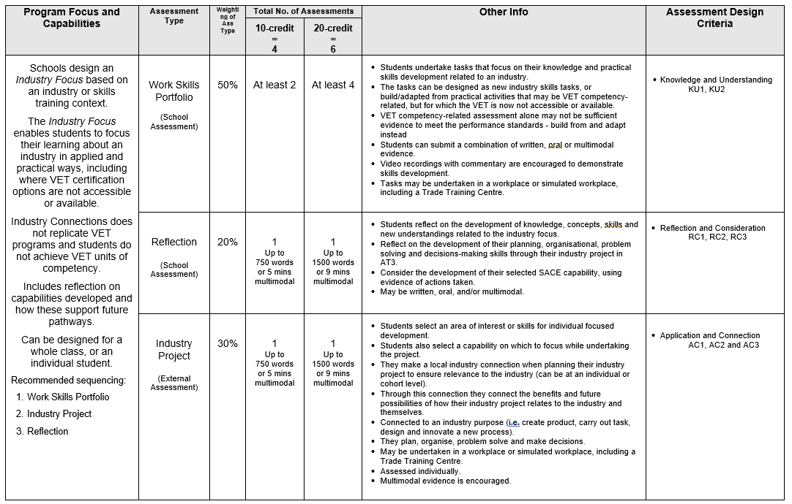
Notes:
This table provides a visual summary and overview of Industry Connections – refer to subject outline for details
Recommended sequencing of programming with students is:
AT1: Portfolio of Work – to learn and develop skills
AT3: Industry Project – to apply the skills in one big project that has impact
AT2: Reflection – on AT1 and AT3 skills and learnings, and benefits and future possibilities

Slide 9
Assessment Type 1: Work Skills Portfolio (50%)
Number of tasks:
- 10-credit (at least 2 tasks)
- 20-credit (at least 4 tasks)
This assessment type focuses on their knowledge, understanding and practical skills development related to an industry.
Students demonstrate evidence that shows specific learning from the industry context, and addresses their development of:
knowledge and concepts related to the industry area
specific skills related to the industry area
ADC: Knowledge and Understanding (KU1, KU2)
Notes:
Summary of Assessment Type 1 – Work Skills Folio (50%)
Refer subject outline for more details
Assessment Type 1 is where students build their skills and show their knowledge – it has a focus for practically ‘doing’ and ‘applying’ skills. Where the program may have a focus for a VET pathway (but is not accredited as VET), the program may be designed so that the learning that might have been undertaken in a unit of competency is undertaken and captured here with a view to compiling a portfolio of evidence that might be able to be used for a future VET RPL process).
AT1 Folio is school assessed, and a sample must be submitted to the SACE Board for moderation.
Criteria that must be assessed: Knowledge and Understanding (KU1, KU2)

Slide 10
Assessment Type 2: Reflection (20%)
10-credit = up to 750 words – 5 minutes – equivalent in multimodal
20-credit = up to 1500 words – 9 minutes – equivalent in multimodal
Students:
reflect on the development of knowledge, concepts, skills and new understandings related to the industry focus
reflect on the development of their planning, organisational, problem-solving and decision-making skills through their industry project in AT3
consider the development of their selected SACE capability using evidence of actions taken.
ADC: Reflection and Consideration (RC1, RC2, RC3)
Notes:
Summary of Assessment Type 2 – Reflection (20%)
Refer subject outline for more details
Criteria that must be assessed: Reflection and Consideration (RC1, RC2, RC3)
AT2 Reflection is school assessed, and a sample must be submitted to the SACE Board for moderation.

Slide 11
Assessment Type 3: Industry Project (30%)
- 10-credit – 750 words – 5 mins – equivalent in multimodal
- 20-credit – 1500 words – 9 mins – equivalent in multimodal
  Students undertake a project and demonstrate:
  planning, organisation, problem solving and decision-making skills
  Students make connections between their project and their development of a chosen capability
  Students consider the benefits and future possibilities of their industry project to the industry and themselves.
ADC: Application and Connection (AC1, AC2, AC3)
Notes:
Summary of Assessment Type 3 – Industry Project (30%)
Refer subject outline for more details
Assessment Type 3: Industry Project – where students can use their skills developed and applied in AT1 Portfolio of Work to a specific project. Connection to capabilities and actions taken.
Criteria that must be assessed: Application and Connection (AC1, AC2, AC3)
AT3 Industry Project is externally assessed and is considered for SACE assessment processes as an investigation. Each student’s Industry Project is marked by the teacher, and submitted to the SACE Board in line with the investigation marking process.

Slide 12
Operational information
Learning and assessment plans are required – each with a different industry focus
Each assessment type has specific assessment design criteria that need to be met.
AT1 and AT2 are moderated
AT3 is externally marked
Notes:
Learning and assessment plans are not required.
Each assessment type must address the specific assessment design criteria specified – assessment design criteria feature only once, so they must be covered in that assessment type, otherwise they are not addressed at all, and students will be disadvantaged.
Recommend use of the planning flowchart available as support materials on the Industry Connections minisite.
When submitting AT1 Portfolio of Work and AT2 Reflection, teachers will need to shade the Performance Standards Record (PSR), therefore it is recommended that teachers maintain a rubric for each student, regardless of if in the sample of not,

Slide 13
Preclusions
Where there is both a 10 and a 20-credit subject, using the same subject code these are precluded against each other.
    For example,
    2ICA10 – Industry Connections A (10-credits) AND
    2ICA20 – Industry Connections A (20-credits)
Students may elect to enrol in different codes using the same Industry focus; however, the programs must remain significantly different to each other.
Notes:
There are preclusions that will impact SACE completion for the 10 and 20 credit codes of the same name.
See table on slide 15.

Slide 14
Preclusions
Subject |  | Precluded
2ICA10 – Industry Connections A 2ICA20 – Industry Connections A |  | 2ICA20 – Industry Connections A 2ICA10 – Industry Connections A
2ICB10 – Industry Connections B 2ICB20 – Industry Connections B |  | 2ICB20 – Industry Connections B 2ICB10 – Industry Connections B
2ICC10 – Industry Connections C 2ICC20 – Industry Connections C |  | 2ICC20 – Industry Connections C 2ICC10 – Industry Connections C

Slide 15

OR
Community Connections OR Industry Connections?
Notes:
Community Connections is also a new Stage 2 subject for teaching in 2022. Both Community Connections and Industry Connections provide flexibilities and options to students in their learning, achieve their SACE, and project themselves into their futures.
Either option can be used for a variety of student circumstances. You know your students and your resources.
In considering factors that will be local to your school and to specific students, there are some guiding thoughts are principles on the next few slides to consider about the differences between using the two subjects.

Slide 16
Community Connections OR Industry Connections?
Sense of belonging and building personal identity
Subject focus
Community application
Community mentors
Lends itself to individual students (but not always)
Sense of pathway and career options
Skills focus
Industry / work
Through-line to a career pathway
Specific student interest in an industry area
Lends itself to a cohort of students (but not always)
Notes:
Broadly;
Industry Connections has been designed as a subject that enables students to practically develop and apply skills to gain a sense of pathway and career options related to industry. It is extremely skills and practice focussed. Industry Connections can also focus on ‘VET-type’ learning when a student can’t actually access accredited VET.
Community Connections has been designed with a focus for complementary learning about a SACE subject without actually doing the SACE subject. It is underpinned by opportunities to build a sense of belonging and personal relevance to the area of the SACE subject.

Slide 17


