Slide 1
SACE Board of South Australia
SACE Leaders Forums
March 2014

Slide 2
Outcomes
A shared understanding of the partnership between the SACE Board, sectors and schools
An understanding of how the SACE Board sees its work
An appreciation of the ‘exit’ or ‘graduate’ qualities of SACE Completers
An appreciation of the SACE as a credible qualification
Awareness of a self review tool that could support a focus on improving outcomes for young people in your school
An understanding of the Online Result Sheets project and its implications
An understanding of the 90 credit aggregate and its implications

Slide 3
Many parts to a ‘whole’ SACE…
Sectors, Schools & Teachers
SACE Board & SACE Board Staff
Students & Families
Moral purpose and inner belief
Support / advice
Policies / procedures to support T, L, A
Range of subjects
Monitoring / intervention systems
Expertise / commitment
‘Assessment literacy’
40 tests / assignments in 33 weeks + external assessments
Determination, work ethic, “grit”
Twin drivers - Accessibility and Credibility
Collaboration, expertise, commitment and outcomes focused
Monitoring / intervention / quality assurance systems and processes

Slide 4
The ‘narratives’
How are students who achieve the SACE described?
How are SACE teachers and their work described?
How is the SACE described?
How are the work of the SACE Board and its key partnerships described?

Slide 5
How does the SACE Board describe its work…?

Slide 7
The SACE Board’s Vision
Student success through the SACE…

Slide 8
The SACE Board’s Mission
To provide a locally and internationally respected SACE that gives all students the Capabilities to move successfully into further learning and work as confident and responsible citizens…

Slide 9
The SACE Board’s work, then, is twofold:
To do what we can, both directly and in partnership with schools and sectors, to support young people to be successful in the SACE;
While also ensuring that the SACE is a credible Certificate that suitably prepares young people for the world beyond school.

Slide 10
The SACE Board’s work…
Increase the % of students achieving the SACE, while ensuring that…
The SACE suitably equips young people for study, work and community life
The SACE is a leading contemporary Certificate, recognised and respected locally, nationally and internationally
The SACE Board is innovative, forward looking, strategic and financially stable
The SACE Board works in true partnership with sectors, schools and other agencies to achieve its vision and mission
Delivering quality outcomes
Advocating for students
Building professional capacity
Strengthening SACE innovation and relevance

Slide 11
Quick discussion…
Partnership
Shared aims

Slide 12
Equipping young people…
literacy and numeracy standards (ACSF Level 3)
Capacity to apply knowledge
Critical thinking – analysis, synthesis, evaluation
Capabilities for living, working, learning
Work ethic
Capacity to plan, prioritise, monitor, adjust, complete, change if necessary
The SACE suitably equips young people for study, work and community life
The SACE is a leading contemporary Certificate, recognised and respected locally, nationally and internationally
Increase the % of students achieving the SACE, while ensuring that…
The SACE Board is innovative, forward looking, strategic and financially stable
The SACE Board works in true partnership with sectors, schools and other agencies to achieve its vision and mission
Is that how students who achieve the SACE are described?

Slide 13
Did you know..?
The SACE is studied in the NT, Malaysia and China
It is considered excellent preparation for university (critical thinking; application; research; work ethic)
VET is incorporated into the Certificate (5558 students in 2013)
It is considered a rigorous qualification - 40 assessment tasks at Stage 2– and they all count!
Teachers must be excellent assessors – they are “accountable” for the quality of their assessment tasks, and for their assessment decisions
The SACE suitably equips young people for study, work and community life
The SACE is a leading contemporary Certificate, recognised and respected locally, nationally and internationally
Increase the % of students achieving the SACE, while ensuring that…
The SACE Board is innovative, forward looking, strategic and financially stable
The SACE Board works in true partnership with sectors, schools and other agencies to achieve its vision and mission
Is that how the SACE is described? Is that how SACE teachers are described?

Slide 14
Quick discussion…
Rigorous
Accessible
Credible
A Certificate that matters

Slide 15
Partnerships…
Data provided to schools
SACE Board and sector partnerships
  Support for analysis of the data
  Ideas / strategies for improvement
Continuous improvement
  – improve student achievement and increase the % of students achieving the SACE
Increase the % of students achieving the SACE, while ensuring that…
The SACE suitably equips young people for study, work and community life
The SACE is a leading contemporary Certificate, recognised and respected locally, nationally and internationally
The SACE Board is innovative, forward looking, strategic and financially stable
The SACE Board works in true partnership with sectors, schools and other agencies to achieve its vision and mission

Slide 16
2013 Results
In 2013, there were 21 685 students with at least one completed Stage 2 enrolment.
13 624 students achieved the SACE in 2013 (93.5% completion rate) compared to 13 404 in 2012 (92.2% completion rate).
41% of the 13 624 SACE Completers undertook some form of VET in their SACE
83.5% of students achieved an ATAR in 2013, compared to 85.8% of students in 2012.

Slide 17
SACE Completion figures for South Australia for 2006 – 2013
Notes:
2006 – 12167 2007 – 12056 2008 – 12237 2009 – 12521 2010 – 12692 2011 – 12367 2012 – 13453 2013 - 13624
(includes Aboriginal and non-aboriginal students)

Slide 18
South Australian Completion Rates 2006-2013
Notes:
2006 - 88.3% 2007 - 88.9% 2008 - 89.6% 2009 - 90.0% 2010 - 90.2% 2011 - 91.6% 2012 - 92.2% 2013 - 93.5%

Slide 19
Number of Requirements not met 2013
Notes:
954 potential completers did not achieve their SACE
871 were missing compulsory requirement
70 were missing 2 compulsory requirements
13 were missing 3 compulsory requirements

Slide 20
Specific Requirements not met 2013

Slide 21
SACE Completion
What is the biggest challenge for students in your school?
Standards
SACE Completers
Complete 200 credits
Can meet the standards in 70 credits of Stage 2 subjects (including RP + literacy, numeracy, PLP)
Complete all of the work – 40 tests / assignments at Stage 2
“low” grades
Could have met the standards but did not complete all of the tasks
Work requirements
“low” grades
Could not meet the standards
Did not complete all of the tasks
“low” grades
Completed all of the tasks but could not meet the standards

Slide 22
Some ideas that work…
Work completion? Standards? Or a combination?
Clarify the expectations of students, families and teachers in relation to work completion
Implement improvement projects
Implement a system designed to monitor work completion issues and enable intervention
Increase accountability for everyone in the community
Hold the expectation…
  The SACE is challenging but achievable
Build partnerships – with the sector, “champion schools”, the SACE Board
Consider…
Increasing the range of subjects offered at the school and/or having “safety nets”
Increasing the “flexibility” within each subject and the number and mode of tasks
Reviewing the work completion policy of the school and the school-wide monitoring and communication systems

Slide 23
Self Review Tool
  Assessment Practices
  Do assessment practices provide students with the best opportunity to demonstrate their learning?
  Within-school Quality Assurance
  How effective are the school’s quality assurance processes?
  Data Management
  How effectively does the school manage assessment related data?
  Communication
  How effectively are assessment policy and procedures communicated to staff, students, and families?

Slide 24
Innovative and forward looking…
Streamline the flow of information between the Board and schools
ORS Project
The SACE suitably equips young people for study, work and community life
The SACE is a leading contemporary Certificate, recognised and respected locally, nationally and internationally
Increase the % of students achieving the SACE, while ensuring that…
The SACE Board is innovative, forward looking, strategic and financially stable
The SACE Board works in true partnership with sectors, schools and other agencies to achieve its vision and mission

Slide 25
SACE Board Leaders Forum
School use/SACE Board support
‘Self Review Tool’

Slide 26
Self review and continuous improvement
Assessment Practices
Within-school Quality Assurance
Data Management
Communication
Notes:
It is important to celebrate what we are doing well and not lose sight of our achievements. Appreciate what has been achieved for students based on the partnership between schools and the SACE Board and particularly the work of teachers and school leaders. As we seek to continually improve student success one of the first steps is to acknowledge our areas of strength, understand why these areas are working well and identify areas where we could do better.
Seek out gaps in practice, processes or the procedures that may inadvertently be contributing to some students not being successful in the SACE.
We have analysed ACER’s Tool for School Improvement, NZQA process for assuring the integrity of students' results, feedback from schools, SA DECD Accountability Framework.
From these sources 4 criteria emerged that can be used to analyse SACE management systems in schools to identify areas for improvement.
Assessment Practices: extent to which the school’s assessment practices are:
guiding teachers and students to manage effective SACE assessments
giving students adequate opportunities to demonstrate their best achievements.
Within-school QA: extent to which the school’s quality assurance practices ensure the integrity of student’s results.
Data Management: extent to which the school’s data management processes ensure that student details, enrolments and results are timely and accurate.
Communication - The extent to which the school’s assessment information, policies and procedures are:
Assisting teachers to carry out the school’s assessment policy and procedures
Communicated effectively to students and their families
Regularly reviewed for accuracy and are comprehensive and up to date.
Self Review Tool, prime purpose to provide school leaders with a vehicle for reflection that may provide insights, impetus and possible areas for development.
Not a checklist or an inspection device, use as appropriate for your school.

Slide 27
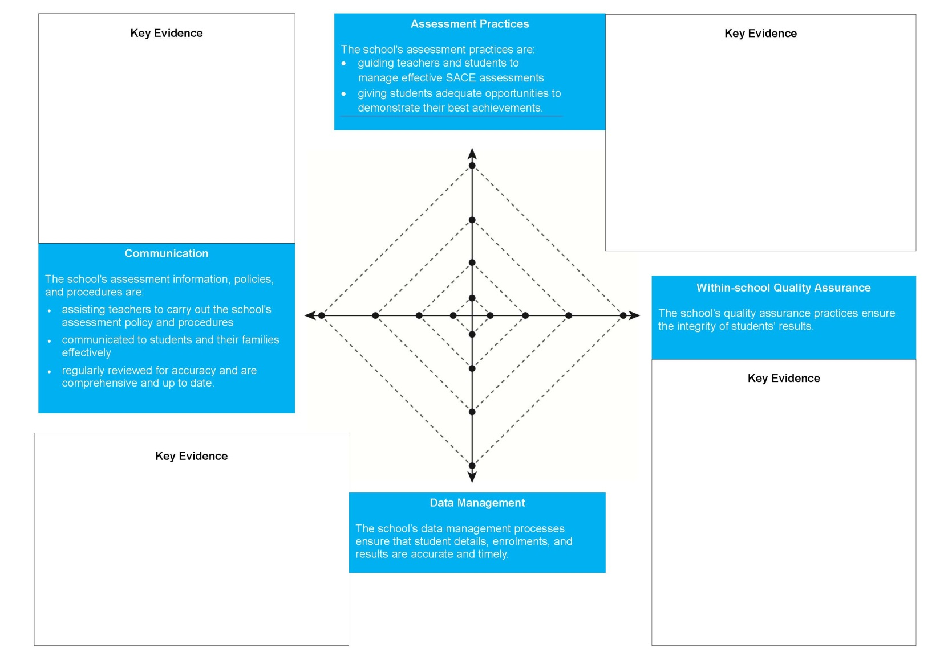
Radar Diagram
Notes:
We have prepared a radar diagram using the 4 criteria, spend 10-15 minutes working to identify evidence of the effectiveness of your schools quality management system and determine your school’s current level of ‘performance’ in relation to these criteria.

Slide 28
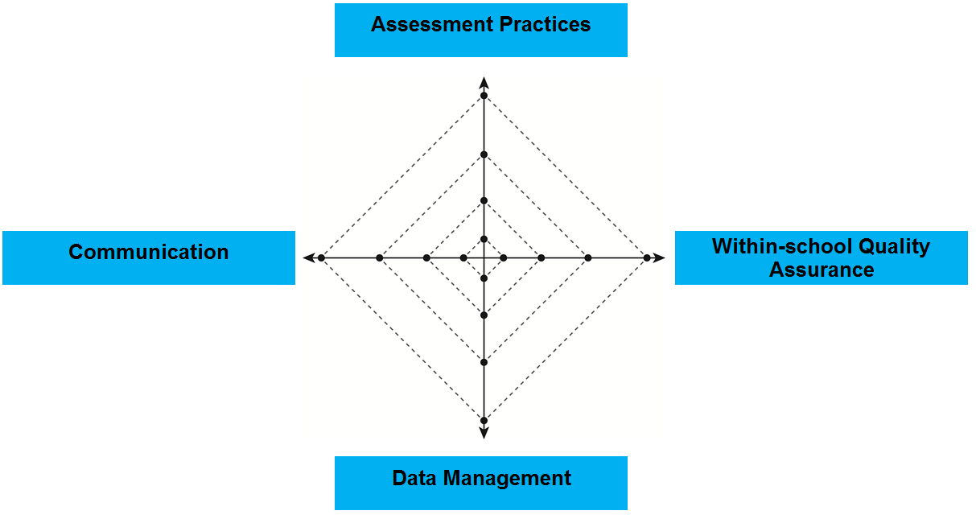
Data Management
Notes:
1. Let me show you an example:
Assessment Practices: might see evidence in your school that: assessment practices across your school generally ensure students are engaged and can demonstrate their learning to the highest level through differentiation and clarity of requirements. Students and teachers generally adhere to SACE Board assessment policies with regards to drafting, editing and verifying student work and meeting deadlines. And that, while feedback to students may be routinely provided, it may not be timely and/or may not provide students with clear steps for improvement or strategies to further develop their learning. Given this evidence you might consider that your school’s assessment practices are pretty good but perhaps not at the highest level. CLICK
Within-school QA: might see evidence in your school that: teaching teams critically analyse all moderation data, student achievement data, and their own teaching practices to develop improvement strategies, learning and assessment plan feedback is carefully considered and applied to teaching and learning programs, changes are formally documented and endorsed by the principal or their delegate. Teachers employ a number of strategies for clarifying standards (e.g. attend clarifying forums, access exemplars on the SACE Board website, cross-mark with colleagues within and outside the school. Teachers benchmark their interpretation of the performance standards prior to submission of results. SACE data shows the school’s assessment decisions are valid and reliable. On the basis of this evidence you might decide that your school’s with-in school QA is operating at the highest level possible. CLICK
Data Management: might see evidence in your school that: student information management practices are not documented, understood or implemented consistently. Student information management practices result in: doubt that most students are being enrolled in appropriate subjects/courses, an initial pattern check is conducted to ensure student enrolments are on track to SACE completion and their intended pathways but subsequent checks, if they occur, are conducted on an ad-hoc basis, requests to the SACE Board to change final enrolments and results, some students receiving incorrect results due to administrative errors. On the basis of this evidence you might consider that the management of SACE data in your school is not really comprehensive and systematised so ascribe a low rating to this criterion. CLICK

Slide 29
Data Management
Notes:
4. Communication: might see evidence in your school that: most teachers access subject related resources and policies from the SACE Board when time permits and that only some teachers use SACE subject operational information for planning purposes. The school community has a limited understanding of the SACE. Students have a general understanding of the SACE, but some students are not familiar with SACE assessment policies and procedures. Changes to school polices and procedures occur on an ‘as needs’ basis. On the basis of this evidence you might consider that while communication of significant SACE information does occur it is not consistently effective so ascribe a reasonable low rating to this criterion. CLICK
For this activity you are asked to record key evidence of the effectiveness of the SACE management systems in your school in relation to the 4 criteria and ‘plot’ your outcome.
Then identify strengths and areas for improvement.
In the example that was developed on-screen Within-school QA emerges as an area of comparative strength and data management as an area of comparative weakness within the overall quality management systems of this fictitious school. Developing and successfully implementing improvement strategies in the area of data management CLICK would strengthen this school’s management of the SACE overall.

Slide 30

Schools Online
Online Results Sheets
(ORS)

Slide 31
Online Results Sheets (ORS)
Transforming paper results sheets into online forms
Begins with School Assessment Results Sheets (Yellow)
Form accessed via Schools Online system (previously DATEX Online)
Notes:
We have decided to build this new functionality into Schools Online primarily because school users are familiar with that system and because feedback from schools strongly supports being able to perform online functions from the one location rather than moving across multiple IT systems.
We have worked closely with schools in the development phases of this project and have tried hard to not make assumptions regarding the way schools work. We also tried to accommodate for the way a schools operates. By way of example, A password reset email will be valid for over 24 hours because we recognise that teachers aren’t always at their desks.
This is an IT project but it isn’t a complicated one in the sense of programming or infrastructure. Its complication and its success is dependent on how well we engage with you in relation to these changes and support you to manage this changes process in your school.
To put this change into some context we are going from a current user base of 500 to one of over 5000.

Slide 32
Benefits
Reduces time spent on paper based administration
Improves the speed and quality of data exchange
Increases time available for teaching and learning
Prevents scanning errors and incorrect form completion
Enables results sheets tracking and monitoring
Notes:
Won’t be a substitute for your school’s QA process that help to ensure that students receive the correct grade.

Slide 33
System Roles
Two new roles created in Schools Online
    Principal’s Delegate
    Teacher

Slide 34
Principal’s Delegate Role
Principal’s Delegate can: (all teacher functionality plus)
    Manage school users
    Edit teachers’ result sheets
    Save and export
    Alert and remind teachers
    Track and monitor school and teacher progress
    Submit final results sheets to the SACE Board.
Notes:
Principal’s Delegate (PD) is nominated by the school Principal and is the person with the authority to submit final results to the SACE Board on your behalf. You can have more than one PD
This will be the only role that will require the SACE Board to create and the only one that will require a paper based process to create.
The PD nomination form will accompany an Access Management Agreement form that needs to be signed by the school Principal.
This agreement outlines the way in which the use of Schools Online needs to be managed at a school level and against a set of standards established for government agencies. The SACE Board needs to comply with this regulations in relation to data security and maintenance.
What functions can the PD perform?

Slide 35
Teacher Role
Teachers can:
    Enter grades
    Withdraw and add students
    Save and export
    Track and monitor their progress
    Reset their password
    Send final results sheet to Principal’s Delegate

Slide 36
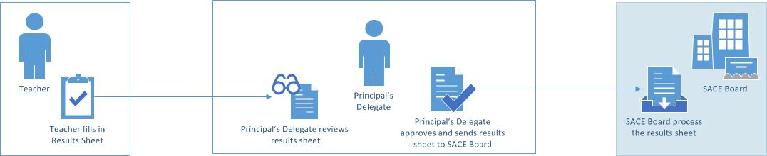
ORS Workflow
Notes:
This diagram illustrates the workflow associated with ORS.
In the system the Results Sheets start with a teacher who enters grades and then sends the Results Sheets to the Principal’s Delegate for review.
The Principal’s Delegate then approves the Results Sheets before submitting them to the SACE Board.
The SACE Board processes the Results Sheets

Slide 37
Online Results Sheets (ORS) - Trial
School Trial
    59 schools
    Diverse representation in sector, location, size
    Starts 17 March, ends 28 March
    Purpose is for schools to test that the system is
        user-friendly
        meets the needs of schools; and
        is stable and robust.

Slide 38
Implementation Timeframe
School Assessment Results Sheets:
    for Research Project A and B (Results Due June)
    live week beginning 2 June 2014
School Assessment Results Sheets:
    all Stage 2 subjects (Results Due December)
    live week beginning 20 October 2014

Slide 39
Next Steps
Increased communication with schools in the lead up to ‘go-live’ date
Distributing the Schools Online Access Management Agreement and nominations of Principal’s Delegate
Supporting and monitoring the creation of users
Provision of training and support materials including:
    Instruction sheets
    FAQs
    Videos
One contact point for all ORS queries
    Schools Online Service Desk on:
  servicedesk@saceboard.sa.gov.au or 8372 7412

Slide 40
Online Results Sheets
What are the implications for you in your school ?

Slide 41
SACE and Tertiary Selection
Changes, updates and reflections

Slide 42
For today
SATAC’s role
Changes for 2015
  University aggregate
  Bonus schemes
Updates and reflections
Questions

Slide 43
SATAC’s role

Slide 44
SATAC’s role
Rules and processes surrounding
  Scaling
  TAFE SA Selection Score
  University aggregate and ATAR
The owners
The brokers
The observers
The doers

Slide 45





SATAC’s role
The owners

Slide 46
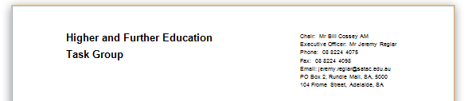
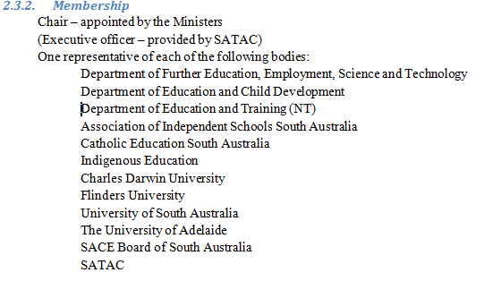
SATAC’s role
The brokers

Slide 47
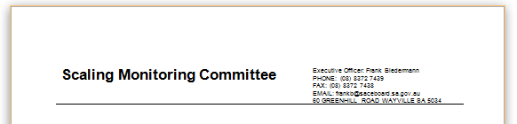
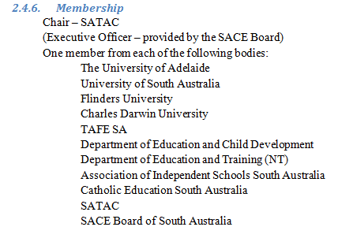
SATAC’s role
The observers

Slide 48



SATAC’s role
The doers

Slide 49
Changes for 2015

Slide 50
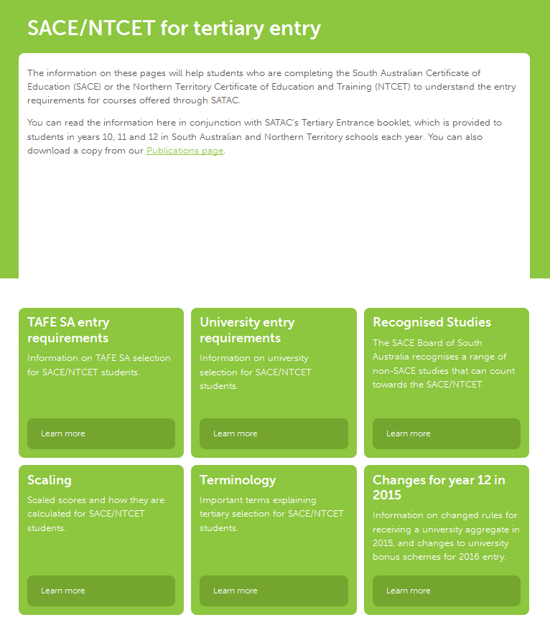
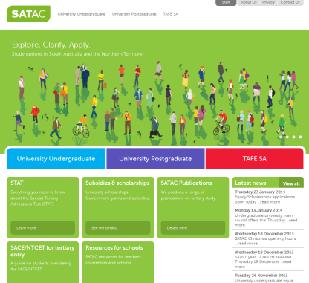
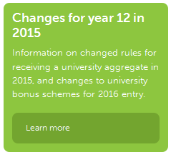
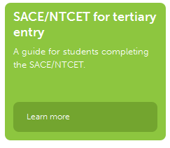
Changes for 2015
90 credit aggregate
Bonus Schemes
http://www.satac.edu.au/pages/changes-for-year-12-in-2015
Notes:
Main points to take away
Resources that are available
SATAC always tries to provide up-to-date information about tertiary selection at http://www.satac.edu.au/pages/sace-ntcet-for-tertiary-entry/
Details regarding tertiary selection are published in SATAC’s Tertiary Entrance booklet http://www.satac.edu.au/pages/satac-publications and are provided to all year 10, 11 and 12 students in 2013.

Slide 51
90 Credit University Aggregate

Slide 52
90 credit university aggregate
90 credit aggregate
Request of the SA Minister of DECD
Prompted a ground-up review of the aggregate and its purpose
Undertaken by the four universities Dec 2012 to Mar 2013
Implementation in 2015 for 2016 entry

Slide 53
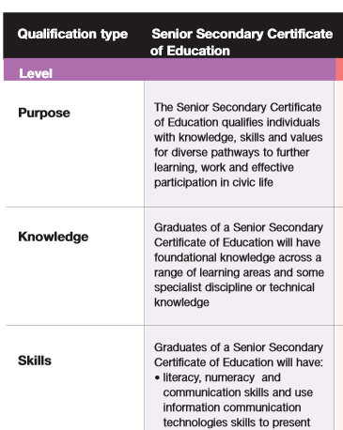
90 credit university aggregate
What is the university aggregate?
The SACE is deliberately broad in purpose
“…pathways to further learning, work and effective participation in civic life…”
  © AQF Council

Slide 54
90 credit university aggregate
What is the university aggregate?
  The university aggregate is a “layer of rules”
Beyond the rules for SACE completion
  “adequate preparation for higher education”
  “provides a measure of academic merit which can be used to calculate the ATAR”

Slide 55
90 credit university aggregate
How do the rules ensure adequate preparation?
  ensure academic studies (TAS)
  ensure depth (20 credit subjects)
  ensure breadth of subject areas (precluded combinations/counting restrictions, flexible option)
  literacy and numeracy (SACE completion)

Slide 56
90 credit university aggregate
Why should South Australia and the Northern Territory be proud of our aggregate?

Slide 57
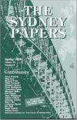
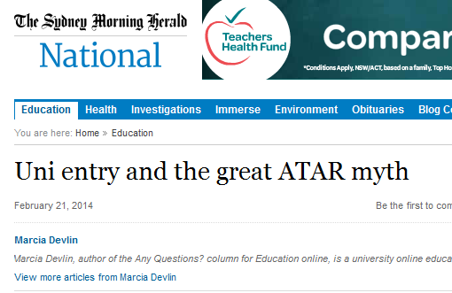


90 credit university aggregate
“The tyranny of the TER…”

Slide 58
90 credit university aggregate
Criticisms of the ATAR
  Socially exclusive
  The province of certain schools and systems
Is this true?
  The ATAR is just a national queuing system

Slide 59
90 credit university aggregate
The ATAR: not as national as one might think
  What is different is what allows you to join the queue
  These are the rules for the university aggregate
  It is these rules that can be socially inclusive or exclusive

Slide 60
90 credit university aggregate
The NT and SA can take pride in our aggregate rules
  Largest list of acceptable subjects
  English Studies not compulsory
  Three attempts
  The flexible option
  Recognised Studies

Slide 61
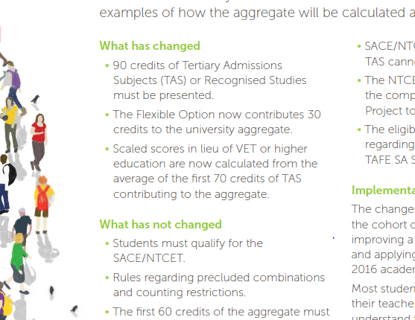
90 credit university aggregate
The changes
  Fact sheet: “what has and hasn’t changed”
Notes:
Main things to take away
“What has changed and what has not changed?” The easiest way for teachers and schools to understand the new rules are to note the sections “What has changed” and “What has not changed” in the fact sheet accessible at SATAC’s website at: http://www.satac.edu.au/pages/changes-for-year-12-in-2015.

Slide 62
90 credit university aggregate
There are now 30 credits in the Flexible Option
  Only a maximum of 20 credits of Recognised Studies will ever count
  This means a maximum of 20 credits of VET, IB, university etc
  After the first 60 credits – breadth is valued
  You can study 3 x 10 credit TAS
Notes:
Main things to take away
Only a maximum of 20 credits of Recognised Studies will ever count towards the university aggregate.

Slide 63
90 credit university aggregate
A challenge to our schools?
Pre-2012 TAS | 2012 TAS | Students | % of Students | Avg ATAR
0 | 80 | 220 | 2.0% | 52.11
0 | 90 | 7540 | 69.3% | 68.50
0 | 100 | 686 | 6.3% | 72.75
10 | 70 | 12 | 0.1% | 68.69
10 | 80 | 603 | 5.5% | 75.48
20 | 70 | 154 | 1.4% | 71.06
20 | 90 | 509 | 4.6% | 81.72

Slide 64
Bonus Schemes

Slide 65
Bonus schemes
Bonus Schemes
  Sponsored by the SA VCs
  Simple, fair, transparent, defensible
  One size fits all (except for Medicine, Veterinary Bioscience)
  Greater clarity regarding Selection Ranks
Notes:
Main points to take away
The new schemes are:
The SA Universities Equity Scheme
The SA Language, Literacy and Mathematics Bonus Scheme
They will come in to affect for students completing in 2015 who are applying for university entrance for 2016.
Preliminary information is available in a fact sheet available at http://www.satac.edu.au/pages/changes-for-year-12-in-2015.
Further information will be provided in a comprehensive information rollout for all schools in Australia when teachers and students return during Term 1 in 2014 and on the SATAC website.
The new Schemes should provide more clarity regarding their Selection Ranks and eliminate applicants choosing their SATAC preferences on the basis of the number of bonus points they attract.

Slide 66
Bonus schemes
The SA Universities Equity Scheme
  School based – data driven
    Remoteness
    Participation in higher education }
    Average ATAR } three-year averages
    Low ICSEA }
  Backed up by individual applications
  Administered by SATAC
  5 points
Notes:
Main things to take away
SA and NT schools attracting bonuses will be determined on an annual basis using measurable, verifiable criteria agreed to by all the universities, which include:
The Commonwealth Government’s Index of Community Socio-Educational Advantage (ICSEA)
The Commonwealth Government’s definition of Remoteness
Participation in university for those gaining an ATAR
Average ATAR gained
Most of these criteria will be based on three-year averages.
Wherever a school does not attract a bonus individual students will still be able to apply for consideration of their socio-economic/socio-educational disadvantage. These, too, will be considered on the basis of verifiable criteria (typically Centrelink data which SATAC can verify direct with Centrelink).
SATAC will process individual applications for consideration in the 2015/2016 cycle which means that students will no longer have to make three separate applications to Flinders, Adelaide and UniSA.

Slide 67
Bonus schemes
The SA Language, Literacy and Mathematics Bonus Scheme
  To strengthen preparation in the context of liberal university aggregate rules
    LOTE
    English Studies/English Communications
    Mathematical Studies
    Specialist Mathematics
  Up to 4 points

Slide 68
Updates and Reflections
Notes:
Main things to take away
Some additional items SATAC are bringing to schools’ attention during 2014.
The main messages are for SACE Co-ordinators, counsellors and are being conveyed through:
SACE Board Management forums
SATAC School Bulletins
SATAC Counsellor Sessions
SATAC’s web resources for schools:
http://www.satac.edu.au/pages/sace-ntcet-for-tertiary-entry/
http://www.satac.edu.au/pages/resources-for-schools--2/

Slide 69
Scaling

Slide 70
Scaling
What if the IOC let you choose your pentathlon?
  http://www.satac.edu.au/pages/scaling
Publishing scaled scores on the Tertiary Entrance Statement?
“damned if we do and…”
Notes:
Main things to take away
Scaling is a requirement of our Universities and TAFE SA to provide fair and equitable comparisons of academic performance across subjects with different objectives, content and assessment practices.
Scaling is explained in depth at http://www.satac.edu.au/pages/scaling, and schools, parents and students are encouraged to find out more about scaling.
We still trust that the conventional wisdom prevails when students are choosing Stage 2 subjects. Scaling should not be a major consideration. Instead, students should be selection subjects based on their skills, abilities and interests. Scaling will typically provide consistent measures of performance for an individual regardless of the subjects chosen.
The universities and TAFE SA do not publish the scaling outcomes of individual subjects. regarding subject selection prevails – subject scaling should not be a consideration.

Slide 71
Scaling
This is not your result…
…it is only a piece in the puzzle in calculating your readiness for the next rung in the educational ladder
Notes:
Main things to take away
Scaled scores, in their own right, are not used for any purpose. Prerequisites and subject bonus point schemes are determined on the basis of the A+ to E- Overall Grade.
Scaled scores are only used for the purposes of aggregation.
SATAC publishes scaled scores so that students so that the calculations of the TAFE SA Selection Score and ATAR are transparent. They are included on the Tertiary Entrance Statement so that students can see the “cause and effect” from their Overall Grades, to their scaled scores, to their university aggregate and ultimately to their TAFE SA Selection Score and ATAR.
We need to reassure students that their Overall Grade is the measure of achievement in the subject (“congratulations on getting an A+”). A scaled score is only one piece in the puzzle in calculating a student’s readiness for the next rung in the educational ladder.

Slide 72
Selection Ranks

Slide 73
Selection Ranks
SATAC’s system stores:
  ATARs
  Selection Ranks (ATAR “look-alikes” after bonuses have been applied)
Offers are only made on the basis of Selection Ranks
For 85%+ of year 12 applicants selection ranks are not their ATAR
Notes:
Main points to take away
Offers are only made on the basis of Selection Ranks. These are numbers on the scale from 0.00 – 99.95 (i.e. that look like ATARs) that are the end product of bonuses being applied to ATARs.
For 85%+ of year 12 applicants selection ranks are not their ATAR.
Students should always try to find out their Selection Ranks by contacting their chosen universities or using resources such as on-line bonus calculators provided by the universities (and not random users of the internet!). SATAC will be exploring ways of displaying selection ranks to applicants in the future.

Slide 74
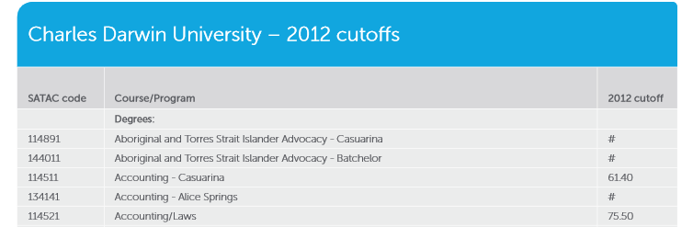
Selection Ranks
Cutoff scores
  The Advertiser/NT News
  SATAC website and Guide
  Universities websites and publications
Are about Selection Ranks not the ATAR

Slide 75
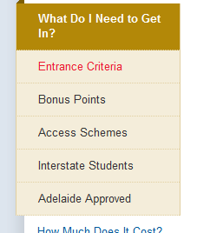
Selection Ranks
Guaranteed entry schemes
  “Preferred”
  “Guaranteed”
  “Approved”
Are about Selection Ranks not the ATAR
(regardless of the website’s language)
Notes:
Main points to take away
The universities guaranteed entry schemes (Preferred, Guaranteed, Approved) apply to and refer to Selection Ranks not the ATAR. SATAC is negotiating with the universities to provide more clarity in the advertising of these schemes, in particular universally referring to Selection Rank and regarding statements alluding to preference number.

Slide 76
Selection Ranks
Selection Ranks
A joint SATAC/university project throughout 2014 to
  Improve awareness
  Improve accessibility
  Standardise terminology

Slide 77
Rules not followed – the “unofficial ATAR”

Slide 78

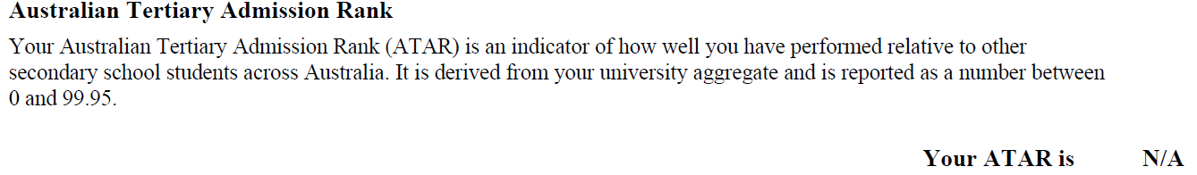
Rules not followed – the “unofficial ATAR”
Consideration of rules not followed
  Counting Restrictions
  Precluded Combinations
  Number of Attempts
Resulting in
Notes:
Main points to take away
The institutions consider that it is a student’s responsibility to find out about and follow the rules regarding aggregation and the calculation of the ATAR and TAFE SA Selection Score.
The rules are made available to all year 10, 11 and 12 students every year. SATAC makes every effort to train school staff in their application at very detailed levels.
The SACE Board provides an on-line facility to check study patterns for not only SACE completion but also ATAR completion – the advice about these two issues is on the same page.
Ignoring these rules (whether this is the student, the school, parents or others) in regard to these rules including those relating to:
Counting Restrictions
Precluded Combinations
Number of Attempts
Studying Tertiary Admissions Subjects
Completing VET studies
can result in students missing out on an ATAR or TAFE SA Selection Score.
Consideration of requests for waiving these rules (what are justifiable grounds?) is brokered by SATAC but the decisions are made by the institutions.
Requests for such consideration are not always successful, and are sometimes not the same for all institutions.
SATAC can be asked to apply an “unofficial ATAR” for a current year application at the institutions’ request. This can assist a student gaining entry in the current year.
Students’ official records are usually not altered.
It is the official records (e.g. with missing ATARs, TAFE SA Selection Scores) that are forwarded to tertiary admissions centres interstate.
It is the official records (e.g. with missing ATARs, TAFE SA Selection Scores) that are stored in SATAC’s archives.

Slide 79
Rules not followed – the “unofficial ATAR”
What happens
  Consideration is brokered by SATAC
Those who decide
  SACE Board
  SATAC
  TAFE SA
  The Universities

Slide 80
Rules not followed – the “unofficial ATAR”
Primary belief
  Following the rules is a student’s responsibility
The outcome?
  Consideration is usually favourable
  Student is usually “looked after”
  For the current admissions cycle only
  History is not rewritten

Slide 81
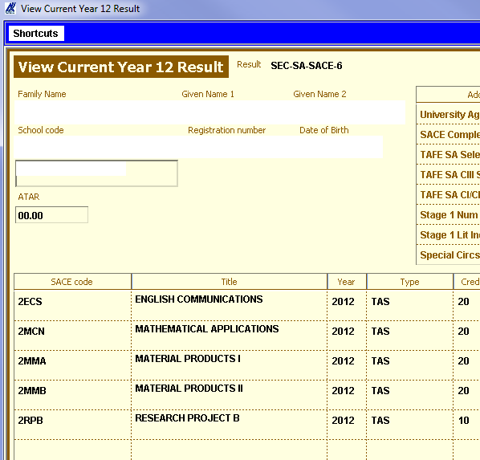

Rules not followed – the “unofficial ATAR”
What we receive from the SACE Board:

Slide 82
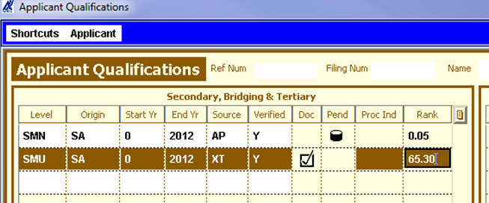
Rules not followed – the “unofficial ATAR”
After (successful) consideration:
  An “SMU” qualification is entered
  Houses the “unofficial ATAR”
Notes:
7 candidates received and “unofficial ATAR” in 2012 for 2013 entry.

Slide 83
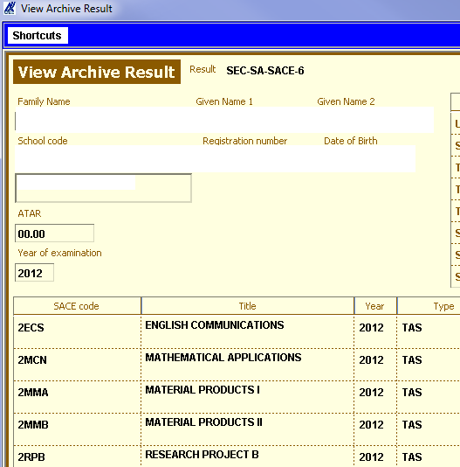
Rules not followed – the “unofficial ATAR”
What goes interstate and into the archives:

Slide 84
Recognised Studies – Some Clarifications

Slide 85
Recognised Studies
Credits towards the ATAR/TAFE SA Selection Score: 0, 10 or 20
Credits at Stage 2 (SACE Board recognition) | Credits towards the ATAR/TAFE SA Selection Score
<10 | 0
10 - 19 | 10
>= 20 | 20
Notes:
Main points to take away
These are the rules. Recognised Studies can only count towards 10 or 20 credits in the university aggregate and TAFE SA Selection Score.
Although there has been confusion in the past regarding certain VET qualifications where advice has been given about 10 credits counting towards Stage 2 for SACE completion and 20 to the university aggregate (hence the ATAR) and the TAFE SA Selection Score, this will not occur in the future.

Slide 86
Recognised Studies
University Studies
Undergoing clarification
  “Degree level”
  “Not introductory in nature” (Anthropology vs Science for Health Professionals)
Always seek approval the year before

Slide 87
Questions?

Slide 88

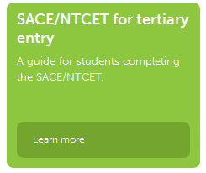

More on SATAC’s role…
Reminder about the principle resources regarding tertiary entry
http://www.satac.edu.au/pages/sace-ntcet-for-tertiary-entry/

