Slide 1
SACE Subject Renewal update
Communication slides prepared by the SACE Board for use by Teaching and Learning Leaders to raise awareness of the subject renewal program within their school.
Notes:
We encourage you to adapt this content to your own school context.
We’ve included some ideas/prompts on slide 17 about what you may choose to include
The slides are designed for you to add your own school branding and images of your students.
If your school has an SRG member, they may like to speak to their experience.

Slide 2
Subject Renewal – what is it?
Subject renewal is a process
to co-design subjects with the community;
that will sharpen content and assessment
and intentionally develop capabilities.
Renewed subjects will have space for student agency (agency)
So that students can engage in real-life learning (deep, authentic learning)
And recognise a broader range of evidence of learning (natural evidence of learning)
Where students evaluate their thinking to regulate the way they learn. (metacognition)
Notes:
Key messages:
Subject renewal is one of the key initiatives of the SACE Board’s Passport to Thrive Strategic Plan, designed to ensure the SACE remains a modern and responsive qualification for a changing world
The renewal process aims to sharpen subject content and assessment, enabling deeper, real-world learning and the development of disciplinary knowledge and capabilities
For students, the renewed SACE will incorporate a fuller appreciation of what students know and can do—not just their performance in tests or exams
For teachers, subject renewal will recognise the vital role of teachers in understanding where each student is at in their development, knowing when to provide support, and when to step back and allow them to flourish
The process is collaborative and co-designed, drawing on the expertise of teachers, leaders, and students across sectors

Slide 3
What are the key drivers for subject renewal?
Student Agency
Students are proactive in the co-creation of their learning pathway and influence how they undertake, demonstrate and action their learning.
Activity:
Working in small groups, consider what you are already doing to enable student agency and how this could be uplifted.

Slide 4
What are the key drivers for subject renewal?
Metacognition
Students are empowered to understand the way they think using feedback and self-evaluation to purposefully consider and enhance their own learning
Activity:
Working in small groups, consider how your current practices support the development of metacognition and how this could be strengthened.

Slide 5
What are the key drivers for subject renewal?
Deep Authentic Learning
Students discuss and apply learning from familiar and unfamiliar situations across a range of meaningful and relevant real-world situations
Activity:
Working in small groups, consider what you are already doing to enable deep authentic learning and how this could be expanded.

Slide 6
What are the key drivers for subject renewal?
Natural Evidence of Learning
NEoL captures the diverse authentic forms of students’ demonstration of learning and achievement, better reflecting what students know and can do
Activity:
Working in small groups, consider how natural evidence of learning is currently enabled and what could be done to build on this further.

Slide 7
What are the key drivers for subject renewal?
Capabilities
Personal Enterprise
Open doors: find opportunities
Quality Thinking
Stretch minds: through global curiosity
Self-Motivated Learning
Strengthen ownership: grasp responsibilities
Principled Action
Embrace perspectives: honour difference
Collective Engagement
Share success: with communities
By designing for agency, metacognition, deep authentic learning & NEoL we are indirectly designing for capabilities
Notes:
Designing for agency, metacognition, deep authentic learning, and natural evidence of learning creates the conditions for meaningful capability development.

Slide 8
What does this look like in the classroom?
In term 3, subject renewal groups tested prototype ideas live in classroom settings.
At the Teaching and Learning Leaders conference, some subject renewal group teachers and students presented these early ideas with learnings. The following slides showcase examples of these classroom prototypes, highlighting student and teacher insights.
Insights from the testing period will inform the evaluation of prototype ideas and guide recommendations for the next phase of subject renewal.

Slide 9
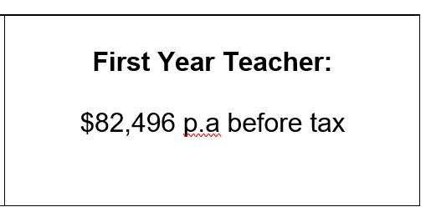

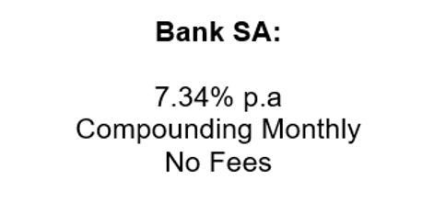

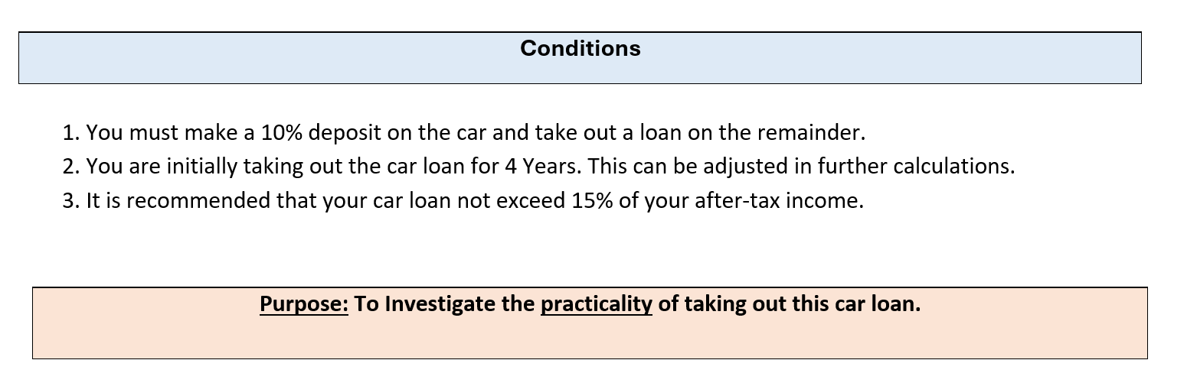
What does this look like in the classroom?
Prototype example for Stage 1 General Maths
Topic: Scenario based modelling (Finance)
Students simulate beginning their first full-time job and must take out a loan. They are posed a few scenario options, for example:
Students have 100 minutes to complete the assessment. With calculators and handwritten notes allowed. After the summative assessment, students are interviewed one-on-one with reflection questions that allow them to provide evidence and elaboration of their learning in their own words.
PROTOTYPE IDEA
Student Agency
Metacognition
Deep Authentic Learning
Natural Evidence of Learning
Notes:
General Maths example.
Moving away from assessments that focus on capturing mathematical doing (static knowledge – recall, procedure, application), where student development of approaches to learning is unintentional or covered and the evidence of learning that is highly curated and uniform
Towards assessment that captures mathematical thinking, where student approaches to learning is uncovered and intentionally developed and evidence of learning is unique
Prototype name: SCENARIO BASED MODELLING
Students are given a theme within a topic to revise for, this theme could be, but isn’t limited to;
Preparing for retirement
Purchasing a house
Trigonometry in construction
Project management
Summative conditions:
Students can work together or individually
100 minutes
No laptops
Calculators allowed
Written notes allowed
Handwritten (range of paper provided with creativity encouraged)
After the summative assessment, students are interviewed one-on-one with reflection questions that allow them to provide evidence and elaboration of their learning in their own words.
Students are required to prepare handwritten pages of notes that will be used during the assessment period. The notes may consist of;
Relevant assumptions or limitations within the context
Key concepts
Examples of key calculations and justification
Problem solving techniques
What the prototype is aiming to achieve:
Students will develop a deeper, and more dynamic understanding of content; connect ideas and develop reasoning (and have it for longer)
Students will develop their conceptual understanding within themes,
Students will be conscious of, and develop their processes to solving problems, including the planning, monitoring and evaluation their approaches
Students will shift from dependency to autonomy in planning and problem solving
Students will be engaged in the revision process

Slide 10
What does this look like in the classroom?
Prototype example for Stage 1 General Maths
Scenario based modelling
Prototype impact
Reflections
Students were apprehensive about change – anticipate it ​
The uniqueness of student work was surprising ​
Design of questions to allow for further exploration is crucial​
Student engagement is key. Differentiate and structure as normal.
PROTOTYPE IDEA
“The assessment helped me view maths with a broader perspective​”
“Instead of formulas, my cheat sheet focused on reminders to expand my mathematical discussion and reasoning​”​
“I learned how to apply maths into the real world​”​
“I was encouraged to explain and critique my results​”​

Slide 11
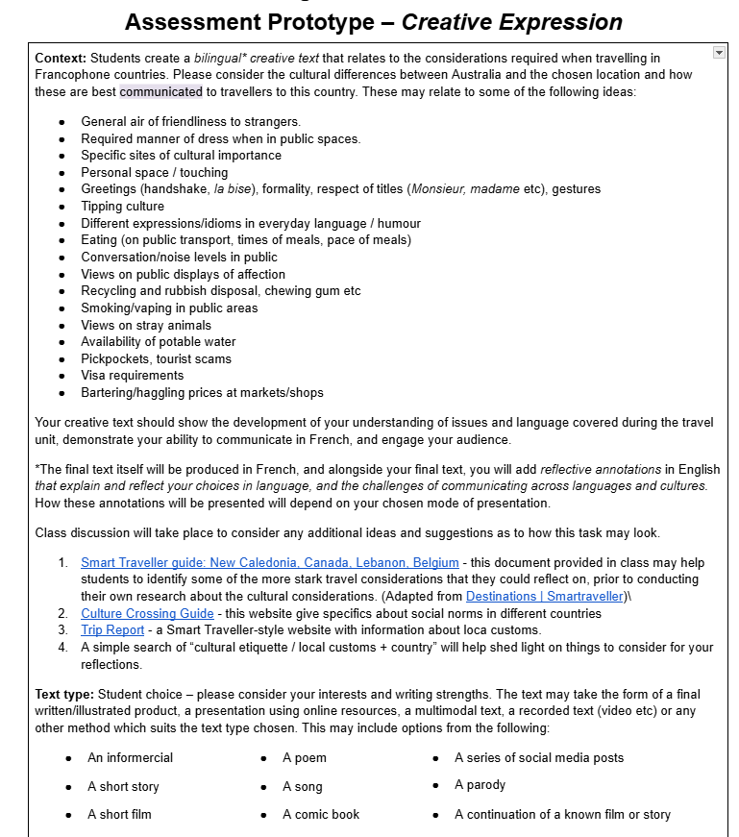
What does this look like in the classroom?
Prototype example for Stage 1 Language Continuers - French
Creative expression
Students create a bilingual creative text that relates to the considerations required when travelling in Francophone countries, including cultural differences between Australia and the chosen location.
The students chose the topic of travel - based on the current topic.
This topic was devised through discussion of what made them nervous/excited about travelling to a French-speaking country.
Class discussion indicated which elements of travel were of interest to them.
Focus on Francophone countries - less Eurocentric.
Exploration of new cultures not previously considered as much.
PROTOTYPE IDEA
Student Agency
Metacognition
Deep Authentic Learning
Natural Evidence of Learning
Notes:
French continuers example.
Moving away from assessments that encourage the production of largely descriptive, informative, decontextualized texts.
Towards assessment that engages students with ideas/big concepts and invites imagination and creative language use that is meaningful to students.
Prototype name: CREATIVE EXPRESSION
Students produce a bilingual creative text of their choice, related to considerations required when travelling in Francophone countries, and considering cultural differences between Australia and the chosen location. eg. sites of cultural importance, gestures and greetings, pick-pockets and tourist scams
Students annotate the creative text in English to explain the reasoning of their language choices.
What the prototype is aiming to achieve:
When students create texts with purpose, voice, and imagination, they engage more personally and deeply with the target language. They become not just learners, but creative communicators using language to respond to audience, context, and culture.
This encourages flexibility, risk-taking, and the transfer of language into new contexts. By reflecting on their choices, students move beyond what they wrote to examine how and why they wrote it. This builds metacognitive awareness and cultural insight, positioning them as meaning-makers and mediators. It also shifts the task from performance and product to learning, where students explore challenges, strategies, and creative decisions.

Slide 12
What does this look like in the classroom?
Prototype example for Stage 1 Language Continuers - French
Creative expression
Prototype impact
What worked well and what didn’t?​
Students found the lack of structure confronting - refinement required to maintain the level of creativity and student agency, while making them feel comfortable in an exploratory space.​
In Language Continuers, students are used to a post-outcome reflection, so annotations and NEoL require some additional strategising.​
How did students respond and engage?​
Ownership - something they chose, rather than something they were obliged to do.​
Curiosity & authentic learning - they learned about a place that they intended to travel one day.
What shifts did we notice in learning, engagement, or assessment?​
The students seemed much more self-directed in this space: their student agency was well explored.​
What did the students feedback?​
Overall a positive experience, but with some challenges regarding the different levels of agency and creativity.
PROTOTYPE IDEA

Slide 13
What does this look like in the classroom?
Prototype example for Stage 1 Biology
Science Inquiry Skills Journal
Journal entries focusing on 4 areas of SIS: Scientific background, data presentation and analysis, evaluation, and recommendations/further questions.
5 practical focused activities throughout the assessment period.
Journal entry for at least 2 activities.
Flexibility to complete different sections for different experiments.
Multimodal evidence encouraged
Teacher questioning and discussion occurred throughout.
PROTOTYPE IDEA
Deep Authentic Learning
Natural Evidence of Learning
Notes:
Biology example.
Moving away from one highly curated written report that is susceptible to abuse of AI, and the limited opportunity to do practicals.
Towards more hands-on practical activities across multiple contexts, with informal capture of student’s original thinking or annotations of ideas, using a range of evidence types gathered over an extended period.
Prototype name: SCIENCE INQUIRY SKILLS JOURNAL
Students engage with a series of practical-related activities to develop a deep understanding of science inquiry skills across a range of contexts. Students must capture evidence of how their learning of science inquiry skills develop across these activities naturally in a lab journal format.
What the prototype is aiming to achieve:
Students engage actively in deep authentic learning through practical hands-on activities, documenting their learning journey in a way that reflects natural, varied, and meaningful evidence. Through this, students develop metacognitive strategies and have agency to pursue learning that emerges from these activities.

Slide 14
What does this look like in the classroom?
Prototype example for Stage 1 Biology
“The journaling was particularly helpful because it was an individual task and meant I had full control of how and what I learned by what I wrote down and asked questions about. “
“Doing repeated experiments and journaling allowed me to reflect on what I wrote and did last time and see if I can change anything, improve anything, stop something or start doing something.”
Science Inquiry Skills Journal
Prototype impact
PROTOTYPE IDEA
“The experiment on osmosis allowed me to see how biology plays a big roll in nursing, the career I would like to pursue after high school.”
“Allowed me to show my learning by having to write down everything I observed and learned and what those observations meant and how it effected the data and stuff.”
“doing lots of prac’s was good but I felt like not everyone got enough time to put their full thinking in the journal.”
“we got to choose some of the experiments we did, and it was mostly self directed in groups.”
“it was good because you were able to see how other people learnt and wrote stuff down which helped me see different perspectives.”
“too many practicals, not enough writing time.”
“I felt like I didn’t have enough time to fully complete journal entries and explore further”
“I feel like, when doing the experiments when something didn’t happen in the way I thought it would I was able to break that down in my own mind and explore what caused it”
“I feel like we should have had more book stuff to set up our knowledge for the practicals, but it was good to explore”
“maybe a little bit too open ended so I think some people were a little confused about what to write”
“I feel like it’s a positive impact on my learning because it makes it much easier to understand because it’s a lot of mini things that are slowly combined”
“I feel like I could produce a better-quality evidence in a single prac report as I would have more time.”

Slide 15
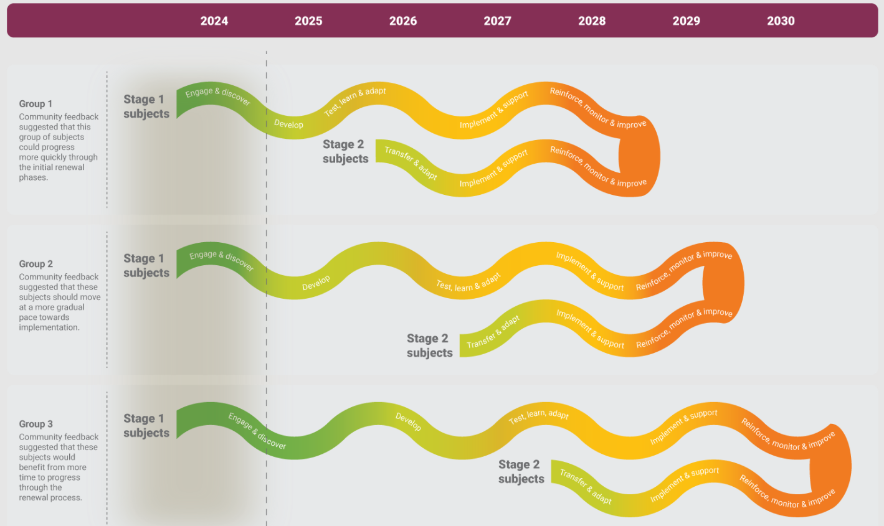
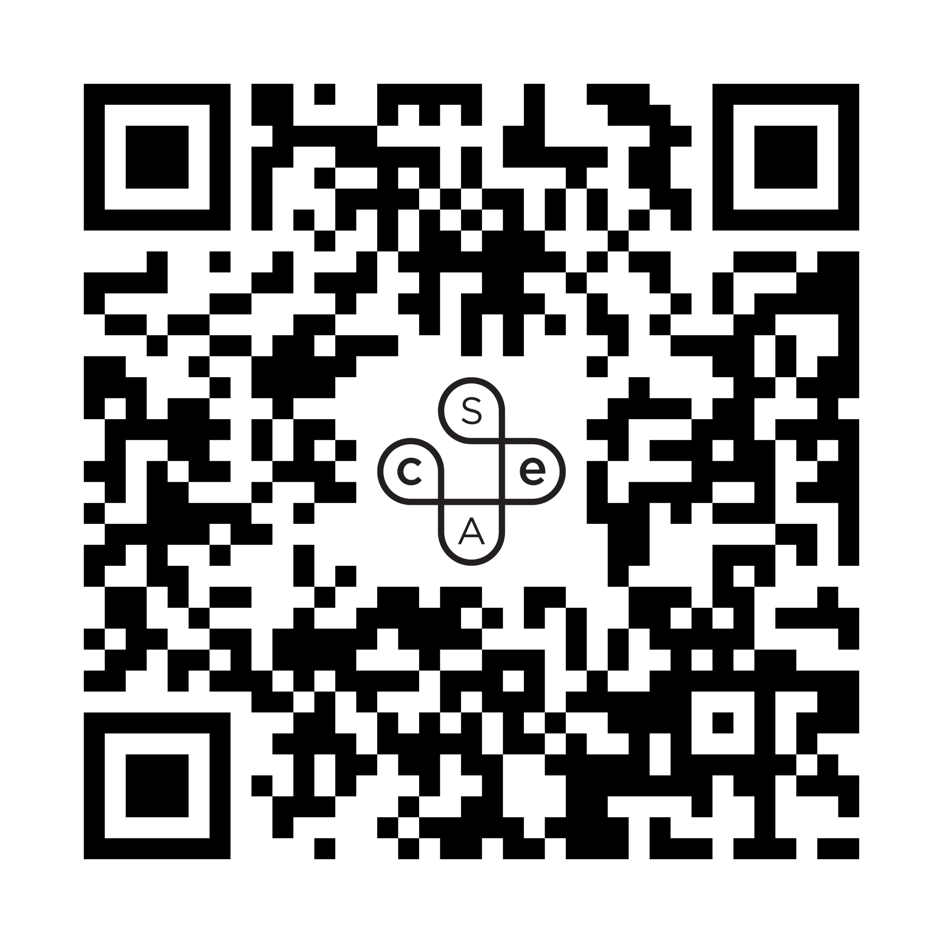
What is the subject renewal roadmap?
Subject renewal on the SACE Board website:
Notes:
Key messages:
The Subject Renewal roadmap outlines the pace and phases of Subject Renewal for each subject.
Subjects have been separated into three groups and will progress at different paces, working through four key phases towards implementation. The groupings were formed based on a variety of factors, including complexity, appetite, how much change the community want (volume, pace & scale), and the impact on the system and the SACE Board to manage the change.
Group 1 subjects are moving at the fastest pace. Those subjects are:
Ancient Studies
Biology
Essential English
General Mathematics
Health and Wellbeing
Language continuers
Modern History
Music - Ensemble Performance
Music - Solo Performance
Music Explorations
Music Studies

Slide 16
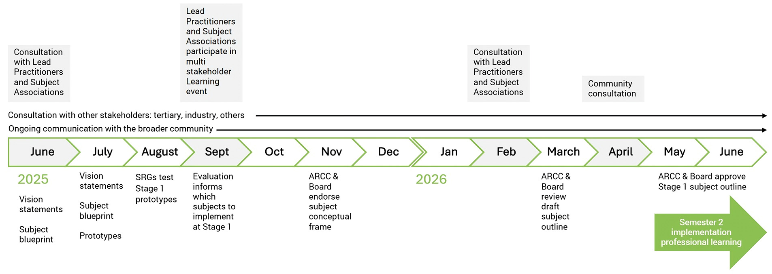
When will group 1 subjects be implemented?
Notes:
Key messages
In 2025 Group 1 subjects developed a vision statement, subject blueprint, and some ideas to prototype and test.
Prototypes will be reviewed and evaluated in the second half of 2025, leading towards a draft subject outline being shared with SACE governance bodies in March 2026
The broader education community will have the opportunity to provide feedback on proposed new subjects during semester 1 2026

Slide 17
What can we do to prepare?
What your school can provide
Insert your school context here…
information about the value your school and students have for subject renewal
What your school can offer (e.g. giving space for SRG members to standup at staff meeting, facilitating collaborative conversations about key drivers, continuing activities in this presentation etc)
What the SACE can provide
Before new Stage 1 subject implementation in 2027, SACE will provide implementation readiness activities in semester 2 2026, including:
professional learning (implementation workshops)
support materials
resources to assist schools in communicating with students and families

Slide 18
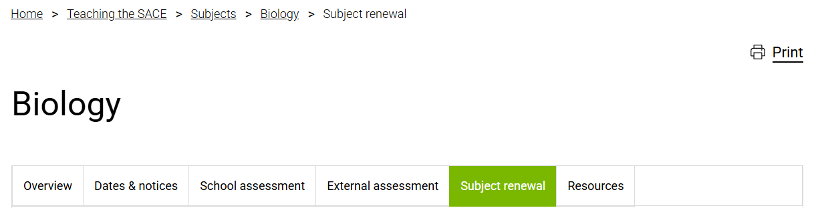
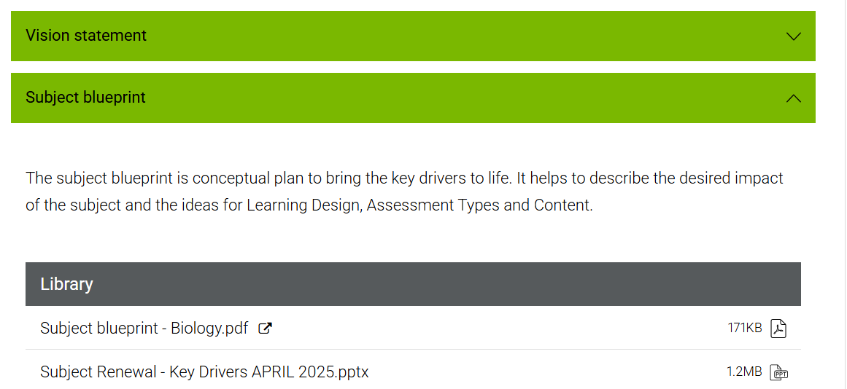
Where to find more?
Notes:
The SACE Board website publishes quarterly updates on the progress of the subject renewal program.
For group 1 subjects this includes a new Subject Renewal section within the subject sections, containing copies of the key artefacts including:
vision statement: a description of what the subject aims to achieve — defining aspirations and setting a long-term direction.
subject blueprint: a conceptual plan to bring the key drivers to life, describing the desired impact of the subject and the ideas for Learning Design, Assessment Types and Content
… with more artefacts to be added as the subject progresses

