Slide 1
Collaborative Curriculum and Assessment Framework for Languages
Framework for consultation
Consultation Period: 1 March to 11 April 2021

Slide 2
CCAFL Continuers level languages are being renewed
Armenian, Auslan*, Bengali, Bosnian, Chin Hakha, Croatian, Dutch, Filipino, Hebrew, Hindi, Hungarian, Karen, Khmer, Macedonian, Persian, Polish, Portuguese, Punjabi, Romanian, Russian, Serbian, Sinhala, Swedish, Tamil, Turkish and Yiddish.
*The framework will also be used for curriculum and assessment development in Auslan, but may be adapted to meet the specific needs of the language.

Slide 3
Curriculum and assessment for CCAFL Languages is developed in stages
Stage 1 | Common curriculum and assessment content CCAFL Framework
Stage 2 | Common language-specific material based on the CCAFL Framework
Stage 3 | State or territory curriculum and assessment documents for each language, including details about school-assessed coursework and other state specific information
CONSULTATION
1 March – 11 April 2021

Slide 4
Timeline
2020 2021 2022 2023 2024 2025
STAGE 2
Language-specific materials
Completed 2022
STAGE 1
CCAFL Framework
Completed 2021
Consultation
2023
Familiarisation
period
2024
Year 11
2025
Year 12
STAGE 3
State-specific
curriculum and
assessment
documents
Completed end 2022
Consultation
IMPLEMENTATION

Slide 5
Currently in Stage 1 framework development
The Framework provides the elements that all languages will have in common.
The Framework has to be finalised before the other stages can proceed.
This consultation only relates to the framework

Slide 6
Framework
When complete, the framework will provide the content that is common to all CCAFL Languages at this level.
It is developed through collaboration between states and territories.
Stakeholders get to input via consultation.
It will provide a comparable structure for all of the languages.
The common content will ensure that all students are equally prepared for the national external examination.

Slide 7
Framework
The framework is designed to:
provide high quality, equitable and inclusive language curriculum and assessment for all students
value prior language learning
provide challenges and opportunities through learning and using new language
emphasise effective communication and intercultural competence.

Slide 8
Framework designed for all Australian students
All senior secondary studies
Framework for consultation
Provides challenges and
opportunities through learning and using new language
Add value
Assesses learning
external examinations are
not proficiency tests
Assess learning
Reflect the Australian context for learning
Requires students to function across languages and cultures
developing plurilingualism

Slide 9
What’s different? Aims
Current CCAFL Framework | Framework for consultation
The aims of the syllabus are to develop the student’s: ability to use [Language] to communicate with others; understanding and appreciation of the cultural contexts in which [Language] is used; ability to reflect on his or her own culture(s) through the study of other cultures; understanding of language as a system; ability to make connections between [Language] and English, and/or other languages; cognitive, learning, and social skills; potential to apply [Language] to work, further study, training, or leisure. | Communicate in the language Engage with cultural and intercultural contexts through language Share personal, community and global perspectives through language

Slide 10
What’s different? Organising features
The Framework:
reflects a modern approach to language learning
provides a clear relationship between each element of curriculum and assessment
creates links to prior learning

Slide 11
What’s different? Objectives
Objectives
Interacting in language
Analysing language
Creating language
Cultural and intercultural
understanding
integral to all
renewed objectives
Current CCAFL framework | Framework for consultation
The student should be able to achieve the following [objectives]: [Objective] 1: Exchange information, opinions, and experiences in [Language]. [Objective] 2: Express ideas through the production of original texts in [Language]. [Objective] 3: Analyse, process, and respond to texts that are in [Language]. [Objective] 4: Understand aspects of the language and culture of [Language]-speaking communities. | Objective 1 Interacting in language Exchange information, opinions, ideas and experiences in the language and reflect on knowledge and understanding of the relationship between language and culture. Objective 2 Analysing language Evaluate, analyse, synthesise, reflect on and respond to texts presented in the language, and mediate between languages and cultures. Objective 3 Creating language Create language to express ideas, demonstrating knowledge and understanding of language as a system and the relationship between language and culture.

Slide 12
What’s different? Learning language
Learning language
Communication skills
Language and culture
Language as a system
Recognises the cognitive demands of learning a language as separate and additional to the demands of using a language
Focuses on the language skills, knowledge and understanding students need to engage with the objectives
Acknowledges the emphases of the Australian Curriculum: Languages

Slide 13
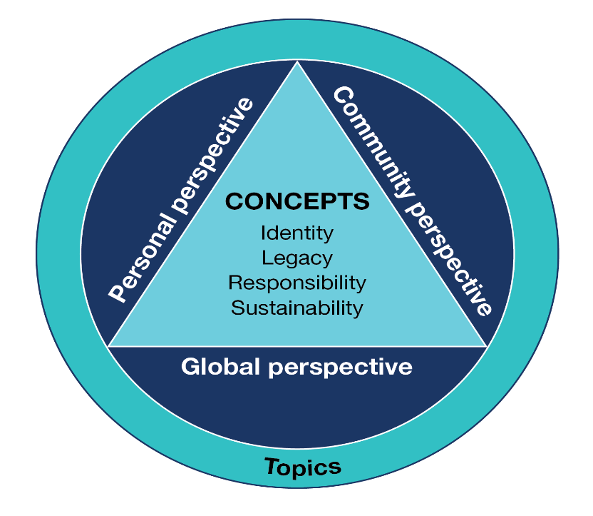
What’s different? Using language
Recognises the cognitive demands of using a language.
All concepts are studied.
Topics are related to the concepts.
Eight topics per language.
Topics selected based on best fit for each language in Stage 2.
Subtopics related to the topics developed by teachers to suit their students.
Subtopics can be studied from any perspective.
Using language
Concepts
Perspectives
Topics
Tasks

Slide 14
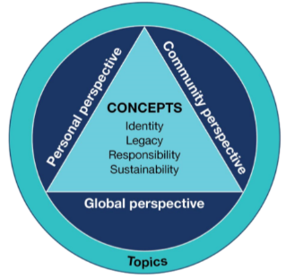
Current CCAFL Framework
Framework for consultation
Concepts | Topics (8 of 12)
Identity | Relationships and human interactions | Perspectives personal community global
 | Living in Australia
 | Inclusivity, diversity and belonging
Legacy | Language-speaking culture
 | History and traditions
 | Innovation
Responsibility | Youth
 | Work
 | Society
Sustainability | Natural environment
 | Sustaining language and culture
 | Global trends
Themes and topics
The individual | The [Language]-speaking communities | The changing world
Personal identity | Lifestyles | Technology
Relationships | History and traditions | Trade and tourism
Education and aspirations | Arts and entertainment | World of work
Values | Values | Social issues

Slide 15
What’s different? Recognising prior learning
Language, general capabilities and cross-curriculum priorities
Language learning emphases from the Australian Curriculum: Languages are incorporated and extended.
Students apply skills, knowledge and behaviours gained through engagement with the general capabilities in Foundation Year to Year 10.
Students have opportunities to study subtopics that link to the cross-curriculum priorities and the Australian context for learning.

Slide 16
What’s different?
Oral examination
Current CCAFL framework
Oral examination (approximately 15 minutes) Purpose The oral examination is designed primarily to assess the student’s knowledge and skill in using spoken [Language]. Specifications The oral examination has two sections. Section 1: Conversation (approximately 7 minutes) Section 2: Discussion (approximately 8 minutes)
Framework for consultation
Oral examination (10–15 minutes) Individual states and territories will decide the specifications for the oral examinations within their jurisdiction. The oral examination will: relate to the objectives, key skills, knowledge and understandings provided in the Framework enable students to address aspects of the topics specified for the language

Slide 17
What’s different?
Written examination
1 of 2
Current CCAFL framework
Reading time: 10 minutes Working time: 2 hours and 30 minutes
Section 1: Listening and responding Part A Questions 1 – 3 15 marks Three texts in [Language] with answers in English Part B Questions 4 – 6 15 marks Three texts in [Language] with answers in [Language]
Section 2: Reading and responding Part A Questions 7 and 8 10 marks Two texts in [Language] with answers in English
Framework for consultation
Reading time: 10 minutes Working time: 2 hours
Section 1: Responding to texts Question 1 7 marks Listening in language, responding in English Text 1 – one listening text in language Question 2 8 marks Listening and responding in language Text 2 – one listening text in language Question 3 15 marks Reading and listening in language, responding in English Text 3A – one reading text in language Text 3B – one listening text in language

Slide 18
What’s different?
Written examination
2 of 2
Framework for consultation
Section 2: Creating language Question 4 15 marks Reading and responding in language Text 4 – one reading text in language Response approx. 150 words Students will choose one of the following: Question 5 or Question 6 20 marks Writing in language Response approx. 250 words
The total length of one playing of the three listening texts will be 4½ – 5 minutes. The total length of the two reading texts will be approx. 450 words. There will be one or two visual texts in this examination. The visual text/s may appear in any of Questions 3, 4, 5 or 6.
Total 65 marks
Current CCAFL framework
Section 2: Reading and responding (continued) Part B Question 9 15 marks One text in [Language] approx. 150 words Response in [Language]approx. 150 words
Section 3: Writing in [Language] One of Questions 10 – 12 20 marks Original text to be written in [Language] Response approx. 250 words
The total listening time, for one reading of the six listening texts without pauses, will be approximately 8 minutes. The total length of the three reading texts will be approx. 550 words.
Total 75 marks

Slide 19
Framework for consultation
Feedback is sought on the framework for consultation from stakeholders in all jurisdictions
Consultation period
Monday 1 March 2021 to Sunday 11 April 2021
The framework and survey are available at:
https://www.sace.sa.edu.au/web/ccafl/consultation
Note: the survey must be completed in one sitting to avoid losing responses.

